Slide 1
Air-sea exchange group report on “Priorities for advancement of the ocean observing system”
Participants: Lisan Yu, Al Plueddeman, Mark Bourassa, Megan Cronin, Chris Fairall, Dave Hosom, Rick Lumpkin, Mike McPhaden, PingPing Xie,

Slide 2
1. What are the needs for advancement of the ocean observing system?
Long-tem Goals
Current status
(c) Short-term increments

Slide 3
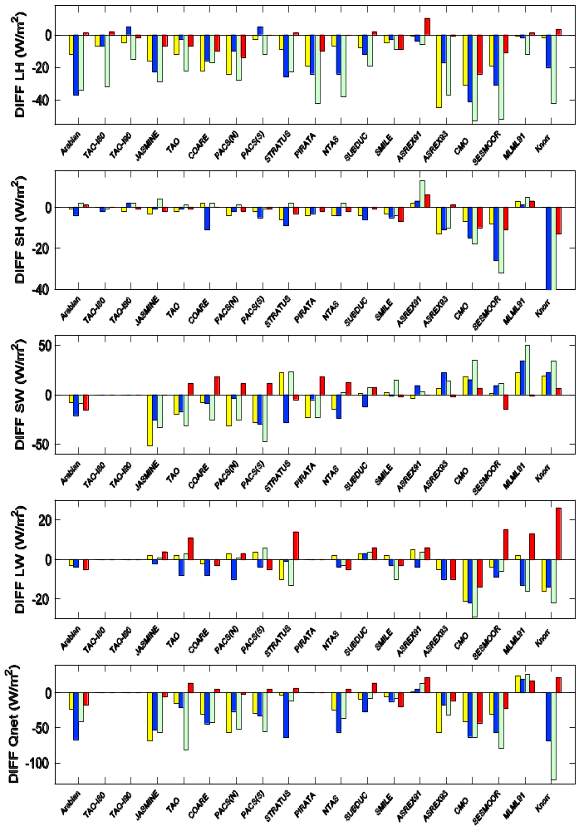
Goals:
  Accuracy for net heat flux estimates: ±10Wm⁻²
  Balanced global energy budget
OAFlux+ISCCP
ERA40
NCEP1
NCEP2
Qnet Mean Diff (Product – Buoy)

Slide 4
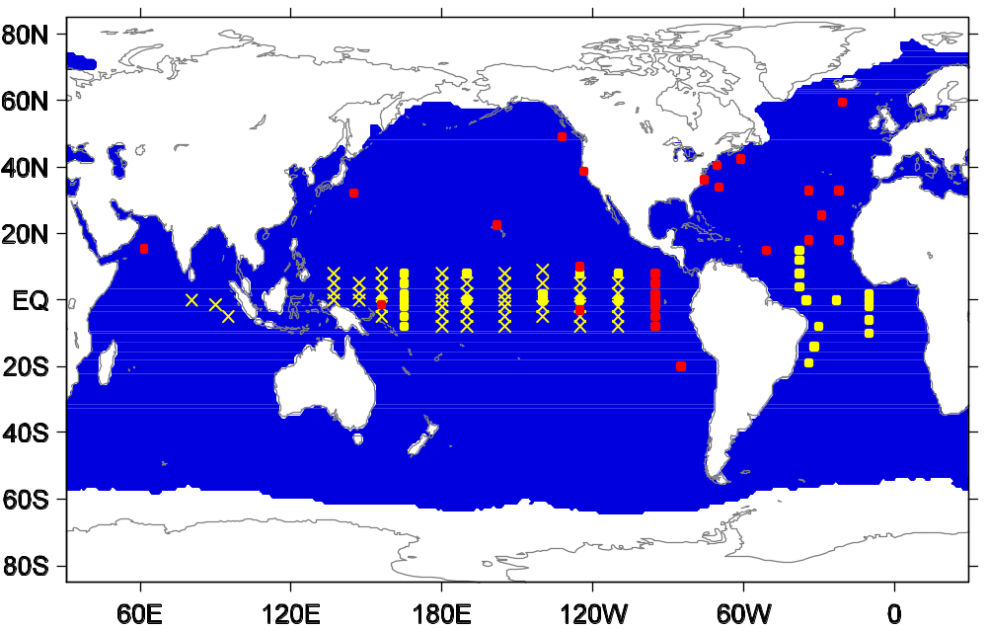
(b) Current status of global air-sea flux measurements:
  There are needs for
  better spatial coverage, particularly at higher latitudes
  high quality, continuous record, long duration
  simultaneous measurements of wind, wave, radiations in addition to humidity, temperature, and precipitation
All components
No Q_{LW}
x No Q_{LW} and Q_{SW}

Slide 5
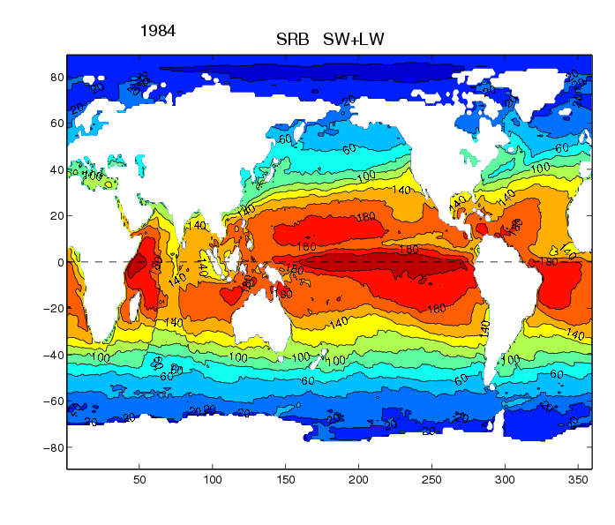
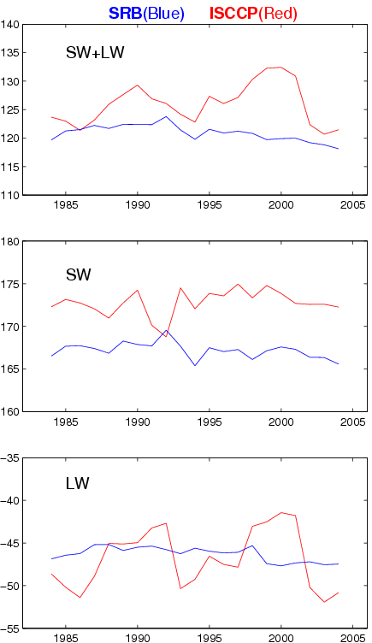
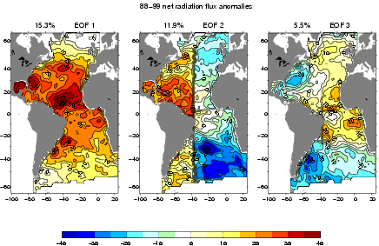
Satellite radiation products: discontinuity in both space and time
There is a need of radiation (longwave and shortwave) sensors at reference sites and along cross-basin VOS sections.

Slide 6
(c) Short-term increments
Review flux observing capacity on existing platforms (buoys, research vessels, VOS, coastal guard/icebreakers…)
Improve efforts to install radiation sensors on all buoys
Improve efforts to install air-sea flux sensors on major cross-basin VOS

Slide 7
2. What are the needs of the ocean observing and user communities?
High frequency sampling (at least 3-hourly, ideally 10-minute)
(2) Error bar information for flux measurements and analysis products

Slide 8
3. What are the recommended priorities for the Climate Observation Program?
Review existing flux observing capacity on existing platforms (buoys, research vessels, coastal guard/icebreakers…)
Improve efforts to install radiation sensors on all buoys, air-sea&flux sensors on arctic research vessels, icebreakers, major cross basin VOS
Reenergize a flux workgroup to focus on review and strategic planning and to prepare for OceanObs (2008?)

