Slide 1
Interlibrary Loan Patterns in DOCLINE
Fiscal Year 2005
Medical Library Association 2007
Philadelphia, PA
Maria Elizabeth Collins
National Library of Medicine, NIH/HHS
Notes:
Good morning. My name is Maria Collins and I’m the team lead for DOCLINE and Loansome Doc.
In 1993, Eve-Marie Lacroix, former Chief of the Public Services Division, conducted a large study of all interlibrary loan done in DOCLINE for 1991 and 1992. This was the first large scale study done of the ILL in medical libraries in the country. The study was published in 1994 in the Bulletin of the Medical Library Association

Slide 2
Scope of Journal Use Study
FY 2005: Oct 1, 2004 – Sept 30, 2005
Journal title use by biomedical libraries
Journal article use
Use through interlibrary loan only
  Not use within the library
  Not personal subscriptions
Notes:
NLM undertook the 2005 study to find out whether there have been major changes in the nature of journal and article usage given all of the changes we have seen in the past decade in ILL and publishing. In particular, the shift towards delivering articles electronically, and the shift towards electronic publishing. Libraries are facing decreasing budgets – fewer staff, less money for journals, and more consortia purchasing arrangements.
The scope of this study covers Gov fiscal year 2005. We looked at the journal titles being used in ILL and journal articles being requested.
The study covers use through ILL only; journals are heavily used within the library, and certainly physicians and researchers have personal subscriptions to the major journals in their field – their association journal etc. To the extent possible, I will compare the findings from this study with data from 1992, the first such large scale study of ILL in medical libraries.

Slide 3
DOCLINE
ILL request routing and referral system
Launched in 1985
3,234 libraries participating in 2005
  2,861 US libraries
  325 Canadian libraries
  48 international libraries
2.48 million requests in FY2005
Fill rate: 91.2%
Average number of routes to complete ILL: 1.2
Notes:
DOCLINE is a unique ILL system. The system contains the serial holdings of nearly all of the medical libraries in the US and Canada. Holdings are restricted to those libraries can provide on interlibrary loan.
Libraries create borrowing profiles indicating their service preferences and their lending partners. When a library enters a borrow request, the system automatically finds a library that holds the needed item and sends the request to that library.
The system was launched in 1985. In 2005 had more than 3,000 participating libraries – most in the US of course, but over 300 in Canada. These libraries are able to fill over 91.2% of all requests they receive.

Slide 4
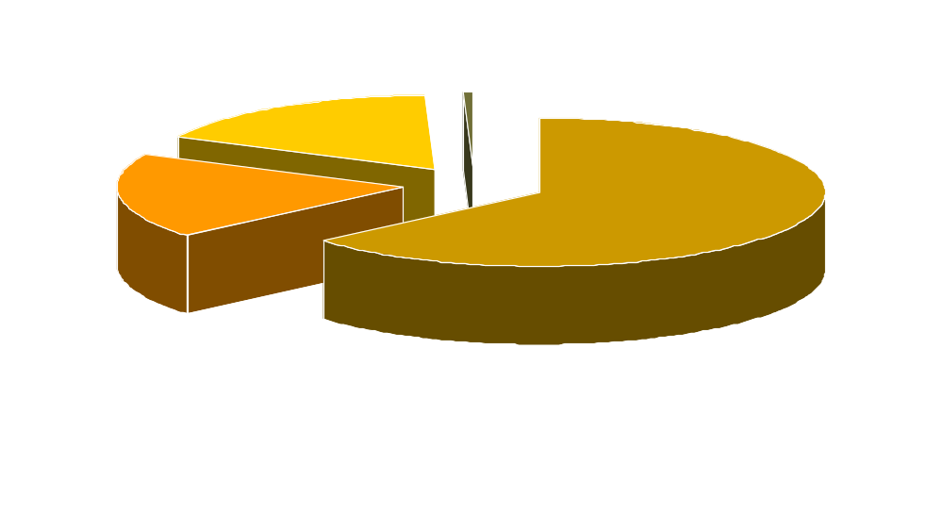
Type of Libraries
(Federal and special libraries)
Notes:
Of the 3,234 libraries using DOCLINE in 2005, over 2,000 were hospital libraries. 609 were academic – these would include medical, dental, nursing and veterinary schools, but also other colleges and universities in need of biomedical literature. There are a few public libraries. The “other” category includes special libraries, government libraries, foundations, associations, etc. Over 300 federal libraries participate in DOCLINE.
Commercial document delivery is prohibited.

Slide 5
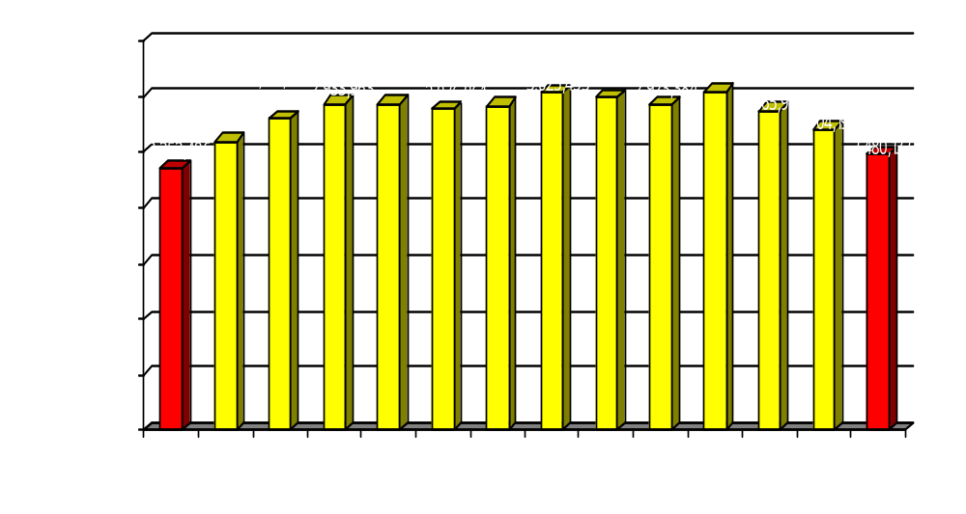
ILL Requests
Notes:
The number of DOCLINE participating libraries has grown over the years, along with the number of items requested. ILL demand peaked in 2002 at 3.03 million requests, and has gradually declined since.
In fiscal year 2005 , there were 2.48 million items requested by Health Sciences libraries. This includes both journal article copies and original materials such as books and audiovisuals.

Slide 6
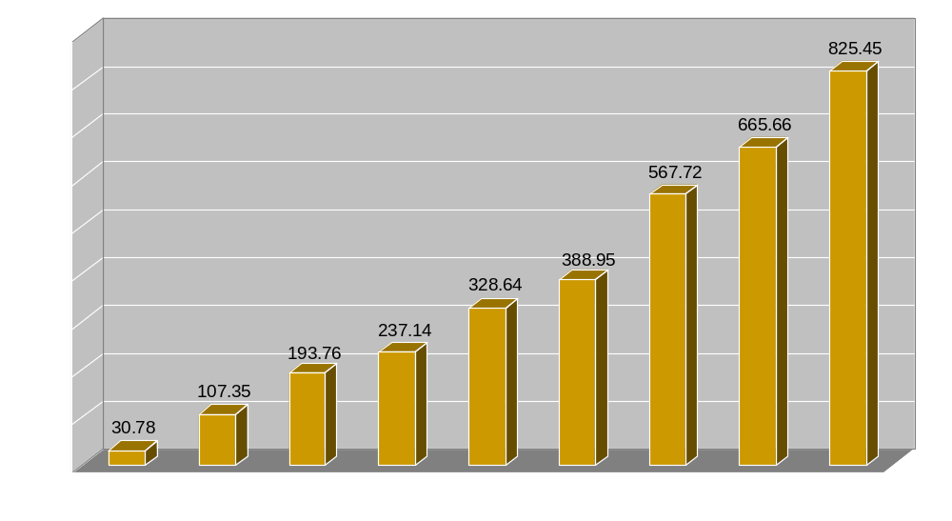
PubMed Searches
Millions of Searches
Notes:
In Biomedicine, most researchers, clinicians, students, and even the public, search PubMed to find articles on their subject. There are about 5,000 journals indexed for PubMed annually, and PubMed is the most searched database in the world of biomedicine.
This chart shows that in 1997, there were about 30 million searches of the PubMed database. By 2005, there were 825 million searches done in PubMed. This is an incredible growth in the use of a citation database.

Slide 7
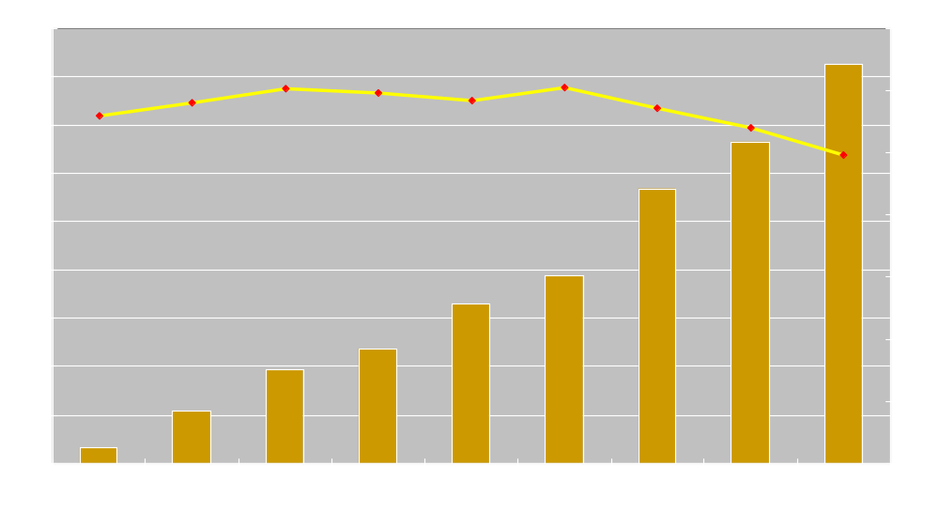
PubMed Searching vs. ILL Requests
Millions of Searches
Millions of ILL Requests
Notes:
If we place ILL requests on this PubMed graph which is shown by the yellow line, you will see that despite PubMed searching reaching nearly over 800 millions searches per year, ILL has actually decreased over the same period.
To me, this remarkable contrast shows libraries have good collection development practices – that you’re meeting the core needs of your users, and that the increasing availability of full-text online allows users and libraries to directly obtain articles. ILL plays a vital part in providing role is supporting our needs of our users under fair use guidelines.

Slide 8
Methodology
ILL transaction data from DOCLINE
2.22 million filled article requests analyzed
Supplemental journal and article bibliographic data from:
  NLM citation system for PubMed – DCMS
  NLM ILS – Voyager
  NLM Serials Extract File - SEF
Summary data downloaded to Microsoft Excel to produce charts and graphs
Notes:
To do this study, we used ILL transaction data from DOCLINE. This includes the basic bibliographic details of the request, with its journal and article identifiers.
Supplemental bibliographic data including language, indexing subset, MEDLINE subject terms, were retrieved from various NLM systems.
Data was analyzed by a series of SQL queries primarily against the DOCLINE Oracle databases. To retrieve supplemental bibliographic and citation data, joins between the DOCLINE Oracle tables and the other NLM system Oracle tables were performed.
Summary data was exported from Oracle and imported into Excel for browsing, formatting, and presentation.
Data of most frequently requested articles was exported to Excel for browsing and analysis by study authors
Data from NLM Serials System – a database of information over 124,000 journal and serial titles, both ceased titles and currently published titles.
Most bibliographic data at the title and article level was standardized due to libraries placing ILL requests using NLM standard keys – PMID, NLM UI. Citation level data entered by users was slightly less standard, but usable. When users entered both bibliographic and citation level information via the DOCLINE “Manual” ordering method, data was generally unusable as it could not be confidently matched to standard bibliographic data by computer. Manual orders account for 1.6% of all journal requests.
The most time consuming task in data analysis was the review of non-standardized data entered by users, and incorporating data into standardized data when possible.

Slide 9
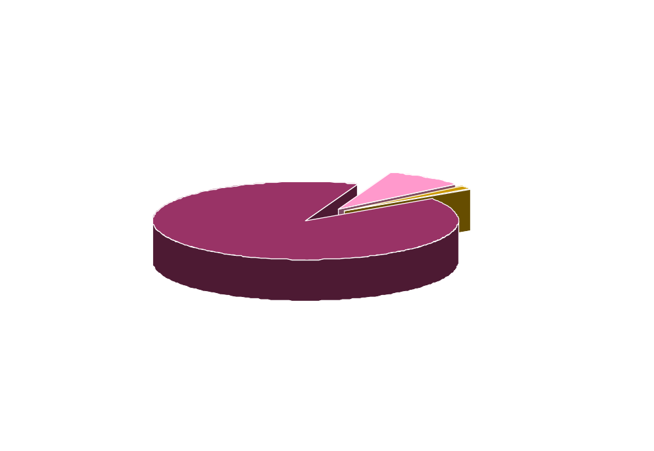
All DOCLINE Requests
Total: 2.48 million requests
Notes:
In Fiscal Year 2005, there were 2.48 million ILL requests put into the DOCLINE system by 3,200 health sciences libraries.
98% of the requests were for journal articles, with 2% being for original materials – books and audiovisuals.
This study focuses on the journal requests, primarily those that libraries were able to fill. Limited information is presented for those that couldn’t be filled by libraries, including NLM, because often the citation is incomplete or incorrect. Only requests that had an NLM UI for the journal title were included in the study since these could be consistently and accurately identified.
The total number of journal requests analyzed for this study was 2.2 million. In FY 2005, just over 205,000 requests could not be filled. Again these not filled requests were not analyzed at the article level.

Slide 10
Serials
124,000 serial titles in NLM’s catalog
  26,000 serial titles held only in Network libraries (not at NLM)
44,680 are currently published serials that are likely to have articles
3,065 libraries reporting holdings
1,440,878 serial holdings reported
Notes:
During the period of this FY2005 study, approximately 124,000 serial titles were catalogued in the NLM Voyager catalog.
44,680 or 36% are currently published excluding dictionaries, annual reports, abstracts & indexes, directories. (2,277)
NLM currently subscribes to 20,900 journals and indexed about 5,000
In 1992, there were 79,000 serial titles in the Serial file. Of these, 28,000 (35% ) were currently published titles. An estimated 24,000 contained articles. Other serials are publications such as directories, indexes, monographic series, and annual reports.

Slide 11
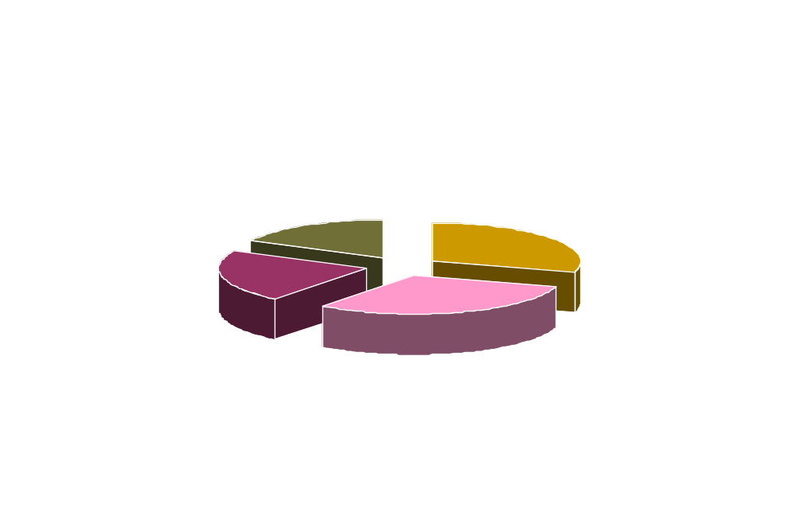
Journal Title Use
21,258 Journal titles used
10 or fewer times:
2005: 60%
1992: 58%
Notes:
This chart shows that 21,258 journal titles used to fill requests by medical libraries.
60% of journal titles had 10 or fewer requests for articles from all the years of the journal by all the libraries in the network.
About 2,500 journals had more than 100 requests in the entire network.
In 1992, requests were filled from about 16,335 journal titles.
In 1992, 58%, or nearly 9,000 of the journal titles, had 10 or fewer requests for articles from any issue over the life of the journal. About 3,000 titles had more than 100 requests.
In 1992, nearly half of the journal titles were used 5 or fewer times

Slide 12
Top Requested Journal Titles
New England Journal of Medicine 1928 - 6,556
JAMA 1896 - 6,320
Obstetrics and Gynecology 1953- 6,000
Nursing Times 1905 - 5,379
Lancet 1823 - 5,264
Academic Emergency Medicine 1994 - 5,155
Obesity Surgery 1991 - 5,118
Clinical Orthopaedics and Related Research 1963- 5,084
Annals of the New York Academy of Sciences 1877 - 4,820
Spine 1976 - 4,777
American Journal of Obstetrics and Gynecology 1920 - 4,146
Annals of Pharmacotherapy 1992 - 4,047
Expert Opinion on Pharmacotherapy 1999 - 3,971
Journal of Clinical Psychiatry 1978 - 3,962
Journal of Advanced Nursing 1976 - 3,938
Notes:
Top Requested Journals
These are the most heavily requested journals for last year. The titles in yellow were in the top requested titles in 1992. We can see here a current interest in obesity literature as well as obstetrics and gynecology
Most of these journals are held by hundreds or even thousands of DOCLINE libraries in the country. The exception here is “Expert Opinion on Pharmacotherapy”, a relatively new journal, for which only 8 libraries report holding the title.
Titles such as JAMA, Lancet, New England Journals, etc. are requested through ILL for issues back to the 1800s.
Title Libraries Owning
The New England Journal of Medicine 2672
JAMA : the journal of the American Medical Association. 2561
Obstetrics and gynecology. 1576
Nursing times. 751
Lancet. 1941
Obesity surgery : the official journal of the American Society for Bariatric Surgery and of the Obesity Surgery Society of Australia and New Zealand. 127
Academic emergency medicine : official journal of the Society for Academic Emergency Medicine. 280
Clinical orthopaedics and related research. 1245
Annals of the New York Academy of Sciences. 264
Spine. 1245
American journal of obstetrics and gynecology. 1746
The Annals of pharmacotherapy. 694
Expert opinion on pharmacotherapy 8
The Journal of clinical psychiatry. 938
Journal of advanced nursing. 613

Slide 13
New England Journal of Medicine
Owned by 2,745 libraries
Requested 6,556 times
Requested by 1,475 different libraries
  1,301 of these libraries own the title (88%)
Filled 6,208 times
Filled by 1,382 different libraries
Why ordering: Lacking the issue
Notes:
Let’s take a closer look at the most requested journal title. The fact that New England of Medicine is popular is no surprise, but the fact that it is the most requested journal title might be. Certainly, this is a core title that we’d expect most libraries to own. And in fact, they do. Over 2,700 DOCLINE libraries report owning NEJM, which is most of our active day to day libraries.
Based upon our numbers, we see that roughly one third of all libraries placed an ILL request for New England Journal of Medicine in FY2005. And roughly one-third of all DOCLINE libraries filled a request for New England Journal of Medicine. Of those libraries who requested a NEJM article, almost all report owning the title.
The reason libraries report they need the article – they lack the issue. In most cases, the issue hasn’t arrived in the library yet. The articles are being requested in the same month as the article publication date.

Slide 14
NEJM: Requests by Pub Year
2005: 505 7.70%
2004: 592 9.03%
2003: 110 1.68%
2002: 105 1.60%
2001: 104 1.59%
2000: 88 1.34%
1999: 60 0.92%
1998: 54 0.82%
1997: 45 0.69%
1996: 78 1.19%
1995: 49 0.75%
1994: 108 1.65%
1993: 103 1.57%
1992: 289 4.41%
1991: 373 5.69%
1990: 190 2.90%
1989: 254 3.87%
1988: 227 3.46%
1987: 169 2.58%
1986: 209 3.19% 57%
Notes:
Just one more look at New England Journal of Medicine before I move on. This slide shows the number of requests placed in FY2005 by the article publication year. You can see that the most current two years are the most frequently requested, but less than one might expect. The numbers quickly drop and are spread across the years. In the 20 years shown on the slide, only 57% of all of the requests were ordered during this time period. The remaining 2,844 requests were for articles published more than 20 years ago and are spread across the remaining years of the title similar to what is shown here. The earliest request was for an article published in 1918 and there were 34 requests for publication year 1934
This trend holds true for journal titles on average as I’ll show you in a few minutes.
NEJM Most Popular
Clinical practice. The thyroid nodule.
N Engl J Med. 2004 Oct 21;351(17):1764-71. Review. No abstract available.
PMID: 15496625 [PubMed - indexed for MEDLINE]
Filled: 39
Pub Year 2005 Most Popular
Clinical practice. Neurocardiogenic syncope.
N Engl J Med. 2005 Mar 10;352(10):1004-10. Review. No abstract available.
PMID: 15758011 [PubMed - indexed for MEDLINE]
Filled: 35
The puzzle of aspirin and sex.
N Engl J Med. 2005 Mar 31;352(13):1366-8. Epub 2005 Mar 8. No abstract available.
PMID: 15755763 [PubMed - indexed for MEDLINE]
Filled: 31
Pain relief during labor.
N Engl J Med. 2005 Feb 17;352(7):718-20. No abstract available.
PMID: 15716567 [PubMed - indexed for MEDLINE]
Filled: 31
A randomized trial of low-dose aspirin in the primary prevention of cardiovascular disease in women.
N Engl J Med. 2005 Mar 31;352(13):1293-304. Epub 2005 Mar 7.
PMID: 15753114 [PubMed - indexed for MEDLINE]
Filled: 30
Pub Year 1991 Most Popular
Beneficial effect of carotid endarterectomy in symptomatic patients with high-grade carotid stenosis. North American Symptomatic Carotid Endarterectomy Trial Collaborators.
N Engl J Med. 1991 Aug 15;325(7):445-53.
PMID: 1852179 [PubMed - indexed for MEDLINE]
Filled: 27
Incidence of adverse events and negligence in hospitalized patients. Results of the Harvard Medical Practice Study I.
N Engl J Med. 1991 Feb 7;324(6):370-6.
PMID: 1987460 [PubMed - indexed for MEDLINE]
Filled: 24
The nature of adverse events in hospitalized patients. Results of the Harvard Medical Practice Study II.
N Engl J Med. 1991 Feb 7;324(6):377-84.
PMID: 1824793 [PubMed - indexed for MEDLINE]
Filled: 22

Slide 15
Journal Titles – Requests Not Filled
Scientific World Journal (e) 2000- 574
Studies in Health Technology and Informatics 1991- 379
CNS Spectrums 1996- 318
Methods in Molecular Medicine 1996- 316
Expert Opinion in Pharmacotherapy 1999- 314
Annals of the New York Academy of Sciences 1877- 279
Current Drug Targets. Inflammation and Allergy 2002- 265
Asia Pacific Journal of Clinical Nutrition 1992- 256
Expert Review of Anti-Infective Therapy 2003- 251
Expert Review of Cardiovascular Therapy 2003- 220
Surgical Technology International 1991- 219
Clinical Gastroenterology and Hepatology 2003- 211
Methods in Molecular Biology (NJ) 1984- 207
Advance for Nurse Practitioners 1993- 203
American Journal of Clinical Pathology 1931- 200
Notes:
There were over 14,000 journals with at least one request that couldn’t be filled.
This is a list of journals for which there were article requests not filled by anyone. Note that it is a very different list from the first. Many are newer journals, and many are not as widely held as the heavily used journals. Annals of the NYAS is the exception here.
NLM has spotty holdings for some of these journals.

Slide 16
Journals Cited in PubMed
2,225,350 filled requests analyzed
1,991,073 requests for articles in PubMed
  89.4% filled articles cited in PubMed
21,258 journal titles used to fill requests
9,966 of those titles are cited in PubMed
Notes:
NLM has a special interest in looking at what proportion of the journal titles requested are cited (included) in PubMed. Nearly 90% of requests filled in DOCLINE are cited in PubMed. That means that of the 21,000 journals used to fill requests, 90% of articles were from those journal titles indexed by NLM and its collaborators over the years – about 10,000 journal titles.

Slide 17
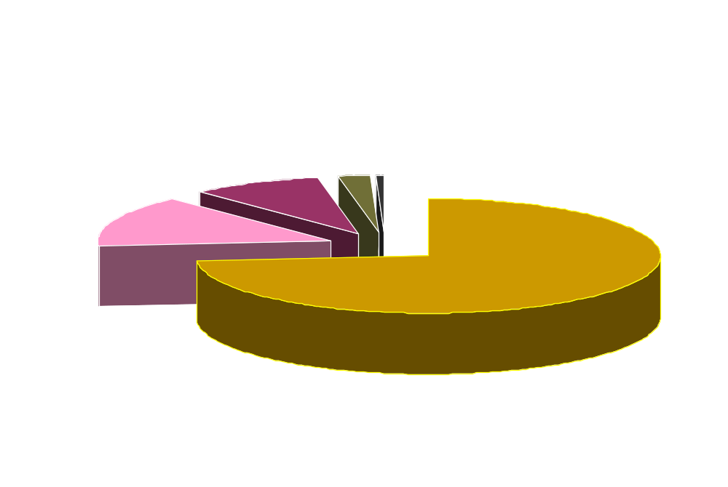
Individual Article Use
>100
47 articles
< 1%
1.03 million articles used once - 73.6%
1.4 million articles used to fill 2.22 million requests
Notes:
This slide is perhaps the most important of the whole presentation:
The major goal of this study was to look at ILL at the article level. Libraries are requesting articles, not journals. This pie shows what we found.
There were 2.22 million articles supplied in 2005. It took 1.4 million unique articles to fill those 2.22 requests.
97% of the articles were used to fill ILL requests 5 or fewer times in the entire country.
There were only 47 articles used more than 100 times.
This is comparable to 1992 where 97% of articles were used fewer than 6 times.

Slide 18
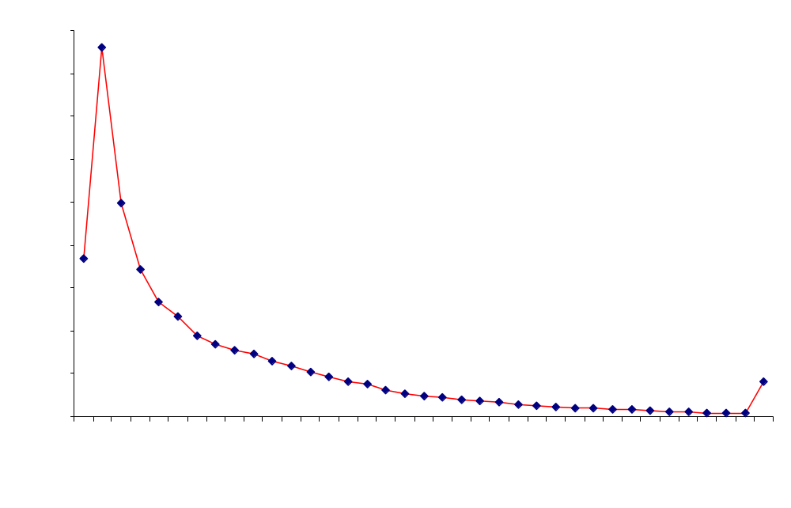
Date Distribution of Article Requests
47.4% older than 5 years
Notes:
Just a methodology note on this slide of the date distribution of filled journal article requests. Of the 2.2 million filled article requests analyzed, 2,290 transactions were discarded for this chart as the publication year information in the transaction was unusable.
In FY2005, 95% of filled requests were for articles published in the last 25 years – this was also true in 1992. However, there has been a shift in the more current published articles.
In FY2005, 72.7% of articles were published in the previous 10 years compared to 85% in 1992. And with publication dates less than 5 years, the percentage of articles filled dropped from 67% in 1992 to 52.6% in FY2005. We attribute this change to the increased availability of full-text articles online.
# Requests Running %
1,169,760 52.6% 2001-2005
1,615,365 72.7% 1996-2005
2,114,165 95.1% 1980-2005

Slide 19
Date Distribution Comparison
FY 1992
25 years: 95%
10 years: 85%
5 years: 67%
FY 2005
25 years: 95.1%
10 years: 72.7%
5 years: 52.5%
New England Journal of Medicine 20 years: 57%
Notes:
To compare the two studies, we see that the percentage of citations older than 5 years filled has increased from 33% of total requests to 47.5% of the total requests. For New England Journal of medicine, 43% of all requests were older than 20 years.
I attribute the increase in the higher percentage of older material to the on-going need for seminal works, and to libraries have to discard older volumes due to space constrictions, and also the increased number of OLDMEDLINE citations has made older research more visible. As a national network, we need to work together to ensure ongoing access to our historical collections.

Slide 20
Other Characteristics of Articles
PubMed
  89.4% of articles supplied were cited in PubMed
Language
  94.3% were from English language journals
  2.7% were from journals that contained no English articles
Publication
  89.9% were from journals that are currently published
Notes:
The other characteristics of articles reveal that 94.3% were from English Language journals. Only 2% were from journals that contained no English articles.
91% were from journals that are currently published.

Slide 21
Journals with articles filled > 100 times
Fertility and sterility (2 articles)
Obstetrical & gynecological survey
Journal of the American College of Cardiology
Annals of surgery
Academic emergency medicine (4 articles)
Journal of critical care
Journal of ultrasound in medicine
Seminars in reproductive medicine
Endocrine practice (2 articles)
Obstetrics and gynecology (20 articles)
Resuscitation (2 articles)
Treatment guidelines from the Medical Letter
Journal of emergency Medicine
American journal of obstetrics and gynecology (5 articles)
Nature Medicine
Journal of psychiatric research
Human reproduction
Lancet
Notes:
There were 47 articles requested more than 100 times in the entire country. All of the articles are cited in PubMed and indexed for Medline. They were requested from this list of titles (in order by the most requested article at first). Note that more than half are from obstetrics and gynecology journals and quite a number from emergency medicine.
82 of the 100 articles were clinical, with 3 research articles and 15 on administrative matters.
We had one article that repeated in the top 100 list for both studies. “Mini-mental state” A practical method for grading the cognitive state of patients for the clinician” by Marshall Folstein, a 1975 article from the Journal of psychiatric research, in the top five in 1992 study, received 116 requests in 2005!!
In 1992, the hot topics were Alzheimer's and arthritis.

Slide 22
In Summary
Volume of ILL has not increased over 1992, with a peak of 3 million in 2002
Use of PubMed increased from 30 million searches per year in 1997 to over 2 million per day in 2005
In 2005, Medical Libraries:
  Filled 2.22 million ILL requests
  Used 21,258 different titles
  Used 1.4 million different articles
Notes:
The total volume of ILL in the US and Canada is at about the same level as in 1992, despite the tremendous increase in MEDLINE/PubMed searching, now free, and the new discovery tools using the Internet/Web.

Slide 23
Articles Used to Fill
73.6% were used only once
97% used 5 or fewer times
47 articles were used > 100 times
89.4% are cited in PubMed
52.6% published within latest 5 years
Most articles requested are English language
Notes:
This study yields evidence that libraries continue to request articles from other libraries for occasional need. Just as in 1992, the majority of articles requested were requested only once in the entire DOCLINE network of 3,200 libraries in the entire year. It took over 21,000 journal titles and over 1 million unique articles to fill the 2 million ILL requests in 2005.
The publication dates of the articles being requested has shifted towards older material. The articles requested were from all publication years of the journals, with only 52% of the articles requested published within the recent 5 years, compared with 67% in 1992.
Not surprisingly, most articles supplied through interlibrary loan were in English (94%), slightly more than in 1992 (92%).
Results of this study clearly show that libraries are not using interlibrary loan to substitute for journal subscriptions. ILL requests are distributed over a great number of journals and over the entire period of publication.
These findings reveal the continuing need for articles of all publication years of a journal, therefore libraries will have to ensure access to their collections of printed material that is not yet readily available electronically. The volume of ILL in health sciences libraries has been steadily decreasing, therefore libraries may choose to collaborate for better efficiency in accessing older printed materials.

Slide 24
More Information
Study published in the Journal of Medical Library Association
  J Med Libr Assoc. 2007 April; 95(2): 189–194.
Full-text available in PubMed Central
Notes:
This study was published in the April 2007 JMLA. The full-text article can be found in PubMed Central.

