Slide 1
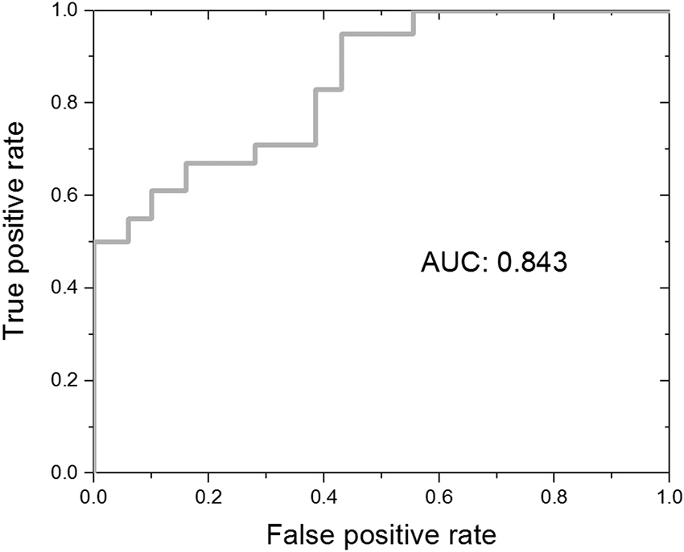

Figure 6. Receiver-operator-characteristics curve obtained using the angular tracking error of the fast circular motion eye test as the assessment metric only for the subset of 30 subjects assessed with Cognitive Stability Index. AUC = area-under-the-curve.
Baruch M, Barth JT, Cifu D, Leibman M. Utility of a multimodal neurophysiological assessment tool in distinguishing between individuals with and without a history of mild traumatic brain injury. J Rehabil Res Dev. 2016; 53(6): 959–72.
http://dx.doi.org/10.1682/JRRD.2015.06.0120

