Slide 1
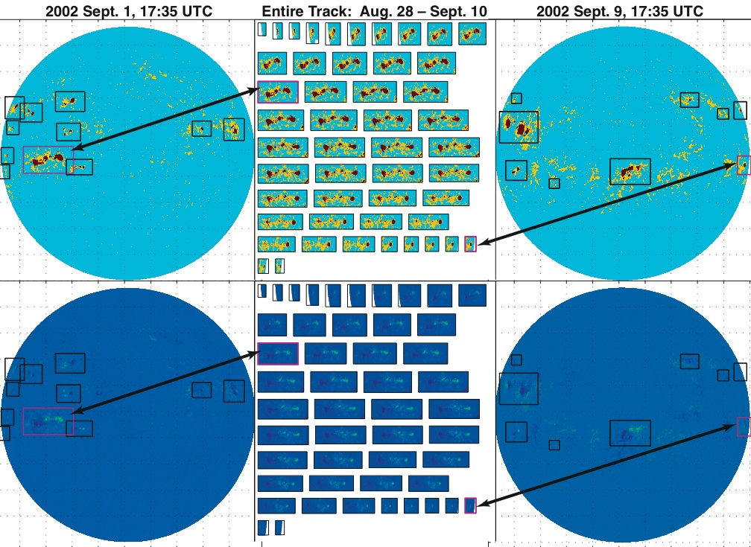
Statistical Object Identification, Tracking, and Analysis
FY05 Highlights
Improved SoHO/MDI tracking. Accounted for spherical solar geometry and different uncertainties in east-west vs. north-south motions of sunspots
Attended HMI science team meeting, Monterrey, CA, Feb. 2006
Initial Kitt Peak classifications reported at AGU, Dec. 2006
Michael Turmon
turmon@jpl.nasa.gov
Project Summary
Identification: Find objects in multispectral science images
Tracking: Link identified objects in series of images
Trajectory Analysis: Model and classify object tracks
Plans for This Year
Support use on SDO by developing region models for HMI imagery
Extend track analysis using object tracks found in FY05
Improve modeling capacity of track analysis
Labeling
Magnetogram
Sunspot
Photogram
Applications
Used to find and track active regions in SoHO/MDI data over 1996-2002 (ApJ 568:396-407).
SDO/HMI data pipeline at Stanford. Summarization & catalogs are critical to HMI, which returns 4096x4096 images every 90 s.
Classify the Kitt Peak imagery (magnetograms, continuum, and line depth), and evaluated for use with the new Kitt Peak vector spectromagnetograph.
Baselined by CNES Picard, which will look for tiny variations in solar diameter and shape.
Pattern recognition,
object identification, tracking
http://www-aig.jpl.nasa.gov/home/turmon/solar/
2005-2007
Notes:
Figure top center:
This illustrates the “object identification” component in MDI data.
A magnetogram and photogram are processed to produce a labeling, or mask, which shows sunspots (black) and faculae (white)
Figure bottom right:
This illustrates the “object tracking” component in MDI data. Labelings/masks are in the top row, and the original magnetograms are in the bottom row.
The top-left image is a labeling for one day, with different active regions (sunspot groups) boxed. This is produced automatically, and agrees with the NOAA hand classification for that day.
The top-right image is similar, 9 days later. The sunspot has been tracked through the intervening days. All presentations of it are shown in the top-middle panel.
Note, we are able to reliably track the sunspot right up to the edge of the solar disc. This is hard to do.

