Slide 1
Grant Management System
Community Corrections

Slide 2
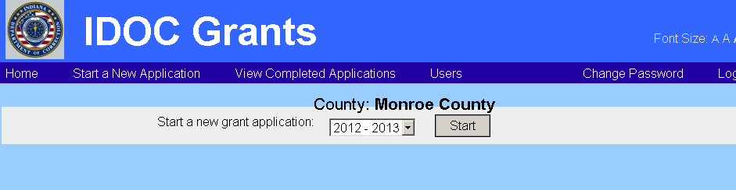
Grant Management System

Slide 3
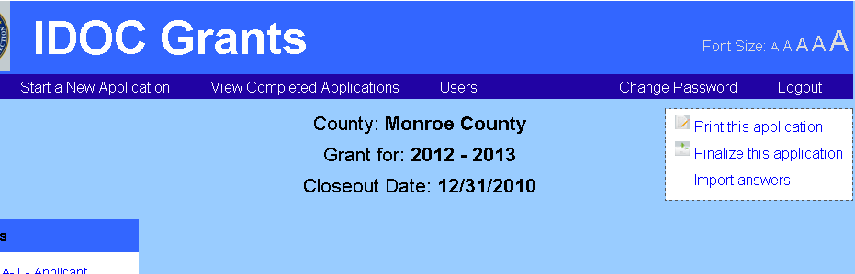
Grant Management System

Slide 4
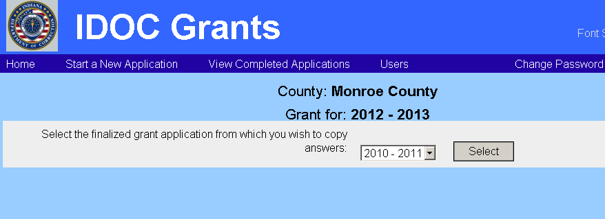
Grant Management System

Slide 5
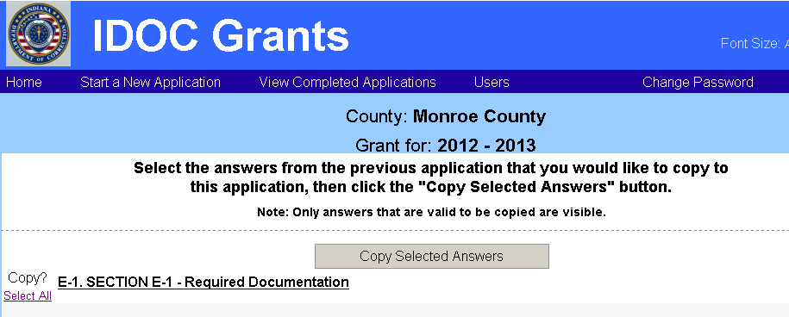
Grant Management System

Slide 6
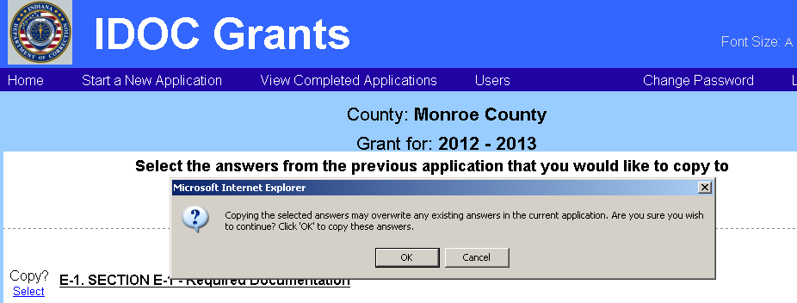
Grant Management System

