Slide 1
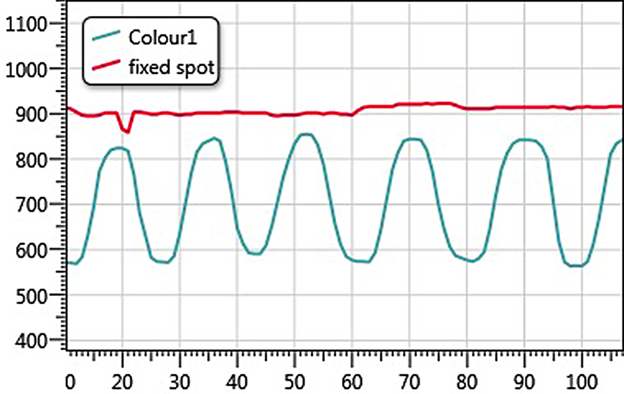

Figure 6. Magnified results of drinking simulation exercise.
Tan KK, Narayanan AS, Koh CH, Caves K, Hoenig H. Extraction of spatial information for low-bandwidth telerehabilitation applications. J Rehabil Res Dev. 2014;51(5):825–40.
http://dx.doi.org/10.1682/JRRD.2013.09.0217
ResearcherID/ORCID: Kok Kiong Tan, PhD: G-6621-2013; Arun Shankar Narayanan: K-2878-2013
Notes:
Figure 6. Magnified results of drinking simulation exercise.

