Slide 1
New Guidelines for Data Result Suppression of Small Cell Numbers in IBIS-Query Output
Public Health Informatics Brown Bag
July 22, 2009
Kathryn Marti, Director
Office of Public Health Assessment

Slide 2
Outline
Introduction
Background
Work Group
Important Concepts
Methodology
The Guidelines
Next steps

Slide 3
Introduction
Why not report data?
  Protect privacy
  Ensure reliable data
Why make data publicly available?
What reports?
  Published reports
  Online static tables
  Web-based data query system output

Slide 4
Background
Current IBIS-Q suppression rules
Enhancements to IBIS-Q BRFSS
Increased likelihood of small cell sizes
Grew to department-wide effort
Develop UDOH-wide policy
HIPAA and more
Sensitivity for vulnerable populations
Notes:
Current IBIS-Q suppression rules - numerator less than 5 or denominator less than 30.
Enhancements to IBIS- small areas, custom age groups, additional cross tabs => small cells
Grew to department-wide effort – include all IBIS-Q data stewards, at least, and Center for Health Data (reports reviewed in Center).
HIPAA and more: confidentiality issues around “Protected Health Information” (PHI), new developments in data linkage ability, the need to serve differing audiences with the data.

Slide 5
Data Suppression Decision Rules Work Group
Charter
Provide guidelines to UDOH programs
Program into IBIS-Q
Work Group Products:
  Decision Rules
  Decision Tree
  Justification of the rules
Notes:
Established by Lois Haggard.
Charter developed by Lois with input from Work Group members

Slide 6
Important Concepts
Confidence Interval
Coefficient of Variation
Power to detect a difference
Context/Use of the estimate
Notes:
The margin of error, or confidence interval, describes the range within which one is most likely to find the true value of the statistic (e.g., the true value of a percentage or a mean in a population). In sample surveys, the confidence interval depends on two parameters: the amount of variation in the data and the size of the sample from which the data are generated.
The coefficient of variation (CV) is a measure of the variability of the estimate compared with the magnitude of the estimate. It may be thought of as the percentage of the magnitude of the estimate that is subject to random error.
The ability to detect a statistically significant difference depends on 1) the magnitude of statistical significance required (usually α <.05), 2) the sample size (n), and 3) the actual magnitude of the difference.
Some estimates will be used to make decisions that impact a great number of people, whereas other estimates will be used to provide a rough idea of the magnitude of a problem or condition.

Slide 7
Coefficient of Variation
CV=[100 x (SE(R)/R)]%
Where:
  SE = the standard error of the estimate
  R = the estimated rate
Unitless measure
Usually expressed as a percentage
Notes:
The coefficient of variation (CV) is a measure of the variability of the estimate compared with the magnitude of the estimate. It may be thought of as the percentage of the magnitude of the estimate that is subject to random error. The CV describes the variability in a set of measurements by expressing the standard deviation or standard error as a percentage of the estimate.

Slide 8
Coefficient of Variation (cont’)
If the estimated percentage is greater than 50%, the CV is calculated by dividing the standard error of the estimate (SE(R)) by one minus the estimate (1-R).
CV=[100 x (SE(R)/(1-R))]%

Slide 9
Coefficient of Variation for Percentages
Example #1
The crude estimated percentage of Utah adults aged 85 and older who were current cigarette smokers in 2007 was 7.65% with a standard error of 3.81%.
CV = 100 x (0.0381/0.0765) = 49.8%

Slide 10
Coefficient of Variation for Percentages (cont’)
Example #2
The crude estimated percentage of Utah adults aged 85 and older who were non-smokers in 2007 was 92.35% with a standard error of 3.81%.
CV = 100 x (0.0381/(1-0.9235))
= 100 x (0.0381/0.0765) = 49.8%
Notes:
You should get the same CV here since example #2 is reporting the complement of the information in example #1. If we were using the general minimum criteria, both percentages would be reported but would include a footnote stating to use caution in interpreting the result because the estimate has a relative standard error greater than 30% and does not meet UDOH standards for reliability.

Slide 11
Coefficient of Variation for Count Data
  D = # of deaths ~ Poisson
  P = # in population where deaths occurred
  R = rate per 100,000 = (D/P) *100,000
  Var(R) = Var [(D/P) x 100,000]
  = (100,000/P)² Var(D)
  = (100,000/P) x ((100,000*D)/P)
  = (100,000/P) x R
  CV = 100 x [SQRT(Var(R))]/R
  = 100 x [SQRT((100,000/P)*R)]/R
  = 100 x SQRT[100,000/(P*R)]

Slide 12
Coefficient of Variation for Count Data (cont’)
  Example #1
  D = 388 Alzheimer’s disease deaths in Utah in 2006
  P = UT Population in 2006 was 2,615,129
  R = (388/2,615,129) x 100,000 = 14.84 per 100,000
  CV = 100 x SQRT[100,000/(P*R)]
  CV = 100 x SQRT[100,000/(2,615,129 x 14.84)]
  = 5.08%

Slide 13
Coefficient of Variation for Count Data (cont’)
  Example #2
  D = 5 Alzheimer’s disease deaths in Utah adults between the ages 55-64 in 2006
  P = 55-64 UT Population in 2006 was 201,340
  R = (5/201,340) x 100,000 = 2.48 per 100,000
  CV = 100 x SQRT[100,000/(P*R)]
  CV = 100 x SQRT[100,000/(201,340 x 2.48)] = 44.75%
Notes:
These two examples illustrate the how the CV increases in a small population that only includes Utah adults aged 55-64 in Example #2, versus the total Utah population used in Example #1.

Slide 14
Methodology
Literature review
Compared suppression rules using BRFSS small area, low prevalence data.
  < 5 observations in numerator or 30 in denominator
  CV greater than 30%
  CV greater than 50%
  the CI length larger than the estimated percent
  1/2 the CI length >10% and denominator less than 50
Notes:
Suppression rules comparison calculations done by Mike Friedrichs and Shelly Wagstaff

Slide 15
Guidelines
Minimum Criteria
For Reporting Both Survey Data and Population Event Data:
✓ CV < 50%
✓ If 30% < CV < 50% an asterisk should be included with a footnote that says: *Use caution in interpreting, the estimate has a relative standard error greater than 30% and does not meet UDOH standards for reliability.
Notes:
• To inform program decisions that involve small numbers of people,
• To be able to measure gross changes in a measure over time or across groups, or
• To inform the allocation of a small amount of money or other resources.

Slide 16
Guidelines
Strict Criteria
For Reporting Survey Data:
✓ > 10 cases in the numerator
✓ AND a CV < 30%
For Reporting Population Event Data:
✓ > 20 cases in the numerator and >100 persons in the population
AND a CV < 30%
Notes:
• To inform program decisions that involve small numbers of people,
• To be able to measure gross changes in a measure over time or across groups, or
• To inform the allocation of a small amount of money or other resources.

Slide 17
<30%
REPORT
<50%
CV=SE/RATE
30<CV<50%
REPORT WITH WARNING
GENERAL
(MINIMUM CRITERIA)
>50%
SUPPRESS OR
AGGREGATE
RATE
<30%
REPORT
>50%
CV=SE/(1-RATE)
30<CV<50%
REPORT WITH WARNING
SURVEY DATA
KIND OF
POPULATION
>50%
SUPPRESS OR
AGGREGATE
<30%
REPORT
TYPE OF
DATA
<50%
CV=SE/RATE
>30%
SUPPRESS OR
AGGREGATE
VULNERABLE
(STRICT CRITERIA)
≥10
RATE
COUNT DATA
<30%
NUMERATOR
REPORT
>50%
CV=SE/(1-RATE)
>30%
SUPPRESS OR
AGGREGATE
SUPPRESS OR
AGGREGATE
<10

Slide 18
SURVEY DATA
<30%
REPORT
GENERAL
(MINIMUM CRITERIA)
CV= 100 x
100,000 .
PR
REPORT WITH WARNING
TYPE OF
DATA
√(
)
30<CV<50%
>50%
SUPPRESS OR
AGGREGATE
COUNT DATA
KIND OF
POPULATION
<30%
REPORT
CV=100 x
100,000 .
PR
≥20/100
√(
)
VULNERABLE
(STRICT CRITERIA)
>30%
SUPPRESS OR
AGGREGATE
CELL SIZE
SUPPRESS OR
AGGREGATE
<20/100
Notes:
Flow Chart created by Sam LeFevre

Slide 19
Next Steps
Program into IBIS-Q and SAS CGI
Determine how to display output and notes
  New Mexico example
  Utah Test server
Get OK from Data Stewards
  Minimum criteria vs. Strict criteria
Notes:
Include link to the documents in Help section of IBIS-PH.
The term, "data reliability." They wanted something like, "statistical stability" that would not imply data errors to users unfamiliar with the term "reliability" and would communicate better what it is actually communicating. And the link to a descriptive narrative was something they wanted, also.
RE New Mexico: Labeling for these flags since reliability is a continuum and any categorization scheme is arbitrary.

Slide 20
Next Steps (con’t)
Suggested text for 30% < CV < 50% :
*Use caution in interpreting, the estimate has a relative standard error greater than 30% and does not meet UDOH standards for reliability.

Slide 21
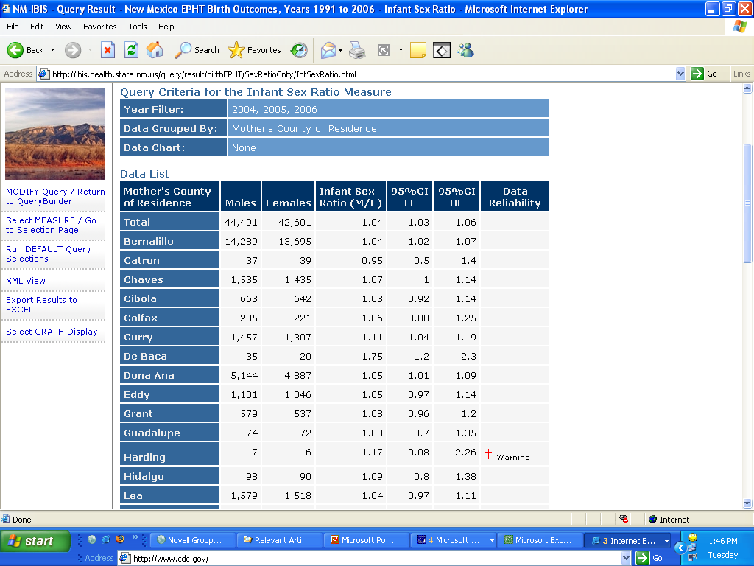

Slide 22
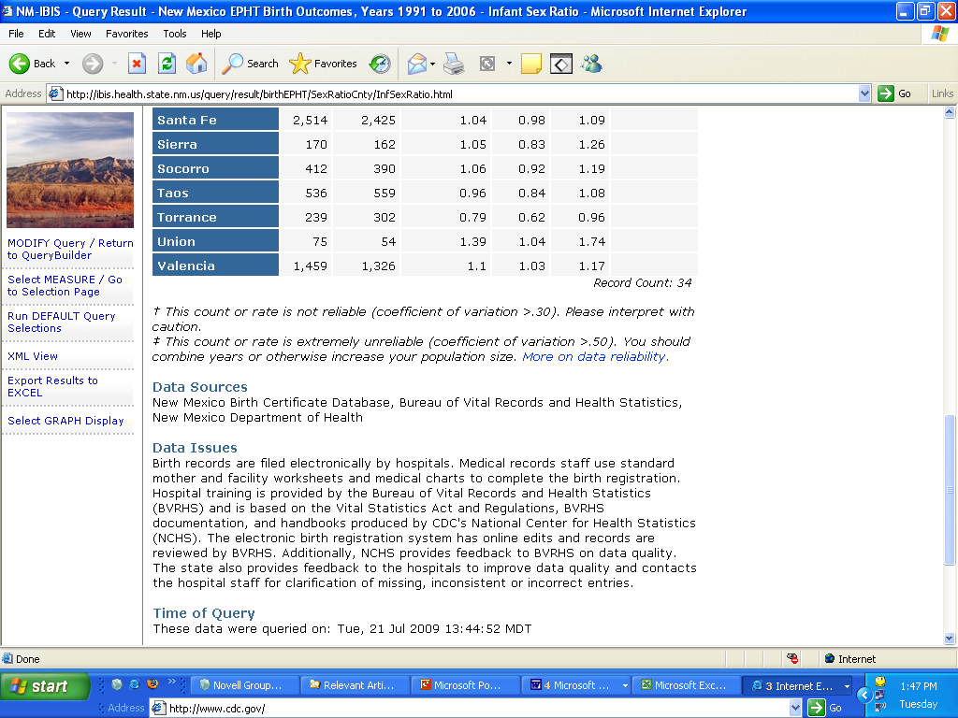

Slide 23
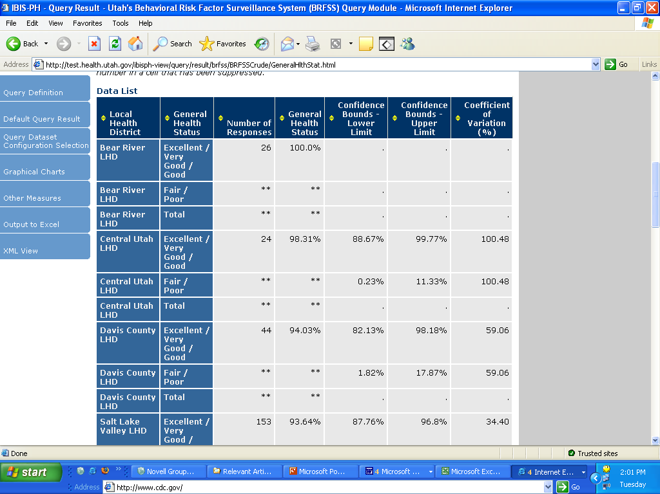

Slide 24
