Slide 1
Monosodium Aspartate for Use in Cardioplegia Solutions
Raymond Lipicky, MD, Director
K Srinivasachar, PhD, Chemist
N Stockbridge, MD, PhD, Team Leader
Division of Cardio-Renal Drug Products

Slide 2
Cardioplegia
Elective procedure to halt cardiac mechanical activity temporarily

Slide 3
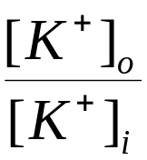
Contractility is controlled by interference with electrical activity
“Resting” membrane potential is set by
Raising extracellular potassium depolarizes the membrane and interrupts the electrical rhythm of the heart.

Slide 4
Cardioplegia solutions have evolved through experience, not controlled clinical trials
Blood
Better preservation
Crystalloid
Better visibility
Blood dilutions

Slide 5
Aspartic acid
Non-essential amino acid
Part of respiratory chain
CNS transmitter
Aspartate
+
α-Ketoglutarate
Glutamate
+
Oxaloacetate
O=C-CH₂-CH-C=O
HO NH₂ OH
Succinyl CoA
Phosphoenol pyruvate
Pyruvate

Slide 6
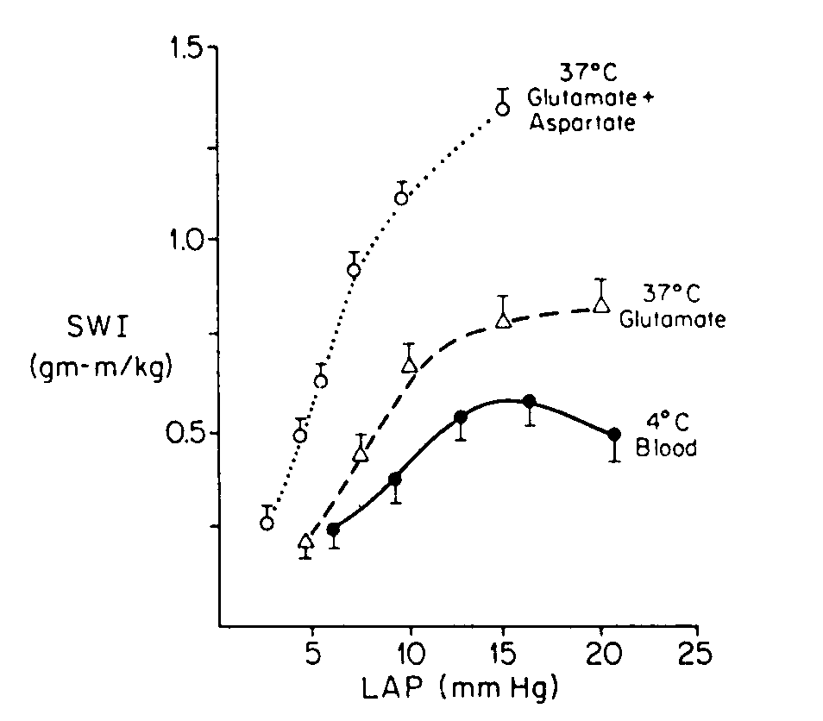
Aspartate aids recovery of function in a reperfusion model

Slide 7
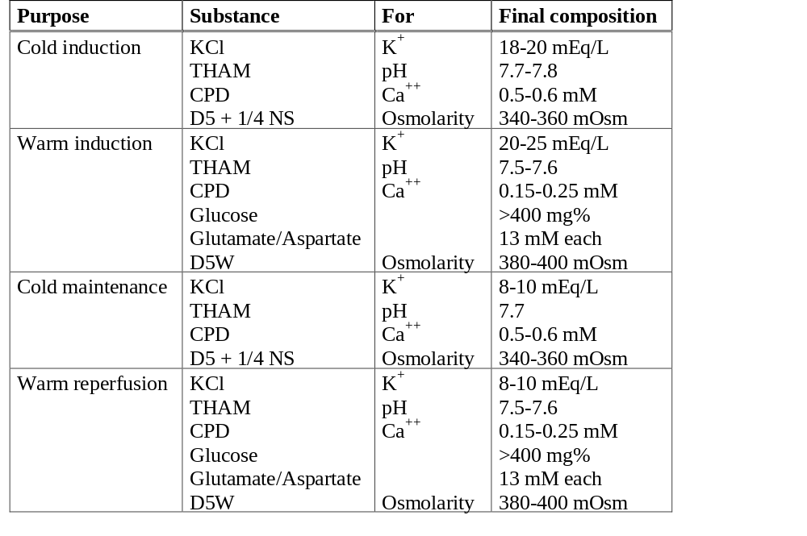
Sample cardioplegia solutions

Slide 8
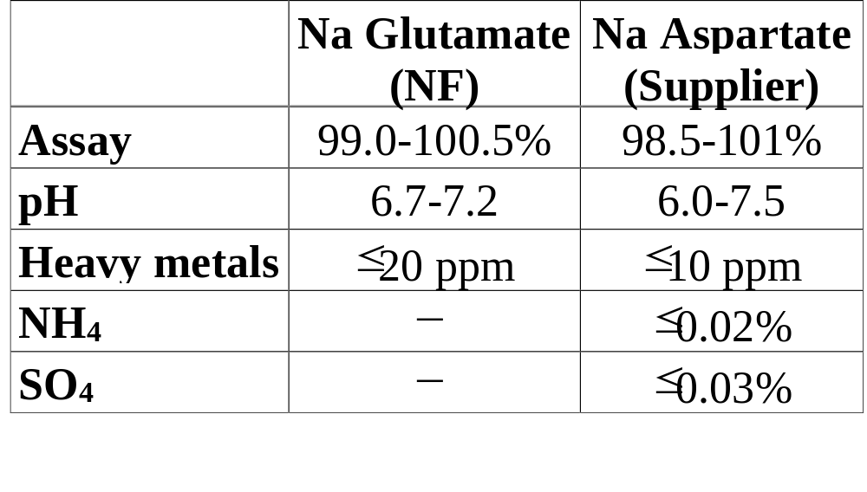
Specifications

Slide 9
Clinical experience
Loop et al., 1992: Less morbidity among 819 consecutive cases with blood cardioplegia with aspartate and glutamate than in 2582 concurrent consecutive cases with crystalloid cardioplegia.
Buckberg et al., 1995: 1.6% total mortality among 1474 cases in 4 centers.

Slide 10
Safety
Aspartate is a natural amino acid with plasma levels to ~30 μM.
Total circulating levels of amino acids equivalent to ~3 mM.
High aspartate and glutamate during maintenance leads to peripheral vasodilation.

Slide 11
Recommendation
Use of aspartate is supported by clinical experience, if not controlled studies
No safety concerns evident in literature
No role for potassium salt
Sodium aspartate should be approved for pharmacy compounding

