Slide 1

National Archives and Records Administration
The Electronic Records Archives Initiative
Digital Strategies 2000
Kenneth Thibodeau
November 16, 2000
Notes:
Information and services survivability
Our Nation’s security, commerce, education, and well-being depend increasingly on our information infrastructure. It is thus critical to ensure the survivability of that infrastructure in the face of malicious attacks or viruses, equipment or software failures, and overload. Survivability means that services will be available when needed and information will be delivered in a timely fashion. Services must operate correctly and the information they deliver must be of high quality or be identified if otherwise. Survivability includes long term preservation of information; a document of historical importance should be preserved, even as underlying storage technologies and information representation evolve and even if it is not accessed for hundreds of years.
P.41

Slide 2
“Information Technology Research:
Investing in Our Future”
“Our Nation’s security, commerce, education, and well-being depend increasingly on our information infrastructure. It is thus critical to ensure the survivability of that infrastructure.... Survivability includes long term preservation of information; a document of historical importance should be preserved, even as underlying storage technologies and information representation evolve and even if it is not accessed for hundreds of years.”
    President’s Information Technology Advisory Committee,
    Report To The President. February 1999
Notes:
Information and services survivability
Our Nation’s security, commerce, education, and well-being depend increasingly on our information infrastructure. It is thus critical to ensure the survivability of that infrastructure in the face of malicious attacks or viruses, equipment or software failures, and overload. Survivability means that services will be available when needed and information will be delivered in a timely fashion. Services must operate correctly and the information they deliver must be of high quality or be identified if otherwise. Survivability includes long term preservation of information; a document of historical importance should be preserved, even as underlying storage technologies and information representation evolve and even if it is not accessed for hundreds of years.
P.41

Slide 3
Electronic Records Archives Scope
Make
Use for business
Deliver to posterity
Receive
Destroy when not needed
The Life Cycle of Records

Slide 4
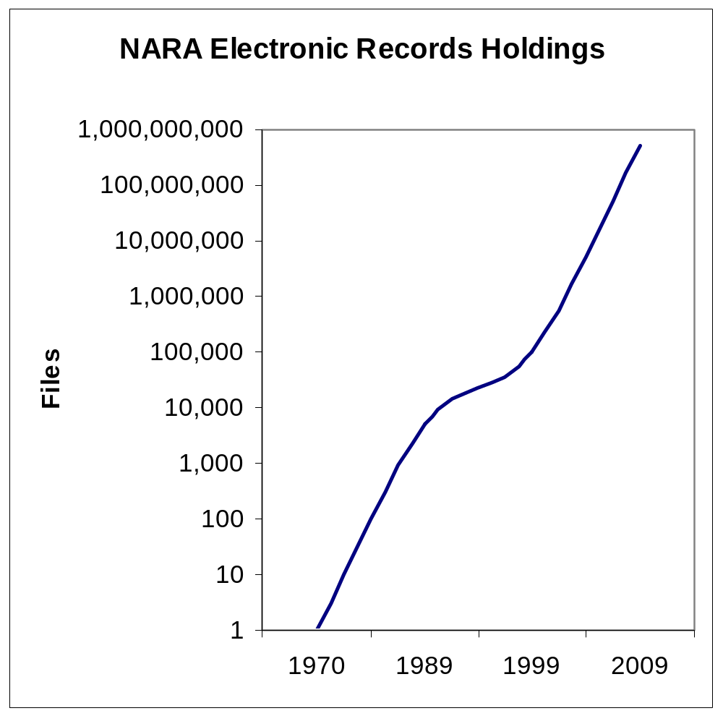
What is the size of the challenge?

Slide 5
What do we need to do?
Overcome technological obsolescence in a way that preserves demonstrably authentic records.
Build a dynamic solution that incorporates the expectation of continuing change in information technology and in the records it produces.
Find ways to take advantage of continuing progress in information technology in order to maintain and improve both performance and customer service
Notes:
• Concern with digital preservation focuses on the twin problems of technology obsolescence and the fragility of digital media. Based on 30 years experience in preserving digital information at NARA, we believe that the media problem is a manageable one, but obsolescence remains a major problem. {Give examples} In fact, a focus on obsolescence is misdirected. Digital preservation is a dynamic problem. It is not enough to keep the information around. You must keep it in a way that enables you to use the best available technology to discover and deliver the information. The National Archives is preserving electronic records from World War II. Our customers would not be happy if they could only access these records by entering requests on punch cards, using 1940’s vintage computers, and getting computer printouts in all uppercase in response. At NARA we want to preserve digital information in a way that takes advantage of continuing technological progress in order to provide continuing improvements in customer service.
• Even apart from concern with customer service, it is clear that a digital preservation strategy must be intrinsically dynamic simply because obsolescence is not a one-time problem. Even solving all the problems of obsolescence that we face today would not be enough. Today’s progress….
• Furthermore, even if we succeed in solving existing problems of obsolescence, it is probable that continuing progress will produce better solutions to the same problems.

Slide 6
What is the Electronic Records Archives?
The Electronic Records Archives is a comprehensive, systematic, and dynamic means of providing continuing access to authentic electronic records over time.

Slide 7
“Information Technology:
The 21st Century Revolution”
“Today's fast-evolving capabilities of computing systems and networks make it possible to recreate, archive, display, and manipulate exponentially greater quantities of electronically generated documents, data, images, sounds, and video streams-and to offer potential instant access to this knowledge to a significant portion of the world's population. But organizing "collections" of these many forms of electronic information and developing systems and software tools to make them available to end users require complex technical innovations, including collaboration among experts from widely disparate fields of knowledge.
Digital Libraries Initiative “Phase Two activities are jointly supported by NSF, DARPA, NIH/NLM, the Library of Congress, NASA, the National Endowment for the Humanities, and the FBI, in partnership with the National Archives and Records Administration, the Smithsonian Institution, and the Institute of Museum and Library Services.”
Supplement to the President's Budget, FY 2001
Interagency Working Group on Information Technology Research and Development
National Science and Technology Council

Slide 8
“Information Technology:
The 21st Century Revolution”
National Partnership for Advanced Computational Infrastructure (NPACI) “ is creating a continuous, ubiquitous, and pervasive national computational infrastructure. NPACI's focus includes providing computation and information resources to enable discovery at scales not previously achievable; developing and deploying integrated, easy-to-use computational environments to foster discovery in traditional and emerging disciplines; and promoting computational literacy to extend the excitement, benefits, and opportunities of computational science to all U.S. citizens.”
Supplement to the President's Budget, FY 2001
Interagency Working Group on Information Technology Research and Development
National Science and Technology Council

Slide 9
How will we develop the
Electronic Records Archives?
NARA
ERA System
Electronic Records Archives Framework
Information Technology Architecture for Persistent Digital Collections

Slide 10
NARA Partnerships
Open Archival Information System (OAIS) Reference Model
  NASA, Consultative Committtee on Space Data Systems
Distributed Object Computation Testbed (DOCT)
  Defense Advanced Research Projects Agency, U.S. Patent and Trademark Office
National Partnership for Advanced Computational Infrastructure (NPACI)
  National Science Foundation
Presidential Electronic Records Processing Operational System (PERPOS)
  Army Research Laboratory, Georgia Tech Research Institute
Archivist’s Workbench
  NHPRC Grant to San Diego Supercomputer Center
International research on Permanent Authentic Records in Electronic Systems (InterPARES)
  7 international research teams, 10 national archives

Slide 11
How do these activities fit together?
OAIS Model
DOCT
NPACI
PERPOS
Archivist’s Workbench
InterPARES
High level framework for administration, entities, functions, data flows
Persistent Object Preservation
Architecture and core technologies for a comprehensive solution based on Persistent Object Preservation
Advanced tools for archival processes
Scale ERA for smaller archives
Archival requirements, electronic records typology, preservation model

Slide 12
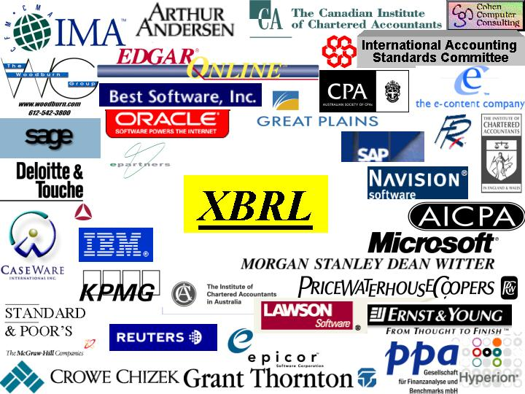

Slide 13



ERA Functional Model
An Open Archival Information System Implementation
Submission
Information
Packages
Producer
OAIS
Archival
Information
Packages
Result sets
queries
orders
Consumer
Dissemination
Information
Packages

Slide 14
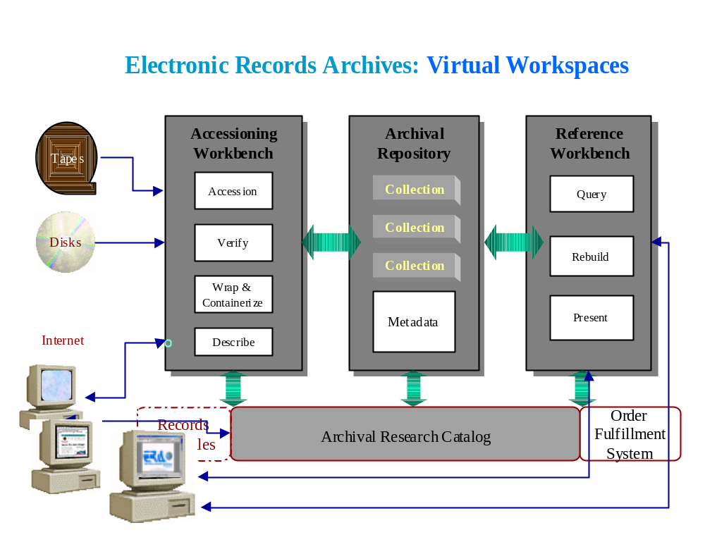
ERA Virtual Workspace Model
Notes:
This slide shows a conceptual view of the Electronic Records Archives from the perspective of the National Archives. ERA contains 3 main structural components: virtual ‘workbenches’ to support the accessioning of electronic records into the archives and reference services for access to those records and an archival repository where the records are maintained over time. Each of the structural components will have built-in functionality to support core processes. For example, the Accessioning Workbench will include functionality for accessioning the records, preparing them for preservation (wrap and containerize), and for extracting data needed for archival preservation. Each component will interact with the others, and with other related systems such as ARC, through ‘application programming interfaces.’ This will enable each component to be optimized for its functions, including enabling replacement of hardware and software in any component with minimum impact on other components or systems.
This independence will only be possible because of technologies being developed in the National Partnership for Advanced Computational Infrastructure. These enabling technologies are shown in the background.
Each structural component will also enable ‘snap-in’ of specialized tools when needed. The slide shows special tools to support transfer of electronic records on different media or from the Internet. Other possible special tools would include software for review and redaction of records subject to FOIA exemptions.

Slide 15
ERA Infrastructure Concept
Gb/sec Internet
Grid Security
Distributed Processing
Mediation among Systems
Distributed, redundant Storage
Infrastructure Independence
Records
Creator
Workbench
Public User
NARA
User
Government
User
Workbench
Workbench
Records
Creator
Repository
Trusted
Repository
Digital
Library
Records
Creator
NARA
User
Public User

Slide 16
The Electronic Records Archives Framework
Special Tool Sets
Responsiveness Adaptability
Archival Functions
Persistence Comprehensiveness Assurance
Enabling Technologies
Infrastructure Independence
Commercial Products
Notes:
Commercial Products: Computer, Storage subsystem, Media, Data management, Communications, Information discovery, Presentation & delivery, Security
Enabling Technologies: Mediate across underlying commercial products, provide interfaces to archival applications
Archival functions: Accessioning, Description, Maintenance, Discovery, Delivery
Special Tools: Media Handlers, special processing for unmanaged records, Access restrictions, Redaction, Equities, Special customer services, Exception processing

Slide 17
What are the Objectives of
Digital Preservation?
Preserve Technology
What is important?
Preserve Things produced with technology
“Data Objects”
Computer Games
Virtual Reality Models
Records
Photographs
Maps

Slide 18
Transformation to Persistent Object Form
Characterize all significant properties of the things that are to be preserved.
Express these requirements in formal models
Transform the objects by
  Encapsulating them in metadata defined in the models
  Eliminating other technical characteristics that are dependent on specific hardware or software, proprietary, or subject to obsolescence.
Use software “mediators” to enable future technologies to interpret the models and metadata.

Slide 19
Persistent Object Preservation
Aims at independence of technological infrastructure
  Do not preserve things in original technological materialization.
  Reduce threats to integrity and authenticity by minimizing changes over time.
Embeds changes in a comprehensive information management architecture designed for preservation
Inherently extensible
Facilitates use of future, advanced technologies, without requiring change in what is preserved.
Currently beyond state of the art of information technology.

Slide 20
Persistent Object Preservation of Records
Focuses specifically on satisfying archival requirements for preservation of records.
Preserves files, series, and archival fonds as well as individual records
Minimizing changes over time reduces threats to integrity and authenticity.
Requirements for integrity and authenticity are controlled explicitly and specifically.
Provides for the performance of archival functions as well as the persistence of the records.
Designed so that use of advanced technologies for search, retrieval & delivery does not compromise integrity.

Slide 21
Collection-Based Persistent Object Preservation
Comprehensive
  All types of computer applications
  All types of electronic records
  Collections as well as individual records
  All required archival processes
Highly Automated
Scalable
  >= X00,000,000 objects,
  and down for small collections and repositories
Implemented over the Internet

Slide 22
Thank you.
For more information:
www.nara.gov/era

