Slide 1
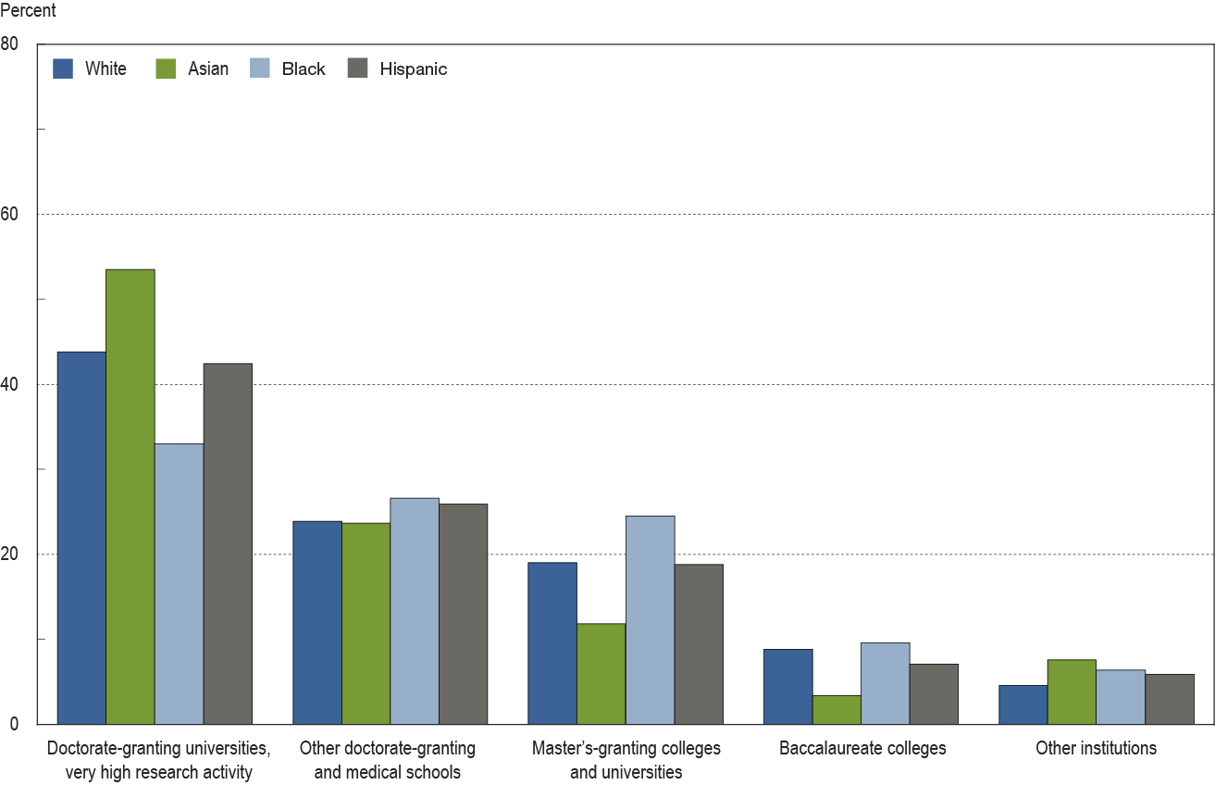
Distribution of S&E doctorate holders employed in
4-year colleges and universities among Carnegie classification of institution, by race/ethnicity: 2006

