Slide 1
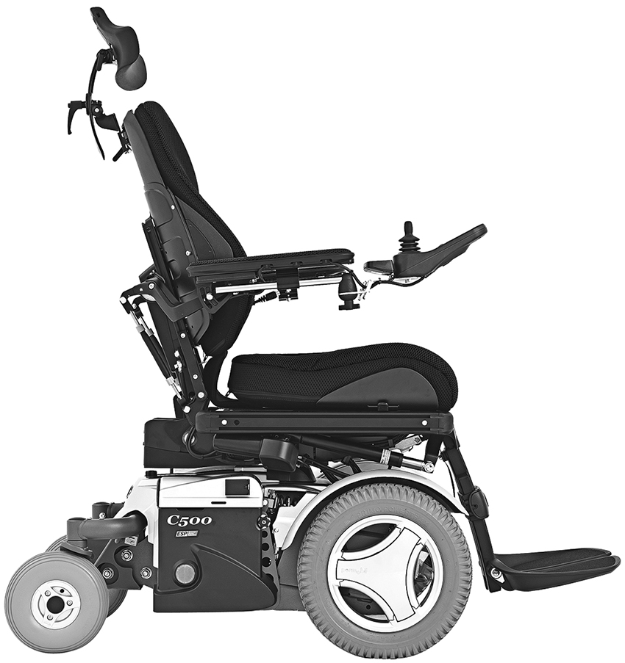

Figure 1. Lateral view of Permobil C500 chair. Photo used by permission from Permobil Inc (Lebanon, Tennessee).
Brose SW, Wali E. Multidisciplinary approach to converting power chair into motorized prone cart. J Rehabil Res Dev. 2014;51(9):1377–82.
http://dx.doi.org/10.1682/JRRD.2014.01.0027
Notes:
Figure 1. Lateral view of Permobil C500 chair. Photo used by permission from Permobil Inc (Lebanon, Tennessee).

