Slide 1

Washington State
Office of Administrative Hearings
Human Resource Management Report
Full Report
Prepared for:
Department of Personnel
By:
Office of Administrative Hearings
October 2006

Slide 2
Human Resource Management Report - Reporting Process
GMAP
Managers’ evaluations includes HR Management Report results
Agency internal GMAP sessions include HR Management Report presentation
Agency director communicates workforce management and HR Management Report expectations & measures to managers
Managers collect and report data for HR Management Report performance measures
Agency Director has agency-wide data analysis and reports prepared
Agency Director presents selected portions of HR Management Report at agency’s assigned Governor’s GMAP forums
Agency HR Office assists managers in data collection, analysis, report preparation
Quarterly reporting to DOP of agency-tracked standard measures
Copy to DOP of agency-internal GMAP reports on HR management as they are done
DOP presents enterprise-wide HR Management Report at Governor’s GMAP forums on Government Efficiency
Base set of data
Quarterly statewide updates
Special request data
DOP collects statewide data and conducts overall analysis
DOP provides agency with centrally available data analysis queries & consultation
DOP submits annual comprehensive statewide status report to Governor & Directors

Slide 3
Human Resource Management Report - Reporting Timeline
Government Efficiency GMAP on enterprise HR Management Report
Government Efficiency GMAP on enterprise HR Management Report
Government Efficiency GMAP on enterprise HR Management Report
Government Efficiency GMAP on enterprise HR Management Report
DOP provides with base set of centrally available data & queries for standard performance measures
DOP sends statewide data update to agencies
DOP sends statewide data update to agencies
DOP sends statewide data update to agencies
DOP sends statewide data update to agencies
Dec 05 | Jan 06 | Feb 06 | Mar 06 | Apr 06 | May 06 | June 06 | July 06 | Aug 06 | Sept 06 | Oct 06 | Nov 06 | Dec 06
Agencies report selected “agency-tracked” HR Mgmt Report standard measures to DOP*
Agencies report selected “agency-tracked” HR Mgmt Report standard measures to DOP*
Agency Directors communicate “workforce management” performance expectations, measures, and reporting process requirements to their managers
DOP delivers comprehensive first annual report statewide human management status to Governor
Agency-internal GMAP sessions on HR Management Report
* “Agency-tracked” means certain HR Management Report data that must be tracked by each agency because it is not available in the central system.
** In addition, agencies send copies of their internal GMAP reports on HR Management Report to DOP as they are completed.

Slide 4
Priorities of Government
Plan the Organization
Managers’ Accountability for Strategic Workforce Management
Strategic Plan
Mobilize Resources
Deliver Services
Manage Financial Resources
Manage Human Resources
Manage Business Processes
Manage Relation-
ships
Achieve Public Value & Benefit
Managers have five primary workforce management functions:
Manage Human Resources
Plan & Align Workforce
Hire Workforce
Deploy Workforce
Reinforce Performance
Develop Workforce

Slide 5
Agency Managers’ Logic Model for Workforce Management
Key Outputs
Initial Outcomes
Intermediate Outcomes
Articulation of managers HR performance accountabilities. HR policies. Job & competency analyses. Workforce plan. Positions classified, salaries assigned.
Workforce levels, competencies, & strategies are aligned with agency priorities
Managers’ accountabilities are communicated & understood
Foundation in place to build and sustain a productive, high performing workforce
Plan & Align Workforce
Hire Workforce
Qualified candidate pools, interviews & backgrounding. Job offers. Appointments and initial performance monitoring.
Best qualified hired & reviewed during appointment period
The right people are in the right job at the right time
Work assignments& requirements defined. Positive workplace environment & relations created. Coaching, feedback, corrections.
Workplace is safe, gives capacity to perform, fosters productive relations
Employees know job requirements, how they’re doing, & are supported
Time & talent is used effectively. Employees are motivated & productive.
Deploy Workforce
Develop Workforce
Individual development plans. Time/ resources for training. Continuous learning environment created.
Learning environment created. Employees are engaged in develop-
ment opportunities & seek to learn.
Employees have competencies for present job & career advancement
Clear performance expectations linked to organizational goals & measures. Regular performance appraisals. Recognition. Discipline.
Employees know how their performance contributes to success of organization. Strong performance rewarded; poor performance eliminated
Successful performance is differentiated & strengthened. Employees are held accountable.
Reinforce Performance
Ultimate Outcomes
Agencies have workforce depth & breadth needed for present and future success
Employees are committed to the work they do & the goals of the organization
Productive, successful employees are retained
Agency is enabled to successfully carry out its mission. The citizens receive efficient, cost-effective government services.
Notes:
Notes:
This is an abbreviated version of the logic model for agency managers’ HRM accountabilities. NOTE - these are the outcomes for agency managers, not the HR office. The role of the HR office is to guide and support managers in achieving these outcomes.

Slide 6
Human Resource Management Report
Standard Performance Measures
Plan & Align Workforce
Percent current position/competencies descriptions [agency tracking system]
Percent supervisors with current performance expectations for workforce management [agency tracking system]
Time-to-fill funded vacancies [agency tracking system]
Percent satisfaction with candidate quality [agency tracking system]
New Hire-to-Promotional ratio [DOP Data/Business Warehouse]
Percent turnover during review period [DOP Data/Business Warehouse]
Percent employees with current performance expectations [agency tracking system]
Employee survey ratings on “productive workplace” questions [DOP standard survey]
Leave usage (sick, LWOP, unscheduled leave) [DOP Data/Business Warehouse]
Overtime usage [DOP Data/Business Warehouse]
Number & type of non-disciplinary grievances [agency tracking system]
Percent employees with current annual individual development plans [agency tracking system]
Employee survey ratings on “learning/development” questions [DOP standard survey]
Percent current performance evaluations [agency tracking system]
Employee survey ratings on “performance accountability” questions [DOP standard survey]
Number/type of disciplinary issues, actions, appeals disposition [agency tracking system]
Turnover rates and types (e.g., retirement, resignation, etc.) [DOP Data/Business Warehouse]
Turnover rate of key occupational categories and of workforce diversity [DOP Data/Business Warehouse]
Employee survey ratings on “commitment” questions [DOP standard survey]
Hire Workforce
Measures to add in the future:
Current workforce plans that align staff with business priorities
Safety and Workers Compensation measures
Competency gap analysis measure
Recognition/reward measure
Others to be determined
Deploy Workforce
Develop Workforce
Reinforce Performance
Ultimate Outcomes

Slide 7
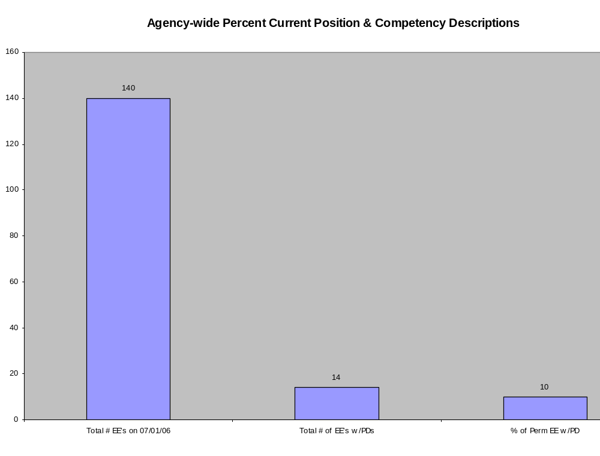
Overall foundation & management accountability system to build & sustain a high performing workforce
Plan & Align Workforce |
HR Management Report category:
Performance Measures
Percent current position/competency descriptions
Percent supervisors with current performance expectations for workforce management
Analysis:
The agency is still transitioning to the new PD form and the PDP.
Our Exempt staff consists mostly of Administrative Law Judges (ALJs) and the PDP process began last year for Senior ALJs.
Action Steps:
The agency is currently in the process of updating all PDs and PDPs for supervisors.
Notes:
Notes:
Plan & Align Workforce is the foundation for the remaining four key HRM functions.
Ideally, each agency should have a comprehensive workforce plan that aligns staffing levels and competencies with business priorities, and identifies strategies to close workforce gaps. Most agencies do not have a workforce plan (a key reason WA did not get an A on Grading of the States). A future action step is to institute workforce planning in the state.
Right now, as a starting point, managers need to know what their HRM responsibilities and performance expectations are. This includes an understanding of the master agreement provisions and new HR policies. Of the XX agencies with represented employees that responded to our inquiry, XX had trained the majority of their managers on those provisions.
Next, a management accountability system needs to be in place. At this point, our best measure is whether managers are receiving performance evaluations. However, what needs to happen is implementation of the Managers HRM Report Card, so that those meaasures are incorporated in the evaluations.

Slide 8
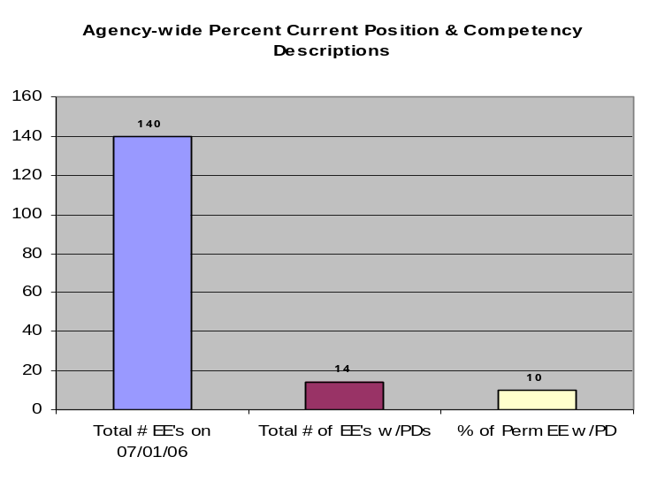
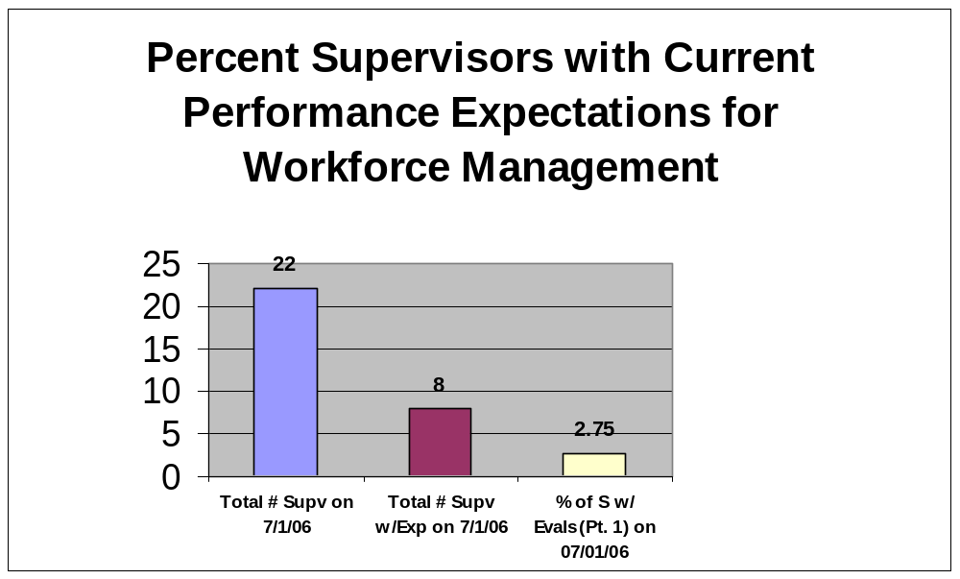
Overall foundation & management accountability system to build & sustain a high performing workforce
Plan & Align Workforce |
HR Management Report category:
Performance Measures
Percent current position/competency descriptions
Percent supervisors with current performance expectations for workforce management
Analysis:
The agency is still transitioning to the new PD form and the PDP.
Our Exempt staff consists mostly of Administrative Law Judges (ALJs) and the PDP process began last year for Senior ALJs.
Action Steps:
Provisions are being made to provide current performance expectations for all supervisors.
The PDP process began this year for our lead and line ALJs and data will be reflected in April’s report.
Notes:
Notes:
Plan & Align Workforce is the foundation for the remaining four key HRM functions.
Ideally, each agency should have a comprehensive workforce plan that aligns staffing levels and competencies with business priorities, and identifies strategies to close workforce gaps. Most agencies do not have a workforce plan (a key reason WA did not get an A on Grading of the States). A future action step is to institute workforce planning in the state.
Right now, as a starting point, managers need to know what their HRM responsibilities and performance expectations are. This includes an understanding of the master agreement provisions and new HR policies. Of the XX agencies with represented employees that responded to our inquiry, XX had trained the majority of their managers on those provisions.
Next, a management accountability system needs to be in place. At this point, our best measure is whether managers are receiving performance evaluations. However, what needs to happen is implementation of the Managers HRM Report Card, so that those meaasures are incorporated in the evaluations.

Slide 9
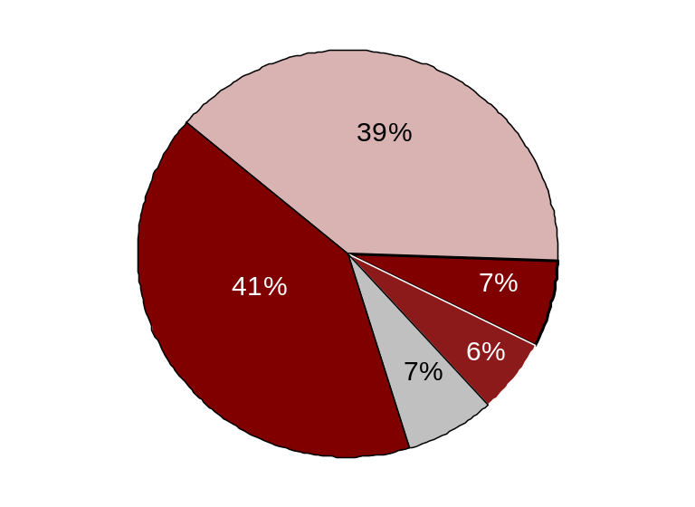
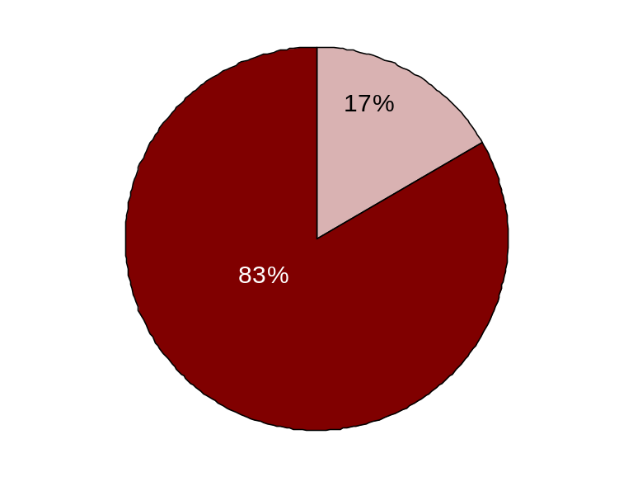
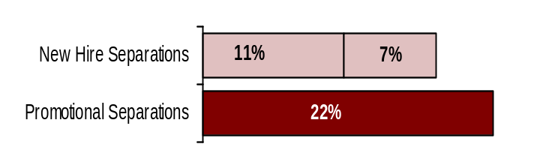
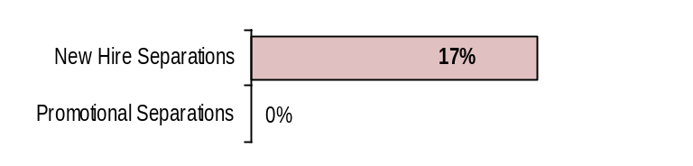
Hire Workforce |
HR Management Report category:
Right People in the Right Job at the Right Time
HR Management Report
(standard measures)
Days to fill vacancies (from requisition to appointment)
% satisfaction with candidate quality
% new hires; % promotional hires
Retention/dismissal rate during review period
Hire Workforce - Slide 1 of 1
Days to Fill Vacancies
Candidate Quality
(managers’ satisfaction rating)
It takes approximately 4-6 weeks to fill a vacancy.
Agency-unique data would be collected and inserted by agency. DOP will provide agencies with suggested standard rating tool.
Report to DOP 10-15-06
Office of Administrative Hearings
Hiring Balance - 2003-05 Biennium
Office of Administrative Hearings Hiring Balance - FY 2006 First Half
New Hires (28)
New Hires (1)
Intra-agency Promotions (5)
Exempts (29)
Exempts (5)
Inter-agency Promotions (4)
Other (5)
Separation during Review Period
Separation during Review Period
**
*
* Released
** Voluntary
*
* Released
** Voluntary
**
Other = transfers, demotions, reassignments, etc
Source: DOP Data Warehouse
Notes:
Notes:

Slide 10
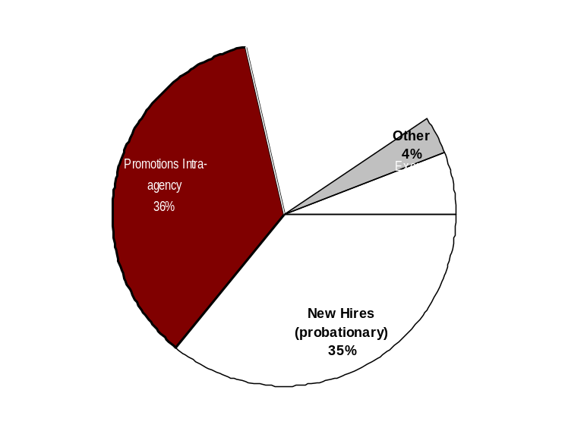
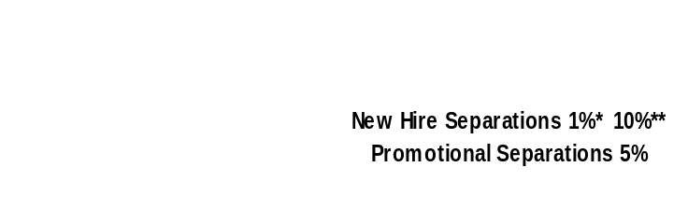
Hire Workforce |
HR Management Report category:
Right People in the Right Job at the Right Time
Performance Measures
Days to fill vacancies
% satisfaction with candidate quality
% new hires; % promotional hires
% separation during review period
Analysis:
Hiring Balance - FY 2006
Total of 20 appointments
Days to Fill Vacancies
Other (3,926)
Approximately 4-6 weeks
Action Steps:
Candidate Quality
(managers’ satisfaction rating)
Separation during Review Period
This data will be reported by agencies to DOP in April 2007
*
* Released
** Voluntary
**
*
Double click on charts to add your agency’s data
Other = transfers, demotions, reassignments, movement in lieu of RIF, etc.
Notes:
Notes:

Slide 11
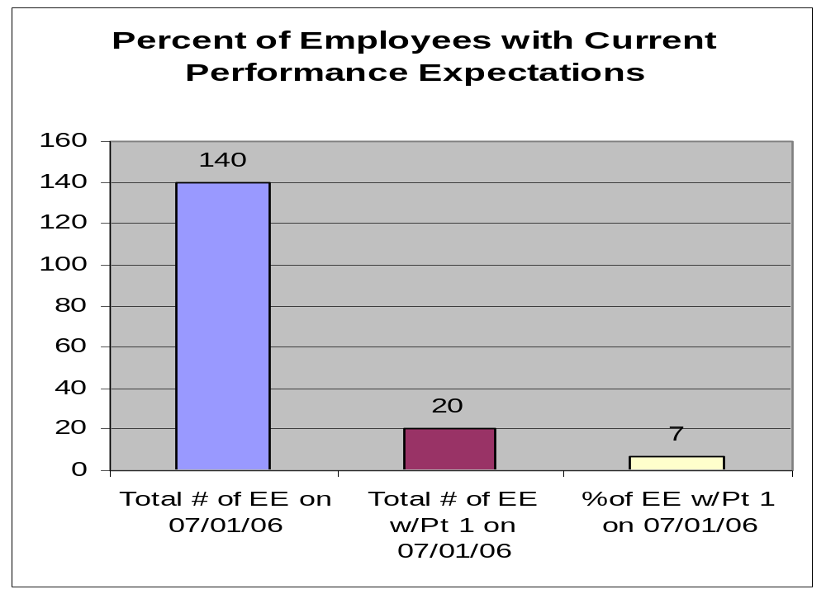
Deploy Workforce |
HR Management Report category:
Employee time and talent is used effectively. Employees motivated.
Performance Measures
Percent employees with current performance expectations
Analysis:
Supervisors are transitioning from the EDPP to the PDP.
Action Steps:
Supervisors are conducting performance evaluation according to employee’s anniversary date or calendar month they’ve chosen to conduct the evaluation.

Slide 12
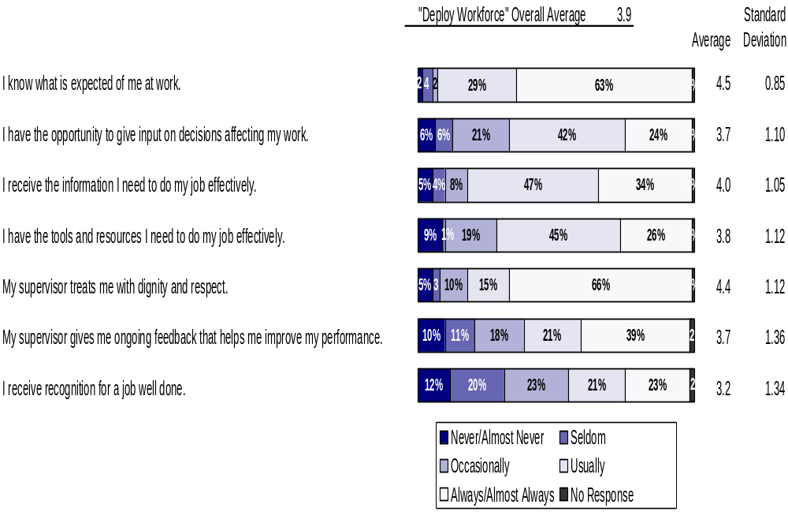
Deploy Workforce |
HR Management Report category:
Deploy Workforce |
Employee time and talent is used effectively. Employees motivated.
Employee time and talent is used effectively. Employees motivated.
HR Management Report
(standard measures)
Employee survey ratings on “productive workplace” questions
Deploy Workforce - Slide 1 of 4
Do employees have day-to-day support to enable successful job performance?
Survey conducted Spring 2006. OAH number of responses = 112

Slide 13
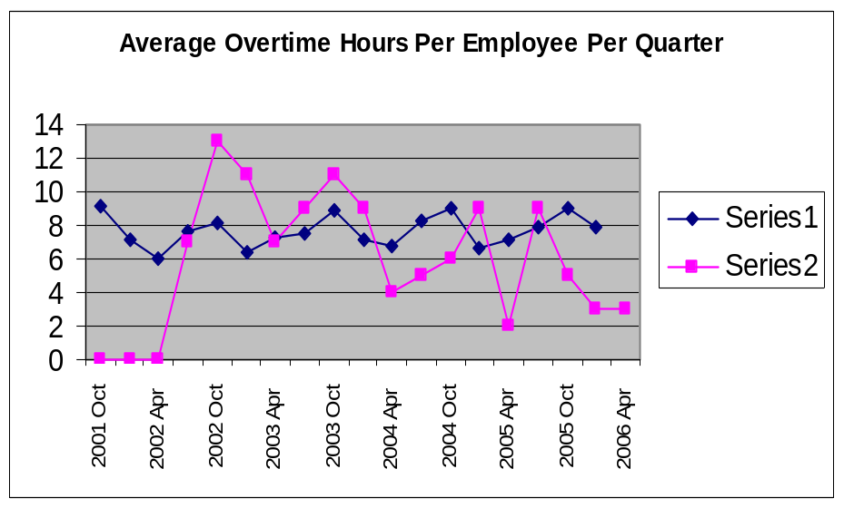
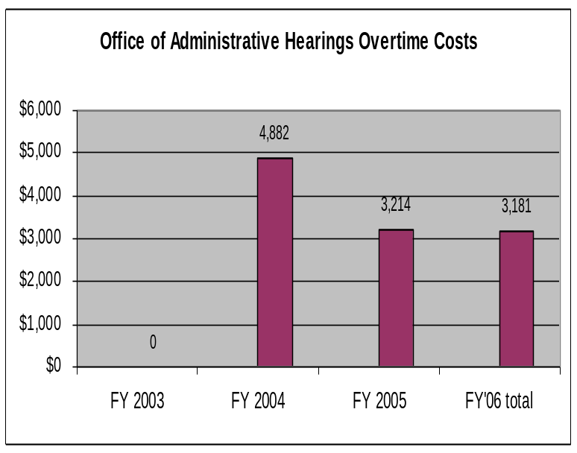
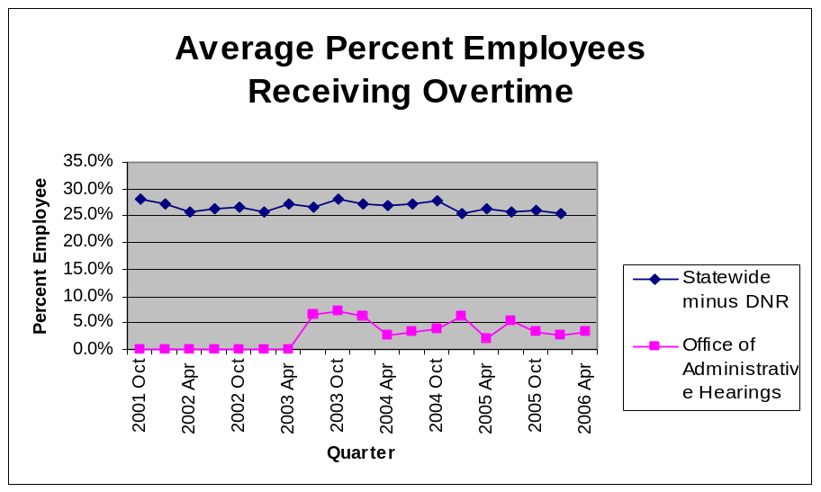
Deploy Workforce |
HR Report Card category:
Employee time and talent is used effectively. Employees motivated.
Overtime: Is employee time well managed?
Deploy Workforce - Slide 2 of 4
Quarter
Statewide Overtime Costs
(In $Millions. All agencies, except DNR)
FY 2003 = $45.2 million
FY 2004 = $46.9 million
FY 2005 = $48.9 million
FY 2006 (1st & 2nd quarters) = $26.7 million
* Per capita
Source: DOP Data Warehouse

Slide 14
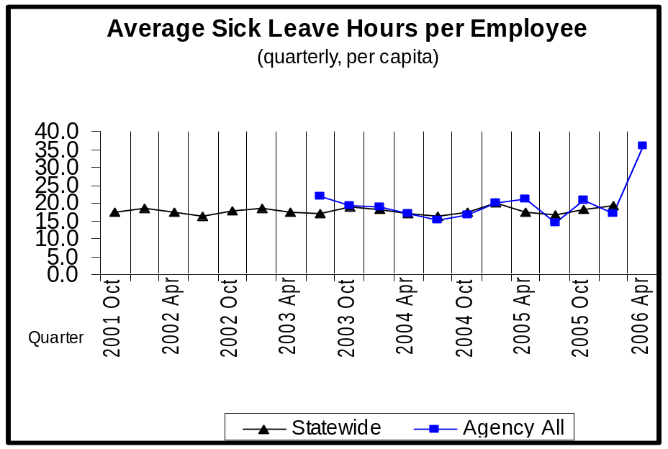
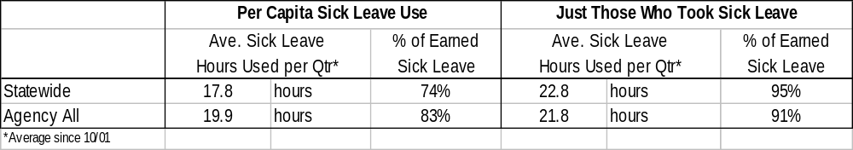
Deploy Workforce |
HR Report Card category:
Employee time and talent is used effectively. Employees motivated.
Leave: Do employees come to work as scheduled?
Average Sick Leave Hours per Employee per Quarter
Notes:
Sick leave usage is scheduled and unscheduled leave.
Only actual leave time gone from work is shown. Leave hours donated and cashed out leave hours are not shown in this display.
Quarter

Slide 15
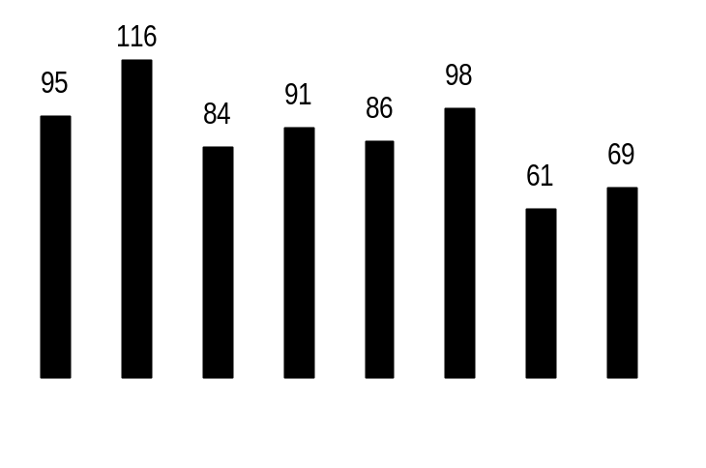
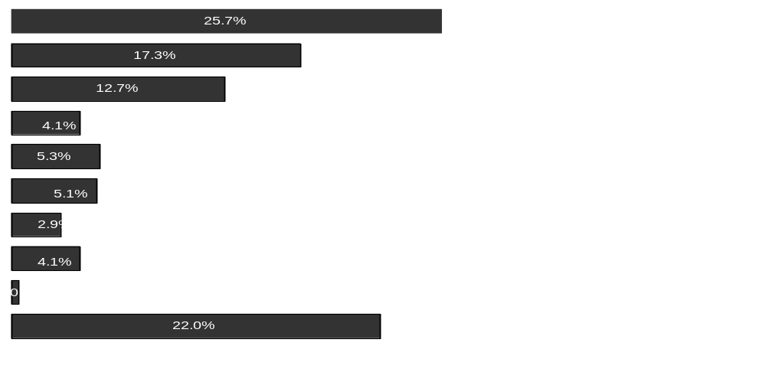
Deploy Workforce |
HR Management Report category:
Employee time and talent is used effectively. Employees motivated.
Employee relations: Are contracts/policies applied appropriately?
Number of Grievances Filed Since 7-1-05
Notes:
The data shown in these charts is for “represented” employees as reported monthly by agencies to the State Labor Relations Office (LRO).
OAH has no represented employees. No grievances have been filed.
Since 7-1-05, no appeals have been filed with the Personnel Resources Board.
All agencies
OAH - No grievances have been filed.
116
95
80
July 05 Aug 05 Sept 05 Oct 05 Nov 05 Dec 05 Jan 06 Feb 06
Discipline
Compensation
Overtime
Work Hours
Bid System
Leave
Hiring/Appts
Non-discrimination
Management Rights
All other
All Other Agencies
OAH – None.
Source: State Labor Relations Office

Slide 16
Deploy Workforce |
Employee time and talent is used effectively. Employees motivated.
Performance Measures
Employee survey ratings on “productive workplace” questions

Slide 17
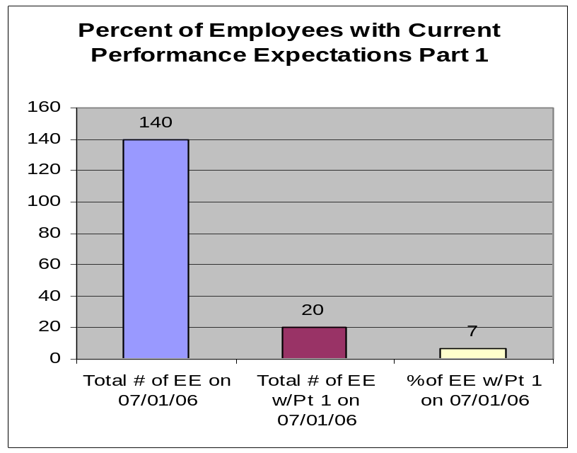
Deploy Workforce |
HR Management Report category:
Employee time and talent is used effectively. Employees motivated.
Performance Measures
Percent employees with current performance expectations
Analysis:
Action Steps:

Slide 18
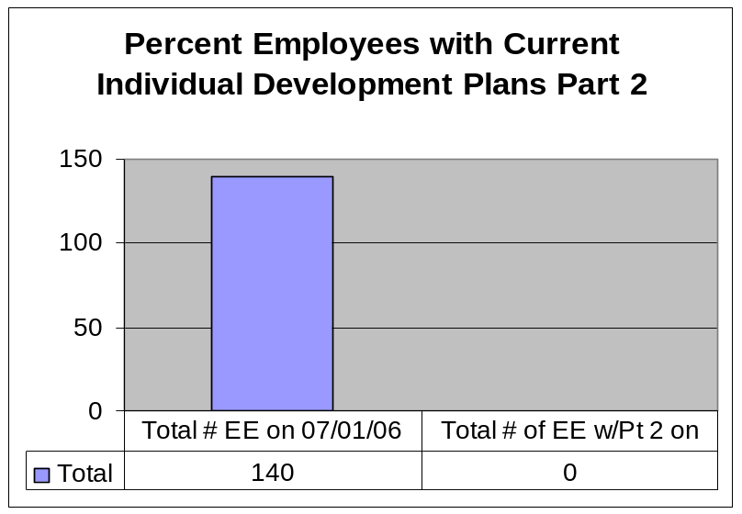
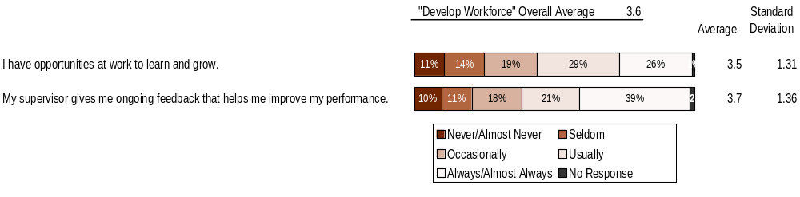
Employees have competencies for present job and future advancement
Develop Workforce |
HR Management Report category:
Develop Workforce |
HR Management Report category:
Employees have competencies for present job and future advancement
Performance Measures
Percent employees with current annual individual development plans
Employee survey ratings on “learning & development” questions
Analysis:
The percent of employees with annual PDPs will be up for the April report.
Overall average score for “Learning & Development” questions is 3.6
Action Steps:
XXX
XXX
Employee perceptions on learning and development:
Survey conducted Spring 2006. OAH number of responses = 112
Employee perceptions on learning and development:
Survey conducted Spring 2006. OAH number of responses = 112
94%
Notes:
Notes:

Slide 19
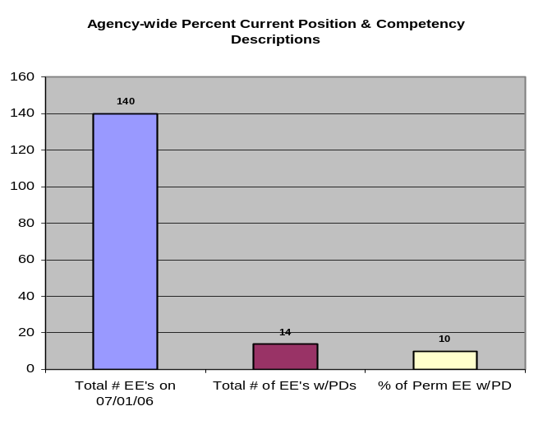
Employees have competencies for present job and future advancement
Develop Workforce |
HR Management Report category:
Develop Workforce - Slide 1 of 1
HR Management Report
(standard measures)
Percent employees with current annual individual development plans
Employee survey ratings on “learning & development” questions
Employee perceptions on learning and development:
Survey conducted Spring 2006. OAH number of responses = 112
Notes:
Notes:

Slide 20
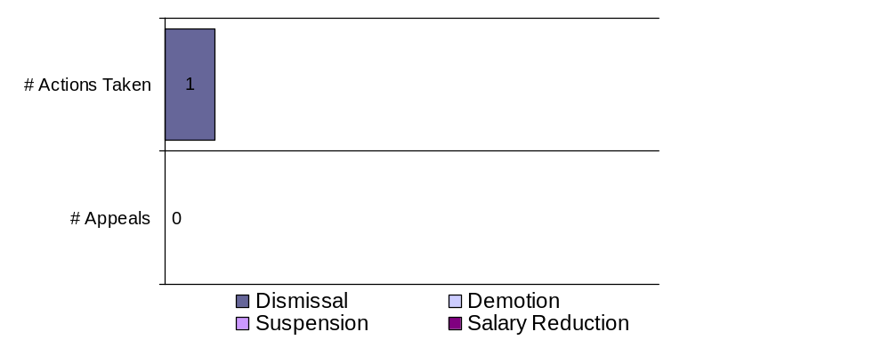
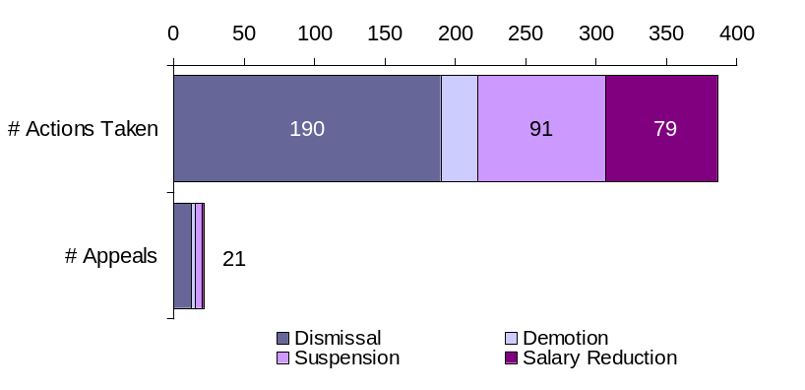
Reinforce Performance |
HR Management Report category:
Successful performance is differentiated & strengthened. Employees are held accountable.
Disciplinary action: Is poor performance dealt with?
Reinforce Performance - Slide 2 of 2
OAH Formal Disciplinary Actions and Appeals
FY 2006 to date (July 1, 2005- April 30, 2006)
Statewide Comparison
Disciplinary Actions and Appeals Filed Since July 1, 2005
None filed during this time period.
Issues Leading to Disciplinary Action and Disciplinary Grievances
Employee did not meet agency standards.
Disposition of Disciplinary-related Grievances and Appeals
There are none for OAH.

Slide 21
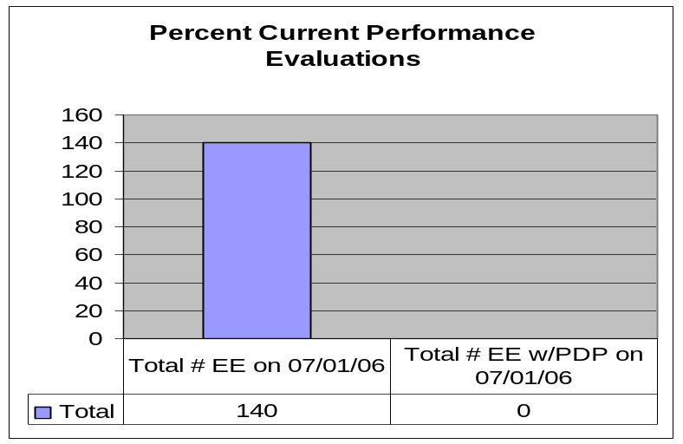
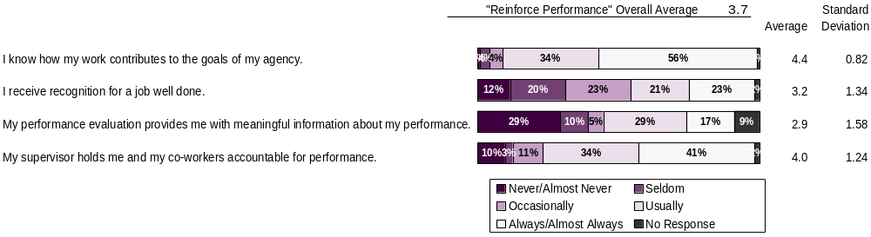
Successful performance is differentiated & strengthened. Employees are held accountable.
Reinforce Performance |
HR Management Report category:
Develop Workforce |
HR Management Report category:
Reinforce Performance |
HR Management Report category:
Employees have competencies for present job and future advancement
Successful performance is differentiated & strengthened. Employees are held accountable.
Performance Measures
Percent employees and managers with current annual performance evaluations
Employee survey ratings on “performance and accountability” questions
Number and type of disciplinary issues, actions, appeals disposition
Analysis:
Performance expectations are currently being done on employees.
These numbers will be up in 2007.
Overall average score for “performance & accountability” questions is 3.6
Action Steps:
Do employees see a meaningful linkage between their performance and the success of the organization?
Survey conducted Spring 2006. OAH number of responses = 112

Slide 22
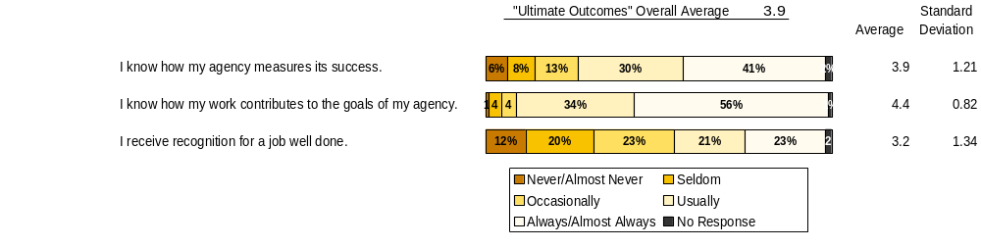
Ultimate Outcomes |
HR Management Report category:
State has workforce breadth & depth for present & future success.
Employees are committed to the work they do and the goals of the organization.
Successful, productive employees are retained.
HR Management Report
(standard measures)
Employee survey ratings on “commitment” questions
Ultimate Outcomes - Slide 1 of 3
Indicators of Employee Commitment
Survey conducted Spring 2006. OAH number of responses = 112
Notes:
Notes:

Slide 23
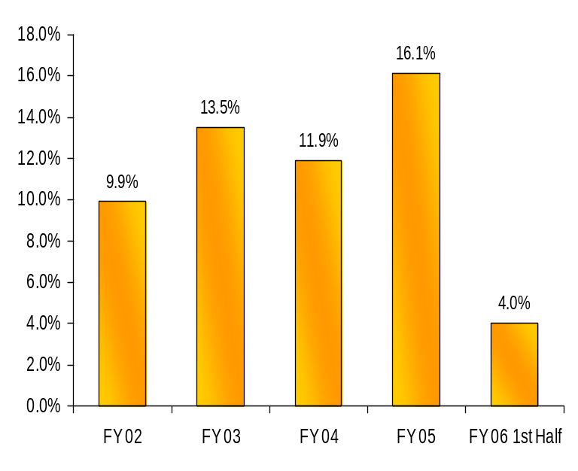
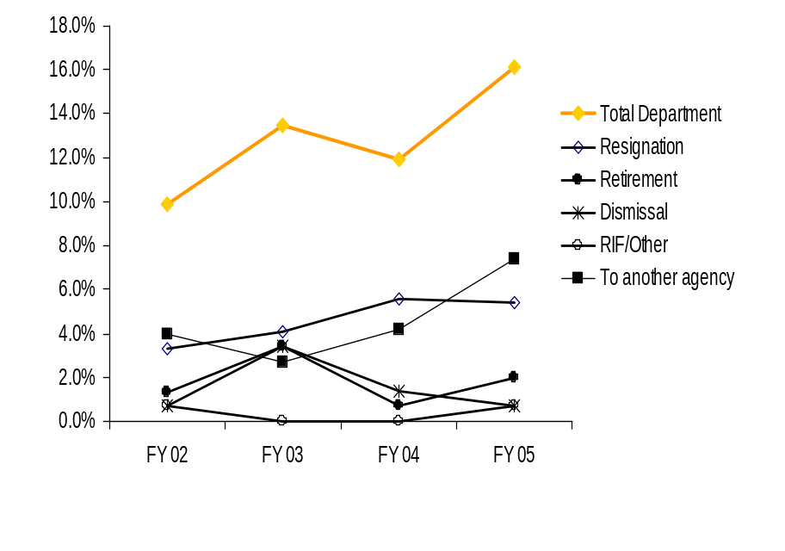
Ultimate Outcomes | continued
HR Management Report category:
Ultimate Outcomes - Slide 2 of 3
Turnover – Office of Administrative Hearings
(Leaving the agency)
Workforce Turnover Breakdown
24
20
17
15
6
Source: DOP Data Warehouse
Notes:
Notes:

Slide 24
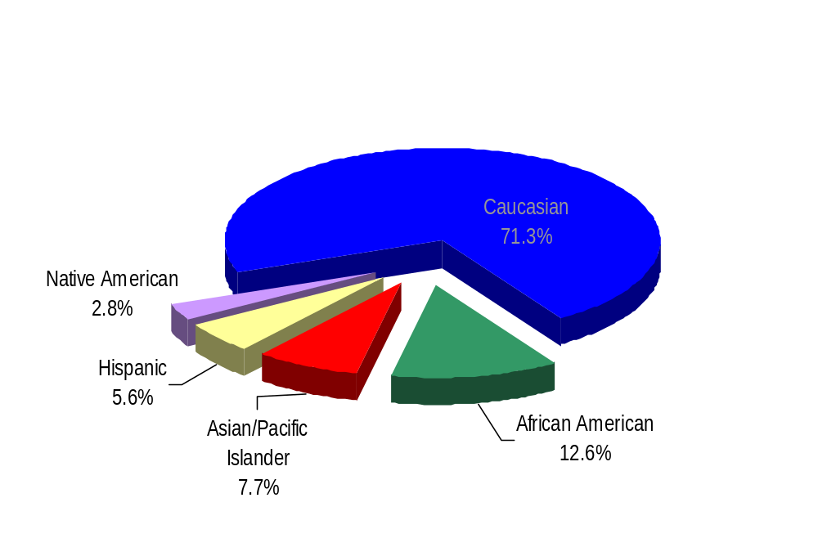
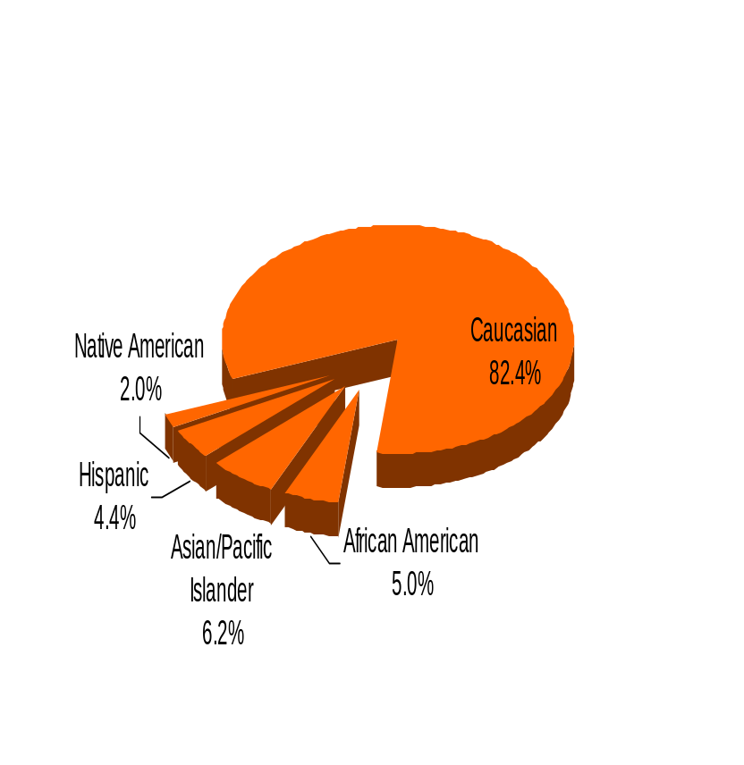
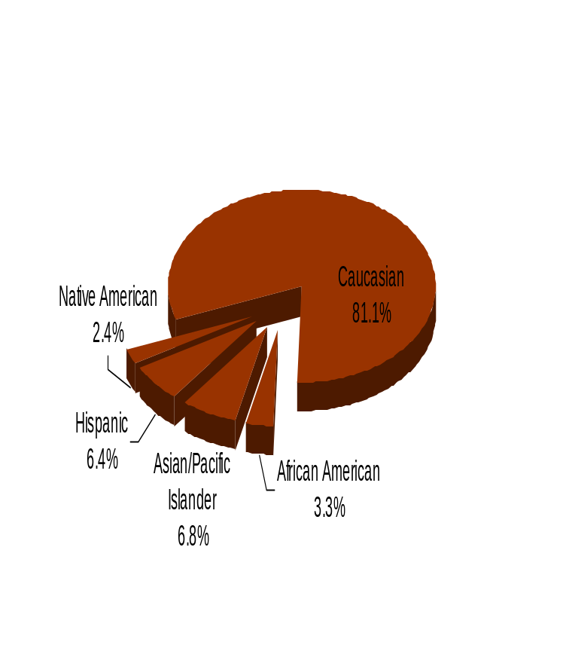
Ultimate Outcomes | continued
HR Management Report category:
Ultimate Outcomes - Slide 3 of 3
Workforce Diversity
Office of Administrative Hearings
Diversity Profile Admin Hearings State
Women 66.4% 52.0%
Persons with disabilities 10.5% 5.2%
Vietnam Veterans 7.0% 7.3%
Disabled Veterans 1.4% 1.3%
Persons over 40 79.0% 73.1%
People of color 28.7% 17.6%
WA State Government
WA Labor Force
Agency data as of January 1, 2006
Source: DOP Data Warehouse

