Slide 1


European American Business Council
2005 Digital Economy Workshop
Michael D. Gallagher
Assistant Secretary for Communications and Information
National Telecommunications and Information Administration
U.S. Department of Commerce
December 19, 2005
www.ntia.doc.gov

Slide 2
The United States and Europe:
Engines For World Growth
As of 2003 → $580 billion in annual two-way trade and $1.7 trillion in two-way stock direct investment.
The U.S. asset base in the European Union (EU) is greater than in Latin America, Africa, Asia, and the Middle East combined.
US/EU represents the largest business relationship in the world → 12 million people are employed in the U.S. and 12 million people are employed in the EU whose jobs rely on this business relationship.
Together, the U.S. and the EU generate over 41% of the world’s economic output, as measured in Gross Domestic Product, as well as 41% of the world’s wealth.

Slide 3
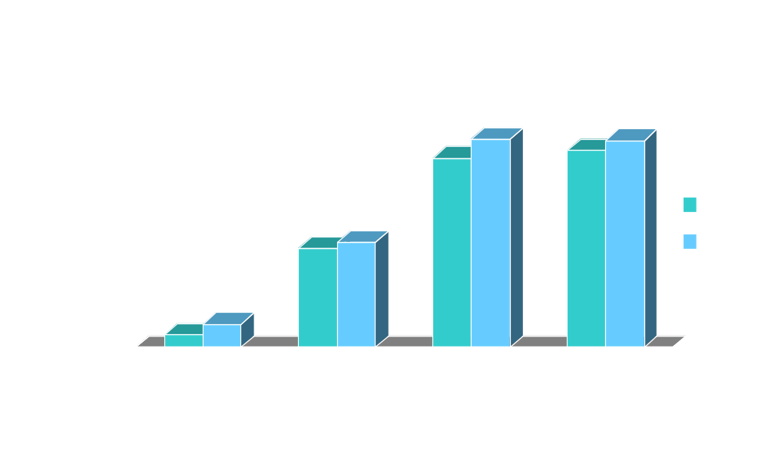
U.S. Telecom Market Continues to Grow…
2004 Total: $784.5 billion (7.9% growth over 2003) 2003 Total: $720.5 billion (4.7% growth over 2002)
Source: TIA’s 2004 and 2005 Telecommunications Market Review and Forecast

Slide 4
ICT Investment Drives Productivity
U.S. productivity grew 4.7% in Q3-2005 and has grown 3.1% over the past four quarters. From December 2000 to December 2004, productivity grew at its fastest 4-year rate in over 50 years.
From 1Q03-1Q05, major segments of IT investment spending grew between 22% and 48%. IT contributed 8.0% in 2003 and 12.0% in 2004 to the rise in GDP. Private fixed investment reached over $2 trillion in 1Q05—a 13.1% increase over 1Q04.
ICT investment has been a driver of growth around the world, not just in the U.S.:
  In OECD countries, ICT investment typically accounted for between .3 and .8% growth in GDP during 1995-2001.
  During the period 1995-2003, US average labor productivity (ALP) increased at an average annual growth rate of 3.06% - more than double that of the previous 22 years (1973-1995). Nearly half (47%) of ALP growth was due to IT contributions to capital deepening and total factor productivity (TFP). (Source: Progress & Freedom Foundation, Digital Economy Fact Book, 7th edition, 2005)

Slide 5
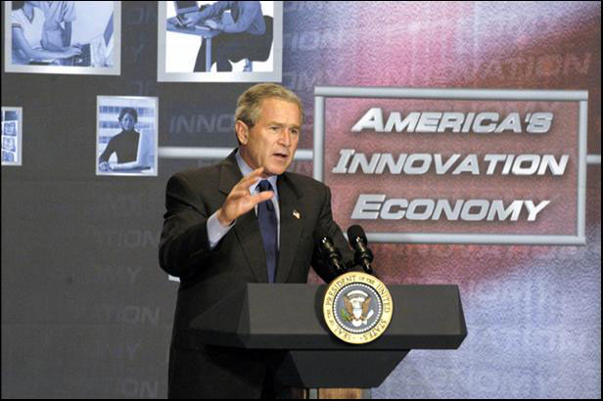
The President’s Broadband Vision
“This country needs a national goal for broadband technology . . . universal, affordable access for broadband technology by 2007.”
– President George W. Bush,
Albuquerque, NM, March 26, 2004
President Bush speaking at the U.S. Department of Commerce June 24, 2004
Government’s Role
"The role of government is not to create wealth; the role of our government is to create an environment in which the entrepreneur can flourish, in which minds can expand, in which technologies can reach new frontiers."
– President George W. Bush, Technology Agenda, November, 2002

Slide 6
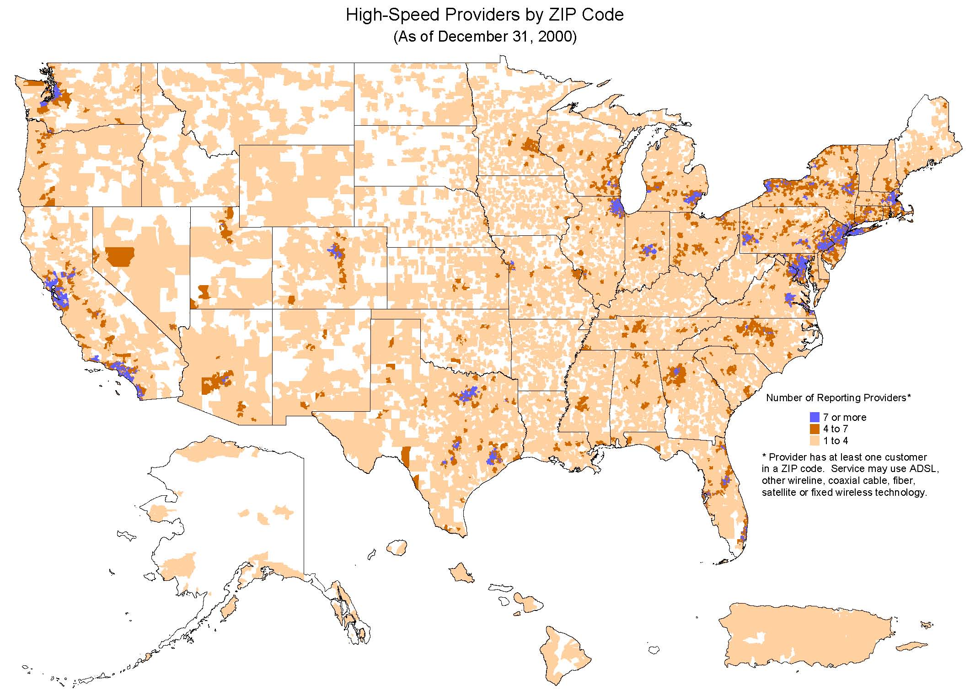
Source: FCC

Slide 7
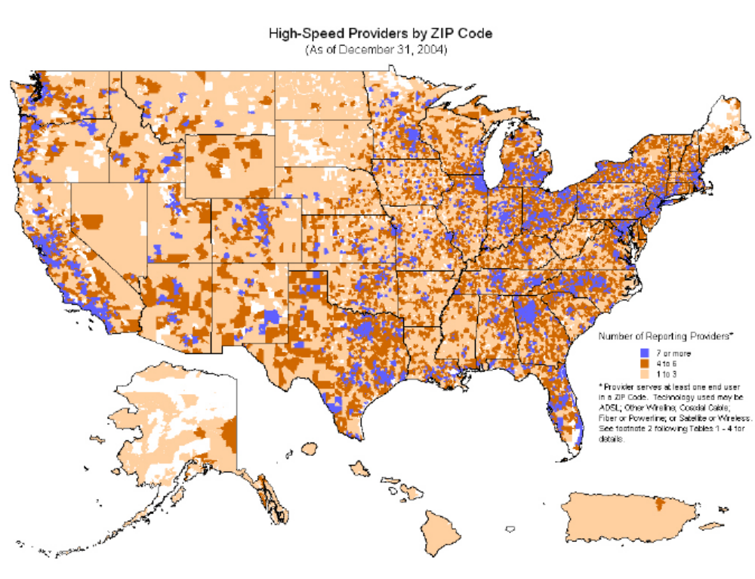
Source: FCC

Slide 8
U.S. Priorities
President Bush has a vision for making advanced technologies available to all Americans – by creating the economic and regulatory environment to enhance competition and promote innovation.
The telecom sector is growing dynamically, and many new technologies show great potential for expanding broadband deployment. IP services are having a very dramatic and positive impact on the U.S. economy.
This Administration is committed to spectrum and broadband policies that create a domestic and international environment for economic growth by removing barriers to the implementation of U.S. technologies and services.
The President’s goal will ensure that all Americans have the personal and economic benefits of high-speed Internet applications and services.

Slide 9
Technology’s Evolution
1969 → ARPANET
1971 → World’s first microprocessor developed
1973 → Cell phones invented, available to the public in 1977
1984 → Internet named and switches to TCP/IP
1985 → 599 cell sites
1989 → WWW created
1992 → Digital cellular telephone system
1993 → 52MB additional RAM for PCs cost $1800
1995 → 257 million personal computers (PC) in use worldwide; average
PC cost $1500 (including peripherals); 16 million Internet users worldwide
1999 → 375 million wireless subscribers worldwide (76 million U.S. subscribers)
2000 → More people watch cable television than broadcast channels
2002 → Wireless subscribers surpass fixed telephone line subscribers
2004 → Broadband subscribers surpass dial-up subscribers; more chips sold for
PC use than business use
TODAY →
  Over 964 million Internet users worldwide
  1.4 billion wireless subscribers worldwide (194.5 million U.S. subscribers)
  178,025 cell sites
  Smart phones bundled with Internet, email, text messaging, MP3 player, ring tones, digital camera, video/video messaging, and location capability
  PDAs incorporate Wi-Fi and Bluetooth technologies (i.e. Hewlett Packard IPAQ x2000)
  820 million PCs in use worldwide – projected to surpass 1 billion by 2007
  Average PC cost $841 (including peripherals) – dell.com desktops start at $379
  RAM costs less than one-hundredth what it did in 1993

Slide 10
Shared Challenges Ahead
We are making strides on both sides of the Atlantic.
We need to continue to work together to promote free trade, private capital, entrepreneurship and support for private sector innovation.
It is important to maintain a regulatory environment that allows the private sector do what it does best -- create jobs, drive capital investment, boost markets, and grow our economies.
Secretary Gutierrez is committed to achieving the objectives of the EU-US TransAtlantic Agenda for Innovation Cooperation and recently participated in the November US-EU Ministerial in Brussels.

