Slide 1
Study of Differential Chromaticity at 150GeV
A.Valishev
Tev. Dept. Mtg 8/25/06

Slide 2
Motivation
After shutdown, vertical chromaticity on the pbar helix at LowBeta is high, which is believed to increase beam-beam induced losses
We consider possible use of O1(2) family for compensation of difference between proton and pbar helices
To increase the efficiency of O1(2), one needs to flip polarities of several octupoles
Since this family is used at injection energy, a measurement of its effect on differential chromaticity was required

Slide 3
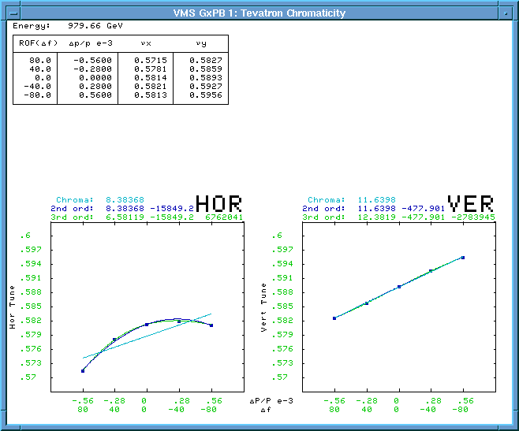
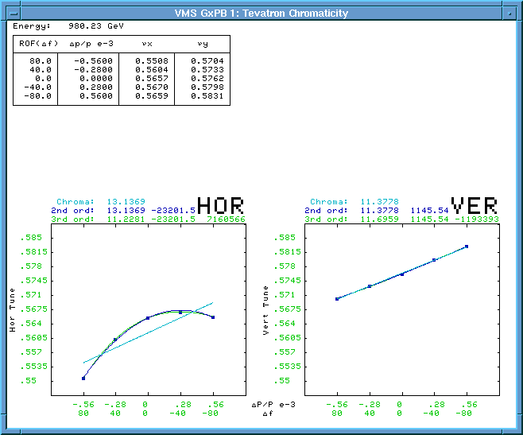
Differential Chromaticity at LowBeta Before Shutdown
Proton helix
Antiproton helix
Ch=6.5 Cv=12.4
Ch=11.2 Cv=11.7

Slide 4
Effect of O1 and O2 on Differential Chromaticity at LowBeta (Before Shutdown)
 | dCh | dCv
O1 (+40A) | 5 | -4
O2 (+50A) | 1.5 | -2.5
dC = dCp - dCa

Slide 5
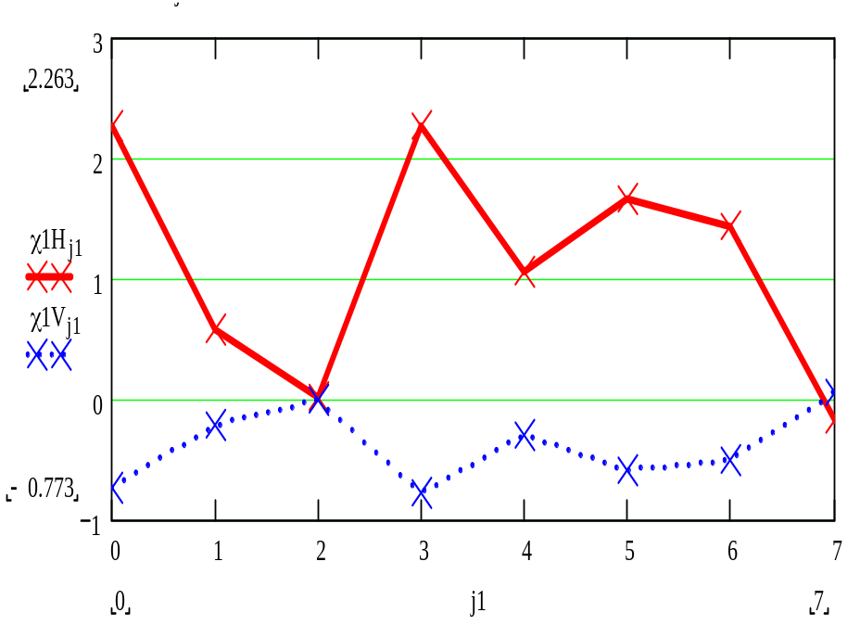
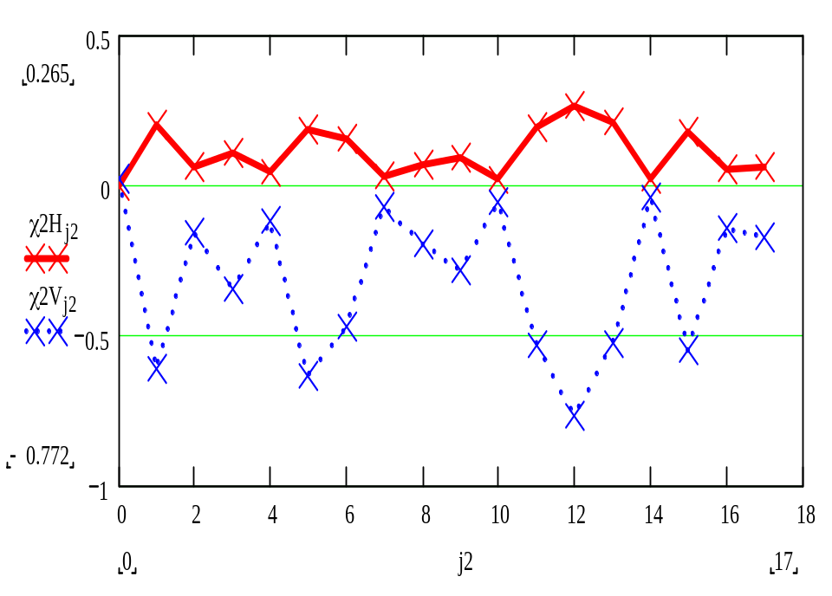
Possible Changes to the Octupole Families
O1- 6
O2 – 3,4,9,12,15
dCh = 6.2 (5) -> 9
dCv = -2.0 (-4) -> -3
dCh = 0.5 (1.5) -> 1.9
dCv = -1.5 (-2.5) -> -5.7

Slide 6
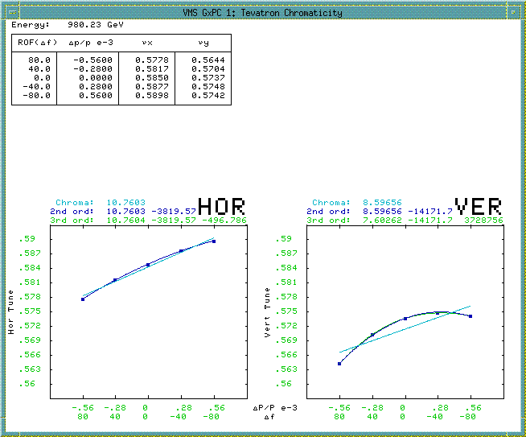
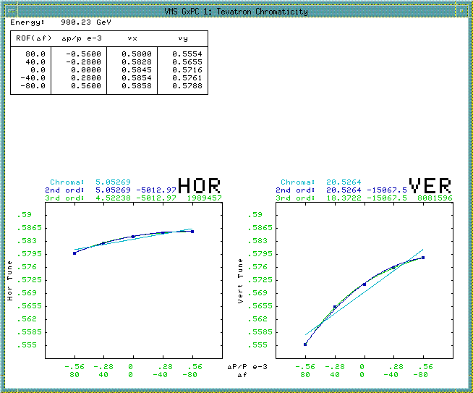
Differential Chromaticity at LowBeta After Shutdown (6/10/06)
Proton helix
Antiproton helix
Ch=10.7 Cv=8.6
Ch=5.0 Cv=20.5

Slide 7
Effect of O1 and O2 on Differential Chromaticity at LowBeta (After Shutdown)
 | dCh | dCv
O1 (-40A) | 1.4 | -4.7
dC = dCp - dCa

Slide 8
Effect of O1 Octupoles at 150GeV
 | ON |  | OFF
 | Ch | Cv | Ch | Cv
proton | 4.1 | 3.5 | 4.7 | 3.2
pbar | -0.3 | 2.6 | -0.6 | 2.0

Slide 9
Effect of O2 on Differential Chromaticity at 150GeV (After Shutdown)
 | dCh | dCv
O2 (-1.27A->0A) | -0.5 | 1.7
O1 (-0.2) | 0.9 | 0.3
dC = dCp - dCa

