Slide 1

State of Washington
Department of Social and Health Services
Human Resource Management Report
November 3, 2006

Slide 2
Overall foundation & management accountability system to build & sustain a high performing workforce
Plan & Align Workforce|
HR Management Report category:
Performance Measures
Percent current position/competency descriptions
Percent supervisors with current performance expectations for workforce management
Agency-wide percent of current Position & Competency Descriptions
84%
Percent of supervisors with current performance expectations for workforce management
100%
Analysis:
DSHS went through an exercise in 2005 to ensure Position Description Forms (PDFs) were updated in preparation for the new Collective Bargaining Agreements.
DSHS has reached 84% compliance in this measure.
Percent of Current Position & Competency Description
Oct ‘06
84%
Target
100%
Action Steps:
Continue to train supervisors in new PDF form.
Finalize all position descriptions by March 31, 2007.
Percent of Supervisors with Current Performance Expectations
Analysis:
Secretary Robin Arnold-Williams sent out a memo in March 2006 to managers communicating her expectations for human resource management.
Oct ‘06
100%
Target
100%
Action Steps:
The Secretary will continue to communicate her expectations on a yearly basis.
Notes:
Notes:
Plan & Align Workforce is the foundation for the remaining four key HRM functions.
Ideally, each agency should have a comprehensive workforce plan that aligns staffing levels and competencies with business priorities, and identifies strategies to close workforce gaps. Most agencies do not have a workforce plan (a key reason WA did not get an A on Grading of the States). A future action step is to institute workforce planning in the state.
Right now, as a starting point, managers need to know what their HRM responsibilities and performance expectations are. This includes an understanding of the master agreement provisions and new HR policies. Of the XX agencies with represented employees that responded to our inquiry, XX had trained the majority of their managers on those provisions.
Next, a management accountability system needs to be in place. At this point, our best measure is whether managers are receiving performance evaluations. However, what

Slide 3
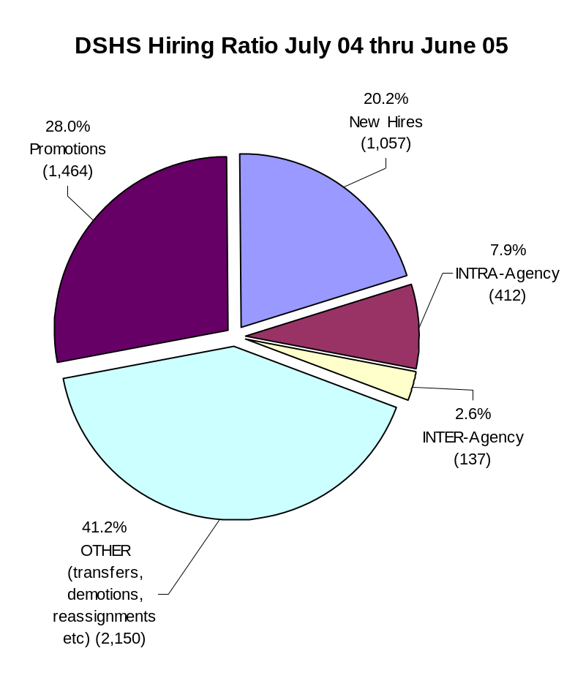
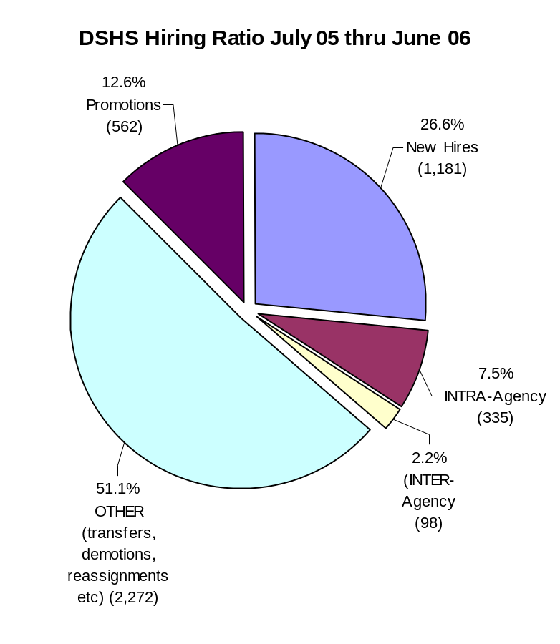
Hire Workforce |
HR Management Report category:
Right People in the Right Job at the Right Time
Performance Measure: New hires and promotional appointments
Total Hires/Promotional
5,220
Total Hires/Promotional
4,448
Source: DOP Data Warehouse
Notes:
Notes:

Slide 4
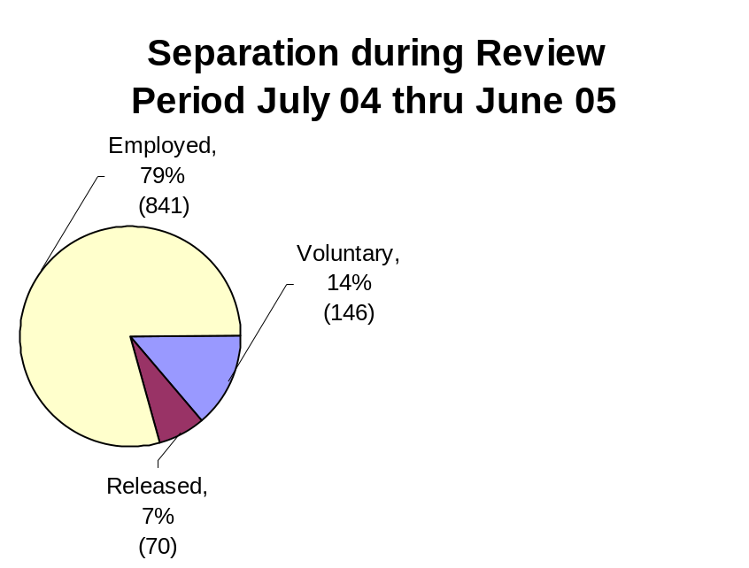
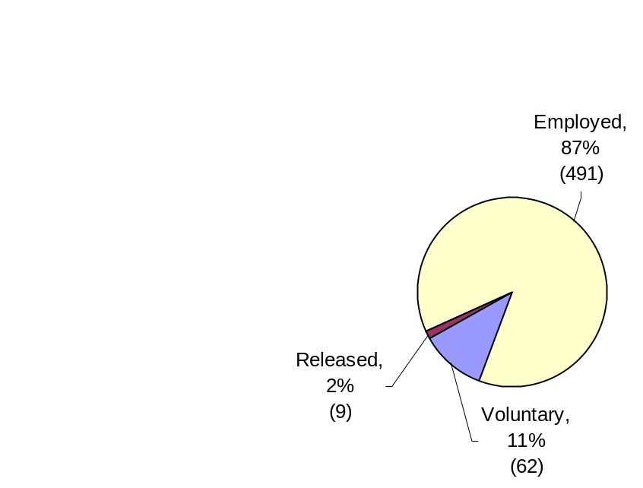
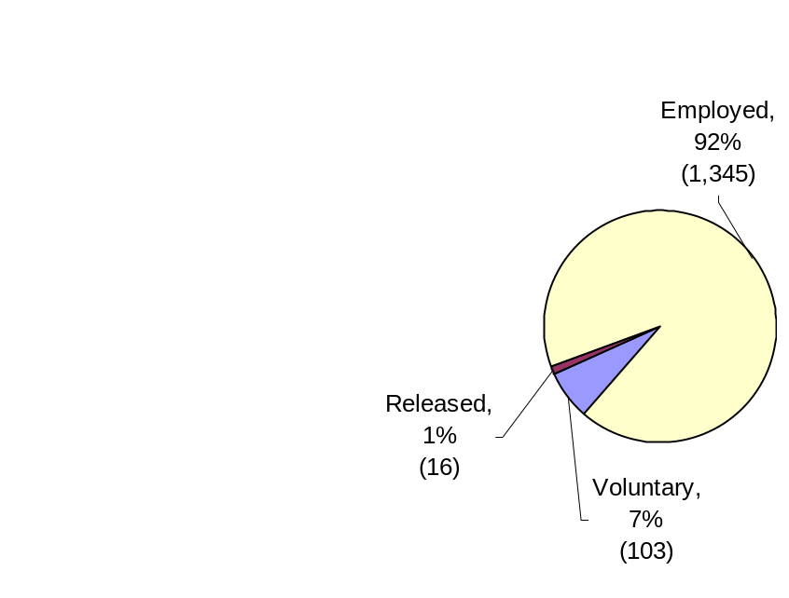
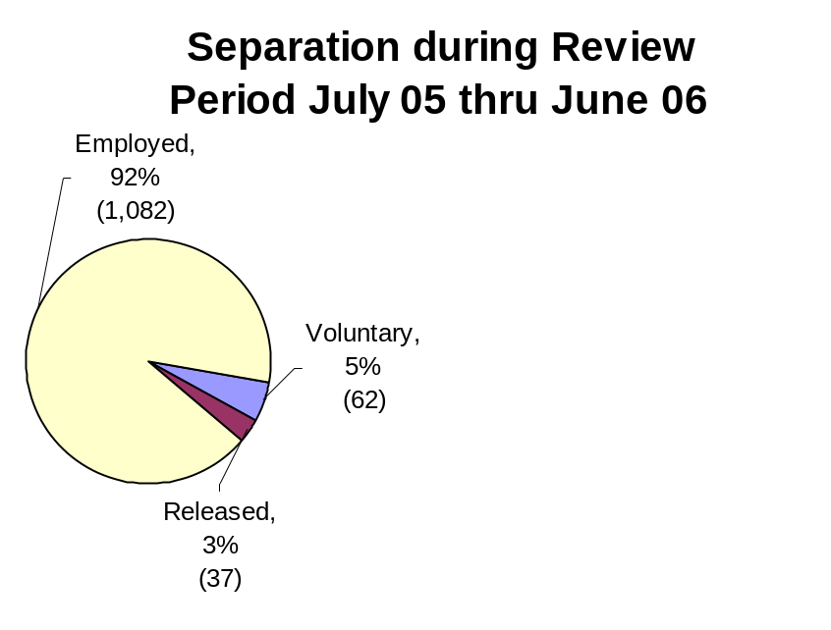
Hire Workforce |
HR Management Report category:
Right People in the Right Job at the Right Time
Performance Measure: Retention/Dismissal rate during appointment period
New Hire Separations During Probationary Period
Promotional Separations During Trial Service
New Hire Separations During Probationary Period
Promotional Separations During Trial Service
Total New Hires: 1,057
Total Promotions: 1,464
Total New Hires: 1,181
Total Promotions: 562
Source: DOP Data Warehouse
Notes:
Notes:

Slide 5
Deploy Workforce |
HR Management Report category:
Employee time and talent is used effectively. Employees motivated.
Performance Measures
Percent employees with current performance expectations
Percent of employees with current performance expectations
59%
Percent of Employees with
Current Performance Expectations
Analysis:
Performance expectation is included in the employee’s annual Performance Development Plan (PDP).
This measure correlates to part 1 of the PDP.
DSHS is using the percent of complete Performance Development Plans as a proxy for this measure.
100%
59%
Action Steps:
Hold managers and supervisors accountable for monitoring completion of performance expectations.
Integrate this measure into our internal performance measures.
Communicate the Secretary’s expectation that PDPs will be kept current and performance expectations included.
DSHS will explore with DOP on tracking options within HRMS.
Target
Oct ‘06

Slide 6
Deploy Workforce |
HR Management Report category:
Employee are motivated and their time and talent is used effectively.
Performance Measure: Employee Survey Ratings on “Productive Workplace”
DSHS Ratings: Comparison to All State Employees (Scale 1 – 5)
Q1. I have the opportunity to give input on decisions affecting my work
Data Notes:
DSHS Employee Survey: March - April 2006
9%
15%
25%
31%
19%
Number of Respondents: 13,311
(77% Response Rate – based on FTEs)
Q2. I receive the information I need to do my job effectively
All DSHS Employees - Unweighted
3%
10%
23%
46%
18%
Q4. I know what is expected of me at work
Action Steps:
Administrations submitted action plans to improve priority areas by August 31, 2006.
The Secretary requested administrations to submit progress reports in February 2007.
Facilitate the Employee Recognition Workgroup in developing proposals.
Increase management participation in formal and informal employee recognition.
2%
2%
4%
10%
38%
45%
Q6. I have the tools and resources I need to do my job effectively
5%
12%
22%
41%
18%
Q7. My supervisor treats me with dignity and respect
5%
5%
9%
24%
56%
Q8. My supervisor gives me ongoing feedback that helps me improve my performance
7%
10%
18%
30%
34%
Q9. I receive recognition for a job well done
13%
15%
22%
26%
23%
Data Source:
DSHS Research and Data Analysis, July 7, 2006
Never
Seldom
Occasionally
Usually
Always

Slide 7
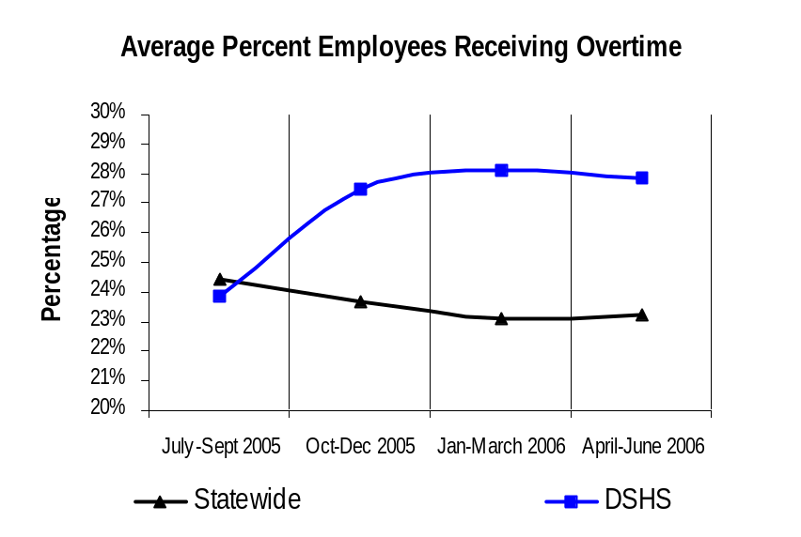
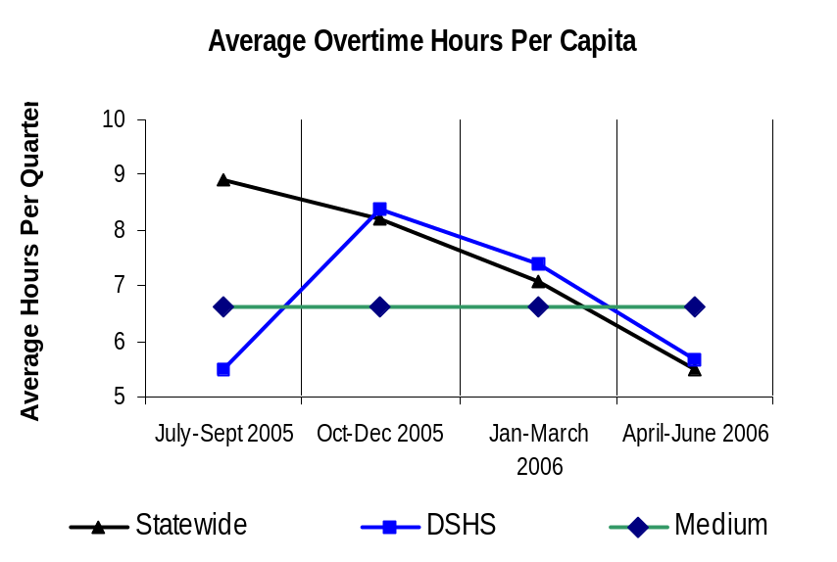
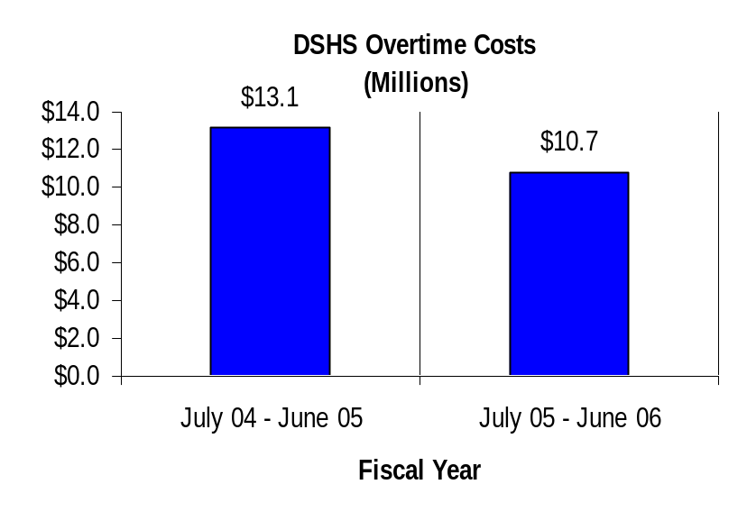
Deploy Workforce |
HR Management Report category:
Employee time and talent is used effectively. Employees motivated.
Performance Measure: Overtime usage
6.6 hours
Data Notes:
Due to the implementation of the HRMS system, overtime hours and dollars for the period between April and June 2006 are through June 15, 2006 only.
Analysis:
Factors of overtime usage –
Institutions operate 24 hours a day, 7 days a week.
Demand for coverage during holidays.
Shift positions often work beyond scheduled shift hours.
Source: DOP Data Warehouse

Slide 8
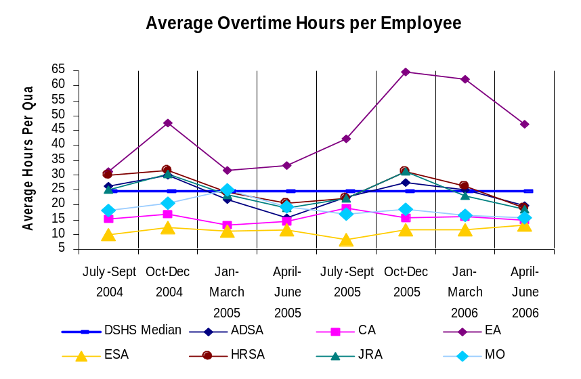
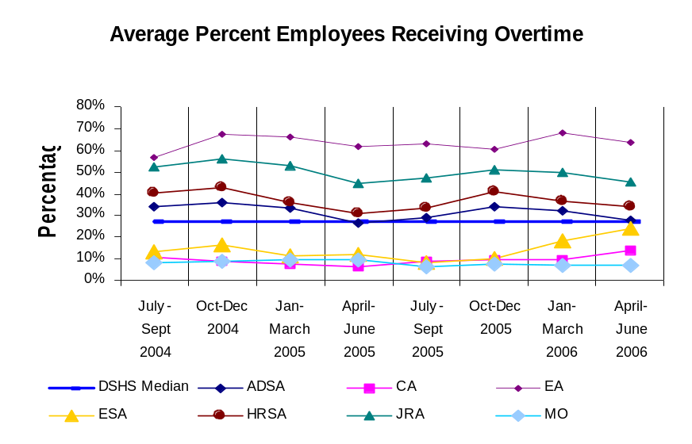
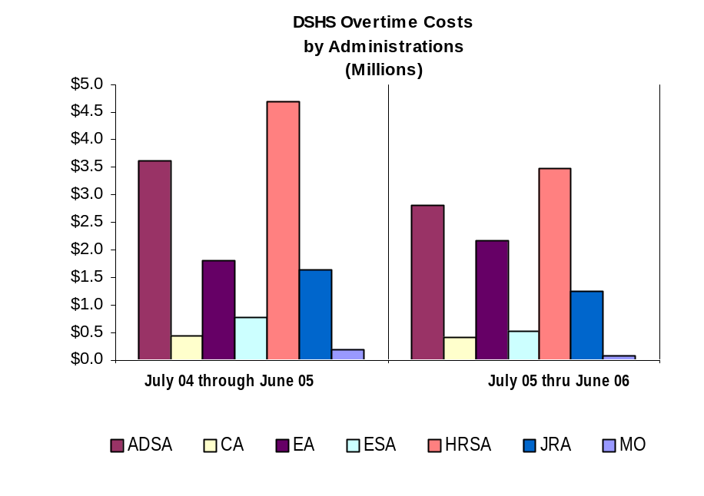
HR Management Report category:
Deploy Workforce |
Employee time and talent is used effectively. Employees motivated.
  Performance Measure: Overtime usage by Administrations
Based on employees who were paid for overtime hours
Acronyms
ADSA: | Aging and Disability Services Administration
CA: | Children's Administration
EA: | External Affairs (Communications, Indian Policy, Legislative Relations, Diversity, Special Commitment Center, Division of Vocation Rehabilitation, Office of Deaf and Hard of Hearing)
ESA: | Economic Services Administration
HRSA: | Health and Recovery Services Administration
JRA: | Juvenile Rehabilitation Administration
MO: | Management Operations (Finance, IT, HR, Research, Facilities, Fraud Investigations, Administrative Services)
Data is through June 15, 2006
Source: DOP Data Warehouse

Slide 9
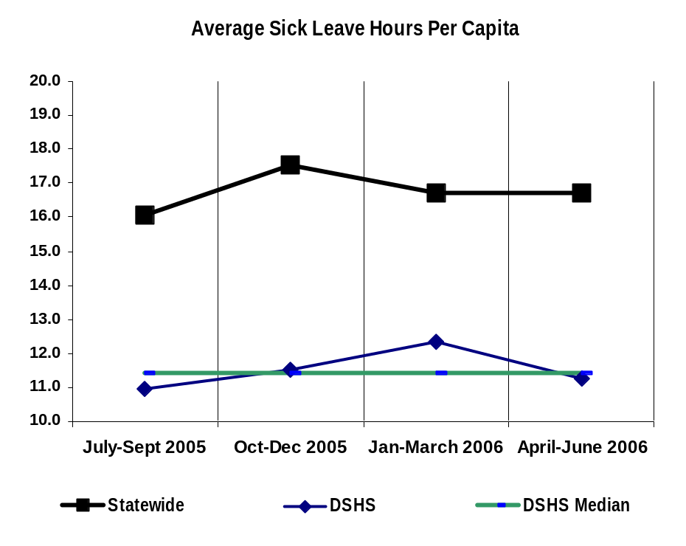
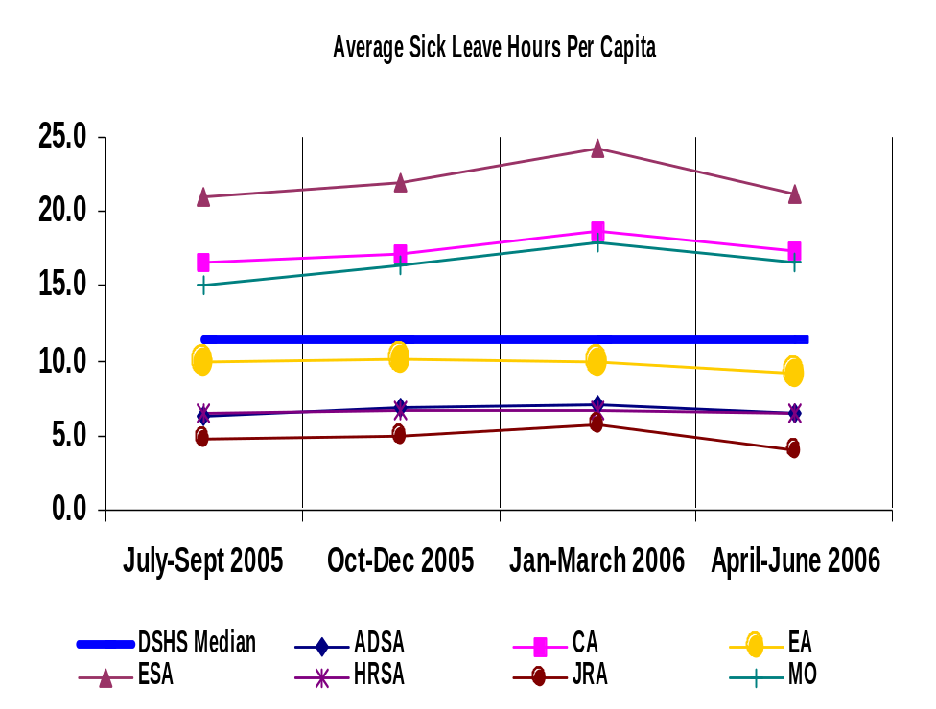
HR Management Report category:
Deploy Workforce |
Employee time and talent is used effectively. Employees motivated.
Performance Measure: Sick leave usage by Administrations
11.5 Hours
11.5 Hours
Data Notes:
Sick leave buyout and shared leave (donated or used) are not included.
The estimate of the last quarter of 2006 is based on the April & May data (dividing the total by 2 and multiplying by 3).
Source: DOP Data Warehouse

Slide 10
Deploy Workforce |
HR Management Report category:
Employee time and talent is used effectively. Employees motivated.
Performance Measures
Number & type of non-disciplinary grievances and disposition
Employee may cite numerous reasons for their grievance
Number of Grievances: 80 total
July ’06 – Sept ’06
Type of Grievances (July ’06 – Sept. ‘06)
Discipline
72%
Compensation
25%
Overtime
1%
Notes:
Grievance filing information is reported monthly by the agency to the State Labor Relations Office (LRO). LRO then maintains statewide data.
LRO tracks which grievances move on to pre-arbitration reviews and arbitrations. They also track outcomes and trends statewide and by agency. This information will be included in future GMAP reports.
Work Hours
12%
Bid System
1%
Leave
16%
Hiring/appts
6%
Non-discrimination
1%
All other
50%

Slide 11
Employees have competencies for present job and future advancement
Develop Workforce |
HR Management Report category:
Percent of employees with current Individual Development Plans
59%
Performance Measures
Percent employees with current annual individual development plans
Employee survey ratings on “learning & development” questions
Analysis:
This measure correlates to part 1 & 2 of the Performance Development Plan.
DSHS is using the percent of complete Performance Development Plans as a proxy for this measure.
100%
59%
Action Steps:
Increase awareness of need for management and employees to understand goals and expectations.
Continue to make this a priority.
Provide on-going training to supervisors and managers.
Facilitate the Employee Recognition Workgroup in developing proposals.
Increase management participation in formal and informal employee recognition.
The Secretary will review administrations’ progress reports on the action plans in February 2007.
Target
Oct ‘06
Q5:I have opportunities at work to learn and grow.
9%
14%
23%
30%
23%
Q8:My supervisor gives me ongoing feedback that helps me improve my performance.
7%
10%
18%
30%
34%
Never
Seldom
Occasionally
Usually
Always
94%
Notes:
Notes:

Slide 12
Successful performance is differentiated & strengthened. Employees are held accountable.
Reinforce Performance|
HR Management Report category:
Performance Measures
Percent employees and managers with current annual performance evaluations.
Employee survey ratings on ‘learning & development’ questions
Percent of employees with current performance evaluations
59%
Analysis:
Performance evaluation is
included in the Performance
Development Plan.
DSHS is using the percent of
complete Performance Development Plans as a proxy for this measure.
100%
59%
Target
Oct ‘06
Action Steps:
Provide on-going training to supervisors and managers.
The Secretary will review administrations’ progress reports on the action plans in February 2007.
Q3. I know how my work contributes to the goals of my agency.
3%
6%
12%
37%
41%
Q9. I receive recognition for a job well done.
13%
15%
22%
26%
23%
Q10. My performance evaluation provides me with meaningful information about my performance.
10%
13%
20%
30%
21%
Q11. My supervisor holds me and my co-workers accountable for performance.
3%
5%
12%
34%
43%
Never
Seldom
Occasionally
Usually
Always

Slide 13
Successful performance is differentiated & strengthened. Employees are held accountable.
Reinforce Performance |
HR Management Report category:
Performance Measures
Number and type of disciplinary issues, actions, appeals disposition
Analysis:
DSHS had a total of 35 primary issues resulting in discipline.
Primary Issues resulting in discipline
14
10
Action Steps:
DSHS is making a concerted effort to settle issues at the lowest level.
Continue to educate supervisors and managers regarding performance management.
8
3
Ethics
Inappropriate Behavior
Insubordination
Work Performance
Disposition of Appeals
Formal Disciplinary Appeals, (July ‘06- Sept ‘06)
Salary Reduction | 1 | Settled
Dismissal | 2 3 | Mediation Scheduled Settled
Demotion | 1 1 | Mediation Scheduled Settled
Suspension | 1 | In Step 2 of Grievance Process
5
2
1
1
Salary
Reduction
Dismissal
Demotion
Suspension
Data as of October 2006

Slide 14
Ultimate Outcomes
HR Management Report category:
State has workforce breadth & depth for present & future success.
Employees are committed to the work they do and the goals of the organization.
Successful, productive employees are retained.
Performance Measures
Employee survey ratings on “commitment” questions
Data Notes:
DSHS Employee Survey: March - April 2006
Number of Respondents: 13,311
(77% Response Rate – based on FTEs)
All DSHS Employees - Unweighted
Q3: I know how my work contributes to the goals of the agency.
3%
6%
12%
37%
41%
Q12: I know how my agency measures its success.
12%
14%
22%
30%
20%
Action Steps:
Implement administrations’ action plans.
Facilitate the Employee Recognition Workgroup to develop proposals by Dec. 31, 2006.
Communicate with employees on what we measure and why we measure.
The Secretary will review the progress reports on the administrations action plans in February 2007.
Q9: I receive recognition for a job well done.
13%
15%
22%
26%
23%
Never
Seldom
Occasionally
Usually
Always
Notes:
Notes:

Slide 15
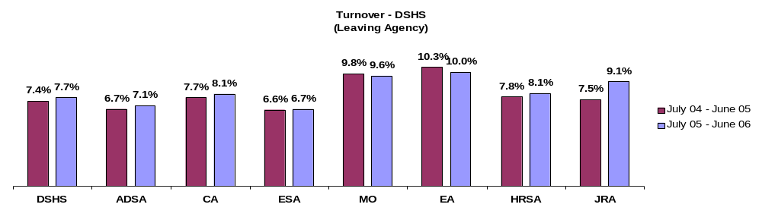
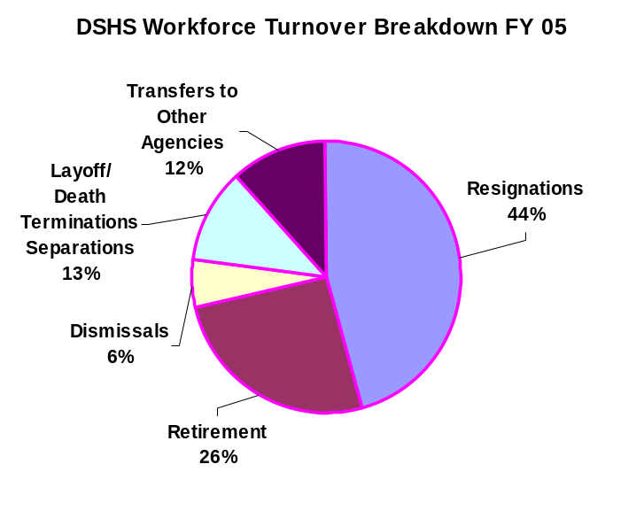
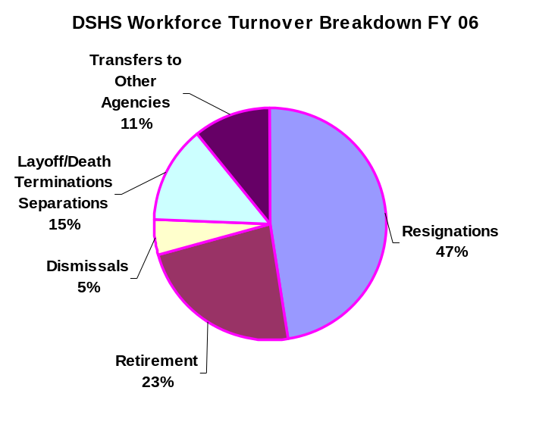
Ultimate Outcomes |
HR Management Report category:
State has workforce breadth & depth for present & future success.
Employees are committed to the work they do and the goals of the organization.
Successful, productive employees are retained.
Performance Measure: Turnover Rates and Types
Data is through June 30, 2006
Source: DOP Data Warehouse
Notes:
Notes:

Slide 16
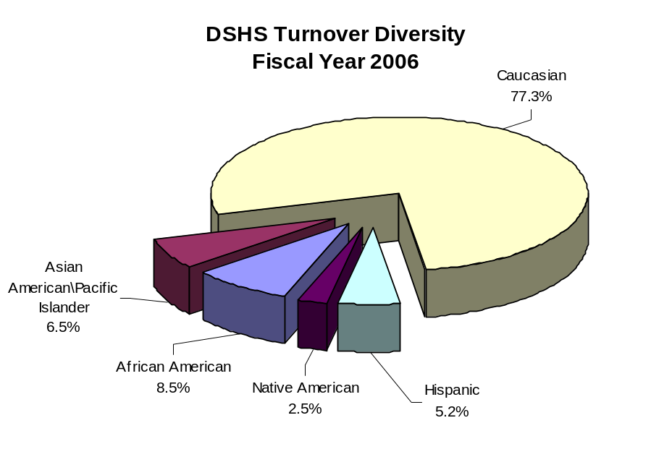
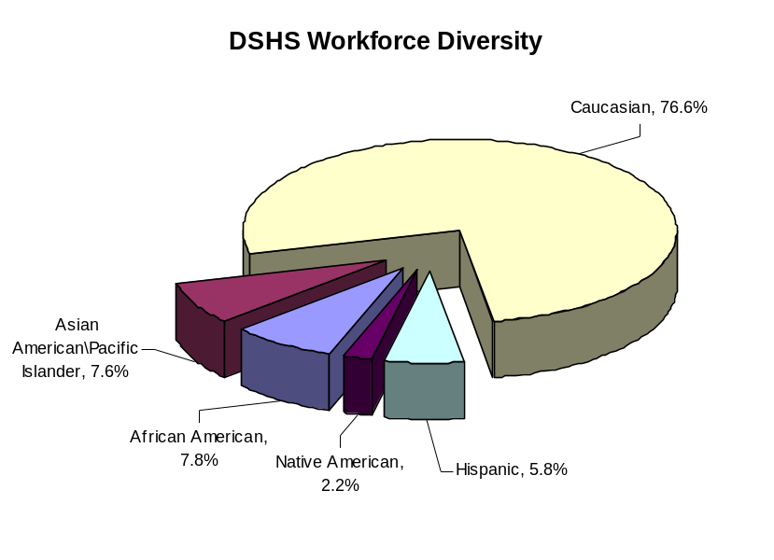
Ultimate Outcomes | continued
HR Management Report category:
  Performance Measure: Workforce Turnover by Diversity - DSHS
Diversity Profile | DSHS Turnover | DSHS Overall
Women | 64.5% | 65.5%
Persons with disabilities | 5.9% | 6.0%
Vietnam Veterans | 6.4% | 5.9%
Disabled Veterans | 1.1% | 1.1%
Persons over 40 | 60.8% | 73.2%
People of color | 22.7% | 23.4%
Data as of June 22, 2006
Source: DOP Data Warehouse

