Slide 1
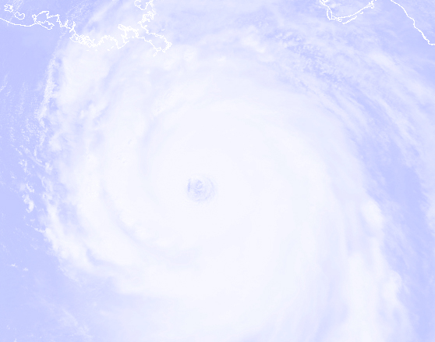
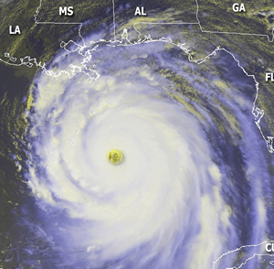
National Hurricane Conference
“Warning Messages: Improving Response”
Sponsor: Office of the Federal Coordinator for Meteorological Services and Supporting Research
Mr. Samuel P. Williamson
Federal Coordinator for Meteorology
Notes:
Good afternoon. I’m Sam Williamson, the Federal Coordinator for Meteorology and the sponsor of this training workshop. First, let me say a big thank you to all of you for attending this training session. Also, I want to thank the moderator of this session, Dr. Betty Hearn Morrow and our distinguished panelists participating this afternoon.

Slide 2
Why Are We Here?
The Ten Most Costly World Catastrophes
DATE
LOCATION
EVENT
LOSS*
1 | 8/24/2005 | U.S., Others | Hurricane Katrina | $45,000
2 | 8/23/1992 | U.S., Bahamas | Hurricane Andrew | 22,274
3 | 9/11/2001 | U.S. | Terrorist Attacks (WTC, etc.) | 20,716
4 | 1/17/1994 | U.S. | Northridge Earthquake | 18,450
5 | 9/2/2004 | U.S., Others | Hurricane Ivan | 11,684
6 | 9/20/2005 | U.S., Others | Hurricane Rita | 10,000
7 | 10/15/2005 | U.S., Others | Hurricane Wilma | 10,000
8 | 8/11/2004 | U.S., Others | Hurricane Charley | 8,272
9 | 9/27/1991 | Japan | Typhoon Mireille | 8,097
10 | 1/25/1990 | Europe | Winterstorm Daria | 6,864
* $ Millions, Insured Losses, 2005 U.S. Dollars
Notes:
- To set the stage, I want to quickly review why we’re all here today.
- This slide shows one reason why…the economic impact of hurricanes on citizens and infrastructure
- Of the 10 largest worldly catastrophes, 7 of the 10 were caused by devastating tropical cyclones; 3 of the top 10 catastrophes took place in 2005, with half of the events taking place in 2004 and 2005!
- With devastations of this magnitude, there is certainly the threat of human deaths, something we the hurricane community, of which each and every one of you in here are part of, try to reduce or totally eliminate!

Slide 3
Why Are We Here?
Coastal Population Growth
More than half of the nation's people live in coastal areas, although coastal counties account for only 17 percent of the total acreage of the contiguous United States (report completed for the independent Pew Oceans Commission)
Nearly half of the world's population lives within 200 kilometers of a coastline and this number is likely to double by 2025 (Population Reference Bureau)
The average population density in coastal areas is about 80 persons per square kilometer, twice the world’s average population density (Population Reference Bureau)
Notes:
- As we all know, coastal populations continue to grow, making more people vulnerable to the impacts of tropical cyclones
- This slide puts this critical aspect into concrete terms
- There are two points I want to drive home:
-- The increased population puts more people in harms way of hurricanes, and
-- The greater population density in our coastal communities increase evacuation challenges
- Both of these points obviously emphasize the critical reason to respond appropriately to hurricane risks and to get out of harms way when required

Slide 4
Why Are We Here?
“Warning Messages: Improving Response”
Active hurricane cycle – potential for more devastation
  Must be prepared
Messages transmitters:
  Tropical Prediction Center / National Hurricane Center (TPC/NHC)
  Local NWS Weather Forecast Offices
  Media
  Emergency managers / Decision makers
  “Community of Influence”
Messages resulting in appropriate response
  Must come from credible sources
  Must be received
  Must be understood
  Must have personal meaning
  Should include action statements
  Often require confirmation
  Are only successful if appropriate response is possible
Notes:
- The bottom line why we’re here…we must be prepared for the next landfalling hurricane, which will inevitably come!
- A key component to this preparedness is “The Message”
- I’ve indicated some of the key agencies / individuals that transmit or relay the message. This includes the TPC/NHC, local NWS offices, media, emergency managers, decision makers, and the “Community of Influence.” You’ll learn much more about the “Community of Influence” during this session
- If the messages is to invoke the approriate response, they must come from credible sources, they must be received, they must be understood, they must have personal meaning, they should include action statements, they often require confirmation, and finally, the appropriate response must be possible

Slide 5
Purpose of this Training Session
“Warning Messages: Improving Response”
Purpose: Provide you specific ideas / concepts on improving response
  Implement while you continue to work with constituents within your communities
Notes:
To summarize, the reason we’re here, the purpose of this session, is to provide you with specific ideas and concepts that you can take back to your daily workplace to help improve response to hurricanes
As you continue to work response plans with your local constituents, or if you’re a deliverer of “The Message,” we hope that you’ll incorporate the information from this session to improve response

Slide 6
The Participants
Moderator: Dr. Betty Hearn Morrow, SocResearch Miami
Panelists: Dr. Steve Lyons, The Weather Channel
Mr. Paul Trotter, National Weather Service
(Weather Forecast Office, New Orleans/
Baton Rouge)
Mr. Mark Welshinger, OFCM
Dr. Brenda Phillips, Co-Director, Center for the
Study of Disasters and Extreme Events,
Oklahoma State University
Dr. Hugh Gladwin, Institute for Public
Opinion Research, Florida International
University
Ms. Naomi Moye, Abraham’s Group
Notes:
- This slide shows the participants for this session
- At this time, I want to introduce the moderator, Dr. Betty Hearn Morrow. She is Professor Emeritus at Florida International University and former director of the Laboratory for Social and Behavioral Research at the International Hurricane Research Center. As a consulting sociologist, most of her work focuses on the complex ways in which social and economic factors affect disaster vulnerability. She has documented the impacts of numerous hurricanes beginning with Hurricane Hugo on St. Croix in 1989, particularly focusing on high-risk populations. She is co-author of two books: Hurricane Andrew: Ethnicity, Gender and the Sociology of Disasters, and The Gendered Terrain of Disaster. Her recent projects include studying early response to Hurricane Charley in southwestern Florida, the impact of Hurricane Ivan on critical government and business organizations in the Pensacola area, a four-state Hurricane Ivan Behavioral Survey, and an exploratory study of Warning Messages completed for the OFCM. With two other panelists, Hugh Gladwin and Brenda Phillips, she is currently working on two research projects related to Hurricanes Katrina and Rita funded by the National Science Foundation.

