Slide 1
State of Washington
Office of Administrative Hearings
Human Resource
Management Report
Plan & Align Workforce
Hire Workforce
Deploy Workforce
Reinforce Performance
Develop Workforce
[Note: This is the standard format provided by DOP as of 8/21/07. Agencies may customize or supplement this format to meet unique needs, as long as the minimum information shown in this format is included.]
October 15, 2007

Slide 2
Managers’ Logic Model for Workforce Management
Outputs
Initial Outcomes
Intermediate Outcomes
Plan & Align Workforce
Articulation of managers HRM accountabilities. HR policies. Workforce planning. Job classes & salaries assigned.
Managers understand HRM accountabilities. Jobs, staffing levels, & competencies aligned with agency priorities.
Foundation is in place to build and sustain a productive, high performing workforce.
Hire
Workforce
Qualified candidate pools, interviews & reference checks. Job offers. Appts & per-
formance monitoring.
Best candidate hired & reviewed during appointment period. Successful performers retained.
The right people are in the right job at the right time.
Ultimate Outcomes
Employees are committed to the work they do & the goals of the organization
Productive, successful employees are retained
State has workforce depth & breadth needed for present and future success
Deploy
Workforce
Work assignments& requirements defined. Positive workplace environment created. Coaching, feedback, corrections.
Workplace is safe, gives capacity to perform, & fosters productive relations. Staff know job rqmts, how they’re doing, & are supported.
Time & talent is used effectively. Employees are motivated & productive.
Develop Workforce
Individual development plans. Time/ resources for training. Continuous learning environment created.
Learning environment created. Employees are engaged in develop-
ment opportunities & seek to learn.
Employees have competencies for present job & career advancement
Agencies are better enabled to successfully carry out their mission. The citizens receive efficient government services.
Reinforce Performance
Clear performance expectations linked to orgn’al goals & measures. Regular performance appraisals. Recognition. Discipline.
Employees know how performance contributes to success of orgn. Strong performance rewarded; poor performance eliminated
Successful perf is differentiated & strengthened. Employees are held accountable.

Slide 3
Standard Performance Measures
Plan & Align Workforce
Percent supervisors with current performance expectations for workforce management
Management profile
Workforce planning measure (TBD)
Percent employees with current position/competencies descriptions
Time-to-fill funded vacancies
Candidate quality
Hiring Balance (Proportion of appointment types)
Separation during review period
Percent employees with current performance expectations
Employee survey ratings on “productive workplace” questions
Overtime usage
Sick leave usage
Non-disciplinary grievances/appeals filed and disposition (outcomes)
Worker safety
Percent employees with current individual development plans
Employee survey ratings on “learning & development” questions
Competency gap analysis (TBD)
Percent employees with current performance evaluations
Employee survey ratings on “performance & accountability” questions
Disciplinary actions and reasons, disciplinary grievances/appeals filed and disposition (outcomes)
Reward and recognition practices (TBD)
Ultimate Outcomes
Hire
Workforce
Employee survey ratings on “commitment” questions
Turnover rates and types
Turnover rate: key occupational categories
Workforce diversity profile
Retention measure (TBD)
Deploy
Workforce
Develop Workforce
Reinforce Performance

Slide 4
Plan & Align Workforce
Outcomes:
Managers understand workforce management accountabilities. Jobs and competencies are defined and aligned with business priorities. Overall foundation is in place to build & sustain a
high performing workforce.
Performance Measures:
Percent supervisors with current performance expectations for workforce management
Management profile
Workforce Planning measure (TBD)
Percent employees with current position/ competency descriptions
Workforce Management Expectations
Percent supervisors with current performance expectations for workforce management = 100%*
*Based on 23 of 23 reported number of supervisors
Data as of July 1, 2007
Source: HRMS & OAH Manual Tracking

Slide 5
Plan & Align Workforce
Outcomes:
Managers understand workforce management accountabilities. Jobs and competencies are defined and aligned with business priorities. Overall foundation is in place to build & sustain a high performing workforce.
Performance Measures:
Percent supervisors with current performance expectations for workforce management
Management profile
Workforce Planning measure (TBD)
Percent employees with current position/ competency descriptions
Management Profile
WMS Employees Headcount = 0
Percent of agency workforce that is WMS = 0%
Managers* Headcount = 13
Percent of agency workforce that is Managers* = 10%
* In positions coded as “Manager” (includes EMS, WMS, and GS)
Analysis:
As of 8/17/07, the HR Manager position was established as EMS, reflecting 0 for WMS positions.
A miscoding of mangers included in EMS was not addressed on the previous report.
This report reflects the correct number of managers in EMS for the agency.
Management 13
Consultant 0
Policy 0
Not Assigned 0
Data as of October 8, 2007
Source: Business Warehouse

Slide 6
Plan & Align Workforce
Outcomes:
Managers understand workforce management accountabilities. Jobs and competencies are defined and aligned with business priorities. Overall foundation is in place to build & sustain a high performing workforce.
Performance Measures:
Percent supervisors with current performance expectations for workforce management
Management profile
Workforce Planning measure (TBD)
Percent employees with current position/ competency descriptions
Current Position/Competency Descriptions
Percent employees with current position/competency descriptions = 84%*
Analysis:
There has been a slight increase in the amount of position/competency descriptions updated since the last reporting period.
The Agency’s goal is to ensure the remaining position/competency descriptions are updated.
Action Steps:
Supervisors have been contacted and the remaining position descriptions will be updated by the next reporting period.
*Based on 108 of 128 reported employee count
Applies to employees in permanent positions, both WMS & GS
Data as of July 1, 2007
Source: HRMS Tracking

Slide 7
Hire Workforce
Outcomes:
Best candidates are hired and reviewed during appointment period. The right people are in the right job at the right time.
Performance Measures
Time-to-fill vacancies
Candidate quality
Hiring Balance (proportion of appointment types)
Separation during review period
Time-to-fill Funded Vacancies
Average Number of Days to fill*: 40.1
Number of vacancies filled: 10
*Equals # of days from hiring requisition to job offer acceptance
Analysis:
Due to budget constraints and vacancy management, data has not changed.
No mechanism was in place to track candidate’s quality.
Action Steps:
Implement E-Recruiting to start measuring candidate’s quality.
HR provide hiring managers information to track candidate’s quality.
Candidate Quality
Percent Number
Candidates interviewed who had competencies needed for the job 0 0
Hiring managers who indicated they could hire best candidate 0 0
Data as of June 30, 2007
Source: OAH Manual Tracking

Slide 8
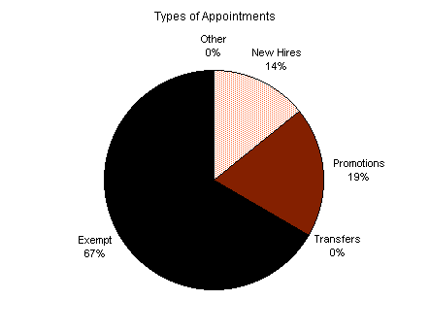
Hire Workforce
Outcomes:
Best candidates are hired and reviewed during appointment period. The right people are in the right job at the right time.
Performance Measures
Time-to-fill vacancies
Candidate quality
Hiring Balance (proportion of appointment types)
Separation during review period
Hiring Balance / Separations During Review Period
Analysis:
Due to budget constraints and vacancy management, there are no significant changes to this data.
Total number of appointments = 21
Time period = July 1, 2006 through June 30, 2007
Includes appointments to permanent vacant positions only; excludes reassignments
“Other” = Demotions, re-employment, reversion & RIF appointments
Separation During Review Period
Probationary separations - Voluntary 0
Probationary separations - Involuntary 1
  Total Probationary Separations 1
Trial Service separations - Voluntary 0
Trial Service separations - Involuntary 0
  Total Trial Service Separations 0
Total Separations During Review Period 1
Time period = July 1, 2006 through June 30, 2007
Data as of June 30, 2007
Source: Business Warehouse

Slide 9
Deploy Workforce
Outcomes:
Staff know job expectations, how they’re doing, & are supported. Workplace is safe, gives capacity to perform, & fosters productive relations. Employee time and talent is used effectively. Employees are motivated.
Performance Measures
Percent employees with current performance expectations
Employee survey ratings on “productive workplace” questions
Overtime usage
Sick leave usage
Non-disciplinary grievances/appeals filed and disposition (outcomes)
Worker safety
Current Performance Expectations
Percent employees with current performance expectations = 92%*
Analysis:
OAH had a decrease in the amount of current performance expectations since the last reporting period.
This is due in part to a policy change to have all reviews conducted during the month of November.
OAH had a turnover in employees due to retirement, promotions and transfers out of the agency.
Performance reviews that were due to be conducted were not done on the employees who left the agency.
Action Steps:
Advise each supervisor of the new policy.
*Based on 118 of 128 reported employee count
Applies to employees in permanent positions, both WMS & GS
Data as of July 1, 2007
Source: HRMS Tracking

Slide 10
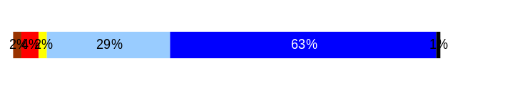
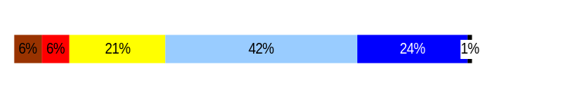
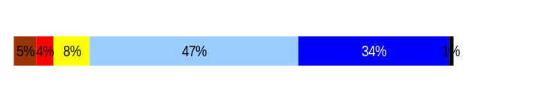
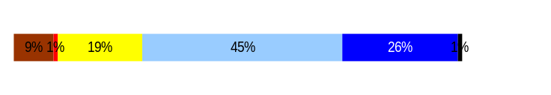
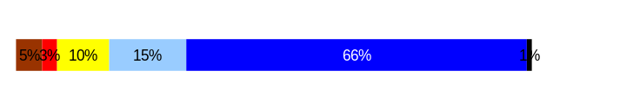
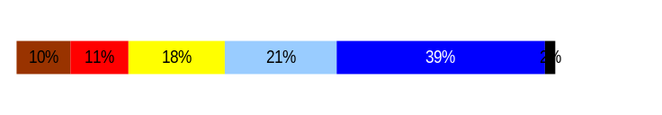
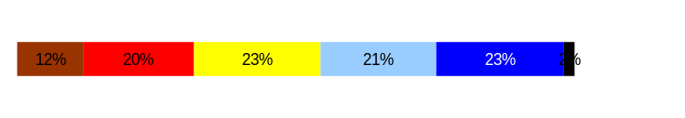
Deploy Workforce
Outcomes:
Staff know job expectations, how they’re doing, & are supported. Workplace is safe, gives capacity to perform, & fosters productive relations. Employee time and talent is used effectively. Employees are motivated.
Performance Measures
Percent employees with current performance expectations
Employee survey ratings on “productive workplace” questions
Overtime usage
Sick leave usage
Non-disciplinary grievances/appeals filed and disposition (outcomes)
Safety and Workers Compensation (TBD)
Employee Survey “Productive Workplace” Ratings
Avg
Q4. I know what is expected of me at work.
Q1. I have opportunity to give input on decisions affecting my work.
Q2. I receive the information I need to do my job effectively.
Q6. I have the tools and resources I need to do my job effectively.
Q7. My supervisor treats me with dignity and respect.
Q8. My supervisor gives me ongoing feedback that helps me
improve my performance.
Q9. I receive recognition for a job well done.
Q4. I know what is expected of me at work.
Q1. I have opportunity to give input on decisions affecting my work.
Q2. I receive the information I need to do my job effectively.
Q6. I have the tools and resources I need to do my job effectively.
Q7. My supervisor treats me with dignity and respect.
Q8. My supervisor gives me ongoing feedback that helps me
improve my performance.
Q9. I receive recognition for a job well done.
Analysis:
The ratings reflect that OAH is consistent in providing a productive workplace for its employees.
OAH exceeds the statewide overall average.
Action Steps:
Continue providing a productive workplace for employees.
4.5
3.7
4.0
3.8
4.4
3.7
3.2
Never
Seldom
Occasionally
Usually
Always
Overall average score for Productive Workplace Ratings: 3.9
Data as of April 2007
Source: Employee Climate Survey

Slide 11
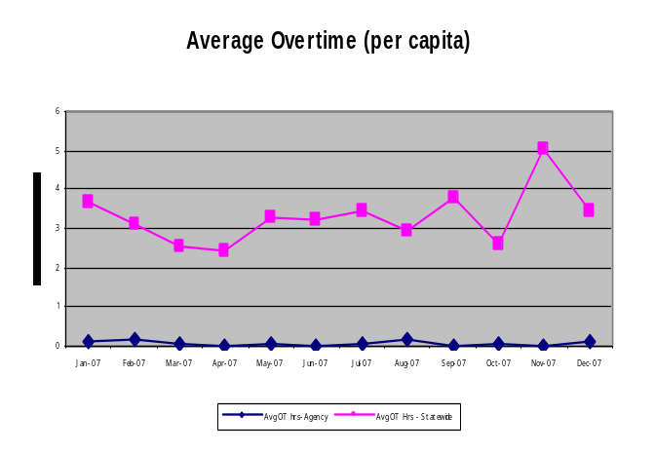
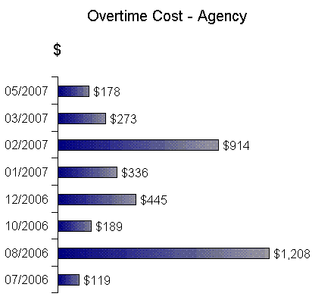
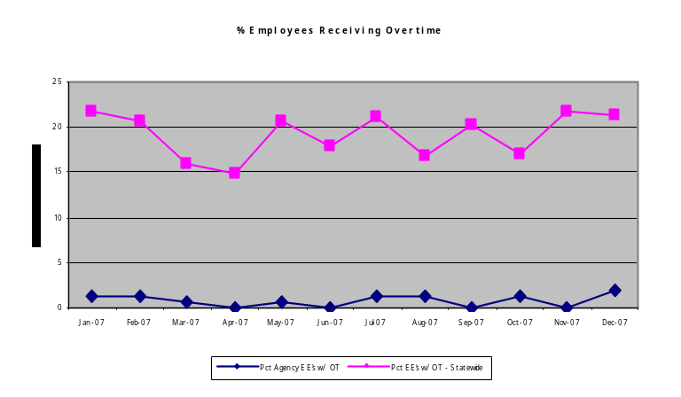
Deploy Workforce
Outcomes:
Staff know job expectations, how they’re doing, & are supported. Workplace is safe, gives capacity to perform, & fosters productive relations. Employee time and talent is used effectively. Employees are motivated.
Performance Measures
Percent employees with current performance expectations
Employee survey ratings on “productive workplace” questions
Overtime usage
Sick leave usage
Non-disciplinary grievances/appeals filed and disposition (outcomes)
Worker safety
Overtime Usage
Overall agency avg overtime usage – per capita, per month: .09**
*Statewide overtime values do not include DNR
**Overall agency avg overtime usage – per capita, per month = sum of monthly OT averages divided by number of months
Analysis:
OT usage for OAH has been moderate as projected on the charts.
The number of employees using OT has been kept to a minimum.
An increase in OT is noted during 02/2007 due to illness and vacations during 08/2006.
Action Steps:
Continue to monitor OT usage and watch for trends during the vacation period.
Overall agency avg employees receiving overtime per month: 1.2%**
*Statewide overtime values do not include DNR
**Overall agency avg employees receiving overtime per month = sum of monthly OT percentages divided by number of months
Data as of June 2007
Source: Business Warehouse

Slide 12
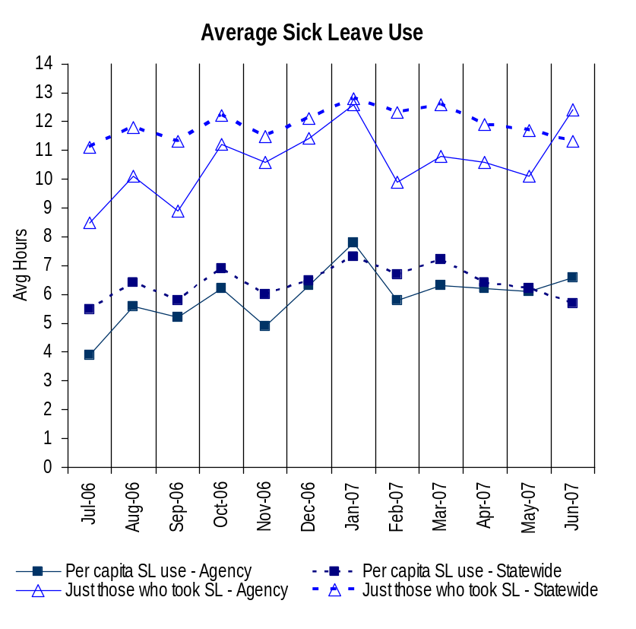
Deploy Workforce
Outcomes:
Staff know job expectations, how they’re doing, & are supported. Workplace is safe, gives capacity to perform, & fosters productive relations. Employee time and talent is used effectively. Employees are motivated.
Performance Measures
Percent employees with current performance expectations
Employee survey ratings on “productive workplace” questions
Overtime usage
Sick leave usage
Non-disciplinary grievances/appeals filed and disposition (outcomes)
Worker safety
Sick Leave Usage
Analysis:
Sick leave usage increased for the months of Aug 06, Oct 06, Dec 06, Jan and Jun 07 due to staff on shared leave and FMLA.
The data reflects sick leave usage is below the statewide average, except for the months of Jan and Jun 07.
Action Steps:
Continue to monitor sick leave usage and identify trends.
Sick Leave Hrs Used / Earned (per capita)
Avg Hrs SL Used (per capita) - Agency | % of SL Hrs Earned (per capita) - Agency
5.9 Hrs | 78.0%
Avg Hrs SL Used (per capita) – Statewide* | % of SL Hrs Earned (per capita) – Statewide*
6.4 Hrs | 82.5%
Sick Leave Hrs Used / Earned (those who took SL)
Avg Hrs SL Used (those who took SL) - Agency | % SL Hrs Earned (those who took SL) - Agency
10.6 Hrs | 106.8%
Avg Hrs SL Used (those who took SL) – Statewide* | % SL Hrs Earned (those who took SL) – Statewide*
11.9 Hrs | 148.4%
Sick Leave time period = July 2006 through June 2007
* Statewide data does not include DOL, DOR, L&I, and LCB
Source: Business Warehouse

Slide 13
Deploy Workforce
Outcomes:
Staff know job expectations, how they’re doing, & are supported. Workplace is safe, gives capacity to perform, & fosters productive relations. Employee time and talent is used effectively. Employees are motivated.
Performance Measures
Percent employees with current performance expectations
Employee survey ratings on “productive workplace” questions
Overtime usage
Sick leave usage
Non-disciplinary grievances/appeals filed and disposition (outcomes)
Safety and Workers Compensation (TBD)
Non-Disciplinary Grievances (non-represented employees)
Total Non-Disciplinary Grievances = 0
* There may not be a one-to-one correlation between the number of grievances filed (shown top of page) and the outcomes determined during this time period. The time lag between filing date and when a decision is rendered can cross the time periods indicated.
Data as of June 30, 2007
Source: n/a

Slide 14
Deploy Workforce
Outcomes:
Staff know job expectations, how they’re doing, & are supported. Workplace is safe, gives capacity to perform, & fosters productive relations. Employee time and talent is used effectively. Employees are motivated.
Performance Measures
Percent employees with current performance expectations
Employee survey ratings on “productive workplace” questions
Overtime usage
Sick leave usage
Non-disciplinary grievances/appeals filed and disposition (outcomes)
Safety and Workers Compensation (TBD)
Non-Disciplinary Appeals (non-represented employees)
Total outcomes = 0
Time Period = n/a
Total outcomes = 0
Time Period = July 1, 2006 through June 30, 2007
Source: Dept of Personnel

Slide 15
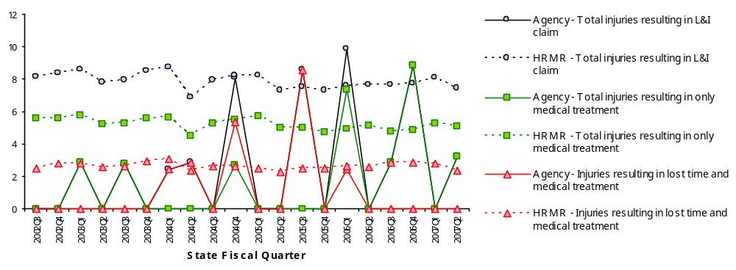
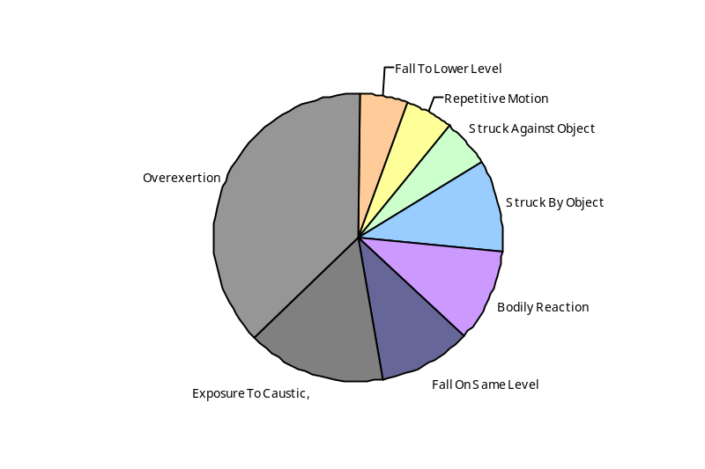
Deploy Workforce
Outcomes
Staff know job expectations, how they’re doing, & are supported. Workplace is safe, gives capacity to perform, & fosters productive relations. Employee time and talent is used effectively. Employees are motivated.
Performance Measures
Percent employees with current performance expectations
Employee survey ratings on 'productive workplace' questions
Overtime usage
Sick leave usage
Non-disciplinary grievances/appeals filed and disposition outcomes
Worker Safety
Worker Safety: Administrative Hearings, Office of
Analysis:
The agency has done fairly well in managing workers safety claims with the exception of total OAH injuries resulting in L&I claims for the fiscal quarters of 2004Q4 & 2006Q1.
The same applies to total OAH injuries resulting in only medical treatment which far exceeds the HRMR agencies’ rate for fiscal quarters 2006Q1 & 2006Q4.
Injuries resulting in lost time and medical treatment exceed the HRMR agencies’ rate for fiscal quarters 2004Q4 & 2005Q3
37% of claims are due to overexertion.
Action Plan:
Review employee workload.
Review staffing levels and distribution of workload.
Explore training needs.
Monitor trends.
Allowed Annual
Claims Rate*^:
Agency vs. All HR
Management Report
(HRMR) agencies
*Annual claims rate
is # claims / 100 FTE
1 FTE = 2000 hours
^Due to natural lag
in claim filing, rates
are expected to
increase significantly
over time
Injuries by Occupational
Injury and Illness
Classification (OIICS)
event:
For fiscal period 2002Q3
through 2007Q2
(categories under 3% or not
adequately coded are grouped
into 'misc.')
Oiics Code | Oiics Description | Percent | Number
21 | Bodily Reaction | 11% | 2
34 | Exposure To Caustic, | 16% | 3
13 | Fall On Same Level | 11% | 2
11 | Fall To Lower Level | 5% | 1
22 | Overexertion | 37% | 7
23 | Repetitive Motion | 5% | 1
01 | Struck Against Object | 5% | 1
02 | Struck By Object | 11% | 2
Source: Labor & Industries, Research and Data Services (data as of 09/03/2007 )
Notes:
HRMR Safety Report Overview
The HRMR Safety Reports are:
- PowerPoint slides created by the Department of Labor and Industries
- Created for each state agency that is reporting their employee safety program results bi-
annually as part of their Human Resources Management Report (HRMR).
- Snapshots of five years of worker’s compensation claim data specific to that agency, as
well as a comparison to the combined data for agencies completing HRMR reports.
- There is a two quarter lag at the end of the five years.
This allows each agency’s payroll data to be entered into L&I’s computer system. This
payroll data is used to compute the number of workers per agency and quarter.
Definitions
Claim – When a covered worker sustains an occupational injury or illness, that worker files a
'claim’ for benefits. A 'claim number' is assigned, and all wage replacement payments, medical
provider bills, etc, for that worker and injury, are associated with that claim number.
Report Detail
'Allowed Annual Claim Rate'
This chart shows your agency's rate of injuries resulting in allowed
claims, by injury quarter, for on-the-job injuries and occupational illnesses. The rate for all
reporting agencies is shown for comparison.
- The rate is the number accepted claims per 200,000 annual worker hours (100 workers)
Three rates are included in this chart:
A)The total rate for all injuries resulting in a claim; the two groups listed below are
exclusive of each other.
B)The rate of injuries which required medical care, but no compensation for lost
time.
C)The rate of injuries which resulted in compensation for lost time in addition to
medical care.
'Injuries by Occupational Injury and Illness Classification (OIICS) Event’
This section contains a pie chart which shows your agency's injuries by type* and a table which
shows the percent and number of accepted claims by OIICS Event description and code.
This information is useful in identifying what causes injuries so prevention can occur. Prevention
might include root cause analysis, education, and hazard mitigation.
* Injury Type is based on the 2 digit Major Group code of the Event or Exposure section of the Occupational
Injury and Illness Classification System (OIICS). Groups with less than 3% of the
total injuries are combined into the 'Misc' category.
How to get this report for your agency:
All worker compensation reports will be available on the L&I website by the 20th of September or
the 20th of March of each year. The data will be provided in a PowerPoint slide to which you will
add your own analyses and action plans.

Slide 16
Reinforce Performance
Outcomes:
Employees know how their performance contributes to the goals of the organization. Strong performance is rewarded; poor performance is eliminated. Successful performance is differentiated and strengthened. Employees are held accountable.
Performance Measures
Percent employees with current performance evaluations
Employee survey ratings on “performance and accountability” questions
Disciplinary actions and reasons, disciplinary grievances/appeals filed and disposition (outcomes)
Reward and recognition practices (TBD)
Current Performance Evaluations
Percent employees with current performance evaluations = 9%*
Analysis:
The data is reflective for GS employees. As of 8/17/07, OAH has no WMS employees.
Implementation of the PDP was phased in over time. It is anticipated that this number will increase dramatically with the Agency’s new policy change to conduct all annual reviews during the month of November, which will make it easier for the supervisors to track.
Action Steps:
Ensure each supervisor is aware of the new policy .
Advise supervisors of the importance to conduct annual reviews.
*Based on 12 of 128 reported employee count
Applies to employees in permanent positions, both WMS & GS
Data as of July 1, 2007
Source: HRMS Tracking

Slide 17
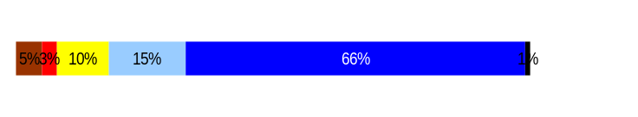
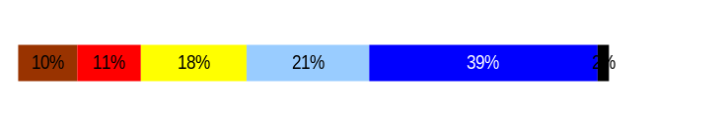
Develop Workforce
Outcomes:
A learning environment is created. Employees are engaged in professional development and seek to learn. Employees have competencies needed for present job and future advancement.
Performance Measures
Percent employees with current individual development plans
Employee survey ratings on “learning & development” questions
Competency gap analysis (TBD)
Individual Development Plans
Percent employees with current individual development plans = 40%
Analysis:
A slight decline is reported this reporting period for employees with current IDPs.
This is due to not performing evaluations on departing staff and the policy change that will have all reviews conducted during the month of November.
The Learning & Development ratings reflect that OAH is consistent in providing opportunities and feedback to its employees.
Action Steps:
Continue to encourage a continuous learning and development environment for employees.
Total # of employees with current IDPs* = 51
Total # of employees* = 128
*Applies to employees in permanent positions, both WMS & GS
Employee Survey “Learning & Development” Ratings
Q5. I have opportunities at work to learn and grow.
Q8. My supervisor gives me ongoing feedback that helps me
improve my performance.
Avg
3.5
3.7
Overall average score for Learning & Development Ratings: 3.6
Data as of July 1, 2007 & April 2006
Source: OAH Manual Tracking & 2006 Employee Climate Survey

Slide 18
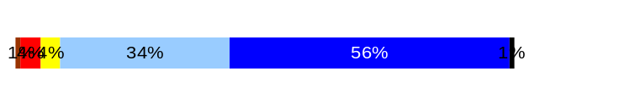
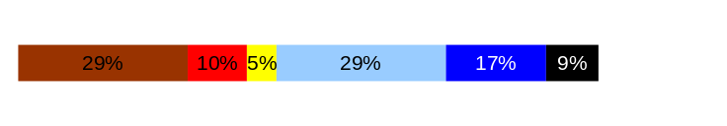
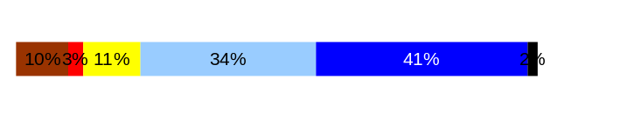
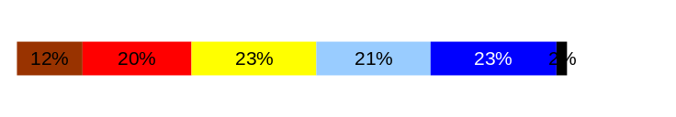
Reinforce Performance
Outcomes:
Employees know how their performance contributes to the goals of the organization. Strong performance is rewarded; poor performance is eliminated. Successful performance is differentiated and strengthened. Employees are held accountable.
Performance Measures
Percent employees with current performance evaluations
Employee survey ratings on “performance and accountability” questions
Disciplinary actions and reasons, disciplinary grievances/appeals filed and disposition (outcomes)
Reward and recognition practices (TBD)
Employee Survey “Performance & Accountability” Ratings
Avg
Analysis:
OAH met and exceeded the overall statewide rating for Q3, Q11, Q9.
Although Q10 is not as high as the statewide average, it provides an opportunity for improvement.
Action Steps:
Encourage supervisors to provide employees with a meaningful and informative PDP.
HR review the 2007 employee data and share with EMT to identify opportunities for improvement if needed.
Q3. I know how my work contributes to the goals of my agency.
Q10. My performance evaluation provides me with meaningful information about my performance.
Q11. My supervisor holds me and my co-workers accountable for performance.
Q9. I receive recognition for a job well done.
4.4
2.9
4.0
3.2
Never
Seldom
Occasionally
Usually
Always
Overall average score for “Performance & Accountability” ratings: 3.7
Data as of April 2006
Source: Employee Climate Survey

Slide 19
Reinforce Performance
Outcomes:
Employees know how their performance contributes to the goals of the organization. Strong performance is rewarded; poor performance is eliminated. Successful performance is differentiated and strengthened. Employees are held accountable.
Performance Measures
Percent employees with current performance evaluations
Employee survey ratings on “performance and accountability” questions
Disciplinary actions and reasons, disciplinary grievances/appeals filed and disposition (outcomes)
Reward and recognition practices (TBD)
Disciplinary Grievances and Appeals
Disciplinary Appeals
(Non-Represented Employees
filed with Personnel Resources Board)
Time Period = July 1, 2006 through June 30, 2007
0 Dismissal
0 Demotion
0 Suspension
0 Reduction in salary
0 Total Disciplinary Appeals Filed with PRB
Disposition (Outcomes) of Disciplinary Appeals*
Time period = July 1, 2006 through June 30, 2007
n/a
*Outcomes issues by Personnel Resources Board
Data as of June 30, 2007
Source: n/a

Slide 20
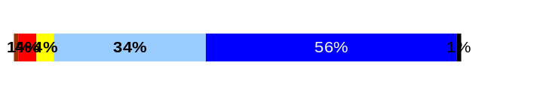
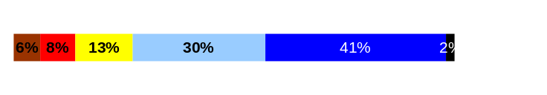
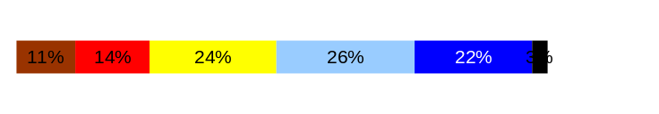
ULTIMATE OUTCOMES
Employees are committed to the work they do and the goals of the organization
Successful, productive employees are retained
The state has the workforce breadth and depth needed for present and future success
Performance Measures
Employee survey ratings on “commitment” questions
Turnover rates and types
Turnover rate: key occupational categories
Workforce diversity profile
Retention measure (TBD)
Employee Survey “Employee Commitment” Ratings
Avg
Analysis:
The ratings are a positive reflection of employee commitment to OAH.
The ratings combined exceed the overall state average for employee commitment.
Action Steps:
Supervisors continue to recognize employees for the work they do and their contributions to the agency.
Q3. I know how my work contributes to the goals of my agency.
Q12. I know how my agency measures its success.
Q9. I receive recognition for a job well done.
4.4
3.9
3.2
Never
Seldom
Occasionally
Usually
Always
Overall average score for Employee Commitment ratings: 3.9
Data as of April 2006
Source: Employee Climate Survey

Slide 21
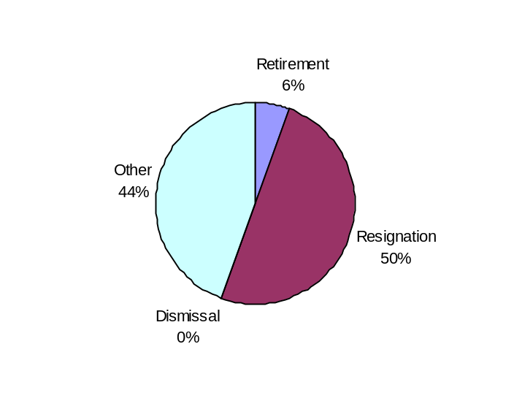
ULTIMATE OUTCOMES
Employees are committed to the work they do and the goals of the organization
Successful, productive employees are retained
The state has the workforce breadth and depth needed for present and future success
Performance Measures
Employee survey ratings on “commitment” questions
Turnover rates and types
Turnover rate: key occupational categories
Workforce diversity profile
Retention measure (TBD)
Turnover Rates
Total % Turnover (leaving state)
Time Period: July 1, 2006 through June 30, 2007
Analysis:
The majority of turnover is due to employees leaving state service for employment in the private sector and education.
Employees also left OAH for promotional opportunities with other state agencies.*
Being a small agency does not provide many promotional opportunities due to retention of staff in higher level positions.
Action Steps:
Monitor reasons for turnover.
Note: Movement to another agency is currently not available in HRMS/BW*
Total Turnover Actions: 12
Total % Turnover: 33%
Data as of June 30, 2007
Source: Business Warehouse

Slide 22
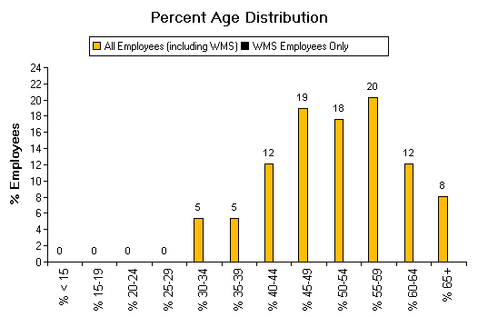
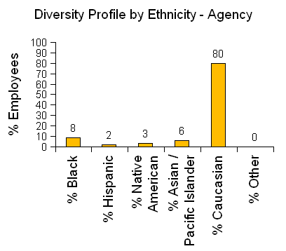
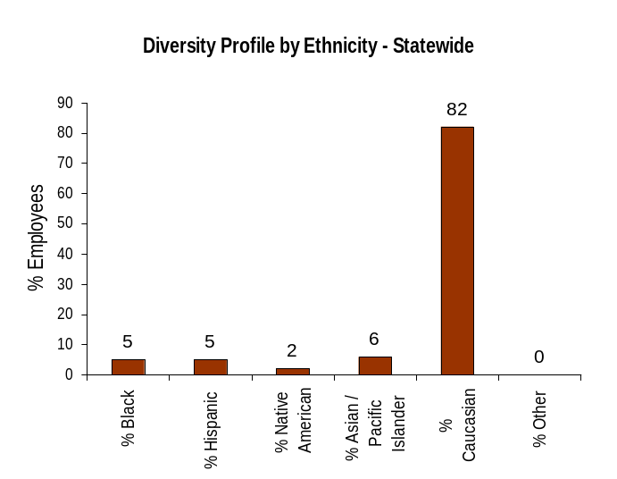
ULTIMATE OUTCOMES
Employees are committed to the work they do and the goals of the organization
Successful, productive employees are retained
The state has the workforce breadth and depth needed for present and future success
Performance Measures
Employee survey ratings on “commitment” questions
Turnover rates and types
Turnover rate: key occupational categories
Workforce diversity profile
Retention measure (TBD)
Workforce Diversity Profile
Agency State
Female 63% 53%
Disabled 14% 5%
Vietnam Vet 7% 7%
Disabled Vet 2% 2%
People of color 20% 18%
Persons over 40 78% 75%
Analysis:
OAH exceeds statewide average for diversity protected groups except for Vietnam Vet and Disabled Vet, which averages the same.
OAH is committed to diversity by reaching out to DOP and community resources during its recruitment efforts.
Action Steps:
Continue to use DOP and various community resources to meet affirmative action goals for the agency.
Data as of September 14, 2007
Source: Business Warehouse

