Slide 1
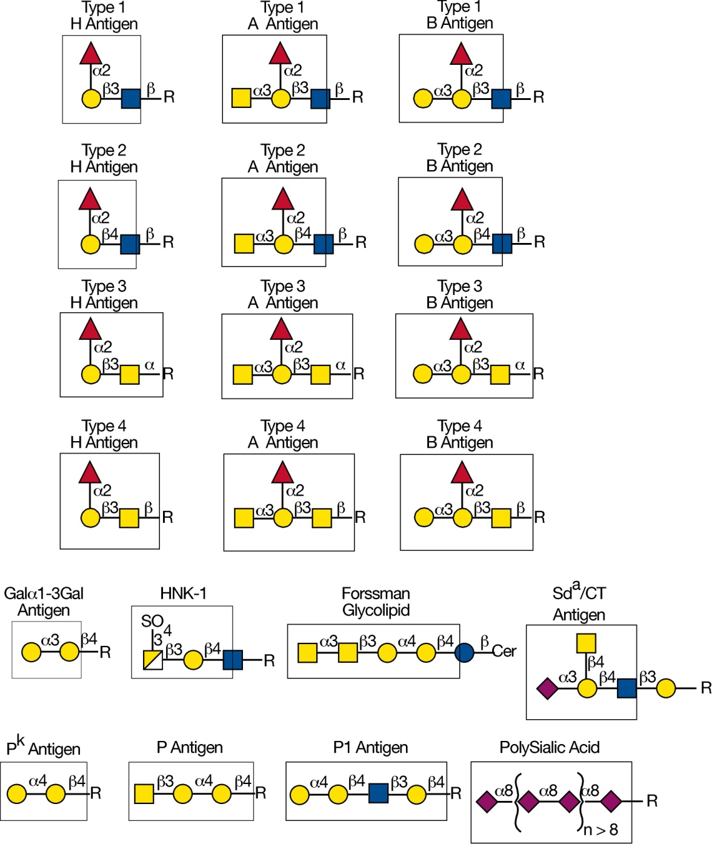


Additional examples of different glycan antigens recognized by specific monoclonal antibodies
Essentials of Glycobiology
Chapter 45, Figure 6
Second Edition
Notes:
FIGURE 45.6. Additional examples of different glycan antigens recognized by specific monoclonal antibodies. The antigens have the structures shown within the boxed area and are named as indicated. Usually, the antigen shown in the box can be linked to almost any glycan and antibodies will still recognize the antigen. Antibodies are also available to glycosaminoglycans and to many glycolipid antigens, including globoside, GD3, GD2, GM2, GM1, asialo-GM1, GD1a, GD1b, GD3, and GQ1b.

