Slide 1
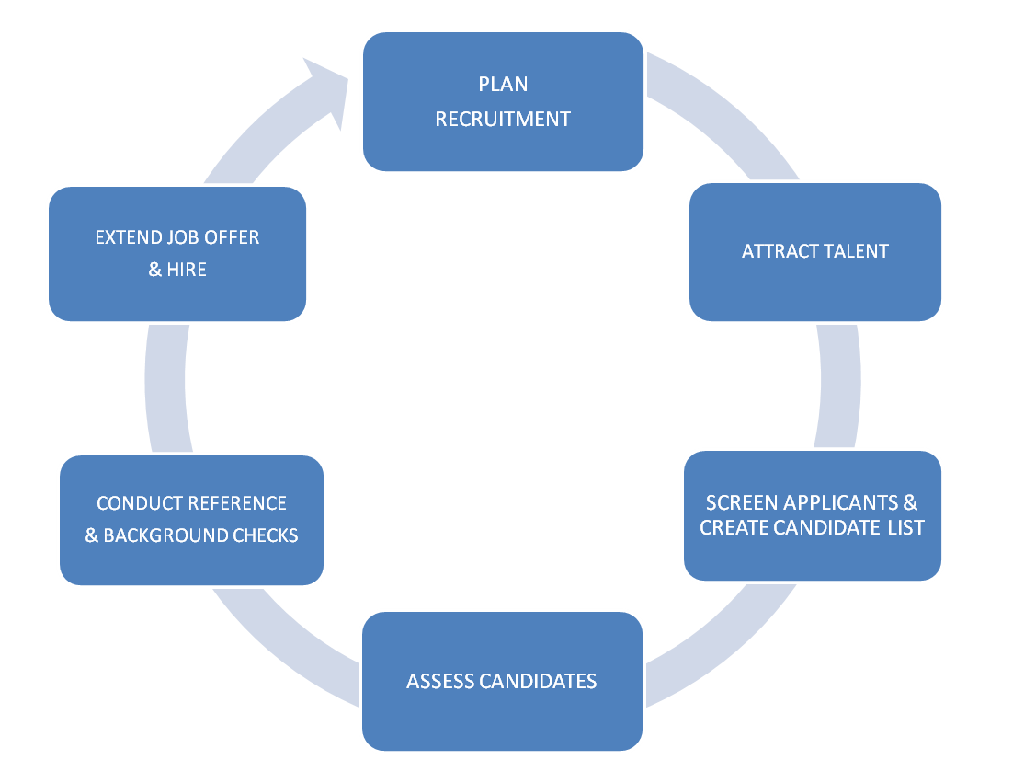
BASIC RECRUITMENT PROCESS
STATE OF WASHINGTON
Note: Variations exist due to labor contracts, civil service rules, individual position requirements and number of applications received.

