Slide 1
Tamoxifen, Endoxifen, and
CYP2D6
Clinical Pharmacology Subcommittee October 18, 2006
Rockville, Maryland
Sally Usdin Yasuda, MS, PharmD
Senior Reviewer, Division of Clinical Pharmacology 1
Office of Clinical Pharmacology
Center for Drug Evaluation and Research
Food and Drug Administration

Slide 2
Outline
Exposure to tamoxifen and metabolites after administration of tamoxifen
Pharmacology of tamoxifen, endoxifen, and other metabolites
CYP2D6-mediated metabolism of tamoxifen and formation of endoxifen in vitro
Role of CYP2D6 in formation of endoxifen in vivo
  CYP2D6 genotype
  Strong Inhibitors of CYP2D6

Slide 3
Case Report
45 year-old woman presented with intense, intolerable hot flashes after being prescribed 20 mg of tamoxifen per day for a week.
Placed on 10 mg per day of paroxetine for depression
Resolution of hot flashes within a week
Hot flashes resumed when taken off paroxetine
Personal Communication from David Flockhart

Slide 4
Classic Understanding of Tamoxifen Pharmacology
2D6
Tamoxifen
4OH-Tam
Estradiol (E2)
E2-ER
4OH-Tam-ER
ERE
Agonism:
Bone
Liver
Uterus
Antagonism:
Breast
CNS
Notes:
The antiestrogenic effects are thought to be related to the ability of tamoxifen or its metabolites to compete with estrogen for binding sites in target tissues such as breast. In cytosols derived from human breast adenocarcinomas, tamoxifen competes with estradiol for estrogen receptor protein.

Slide 5
Hypothesis:
CYP2D6 inhibition interferes with formation of 4-OH-tamoxifen
12 women with hx of breast cancer receiving tamoxifen (20 mg/day) as adjuvant treatment for at least 4 weeks before starting the study
  History of troublesome hot flashes for which treatment with a non-hormonal agent was considered to be appropriate
Blood samples collected before and after 4 weeks of co-administration of tamoxifen with 10 mg/day paroxetine

Slide 6
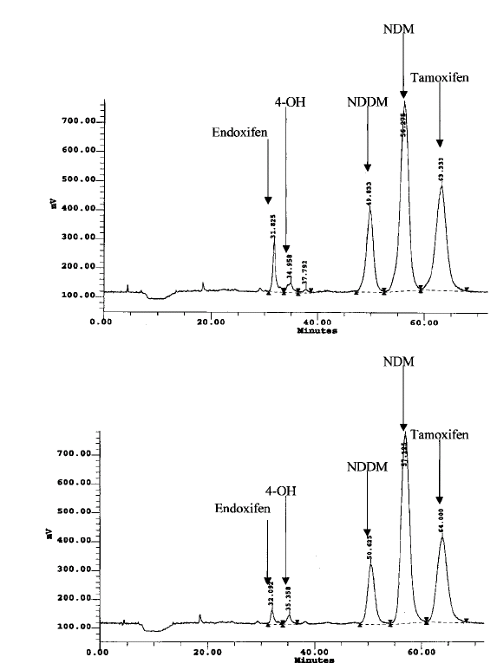
Paroxetine Administration Decreased the Concentration of One Metabolite
4OHTam
X
X
Separated, purified, identified
and synthesized metabolite X:
Before
4-hydroxy-N-desmethyl tamoxifen
(Endoxifen)
Concentration of
endoxifen is ~
10x > 4-OH-tamoxifen
X
After
X
As modified from Stearns et al.
JNCI 2003: 95:1758-1764.

Slide 7
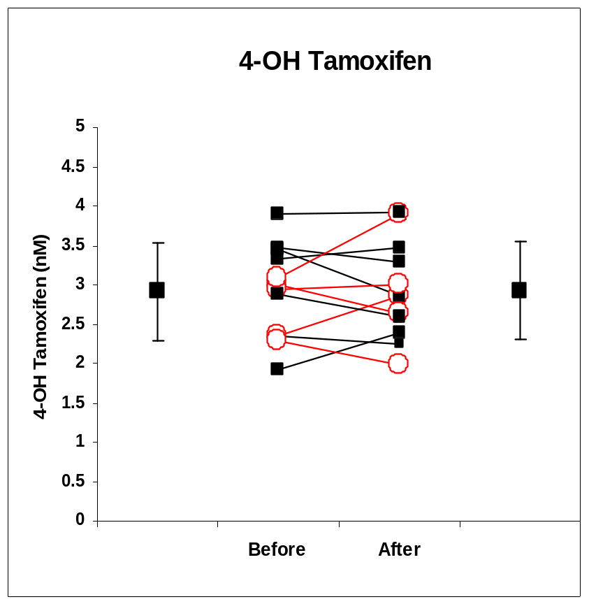
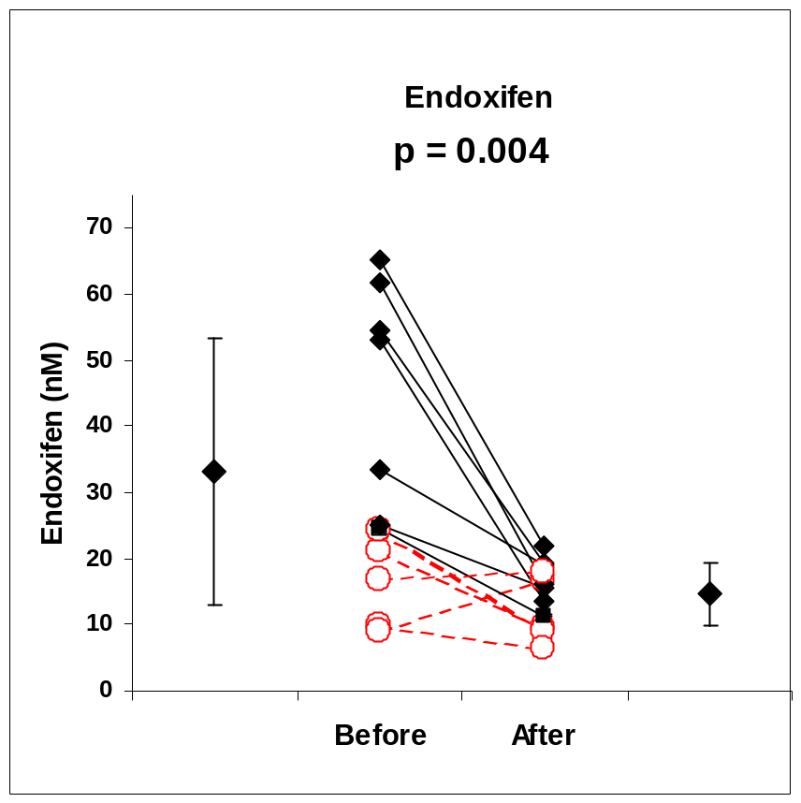
Paroxetine and CYP2D6 genotype change the plasma concentrations of endoxifen
(but not of tamoxifen, N-desmethyl, or 4-hydroxy-tamoxifen )
from Stearns et al. JNCI 2003: 95:1758-1764, as communicated by D. Flockhart
Notes:
Endoxifen decreased by 64% in WT and by 24% in women with variant allele. Baslien eendoxifen concentrations were lower in women with variant allele than in WT. Paroxetine had no statistically singiicant effect on enedoxifen levels in women with variant allele (*4, 6, 8).

Slide 8
What is the relative pharmacological activity of tamoxifen and its metabolites?
Tamoxifen and N-desmethyl-tamoxifen have similar pharmacologic activity¹
4-OH-tamoxifen is 30-100 times more potent as antiestrogen than tamoxifen²
Endoxifen is equipotent to 4-OH-tamoxifen (and has 5-10x higher concentration)
¹Nolvadex (Tamoxifen Citrate) label. 9-27-2005. Wilmington, Delaware,
AstraZeneca Pharmaceuticals LP.
²Coezy E, Borgna JL, and Rochefort H. Cancer Res. 1982;4:317-23.

Slide 9
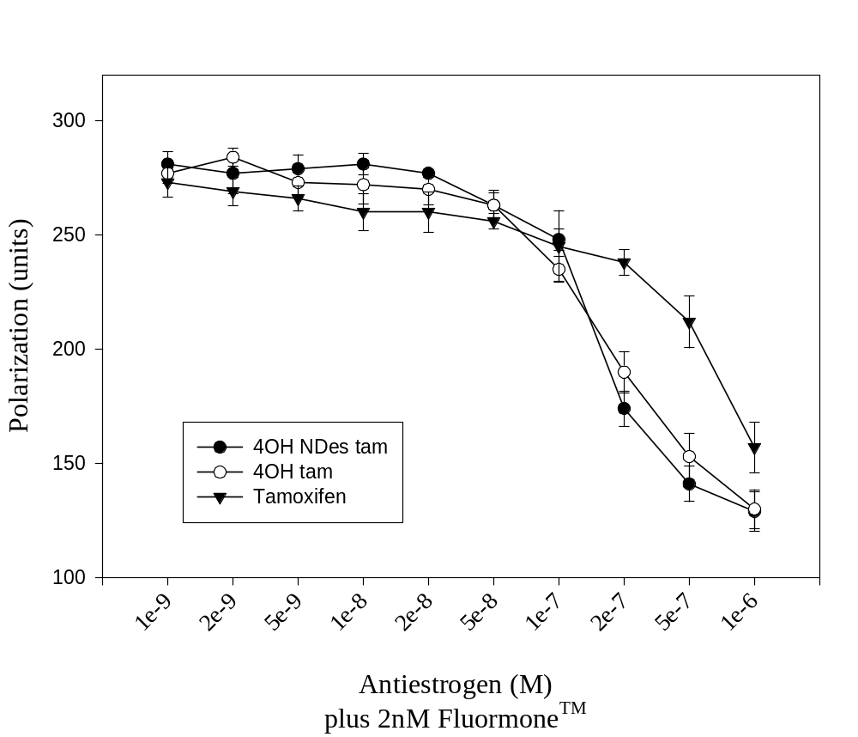
4-OH-Tamoxifen and 4-OH-N-Des-Tamoxifen have equal affinities for Estrogen Receptor α
Johnson MD, et al. Breast Cancer Research and Treatment, 2004; 85:151-159.

Slide 10
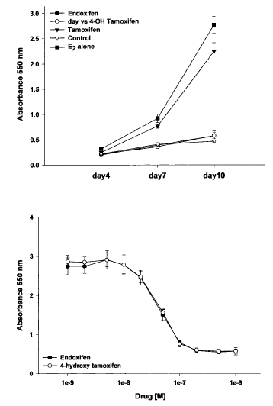
Endoxifen and 4-OH-Tamoxifen are Equipotent as Inhibitors of Estrogen Stimulated Cell Proliferation in MCF7 Cells
Stearns V et al. JNCI 2003; 95:1758-64

Slide 11
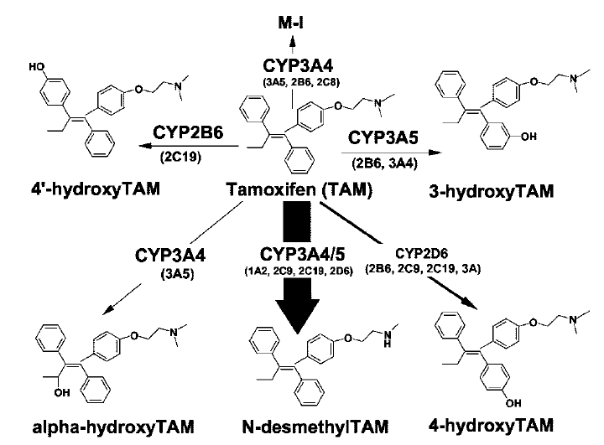
In vitro studies suggest N-desmethyl-TAM accounts for majority of primary TAM oxidation
Desta et al. JPET 2004; 310:1062-1075
Notes:
Pathways for N-desmethyl and 4-hydroxy determined by correlation experiments in characterized HLMs and inhibition with isoform specific chemical inhibitors and in a panel of expressed p450s. These findings allowed for the path forward for studies of secondary metabolism.

Slide 12
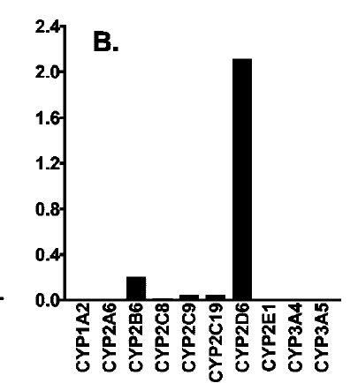
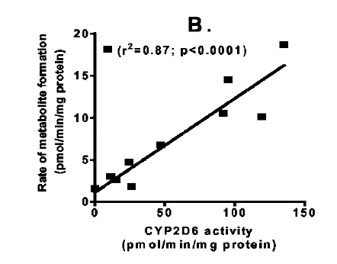

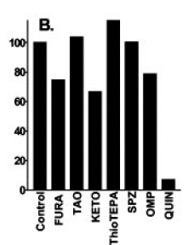
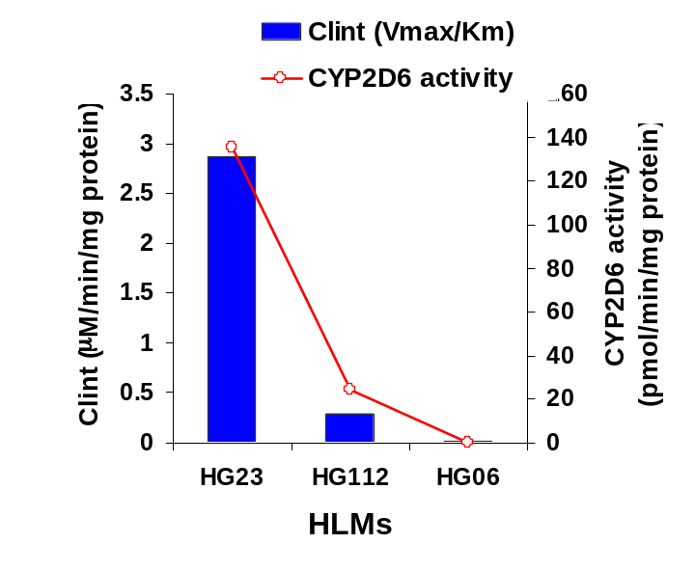
CYP2D6 is the principal route of metabolism to Endoxifen
Desta et al. JPET 2004; 310:1062-1075 and personal communication from D. Flockhart
Notes:
Next, these investigators evaluated the metabolism to endoxifen and other secondary metabolites uing N-desmethyll and 4-hydroxy as substrates. They have shown that endoxifen is formed from both N-desmthyl and 4-hydroxy. A series of experiments including correlation studies in a panel of HLMs showed significant correlation between endoxifen formation from N-desmethyl and CYP2D6 activity (upper right). In chemical inhibition experiments in HLMs, Q almost completely inhibited formation of endoxifen from N-desmethyl, and other inhibitors showed much less effect, supporting CYP2D6. Finally, in expressed P450s

Slide 13
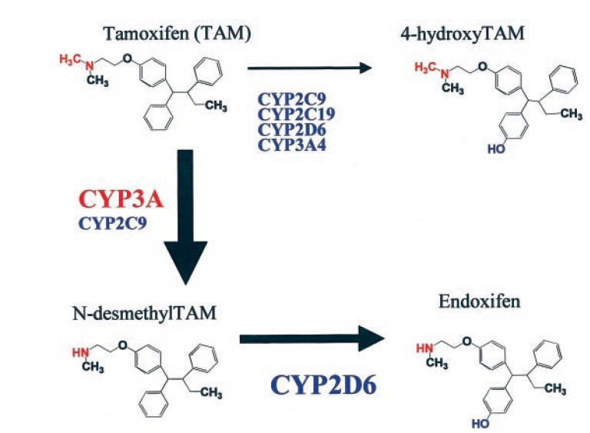
CYP3A4
modified from Stearns et al. JNCI 2003: 95:1758-1764

Slide 14
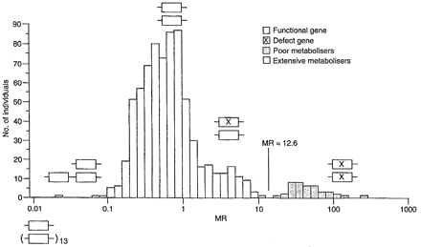
Pharmacogenetics of CYP2D6 (debriosquine metabolic ratio)
Alvan G, Bertilsson L, Dahl M.-L., Ingleman-Sundber M, and Sjöqvist F.
Drug Metab Sip 2001; 29:580-585

Slide 15
CYP2D6 Genotype, CYP2D6 Inhibitors, and Tamoxifen Exposure
80 pre- and postmenopausal women with newly diagnosed breast cancer starting tamoxifen (20 mg/day) as adjuvant therapy
Blood samples for determination of tamoxifen and metabolites in plasma
Genotype functional and variant alleles of:
  CYP3A5 (*1, *3)
  CYP2D6 (*1, *3, *4, *5, *6)
  CYP2C9 (*1, *2, *3)
  SULT1A1 (*1,*2)
No statistically significant associations of candidate genotypes with tamoxifen or metabolite exposure except for CYP2D6
Jin Y et al. JNCI 2005; 97:30-39

Slide 16
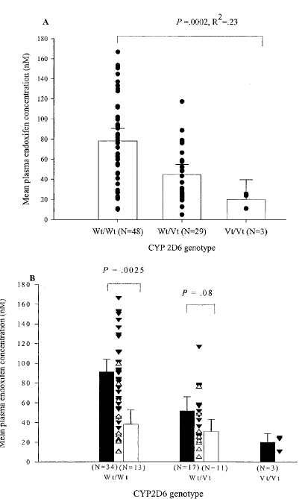
CYP2D6 Vt/Vt genotype has decreased endoxifen exposure
Jin Y et al. JNCI 2005; 97:30-39

Slide 17
CYP2D6 inhibitors decrease endoxifen exposure
Strong: paroxetine, fluoxetine
Weak: amiodarone, sertraline
Other: metoclopramide, citalopram
Jin Y et al. JNCI 2005; 97:30-39

Slide 18
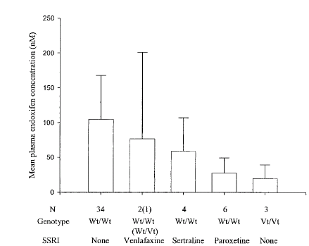
Commonly used antidepressants and endoxifen concentrations
CYP2D6 inhibitor:
Strong: Paroxetine
Weak: Sertraline
Jin Y et al. JNCI 2005; 97:30-39

Slide 19
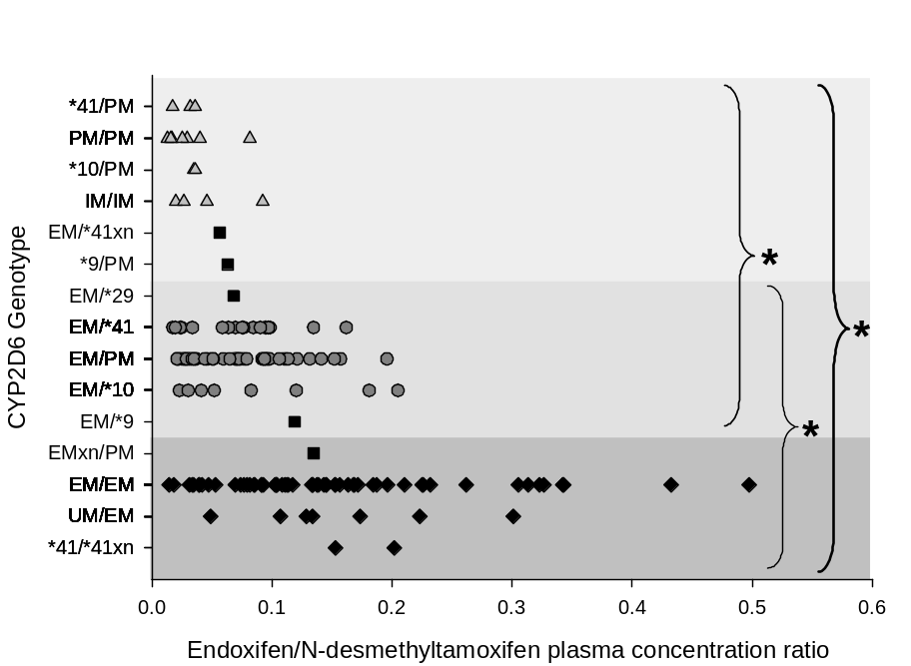
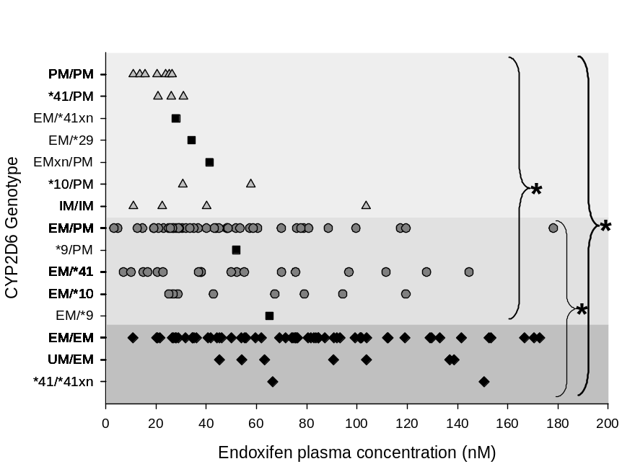
Effect of CYP2D6 genotype on endoxifen/NDM ratio and endoxifen plasma concentration (n=158)
*, P < 0.001
*, P < 0.01
Borges S et al. Clin Pharmacol Ther 2006; 80:61-74.

Slide 20
Conclusions
Endoxifen is an active metabolite of tamoxifen, present in patients at 5-10 x greater concentration than 4-OH-tamoxifen
In vitro studies demonstrate the primary role of CYP2D6 in the formation of endoxifen.
Potent inhibitors of CYP2D6 reduce endoxifen concentrations in patients taking tamoxifen
CYP2D6 genotype correlates with endoxifen concentrations in patients taking tamoxifen

Slide 21
Acknowledgements
Larry Lesko, PhD
Shiew Mei Huang, PhD
NAM Atiqur Rahman, PhD
Felix Frueh, PhD
Myong-Jin Kim, PharmD
Todd Skaar, PhD
David Flockhart, MD, PhD

