Slide 1
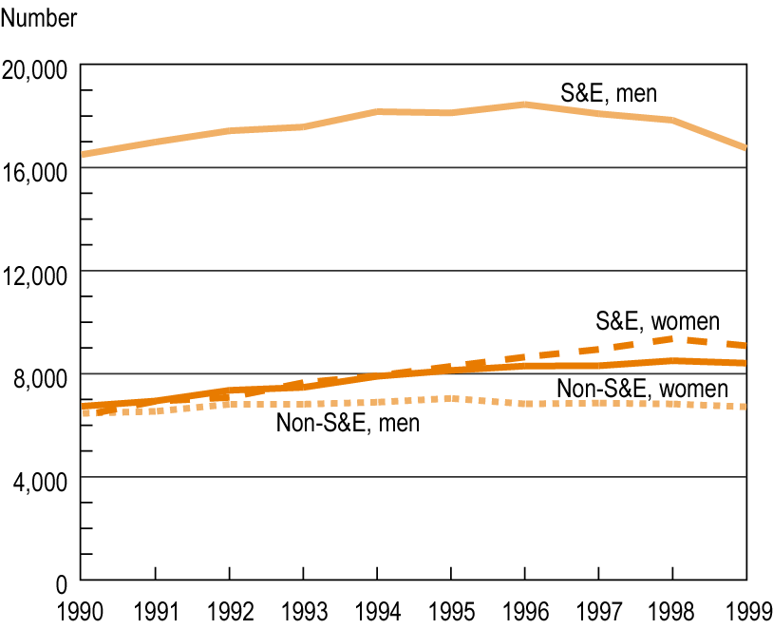
Doctoral degrees awarded in S&E and non-S&E fields, by sex: 1990-99
Notes:
1

