Slide 1
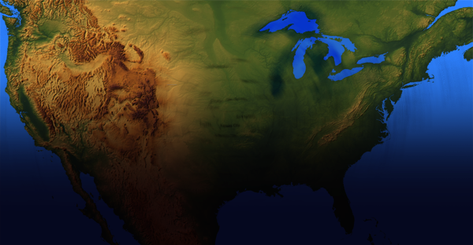
U.S. Obesity Trends in
Adults
From 1991-1998
Source: Mokdad AH, Serdula MK, Dietz WH, et al.
JAMA, October 27, 1999; 282(16):1519-1522

Slide 2
Methods
Data were analyzed from all states that participated in the Behavioral Risk Factor Surveillance System (BRFSS) from 1991 to 1998.
The BRFSS is a cross sectional random-digit-dialed telephone survey of noninstitutionalized civilian adults aged 18 years or older.
SAS and SUDAAN data analysis programs were used because of the complex sampling design.

Slide 3
Limitations and Implications
  Weights and heights were self-reported. Because overweight individuals tend to underestimate their weight, true obesity rates could be underestimated.
  Only households with telephones are included in BRFSS. People without telephones are likely to be of lower socioeconomic status, a factor associated with obesity.

Slide 4
Results
The prevalence of obesity (BMI greater than or equal to 30 kg/m²) increased from 12% of the U.S. population in 1991 to 17.9% in 1998.
Obesity increased in every state, in both sexes, and across all age groups, races, and educational levels, regardless of an individual’s smoking status.

Slide 5
Recommendations
Strategies and programs for weight maintenance and weight reduction must become a higher priority.
Public health messages should focus increasingly on balancing caloric intake with physical activity.

Slide 6
Recommendations
A wide range of participants, including physicians, public health professionals, legislators, communities, and organizations must become engaged to control the obesity epidemic.

Slide 7
Research Needs
Identify periods of risk across the life span for developing obesity and the factors that most contribute to the complex problem of obesity.
Explore and identify individual behavioral change and environmental interventions that work in medical settings, schools, worksites, and communities.

Slide 8
Prevalence of Obesity* Among U.S. Adults
BRFSS, 1991
(*Approximately 30 pounds overweight)
<10% 10% to 15% >15%
N/A

Slide 9
Prevalence of Obesity* Among U.S. Adults
BRFSS, 1992
(*Approximately 30 pounds overweight)
<10% 10% to 15% >15%
N/A

Slide 10
Prevalence of Obesity* Among U.S. Adults
BRFSS, 1993
(*Approximately 30 pounds overweight)
<10% 10% to 15% >15%
N/A

Slide 11
Prevalence of Obesity* Among U.S. Adults
BRFSS, 1994
(*Approximately 30 pounds overweight)
<10% 10% to 15% >15%
N/A

Slide 12
Prevalence of Obesity* Among U.S. Adults
BRFSS, 1995
(*Approximately 30 pounds overweight)
<10% 10% to 15% >15%
N/A

Slide 13
Prevalence of Obesity* Among U.S. Adults
BRFSS, 1996
(*Approximately 30 pounds overweight)
<10% 10% to 15% >15%
N/A

Slide 14
Prevalence of Obesity* Among U.S. Adults
BRFSS, 1997
(*Approximately 30 pounds overweight)
<10% 10% to 15% >15%
N/A

Slide 15
Prevalence of Obesity* Among U.S. Adults
BRFSS, 1998
(*Approximately 30 pounds overweight)
<10% 10% to 15% >15%
N/A

