Slide 1
California’s Phaseout of MTBE - Background and Current Status
UC TSR&TP Advisory Committee Spring Meeting
Cal EPA, Sacramento
March 17, 2003
Gordon Schremp
California Energy Commission
gschremp@energy.state.ca.us

Slide 2
Introduction
Background - history of MTBE use
Factors associated with decision to phase out the use of MTBE
Subsequent Actions (1999-2003)
Elements necessary for successful phaseout
Anticipated impacts of MTBE removal
Other issues affecting California
Study to examine causes of today’s high prices
Closing remarks

Slide 3
Background - MTBE Use
MTBE used in gasoline since late 1970s
Required seasonal use beginning 1992
  Winter oxygenated fuels program
  Designed to reduce carbon monoxide emissions
  Most refiners selected MTBE
  Approximately 11 percent of gasoline volume
Mandated year-round use in 1995 & 1996
  Reformulated gasoline (RFG) program to control emissions of toxics and pollutants that contribute to the formation of photochemical smog
  Federal law requires minimum use of oxygenates in all RFG regions (2 percent by weight)
  California regulations permit discretionary use, but federal mandate applies to 80 percent of State

Slide 4
Background - MTBE Use (cont.)
Gasoline demand and supply
  Gasoline demand in California during 2003 estimated in range of 15.6 to 16 billion gallons
  Demand expected to increase between 1.6 and 3 percent per year
  Refineries located in California produce the majority of gasoline for the State
  Imports of gasoline and blending components increase each year, while refinery capacity remains relatively flat (annual growth rate of 0.5 percent)
  California represents nearly 12 percent of United States gasoline demand

Slide 5
Background - MTBE Use (cont.)
Types and quantities of fuel oxygenates
  MTBE is primary oxygenate of choice
    Superior blending properties
  1.4 billion gallons blended in California gasoline during 2002
  Blending concentration of over 9 volume percent for entire gasoline pool
  Ethanol use in 2002 less than 100 million gallons
    ConocoPhillips was first company to use ethanol in California reformulated gasoline

Slide 6
MTBE concentration declining over time

Slide 7
Factors Associated with Decision to Phase Out the Use of MTBE
Water resource contamination concerns
  Detections of MTBE in water wells
  Prediction that contamination would spread and cleanup costs dramatically increase
Potential health concerns also raised
Studies ordered by California Legislature to determine:
  Cost to eliminate MTBE
  Assess risk to people and the environment of continued use
  Initial work conducted by California Energy Commission and University of California

Slide 8
Factors Associated with Decision to Phase Out the Use of MTBE (cont.)
Initial studies completed by late 1998
  UC - Annual water remediation costs estimated at $340 MM to $1.5 billion
  CEC - Gasoline production cost would only increase 2 - 3 cents per gallon with use of ethanol
    Annual cost to California consumers of $300 to $450 million
Executive Order issued by Governor Davis during March 1999
  Phases out use of MTBE by December 31, 2002
  California Air Resources Board (ARB) amends gasoline specifications banning MTBE, ethanol only acceptable fuel oxygenate substitute

Slide 9
Subsequent Actions - 1999
Energy Commission determines that timetable to remove MTBE cannot be advanced
ARB adopts Phase 3 RFG regulations
  Ethanol only permissible oxygenate
  Gasoline specifications changed
    lowers sulfur from 40 to 20 ppm
    lowers benzene from 1.0 to 0.8 vol. percent
    aromatics limit increased from 30 to 35 vol. percent
    distillation (T50 and T90) increased by 3 to 5 degrees F.
    olefins unchanged

Slide 10
Subsequent Actions - 2001
US EPA denies request by California to receive waiver from the federal minimum oxygen requirement - June 12
  70 percent of State’s gasoline must contain an oxygenate - increases to 80 % by 2003
  Failure to issue waiver will cost California consumers at least an additional 3 cents per gallon or $475 million per year
California Air Resources Board sues US EPA to obtain waiver - August 13
  Final arguments heard in Ninth Circuit Court of Appeals (February 2003) - awaiting decision

Slide 11
Subsequent Actions - 2002
CEC revised estimates for MTBE phaseout
  3.4 to 6.4 cents per gallon
  $540 MM to $1 billion per year
Stillwater Report raised supply and infrastructure concerns
  Estimated 5 to 10 percent decline in gasoline supply and increased potential for price spikes
Legal action by Lake Tahoe utility
  Several companies sued for MTBE contamination
  Finding of “defective product” by jury
  Settlement for $68 million

Slide 12
Subsequent Actions - 2002 (cont.)
Governor Davis issues Exec. Order D-52-02
  MTBE phaseout delayed until January 1, 2004
A number of refining companies announce early phaseout of MTBE in California
  BP, ChevronTexaco, ExxonMobil, and Shell plan to eliminate use of MTBE by early 2003
  The refineries operated by these companies required less modifications & more self-sufficient with regard to their distribution infrastructure
  Including Phillips, 60-70 percent of California’s gasoline will contain ethanol during 2003
ARB amends gasoline regulations to delay implementation date until the end of 2003

Slide 13
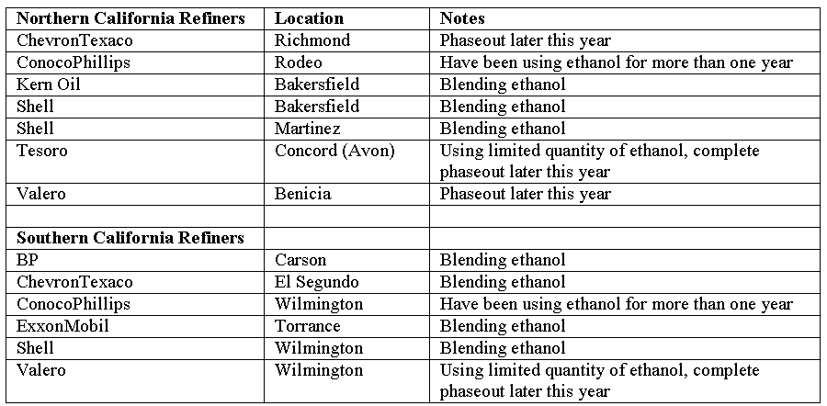
California Refinery Status - 2003
Majority of Southern Calif. production MTBE-free, less than 50 percent in Northern Calif.

Slide 14
Elements Necessary for a Successful MTBE Phaseout
Ethanol supplies must be adequate
Ethanol logistics must be in place
Refinery modifications must be completed
Gasoline supply (imports) must be available
Import infrastructure must be sufficient to accommodate anticipated increase in imports
“Successful” means that transition to ethanol occurs without disruption to the market and minimal impact on consumers and the economy

Slide 15
Anticipated Impacts of MTBE Removal
Demand for ethanol will increase
  Calif. will require significant quantities of ethanol
    560 to 580 million gallons by 2003
    760 to 990 million gallons by 2004
  Current US ethanol production capacity approximately 3 billion gallons per year
  Energy Commission survey (December 2002) of ethanol industry concludes that supply should be sufficient to meet California’s incremental ethanol demand

Slide 18
Ethanol Survey Update

Slide 19
Survey Results - U.S. Ethanol Production Capacity (MM Gallons)

Slide 20
Anticipated Impacts (cont.)
Ethanol Logistics
  Ethanol supplies will be delivered to California via rail and marine vessel
  Ethanol is delivered to main staging areas before being trucked to gasoline terminals
  Modifications nearing completion to allow terminal in Southern California to receive “unit trains”
  Remaining terminal modifications scheduled for completion later this year
  Large shipments of ethanol began to arrive in California during December of 2002
  Refiners will try and keep ethanol inventories at high levels as a hedge against a potential interruption of deliveries

Slide 21
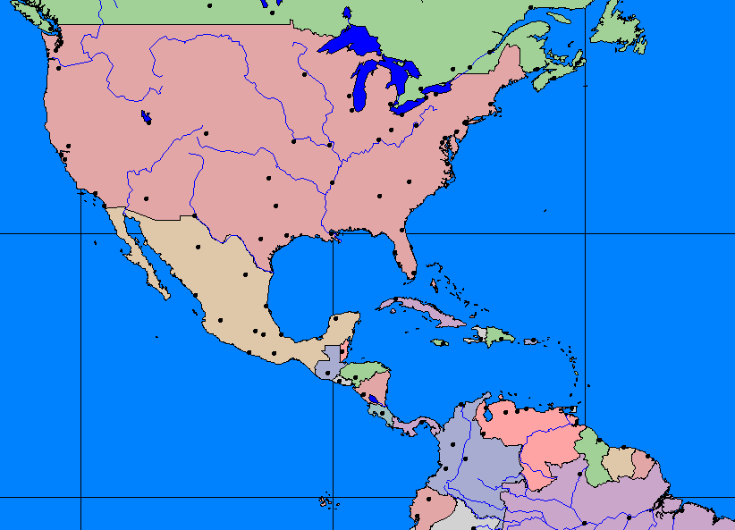
Ethanol Sources and Transportation
Midwest Supply - Majority of Supply to California
Oregon Terminals
European Supply
SF Bay Refineries
Los Angeles Refineries
Not shown: Central California Refineries (Bakersfield)
Caribbean Supply
Brazilian Supply

Slide 22
Anticipated Impacts (cont.)
Reformulated gasoline production from California refineries will decline
  Gasoline with MTBE at 11 vol. percent
  Refiners must remove additional 5 percent of gasoline components prior to blending ethanol to avoid violation of volatility standards (Rvp)
  Ethanol blended at nearly 6 vol. percent
  Absent any other adjustments, gasoline production would decrease by 10 percent
  But some refiners have:
    Increased alkylate production, imported more blending components, converted some conventional gasoline to RFG & delayed transition away from MTBE
  Summer 2003 production decline about 1 to 2 %

Slide 23
Anticipated Impacts (cont.)
Imported components will have to increase
  Production decline of 1 to 2 percent equates to a daily volume of 10-20 thousand barrels
  Coupled with an expected demand increase of 1.6 to 3 percent, an additional 26 to 50 thousand barrels per day of blending components will be required to provide adequate gasoline supplies
  Phase 3 RFG for ethanol blending is a more difficult formulation to produce for refiners outside the US
    A number of the foreign refiners who produced summer grade Phase 2 RFG do not consistently produce Phase 3 RFG for ethanol blending at their facilities
    2 refiners have sent cargoes of the new summer RFG, but the ships have yet to arrive

Slide 24
Anticipated Impacts (cont.)
Logistics
  Marine logistics infrastructure already strained
    tank storage capacity scarce
  Ability of system to smoothly accommodate additional volume and segregation needs is greatest concern in California
    Recent price increases in California are partially a result of a strained system
  Marine infrastructure study underway by Stillwater Associates to be released in April

Slide 25
Other Issues Affecting California
National energy legislation - under debate
  Renewable fuel standard (RFS)
    Adoption of RFS could significantly increase demand for ethanol, potentially straining supplies, unless “planned” capacity expansions receive funding and complete construction per announced schedules
    Elimination of Federal oxygen requirement could help, but California is still expected to require significant amounts of ethanol regardless of the minimum oxygen requirement
  National MTBE phaseout
    Mandatory elimination of MTBE in rest of country would decrease gasoline supplies in the US
    Demand for clean blending components to replace lost volume would increase
    Sources from outside the US could command higher values

Slide 26
Other Issues (cont.)
Regional MTBE bans
  CT scheduled to phaseout MTBE by October 1, but their legislature is considering a delay
  NY scheduled for end of year, rest of Northeast may or may not follow
  Decreased availability of supplies cited by ESAI
  NYMEX has also raised concerns about potential impact on the futures markets if multiple fuels
    NY harbor is delivery point for futures contracts which specify federal RFG containing MTBE
    No plans to offer futures contracts for RFG containing ethanol
    Fewer contracts, less hedging opportunities and resulting increased volatility of gasoline prices in the region

Slide 27
Other Issues (cont.)
Cleaner fuel standards for gasoline and diesel fuel
  Lower sulfur levels for gasoline and diesel fuel in the US may lead to further refinery consolidation
    Additional need to import cleaner components
Stricter fuel standards in other countries
  Competition for clean components will increase unless refinery capacity expansions keep pace with growing demand
Reduction of contributions to federal highway account
  Use of ethanol reduces federal excise tax
  California contributions will decline significantly

Slide 28
Ethanol Use Reduces Federal Excise Tax

Slide 29
Ethanol Use Decreases Highway Account Receipts

Slide 30
Study to Examine Causes of Today’s High Gasoline Prices
March 14 - Governor Davis orders investigation of high prices
  Assessment will include gasoline, diesel fuel, natural gas and electrical generators
  Energy Commission and Public Utilities Commission will conduct analysis
  Study to be completed within 15 days

Slide 31
Closing Remarks
Transition away from MTBE will be completed later this year
Energy Commission will continue to monitor the transition and adequacy of supplies
Growing demand for gasoline and anticipated production declines will increase the need to import clean blending components
Costs to produce gasoline may be greater on a sustained basis

