Slide 1

US Weather Research Program & the Joint Hurricane Testbed
Ward R. Seguin
USWRP Interagency Program Office
Presented to the IHC
March 3, 2004

Slide 2
USWRP
Established in 1994 by four agencies to facilitate the coordination and collaboration among members supporting weather-related research and to allow USWRP members to leverage sponsored research and development.

Slide 3
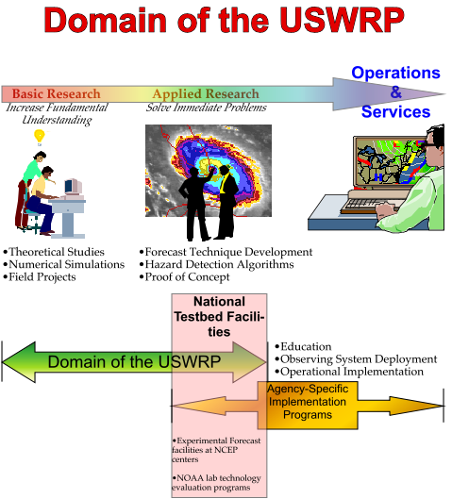

Slide 4
JHT Mission
To advance the transfer of new research and technology into operational hurricane prediction.

Slide 5
The JHT Infrastructure
Supported by NOAA USWRP
IWG makes decisions in the context of the overall interagency USWRP priorities
IPO provides funding, coordination and grants support
SSC provides science guidance and proposal reviews
JHT Director and Administrator, with technical assistance, provide day-to-day operations coordination and support

Slide 6
Resource and overall JHT support issues
  Funding in research component of NOAA transferred to operations. Perhaps not a good permanent resource solution (detracts from flexibility in research funding).
  Uncertainty concerning overall coordination, funding decisions and grants support (basically the IPO functions) as NOAA USWRP moves from OAR to NWS in FY2005. Details and logistics of this move need to be determined.

Slide 7
Achievements
Initiated and funded two, two-year JHT project cycles and completed one
Accepted a number of projects for operational implementation
JHT is being used as a model for emerging and future testbeds

Slide 8
USWRP & JHT Challenges
Establishing a fair competitive grants program open to all
Applying a process to select viable projects
Developing and maintaining an infrastructure to test and evaluate testbed projects
Assimilating new technologies into current operations
Ensuring a pipeline of transition ready projects by supporting applied research

Slide 9
Future Plans
Continue to refine the process of announcing and awarding transition research grants
Issue an Announcement of Opportunity in June/July 2004 for grants beginning in 2005
Work to transition model research results to the Development Testbed Center

