Slide 1
Special thanks to:
Michael Studinger, John Anderson, and Cindy Alley for figures;
Many colleagues for ideas and discussions;
NSF OPP for funding.

Slide 2
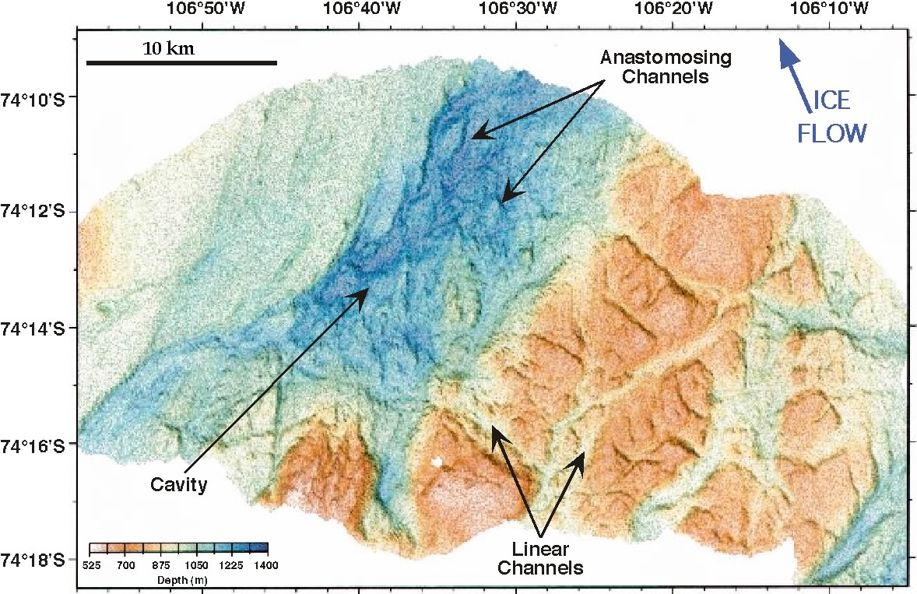

Slide 3
Outburst Floods from Big Ice:
Normal but Important?
R.B. Alley, T.K. Dupont, B.R. Parizek, S. Anandakrishnan, E.B. Evenson, D.E. Lawson & G.J. Larson

Slide 5
Hypothesis in Brief
Glacier overdeepens;
Climate change causes retreat; later, cooling, ice-shelf formation and grounding;
Freeze-on to sill and surface-slope reversal occur, trapping water;
Ice thickens, thaws, loses slope reversal;
Outburst flood and surge follow.

Slide 6
Evidence?
Certainly not proven;
But, each piece of hypothesis observed in nature and supported by models;
And, geomorphic features support former occurrence of such floods.

Slide 7
Can glaciers overdeepen?
Certainly;
Basins with closed contours widely observed;
Mechanisms rather well understood (see Alley et al., Stabilizing feedbacks in glacier-bed erosion, Nature, 2003, with cover and News & Views); also from isostatic depression.

Slide 8
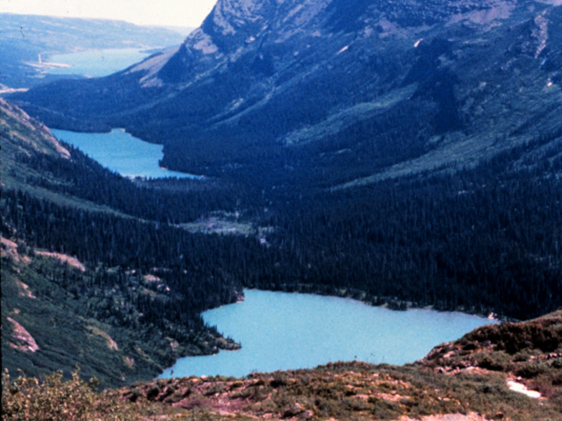

Slide 9
Can climate fluctuations cause retreat, advance?
Surely, this one is easy;
While we haven’t observed an ice-shelf advance into an overdeepening, we are in a warm time with almost no advances of cold ice occurring;
Any advance of numerous ice masses could place an ice shelf over an overdeepening.

Slide 10
Can an advancing ice shelf ground on a basin sill?
Highly likely;
Haven’t observed it, but again, we are in a retreat phase now;
Certainly, local grounding of ice shelves common;
Bindschadler interpreted Crary Ice Rise temperature profile as showing grounding.

Slide 11
Can the ice then thicken over the water upglacier of the sill?
Highly likely;
If an ice shelf grounds, it may already have been thickening, with continuation likely;
Grounding will increase resistance to flow, hence favor thickening.

Slide 12
Can the water behind the sill remain trapped for a while?
Highly likely.
Trapping by freeze-on and by development of reversed ice-air surface slope.
One may be sufficient to cause trapping; both together almost certainly sufficient.

Slide 13
Can the ice freeze to the sill?
Highly likely;
Siple Coast ice streams show tendency for fast-flowing ice to freeze to bed;
Ice shelf with basal melting more likely than ice stream to freeze to bed if grounded;
Crary Ice Rise seems to have done this;
Ice stream C trying to freeze on, maybe others also.

Slide 14
Can a slope reversal develop?
Highly likely;
Strong contrast in topography or basal slipperiness favors rafting of ice over through longitudinal stresses rather than sudden thinning;
Dupont has modeled, and works well;
Observed over Lake Vostok, in ice rumples, in other places.

Slide 15
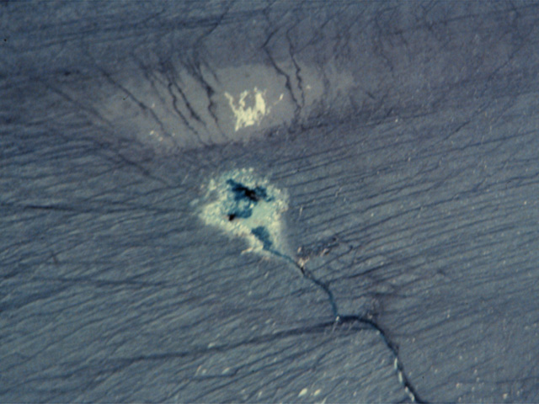

Slide 16
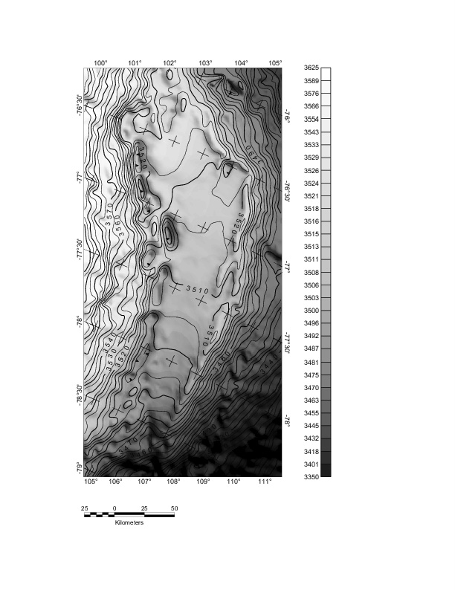

Slide 17
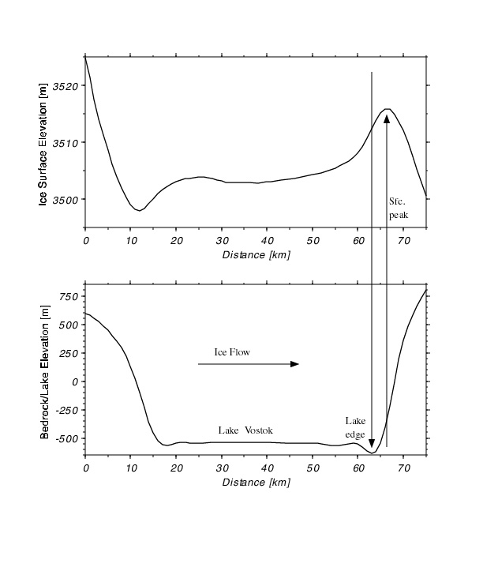

Slide 18
Why need both sealing mechanisms?
D. Mickelson showed Green Bay lobe frozen-toe outbursts, but not huge;
Some frozen toes drain (e.g., Trapridge);
Reversal trapping known (e.g. Vatnajokull);
But tunneling through possible (e.g., along fracture zones, etc.);
With both, more likely to hold water (e.g., Lake Vostok?).

Slide 19
Can one or both sealing mechanisms be lost?
Highly likely;
Thickening and rising shear stress favor thawing (propagation of Trapridge bulge, Svalbard surges, ice stream C bulge);
Thicker ice less likely to have surface-slope reversal (Dupont);
And, thawing reduces contrast hence likelihood of slope reversal.

Slide 20
Can sealing loss trigger a flood?
Highly likely;
If ice thickened upglacier, trapped water at higher head than ocean;
Jokulhlaups well-known, well-characterized and modeled.

Slide 21
Can sealing loss trigger a surge?
Likely;
Thawing over a sill must speed ice flow;
If the sill is sufficiently lubricated (say, by till) the speed-up may be large;
Not observed yet, but seems likely.

Slide 22
Where might this have occurred?
Proximal Heinrich layers meltwater-washed silts despite cold conditions; J. Andrews reports channel across Hudson Strait sill;
J. Anderson et al. have >100 m channels in 1400 m water in front of PIG, which is overdeepened and silled;
G. Denton & D. Sugden have Labyrinth, others indicating subglacial outburst floods.

Slide 23
Now what?
Haven’t observed it all, but we shouldn’t have because we’re in a warm phase now;
Haven’t modeled it all, but Dupont has made important chunks of the model work;
Nature has all the elements needed to make this go;
Explanatory; important geomorphically, possibly also glaciologically & climatically.

