Slide 1
Debuncher Muon Source at Fermilab
Update
David Neuffer
Fermilab

Slide 2
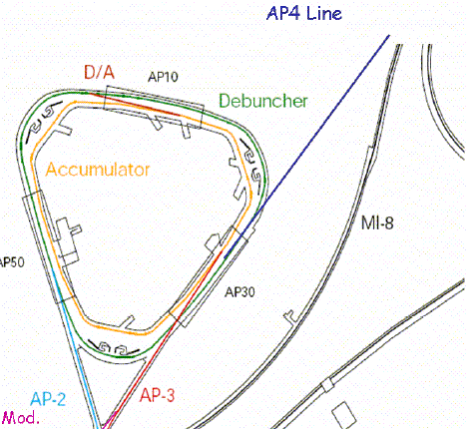
New Scenario overview
Protons from Booster injected into Accumulator
Stack 1 to 6 booster turns, debunch
  ~5·10¹² n_{turns} protons
  ε_{L} = n_{turns} 8 eV-s
Rebunch
  to ~40ns rms single bunch
  Takes 0.1 to 0.2 s
  Could be done in Accumulator ??
Extract into Debuncher
  Complete rebunching
Slow extract to muon conversion experiment
  over ~1.33s
Slow
extraction
Booster
Transfer
Protons from Booster
via Recycler
Parameter | Symbol | Accumulator | Debuncher
Circumference | C=2πR_{ave} | ~454m | 504m
Momentum | P | 8.89 GeV/c | 8.89 GeV/c
Transition | γ_{T} | 5.4 | 7.52
betatron fns | β_{x}, β_{y}, η _{m} | 47, 40, 9.6 | 19.8, 17, 2.2
Tunes | ν_{x}, ν_{y} | 6.9, 8.9 | 9.65, 9.76

Slide 3
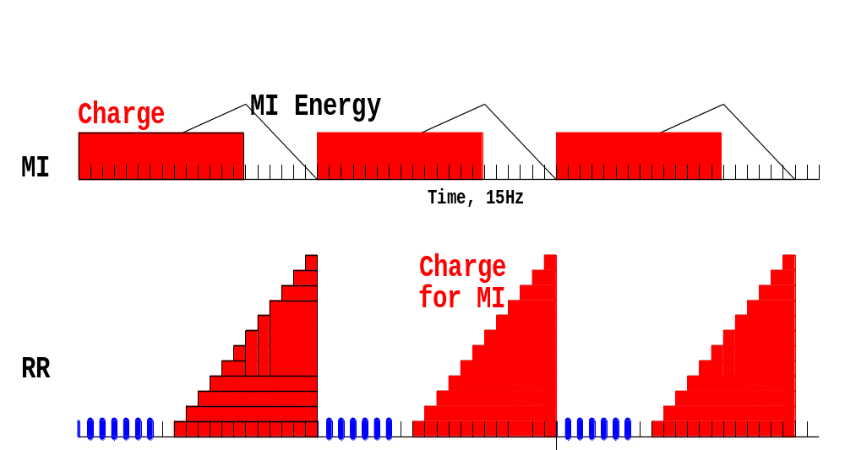
MI 1.33sec=20 Booster Pulses
There will be up to 6*5x10¹²protons per 1.33sec ~2.2x10²⁰ per year

Slide 4
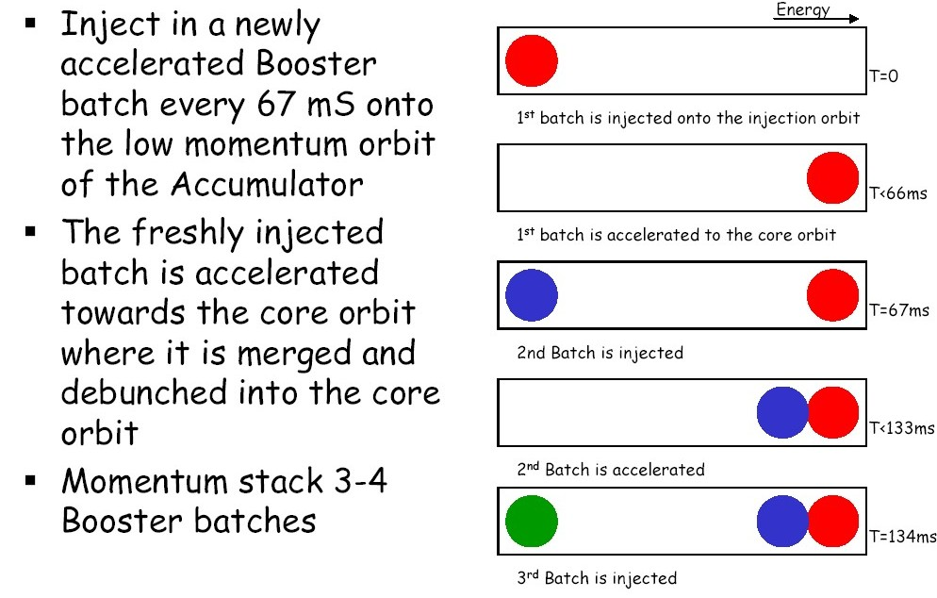
Momentum stacking in Accumulator
Up to 6 batches ??

Slide 5
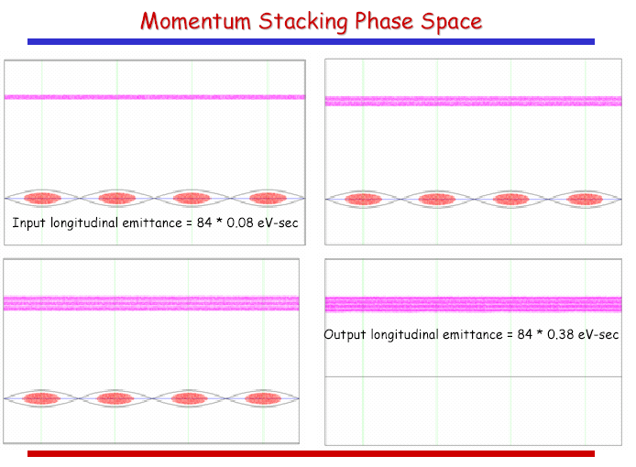
Longitudinal stacking in the Accumulator
ΔE_{full} = 20 MeV

Slide 6
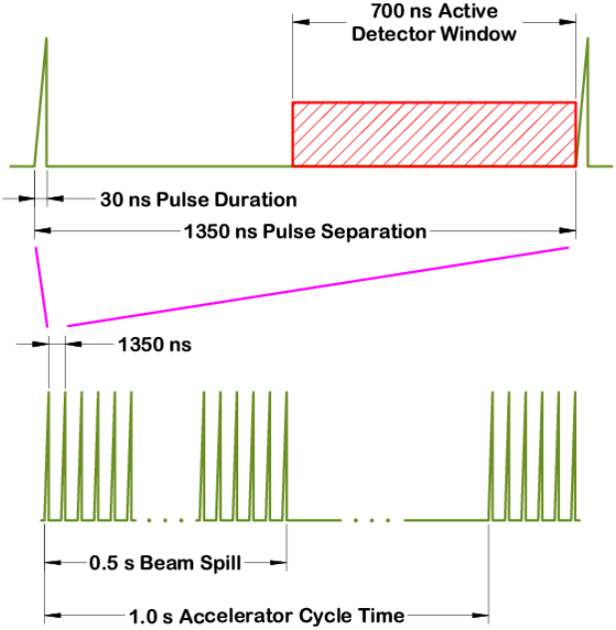
Beam requirements for ~MECO
Bunch beam to a fraction of the debuncher circumference
  < ~200ns of 1700ns
Keep beam leakage outside that bunch length to a minimum
Debuncher timings similar
to MECO/BNL
  But longitudinal emittance larger
  <10 eV-s → ~8 N_{turns} eV-s
Develop most effective/efficient
bunching scheme
  barrier bucket?
  multiharmonic?
MECO/BNL running cycle

Slide 7
Larger Emittance 4 -> 6 batches
Emittance of proton beam is N_{batches}×8 eV-s
  4 batches is 32 eV-s
  6 batches is 48 eV-s
  + dilution
Can bunch 6 batches
  Requires ~2 × V_{rf} as 4 …
With ε_{L} = 48 eV-s, ΔE = 300 MeV, ΔT > 160 ns
  Longer bunch length reduces duty cycle

Slide 8
Barrier Bucket Bunching parameters
Barrier bucket: 30kV, 40º
  0.135s transition time
H=4 rf (2.367MHz 50→150 kV)
  0.05s ramp/bunching time
Hold at 150 kV
Beam is bunched to 10º, σ_{E} =60 MeV
  ε_{L} = 47.5 → 52.8 eV-s emittance growth
  Corresponds to ~ 6 booster turns
Requires ~2× rf as 4-batch bunching

Slide 9
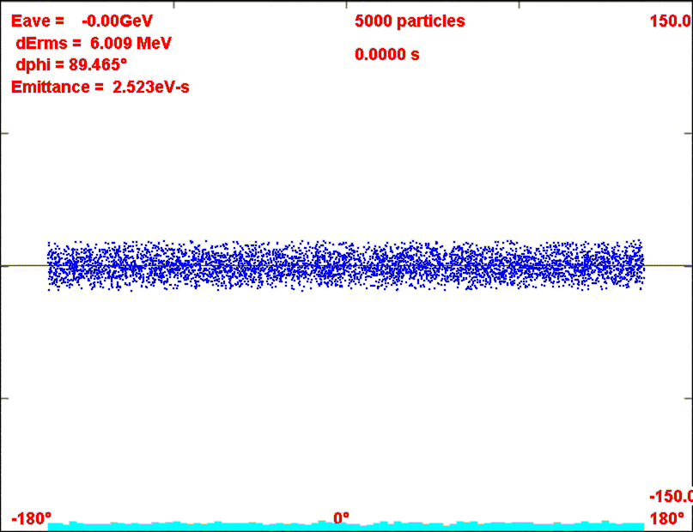
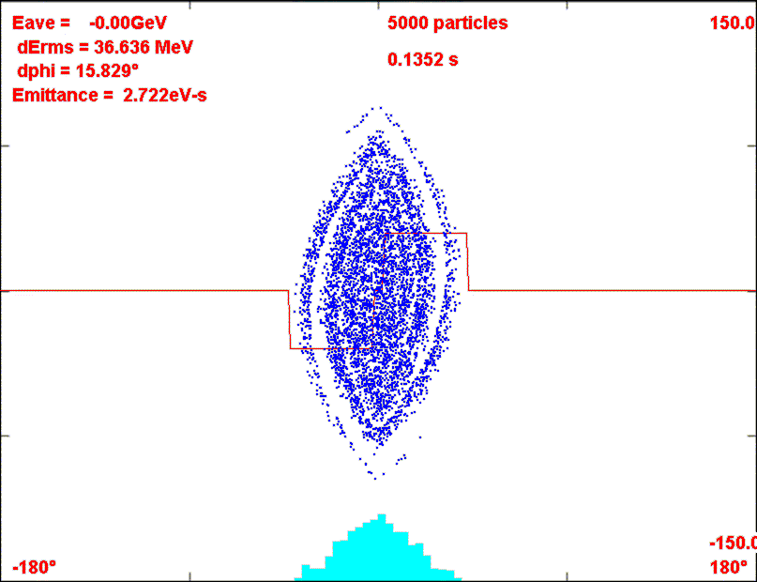
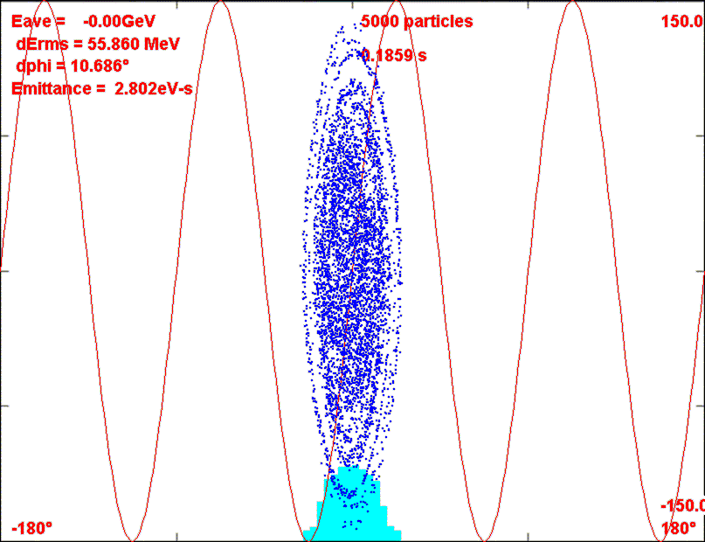
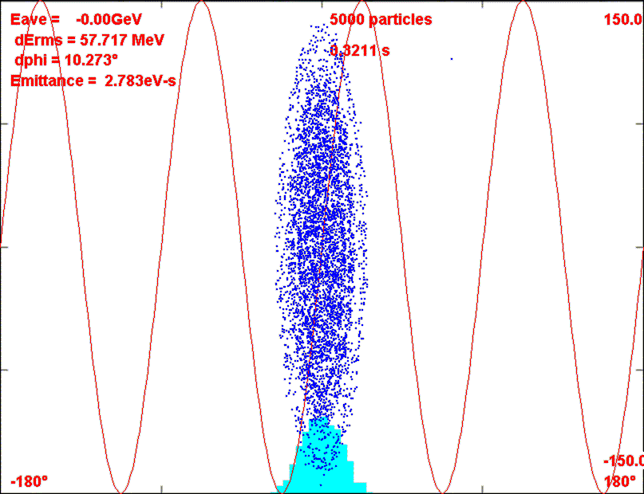
Barrier bucket bunching-

Slide 10
4-Harmonic parameters-6 batch
4 harmonics
  h=1: 0 to 8 to 38 kV; h=2:0 to 4 to17 kV, h=3: 0 to 2.7 to 12kV
      0.0323s
  h=4 :60 to 125 kV
Emittance increases from 47 to 52 eV-s
Faster bunching than barrier bucket case …
  ~0.2s is reduced to ~0.05s
Scenarios assume gap formed in Debuncher and transfer to accumulator

Slide 11
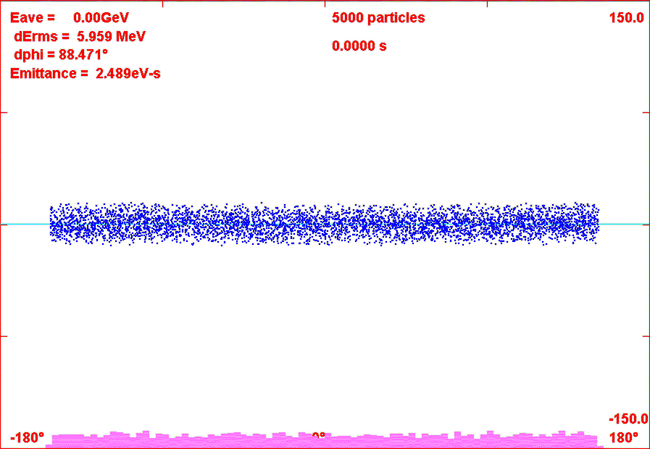
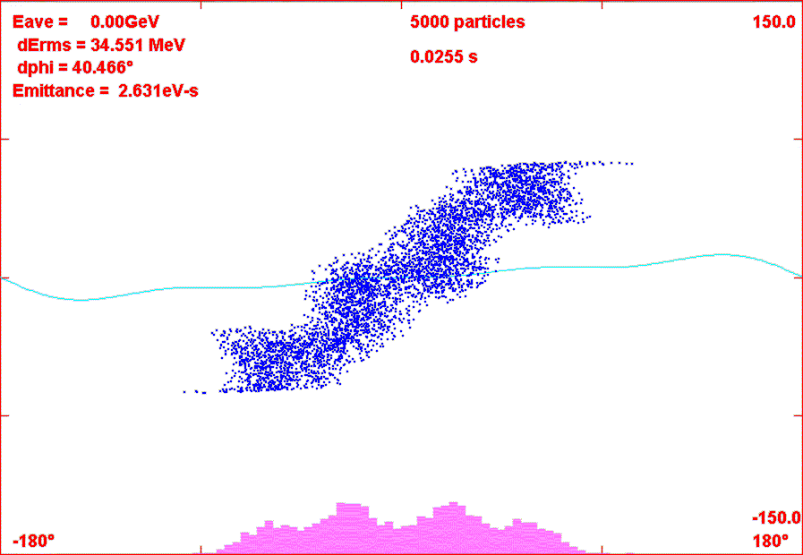
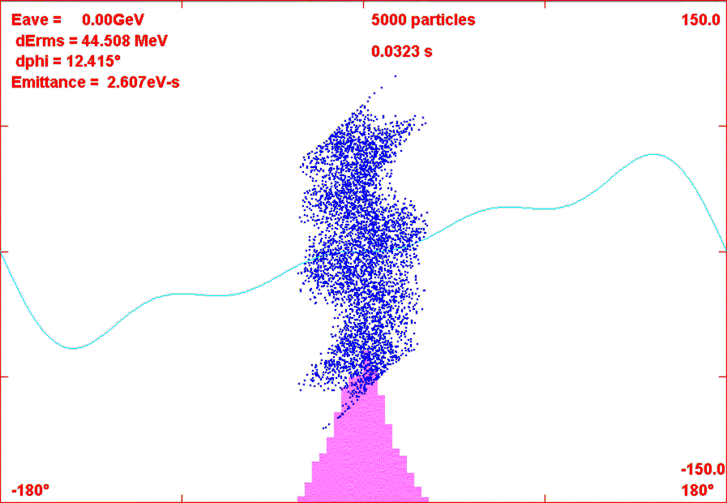
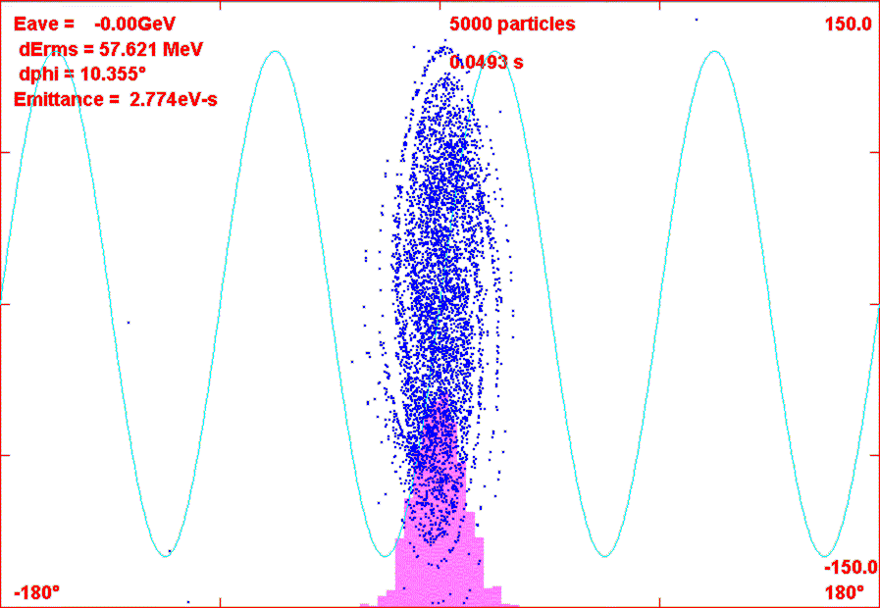
4-harmonic buncher

Slide 12
Can bunch in Accumulator Instead …
If accumulator and debuncher are both used in μ 2 e
  NOT USED FOR SNUMI ??
  Bunching time does not count against experiment time
Bunching time (0.3s) then does not count against slow extraction time (<1.33s)
Less isochronous (more V_{rf} but shorter bunching time)
Similar schemes with more rf required.

Slide 13
Hybrid scheme
Accumulator
  Momentum stack 1 to 6 booster batches
  Adiabatically bunch at h=1- 4kV
    500ns gap for kicker
    Some beam/halo cleaning in Acc and transfer
    Adiabatic easier at γ_{T}=5.5
  Transfer to Debuncher
Debuncher
  h=1 90-degree phase rotation at fixed voltage
    40kV - 0.007s
  Capture and store at h=4
    ~200 to 250 kV ~0.02s; σ_{τ} = 42ns fairly long bunch
    Beam halo cleaning also ….

Slide 14
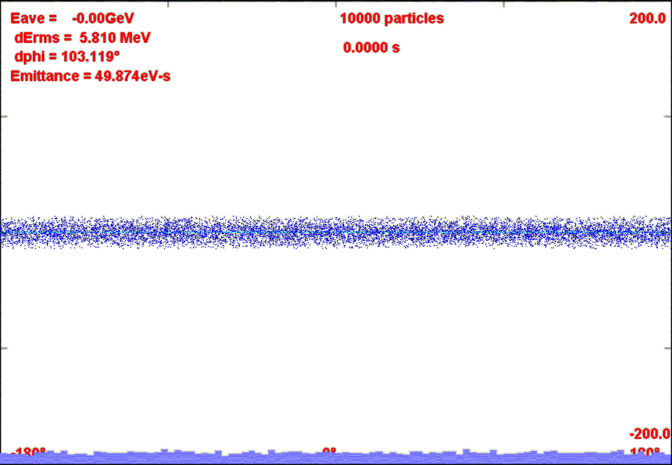
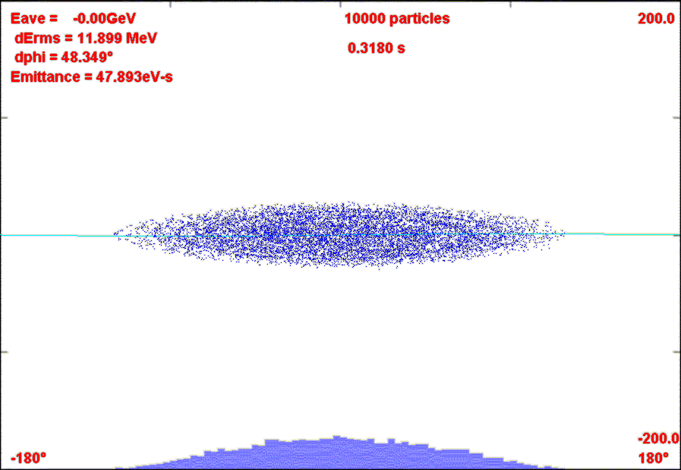
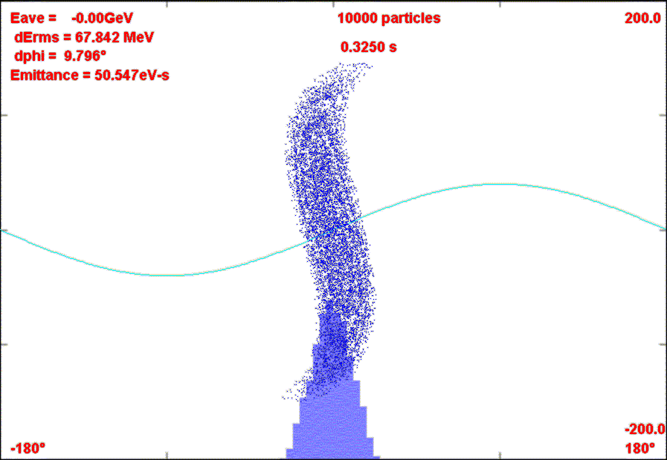
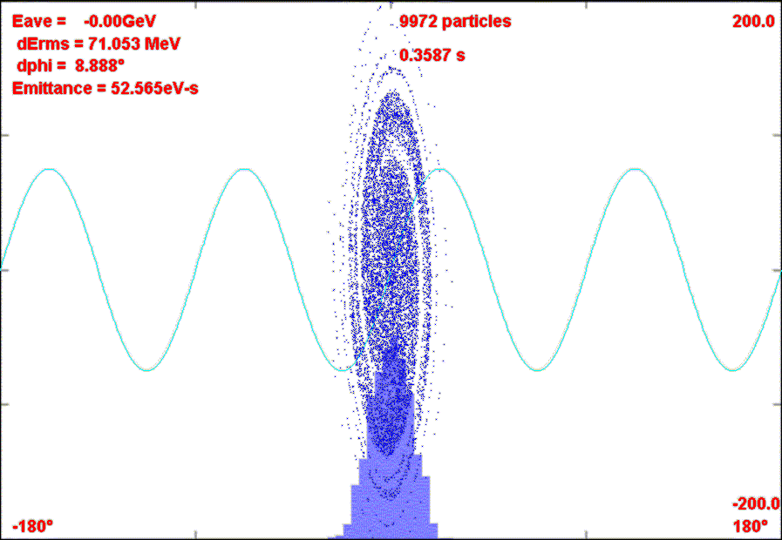
Bunch, Rotate, Store scenario

Slide 15
Comments on Hybrid scenario
Adiabatic bunching is better in Accumulator
  Phase-Energy rotation better in Debuncher
Uses only h=1 and h=4 rf
  Rf voltage requirements relatively modest
  Could be improved using some higher harmonics
Do not need separate extraction gap formation in Accumulator
  Extraction gap formed by h=1 adiabatic buncher
  Gap > 500ns; transfer kickers are correspondingly easier
Beam Halo clearing in Accumulator possible

Slide 16
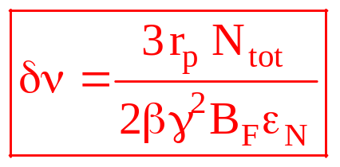
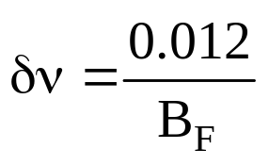
Space Charge Limit
Space Charge tune shift:
Parameters: N_{tot}=3×10¹³,ε_{N} =20π mm-mrad
~Debuncher Ring: 1 bunch, 100ns/1.7μs : B_{F}= 0.059
  →δν = ~ 0.20: not too large??
  Intensity limit?

Slide 17
Needed to develop concept:
Longitudinal bunching scenario
  Develop optimum
Injection/Extraction lines
  Slow extraction line to target
  Location of mu-e detector
Extinction
  Is full width ~200ns short enough?
    Favors Al target
  Smaller value means stacking fewer Booster batches
  calculations/methods/improvements

