Slide 1
NPP/SDS OVERVIEW
MATT SCHWALLER
February 9, 2004
…The NPP Science Team and other appropriate science measurement teams shall assist in addressing the roles and functionality of the SDS.
from the NPP Level 1 Requirement 2.1.2.4

Slide 2
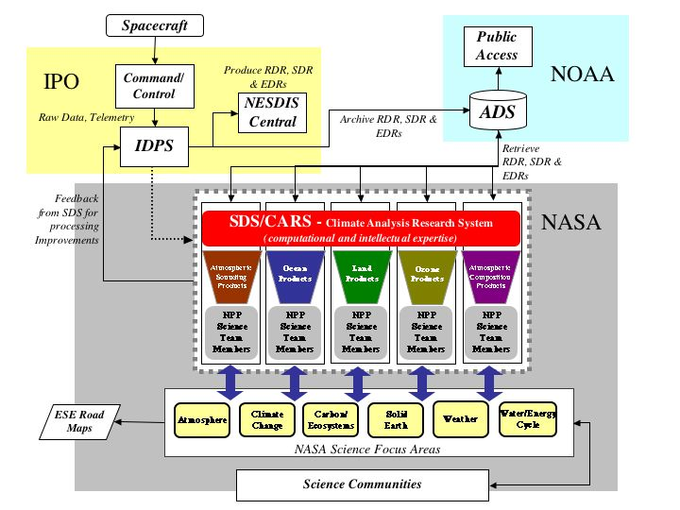
Slide presented at the November NPP Science Team meeting

Slide 3
SDS Budget
SDS is constrained by budget
Congressional “conference language” allocation for FY04: $8.5M
  Note: recent email provided this direction: “Due to considerations associated with the preparations of the FY04 Operating Plan, please be sure to hold off from presently taking action to implement any of [these funds]”

Slide 4
Basic SDS Objectives
Based on current set of program policies (see back up charts), the SDS will
  assess the quality of the NPP EDRs for accomplishing climate research (2.1.2)
  acquire RDRs, SDRs, and EDRs from the ADS (2.1.2.2)
  provide suggested algorithm improvements to the IDPS (2.1.2.3)
  process selected data subsets … in support of Calibration/Validation activities (2.2.2)
  enable a fully distributed interoperable architecture of Climate Analysis Research System (CARS) elements, organized around key EDRs (2.1.2.4)
These objectives translate into a set of SDS functions (see back ups)
  Network/Transport Function
  Ingest/Storage Function
  Characterization/Verification Function
    Trend, analyze, process
  Reporting Function

Slide 5
Allocation of SDS Functions
SENSOR CHARACTERIZATION
Sensor characterization & improved calibration
SDR & EDR EVALUATION
SDR & EDR evaluation & associated algorithm improvement take place within discipline CARS
Transport of NPP EDRs, SDRs, RDRs, ancillary data
Transport of NPP EDRs, SDRs, RDRs, ancillary data
Reporting
Data Reception and Storage
Reporting
Data Reception and Storage
Characterization, Verification & Long-Term Calibration
Characterization, Verification & Long-Term Calibration
Skills Mix: engineering and sci cal/val expertise in satellite/instrument geometry & radiometry
Skills Mix: discipline expertise in geophysical measurement and retrieval
Funded by
NPP/SDS

Slide 6
Enabling Measurement Systems via CARS
Transport of NPP EDRs, SDRs, RDRs, ancillary data
Example: Ocean CARS
Reporting
Data Reception and Storage
Ocean Color / Chlorophyll
Sea Surface Temperature
Sea Ice Characterization
Characterization, Verification & Long-Term Calibration
MODIS
SeaWiFS
Field Campaigns
buoys
OCTS
Community Product Generation
Modeling and Assessments
Decision Support Systems
Funded by
NPP/SDS

Slide 7
A Universe of ESE CARS
A constellation of CARS with NPP funded functions
All contribute to the 24 measurements set

Slide 8
SDS in the NPP Context–Pre-launch/Prototype Phase
IPO
NOAA
IPO/NPP Command, Control & Communications Segment
Delivery / Anomaly Coordination
NOAA SAA/CLASS
IPO/NPP Space Segment
Metrics Database
Data Validation
Data Ordering Process
Search and Order
Ingest
Archive
Product Distribution
Billing and Accounting
USERS
Test data
Customer Service
2
EDR analyses
test data
Delivery / Anomaly Coordination
1
Test Data
NASA
NASA SDS
NPP Science Team
Reports, EDR analyses
Reporting
3
Data Reception and Storage
NPP Project Office
Characterization, Verification & Long-Term Calibration
SDS Responsibilities: tools/procedures for post-launch characterization & validation of NPP SDRs & EDRs
SDS Enabling Capabilities: long-term cal/val of SDRs and EDRs for modeling, and community consensus products (e.g., CDRs)

Slide 9
Implementation Issues
BASIC ISSUE: meeting the functional requirements while “enabl[ing] a fully distributed interoperable architecture of Climate Analysis Research System (CARS) elements, organized around key EDRs”
Other issues that come to mind…
Definition of CARs (one size doesn’t fit all)
Allocation of RDRs/SDRs/EDRs to CARS
Phasing and lifecycle
  What capabilities must be active at launch
  What capabilities can be phased in later
Cost constraints

Slide 10
BACK-UP SLIDES & OTHER STUFF

Slide 11
Parsing SDS Policy Language–1

Slide 12
Parsing SDS Policy Language–2

Slide 13
Parsing SDS Policy Language–3

Slide 14
Parsing SDS Policy Language–4

Slide 15
SDS in the NPP Context–ICO Phase
IPO
NOAA
Delivery / Anomaly Coordination
NOAA ADS
IPO/NPP Command, Control & Communications Segment
Metrics Database
Data Validation
IPO/NPP Space Segment
Data Ordering Process
Search and Order
Ingest
Archive
Product Distribution
Billing and Accounting
USERS
EDRs, SDRs, RDRs, ancillary data
Customer Service
EDR & SDR evaluations
Delivery / Anomaly Coordination
EDRs, SDRs, RDRs, ancillary data
NASA
NASA SDS
Reports, Product Evaluation
NPP Science Team
Reporting
3
Data Reception and Storage
NPP Project Office
Characterization, Verification & Long-Term Calibration

Slide 16
SDS in the NPP Context–Operations Phase
IPO
NOAA
Delivery / Anomaly Coordination
NOAA ADS
IPO/NPP Command, Control & Communications Segment
Metrics Database
Data Validation
IPO/NPP Space Segment
Data Ordering Process
Search and Order
Ingest
Archive
Product Distribution
Billing and Accounting
USERS
EDRs, SDRs, RDRs, ancillary data
Customer Service
Recommended Algorithm Updates
Delivery / Anomaly Coordination
EDRs, SDRs, RDRs, ancillary data
NASA
NASA SDS
Reports, Recommended Algorithm Updates
NPP Science Team
Reporting
Data Reception and Storage
NPP Project Office
Characterization, Verification & Long-Term Calibration
Cal Parms
Software
Community Product Generation
Modeling and Assessments
Decision Support Systems
et cetera

