Slide 1

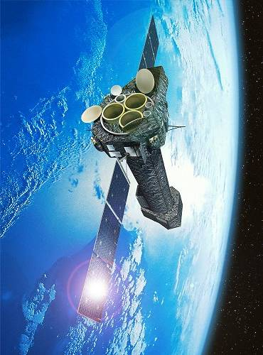
Observation of Solar Wind Charge Exchange Emission from Exospheric Material in Earth's Magnetosheath
S. L. Snowden, M. R. Collier, T. Cravens, K. D. Kuntz, I. Robertson
Specifically planned XMM-Newton proposal to observe magnetosheath SWCX emission
Long (100 ks) observation at a dim part of the sky
Designed to test Robertson & Cravens magnetosheath emission model
SWCX emission observed in spite of lower solar wind flux
Local Bubble and Beyond II – Philadelphia, PA – 21-24 April

Slide 2
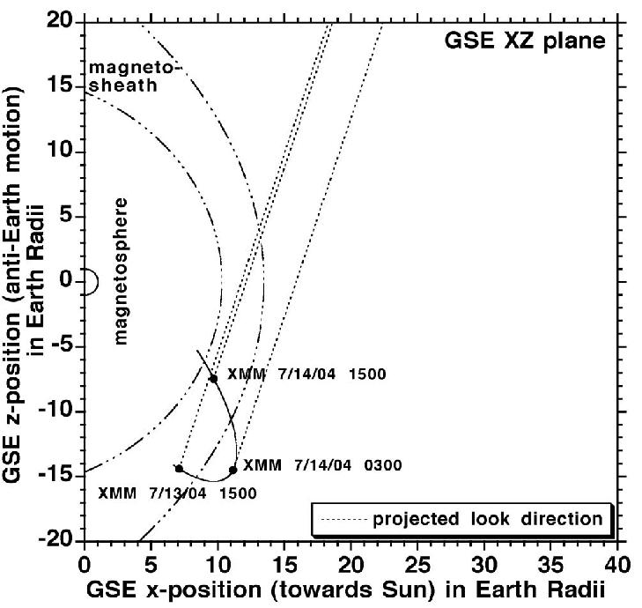
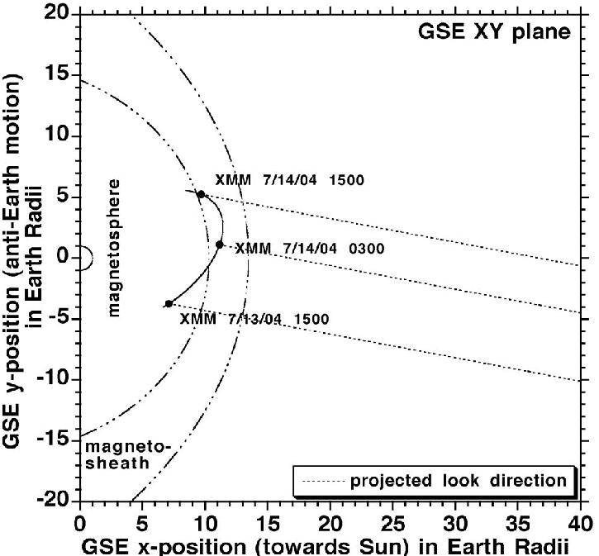
XMM_Newton Observation Geometry
Maximum elongation of orbit towards Sun
Look direction north through the magnetosheath close to the subsolar point.
Tricky to combine low cosmic background and best scan through the magnetosheath

Slide 3
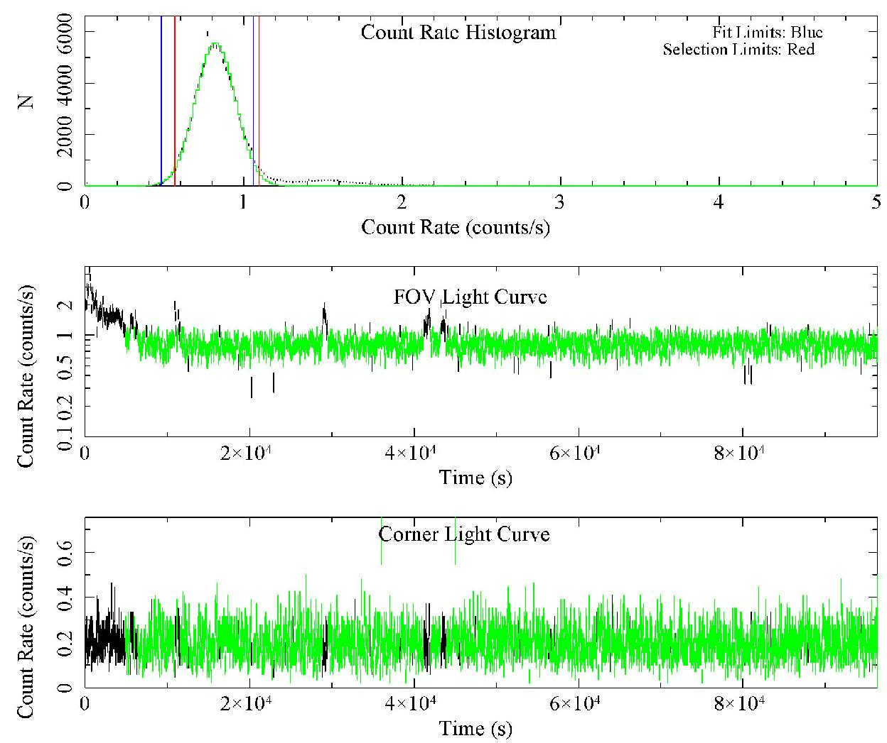
X-ray Observation
The observation was relatively free from soft-proton contamination

Slide 4
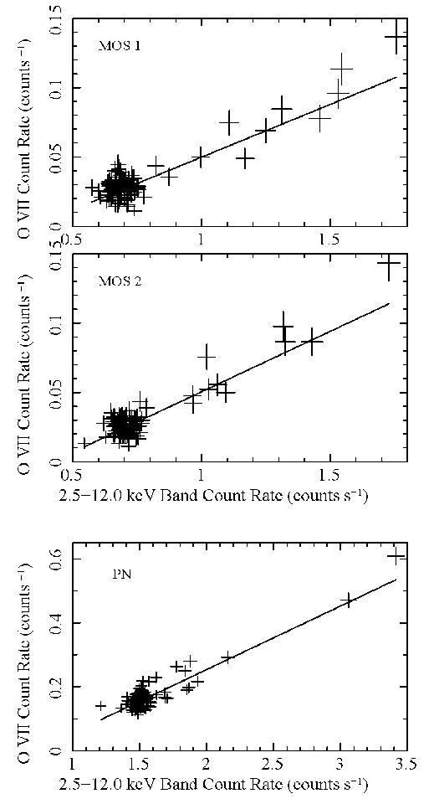
Extract Light Curves
OVII and Hard Band (2.5-12.0 keV)
Scatter plot of OVII count rate versus hard count rate to identify soft proton contamination
Correlation indicates contamination => exclude outliers
Add MOS1, MOS2 and PN count rates, uncertainties added in quadrature
Include only data where all three instruments are accepted

Slide 5
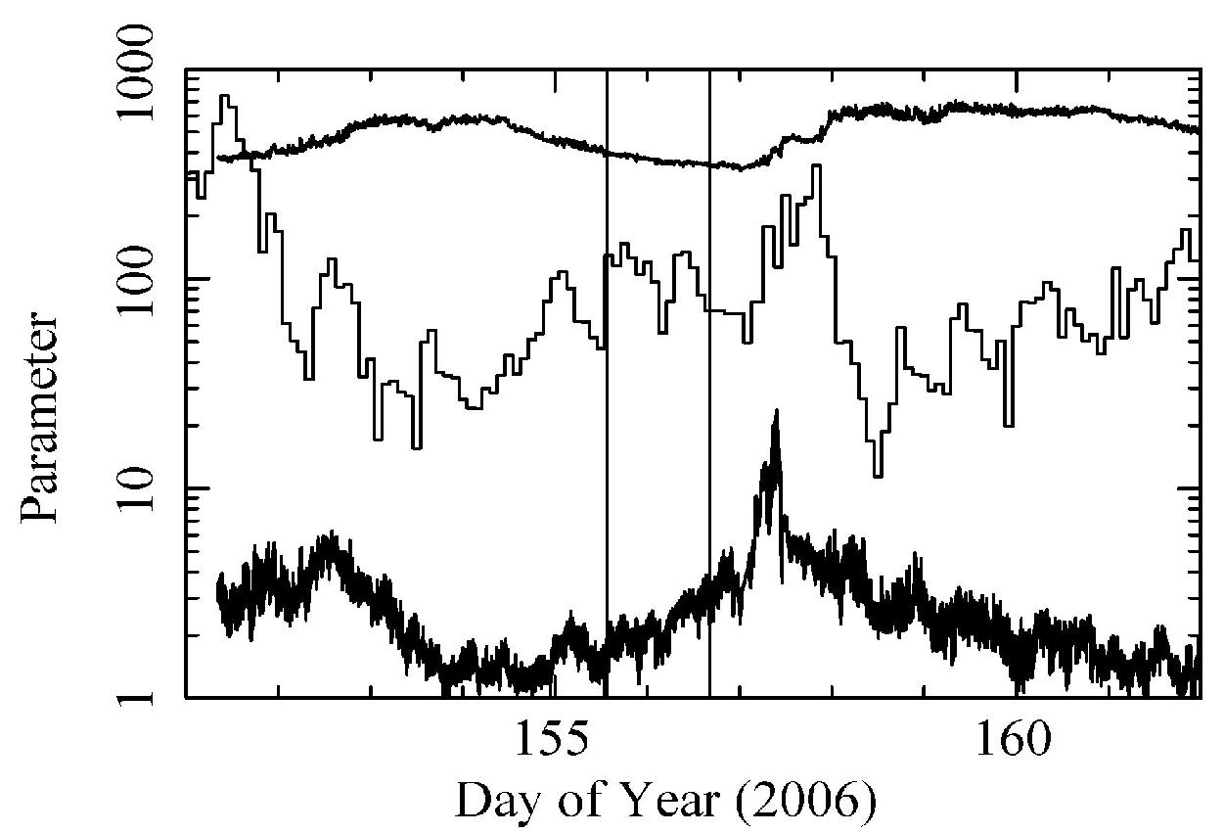
Extract the Solar Wind Fluxes
Observation
H⁺ Speed km s⁻¹
Solar wind proton speed
Solar wind OVII flux
Solar wind proton flux
OVII Flux – 10³ cm² s⁻¹
H⁺ Flux – 10³ cm² s⁻¹

Slide 6
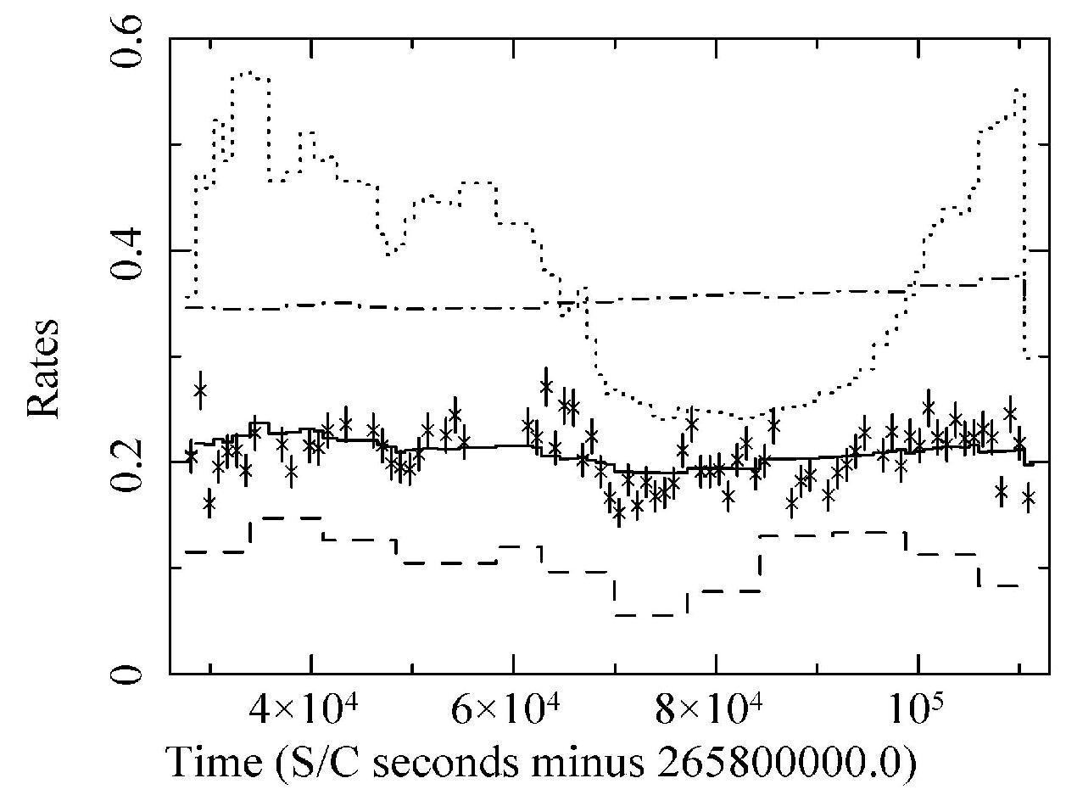
Data and Model
Magnetosheath Model
Fit constant plus scaled magnetosheath model
Insufficient heliospheric model variation to get a significant fit
Best fit has a terrible χ² value, ~2.6
Dominated by scatter, undersampling of OVII variation?
Heliosphere
Model
OVII Flux

Slide 7
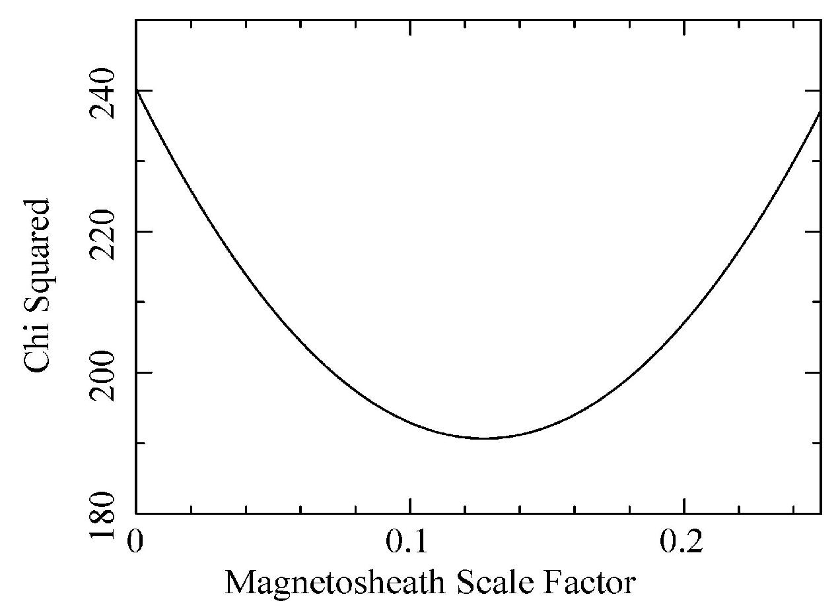
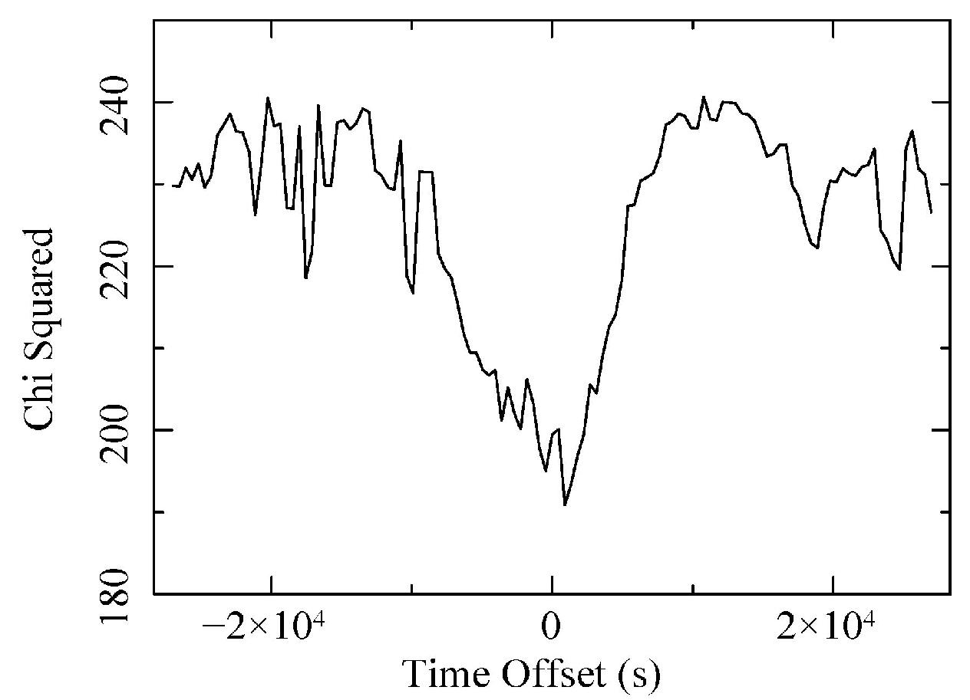
Examine Correlation
The correlation coefficient is 0.43 for 77 samples, for a probablility >99%
While the χ² value is bad (~190 for 75 dof), the χ² minimum is deep
If the model is shifted in time, the χ² minimum at zero shift is relatively narrow and deep
These are qualitative arguments but support a significant correlation between the model and the data

Slide 8
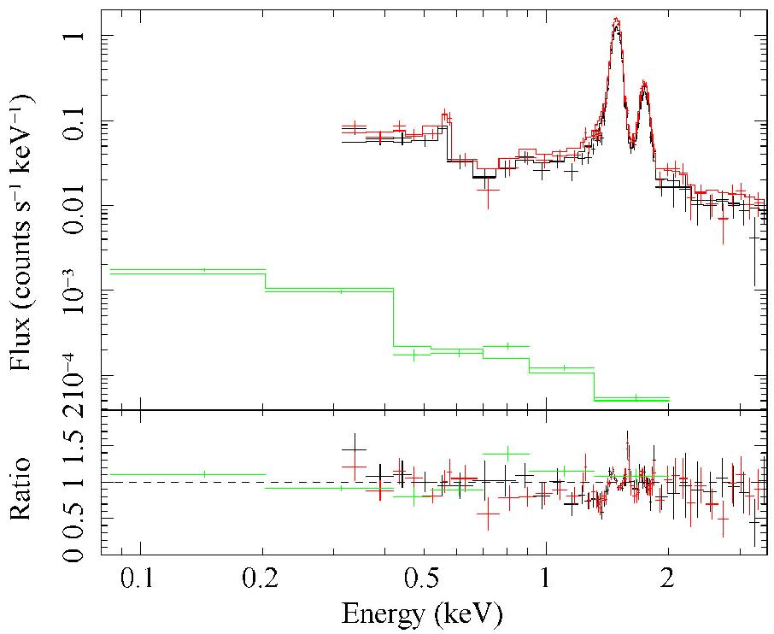
Spectral Fit
Fit for OVII and OVIII – the strongest SWCX lines in the XMM band
Use XMM-ESAS to model the particle background
Use RASS spectrum to constrain the fit
Add a power law for any soft-proton contamination
OVIII – 0.39(0.17) LU total
OVII – 4.3(0.3) LU total
1.6 LU mag.
OVII measurements agree well with other local values (Smith et al., Kuntz & Snowden)

Slide 9
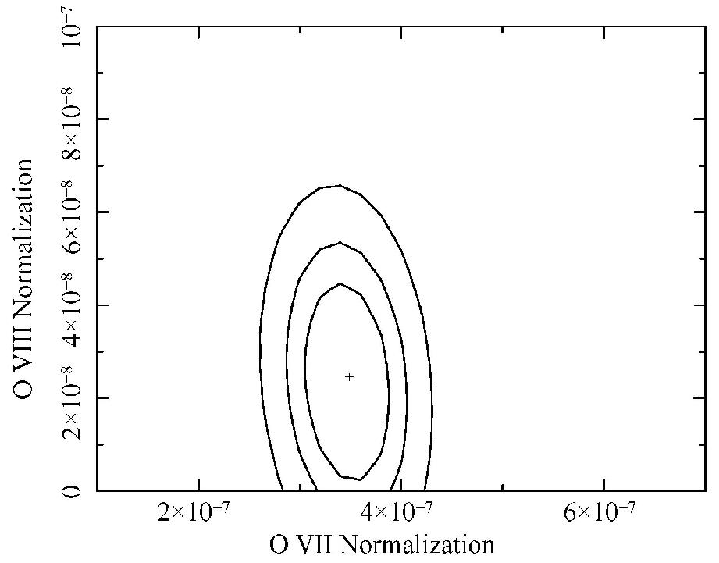
χ² Contours for OVII and OVIII
The spectral fit is reasonably good so the contours are significant
OVIII detection marginal
OVII significant

Slide 10
Conclusions
Strong correlation found between SWCX magnetosheath emission model
=> First clear verification of SWCX model using X-ray data
Model agrees to 36% on first cut
Observing SWCX in X-rays can lead to remote sensing of the magnetosheath.
Results will form the basis for modeling the contribution of magnetosheath SWCX emission to astrophysical observations
  Subtraction at this point might be unfeasible but marking observations at risk will be easy.

