Slide 1
Please Touch! A Computer Adaptive Approach for Assessing Early Science
Daryl Greenfield
University of Miami
dgreenfield@miami.edu
IES 5th Annual Research Conference: June 29, 2010

Slide 2
Quick Overview
Science instruction in preschool (Too soon or just right?)
Current state of preschool science assessment
Completed work on direct assessment of preschool science as part of IES funded ECHOS development project
Current work on computer adaptive version of preschool science assessment funded by IES measurement grant.

Slide 3
Science Instruction in Early Childhood: Too Soon or Just Right?
NRC, 2007, “Taking Science to School”
A major component of this report documented the importance of the preschool period for introducing science and the need to capitalize on cognitive research on how young children learn.
“We are underestimating what young children are capable of as students of science – the bar is almost always set too low … science education as currently structured does not leverage the knowledge and capabilities students bring to the classroom. For students from diverse backgrounds, the problem is even more profound.”

Slide 4
Science Instruction in Early Childhood: Too Soon or Just Right?
School Readiness Standards: 2006: Most states, science embedded in “general knowledge.” 2009: Many states “science” now freestanding readiness domain; “nature & science” is designated Head Start readiness domain
Head Start children in Florida, enter KG with lowest readiness scores in nature and science (Greenfield et al., 2009).

Slide 5
Current State of Assessment of Early Science
Recent reviews of early childhood assessment in general (Snow & Van Hemel, 2009) and science in particular (Brenneman et al., in press) discuss the lack of valid and reliable early science assessments
Quasi-experimental design assessing effectiveness of preschool science curriculum used general receptive vocabulary score (PPVT-III) as main outcome (French, 2004)
Other early science interventions use assessments directly linked to the intervention (e.g., Gelman et al., 2010; Gropen, Clark-Chiarelli, & Hoisington, 2006 Samarapungavan, et al., 2007; Witt & Kimple, 2006)

Slide 6
Need for Better Assessment of Early Science
Measures of preschool science that are not directly tied to a specific curriculum are needed to evaluate science-based curricula and interventions, but currently there are none available.
In response to this need, our team developed a reliable and valid Item Response Theory (IRT)-based direct assessment of preschool science using the guidelines for measurement development from the Standards for Educational and Psychological Testing (AERA, APA, & NCME, 1999).

Slide 7
    Determine the purpose of the test and identify constructs to be measured
    Purpose: measure preschool children’s science readiness
    Constructs to be measured: science process skills and content knowledge

Slide 8
Create a test blueprint
    Reviewed existing standards in order to document current expectations surrounding preschool science:
    Three broad content areas emerged: Life Sciences (42% of all entries), Earth/Space Sciences (27%), and Physical/Energy Sciences (31%)
    Eight process skills emerged: Observing, describing, comparing, questioning, predicting, experimenting, reflecting, and cooperating

Slide 9
Create an initial test item pool from blueprint
    Most items reflect both a process skill (e.g., Observing) and a content sub-category (e.g., Living Things in the category of Life Sciences). Some items reflect only a process skill.
    Examiner’s prompts are verbal.
    Examinee’s response formats include verbal, pointing, sorting, and sequencing.

Slide 10
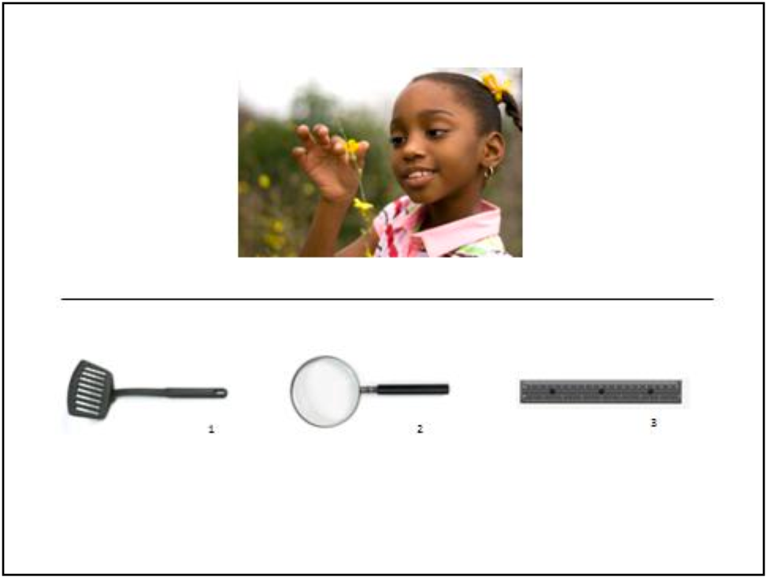
Example Items
LaTasha wants to see the tiny parts of the flower. Point to what she should use to see them

Slide 11
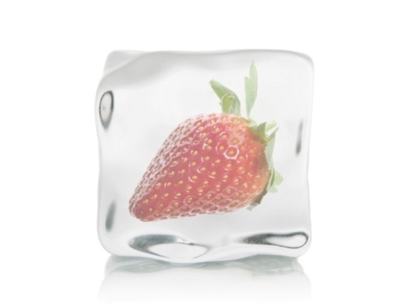
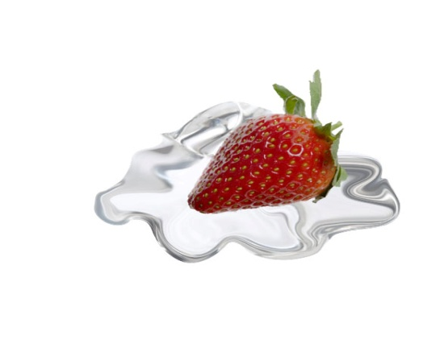
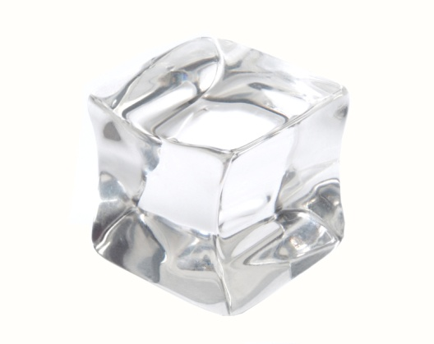
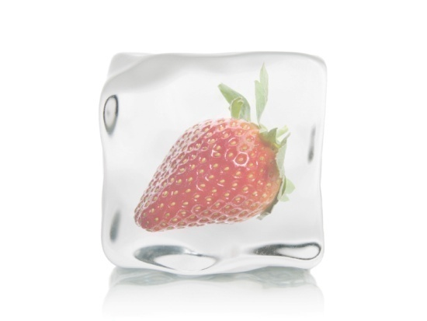
What will happen if I heat this ice cube Touch the picture of what will happen
Notes:
PE
45
What will happen if I heat this ice cube? (top pic appears) Touch the picture of what will happen (bottom pictures appear)
(left picture)

Slide 12
Conducted a content review of the items
Experts in the fields of science, measurement, and early childhood were recruited to review and rate all items on developmental appropriateness, content validity, and difficulty level.
Feedback from experts was used to revise and delete items where necessary, resulting in an initial set of 150 items.

Slide 13
  Pilot Data Collected on Test Items
In Fall 2007, the initial 150 items were pilot tested. In Spring 2008, new and revised items were pilot tested along with a subset of original items.
  The sample consisted of 280 three- and four-year-old Head Start children.
Items were analyzed at end of each data collection with Rasch model. Analysis provides index of item difficulty and indicated which items needed to be revised or excluded. Data also showed growth in science across year.
80 items chosen to provide coverage across the range of Head Start children’s science ability levels, while representing the content areas and process skills in the proportions specified by the blueprint.

Slide 14
Follow-up Study with 80 item assessment (Fall & Spring 2008-2009)
High person reliability (.93) and item reliability (.98).
Science scores were positively correlated with other measures of academic school readiness (r = .72 with vocabulary; r = .66 with math).
Science scores were also positively correlated with adaptive learning behaviors (r = .23 with motivation ratings), and negative correlated with classroom problem behaviors (r = -.25 with shyness ratings).

Slide 15
Results of Quasi-Experimental ECHOS Study
HLM Two-level Models (children nested within classrooms)
Children in ECHOS classrooms obtained significantly higher scores at the end of the year relative to children in non-ECHOS classrooms, after controlling for demographic covariates (age, sex, and ethnicity) and science scores at the beginning of the year
Fixed Effects |  | Coefficient | df | t-ratio
Intercept (β₀₀) |  | 497.875 | 28 | 154.616***
 | Condition (γ₀₁) | 23.920 | 28 | 3.484***
 | Sex (β ₁₀) | 10.519 | 257 | 1.712
 | Age (β ₂₀) | 0.150 | 257 | 1.985*
 | Hispanic (β ₃₀) | 16.913 | 257 | 2.390*
 | Other (β ₄₀) | 13.675 | 257 | 1.153
 | Fall Science total score (β ₅₀) | 0.866 | 28 | 16.425***
 | Condition (γ₅₁) | -0.031 | 28 | -0.320
Random Effects |  | Variance Component | df | χ²
 | Intercept, u_{0j} | 32.298 | 28 | 34.619***
 | Fall Science total score, u_{1j} | 0.022 | 28 | 48.059**
 | Level-1 effects, r_{ij} | 2322.300 | -- | --
Hierarchical Linear Modeling Results for Final Level 2 Model testing Science Curricular Effects
* p < .05. ** p < .01. *** p < .001.

Slide 16
Status of Flip Book Preschool Science Assessment
Manuscript will be submitted for publication this month
Finalizing administration manuals
Available for other researchers to use beginning this fall
  Write/email us for details

Slide 17
Computer Adaptive Lens on Science
Out team is currently developing Lens on Science an adaptive version of the assessment that will be administered using a computer tablet with touch screen technology (funded through an IES measurement grant).

Slide 18
Advantages: Shorter Administration Time
  An adaptive test selects items that provide a maximal amount of information about each child’s ability, achieving a reliable score using fewer items than fixed-format assessments.

Slide 19
Advantages: Assessor Bias & Costs
  Expenses for training and employing staff to become reliable assessor are greatly reduced as well as reducing assessor biases.

Slide 20
Advantages: Customized & Flexible
  Each child receives a customized set of items; this allows for the item bank to be expanded over time; this flexibility leads to continuous improvement in the assessment process.

Slide 21
Advantages: Better Data Management
  Children’s responses are automatically recorded when they touch a picture choice; scores are computed automatically and moved to a database, reducing administration, scoring, and data entry time as well as human error that occurs at each of these steps.

Slide 22
Progress on Lens Assessment
Currently creating 400 items through design and review process
Pilot test with small group of Head Start children, Fall, 2010
Non-adaptive data collection with 500 Head Start children, Spring, 2011
Revisions and development of adaptive algorithms, Fall, 2011
Adaptive data collection with 500 Head Start children including validation measures, Spring 2012

Slide 23
THANKS TO:
UM Project Staff
  Ximena Dominguez, Ariela Greenberg, Janna Fuccillo, Michelle Maier, Lizzy Bell, Irena Nayfeld, Heidi Guevara, Patricia Jamarillo, Lindsey Calle,
  Our Partners
  Miami Museum of Science
  Miami Dade County Head Start/Early Head Start Program
  Florida Head Start Association
Our Funder
  Institute of Education Sciences

Slide 24
References
Brenneman, K., Boller, K., Atkins-Burnett, S., Stipek, D., Forry, N., Ertle, B., French, L., Ginsburg, H., Frede, E., & Schultz, T. (In press). Measuring the quality of early childhood math and science curricula and teaching. In M. Zaslow, I. Martinez-Beck, K. Tout, & T. Halle (Eds.), Measuring quality in early childhood settings. Baltimore: Paul H. Brookes Publishing Co.
French, L. (2004). Science as the center of a coherent, integrated early childhood curriculum. Early Childhood Research Quarterly, 19, 138-149.
Gelman, R., Brenneman, K., MacDonald, G, & Roman, M. (20010). Preschool Pathways to Science, Baltimore, MD: Brooks Publ. Co.
Greenfield, D. B., Jirout, J., Dominguez, X., Greenberg, A.C., Maier, M., & Fuccillo, J. (2009). Science in the preschool classroom: A programmatic research agenda to improve science readiness. Early Education and Development, 20(2), 238-264.
Gropen, J., Clark-Chiarelli, N., & Hoisington, C. (2006). Preschool assessment in science. Newton, MA: Education Development Center, Center for Children & Families.
National Research Council (2007). Taking science to school: Learning and teaching science in grades K-8. Committee on science learning: Kindergarten through eighth grade. R. A. Duschl, H.A. Schweingruber & A.W. Shouse, Editors. Washington, D.C.: The National Academic Press.
Samarapungavan, A., & et al. (2007, March). Examining kindergarten students' science learning from a life science inquiry unit. Paper Presented at the American Education Research Association, Boston, MA.
Snow, C.E., & Van Hemel, S.B. (Eds.) (2009). Early childhood assessment: Why, what, and how. Board on Children, Youth, and Families, Board on Testing and Assessment, Division of Behavioral and Social Sciences and Education. Washington, DC: The National Academies Press.
Witt, S. D., & Kimple, K. P. (2006). "How does your garden grow?" teaching preschool children about the environment. Early Child Development and Care, 178(1), 41-48.

