Slide 1


Welcome!
Accounting and Financial Services Greater Southwest Center
December 12-13, 2000
www.finance.gsa.gov
We’re on the ball

Slide 2
PBS Accounts Receivable and
Financial Analysis Division
Reimbursable Work Authorizations
Theresa McIntyre
  Team Leader
  817-978-7216
Accounting and Financial Services, Greater Southwest Center
We’re on the ball

Slide 3
Topics of Discussion
Reimbursable Work Authorizations
  RWA Customer Guide
  GSA FORM 2957
  RWA Billing Process
Accounting and Financial Services, Greater Southwest Center
We’re on the ball

Slide 4
Just what are RWAs?
Definitions/Purpose
  PBS provides services to Government owned or leased space on a reimbursable basis
  Agreement or Contract
  RWAs capture and bill customers for the costs of services above basic operations financed through rent
Accounting and Financial Services, Greater Southwest Center
We’re on the ball

Slide 5
How are they Classified?
Types or Classes of RWAs
  Recurring (Costs not readily identifiable to RWA)
    R - cover any period of time not to cross fiscal years
    C - recurring services provided to private sector customers
Accounting and Financial Services, Greater Southwest Center
We’re on the ball

Slide 6
How are they Classified?
Types or Classes of RWAs
  Nonrecurring (Costs are identifiable to RWA)
    A - Non-prospectus repairs and alterations with design and construction
    B - Prospectus repairs and alterations
    D - Nonrecurring services to private sector
    E - Nationally declared emergencies or disasters (FEMA)
    F - Blanket
    N - Non-prospectus space alterations
Accounting and Financial Services, Greater Southwest Center
We’re on the ball

Slide 7
Foundational Units
Billing Term Indicators
  Note: Very important codes that determine how the RWA is processed in the Accounting System
Accounting and Financial Services, Greater Southwest Center
We’re on the ball

Slide 8
What are Billing Types?
Fixed Priced
Credit Card
Accounting and Financial Services, Greater Southwest Center
We’re on the ball

Slide 9
What are Billing Terms?
Advance
Completion or Termination
Monthly
Quarterly
Annually
Accounting and Financial Services, Greater Southwest Center
We’re on the ball

Slide 10
Other Vital Information Needed from the Customer
Agency Contact and Phone Number
Description of Work
Requested Work Dates
Agency Certified Amount
Agency Accounting Data
Agency Finance Billing Address
Accounting and Financial Services, Greater Southwest Center
We’re on the ball

Slide 11
RWA Processing System
Daily
Billing
Monthly
Yearend
Purge
FMIS RWA Review Reports
Accounting and Financial Services, Greater Southwest Center
We’re on the ball

Slide 12

RWA Daily Processing
Press Any Key to Begin
Accounting and Financial Services, Greater Southwest Center
We’re on the ball

Slide 13
Daily Processing
RWA Input
  Accounting & Financial Services Greater Southwest Center
  Finance assigns BOAC
  Online Input of RWA data, subsequent changes, and amendments
Accounting and Financial Services, Greater Southwest Center
We’re on the ball

Slide 14
Establishment & Changes
Unfilled Customer Orders
  Applies to all RWA Types
  Except C&D RWA Types / Prepaid Billing Types (Back-End Process)
  Adds, Deletes, and Changes (A,D&X) of RWA authorized amount affects unfilled customer orders (G/L 2999/2995)
  J7 action code, Detail Org Code, Detail Building Number for R types.
  Document Number is “UFCO” followed by input code
Accounting and Financial Services, Greater Southwest Center
We’re on the ball

Slide 15
Establishment & Changes
Object Class Plan & Budget Plan
  Applies only to C and R type RWAs
  Allocated monthly by using the Authorized Amount / Calculated Duration
  Generate one Object Class Plan (41) and one Budget Plan (42) for each duration month of the RWA
    “41” Action Code, Detail Org Code, Detail Object Class, Detail Building Number
    “42” Action Code, Detail Org Code, Detail Function Code, Detail Building Number
Accounting and Financial Services, Greater Southwest Center
We’re on the ball

Slide 16
Daily Processing
All entries with an RWA Number in the Cost Center A field are updated to the RWA Database
  Expense Amount
    Cost Amount - General Ledger is “5141”.(Nonrecurring/ Exception for “N9”)
  Collection Amount
    If Fund is 192X and Action Code is B3,C2,87, 88, or B2 - General Ledger is 103X (Recurring & Nonrecurring)
Accounting and Financial Services, Greater Southwest Center
We’re on the ball

Slide 17
Billing Process
Pre-billing
Billing
Accounting and Financial Services, Greater Southwest Center
We’re on the ball

Slide 18
Pre-billing
Monthly Process (10th)
Bank Pre-Validate Credit Card
Accounting and Financial Services, Greater Southwest Center
We’re on the ball

Slide 19
Billing Process
Processed Monthly (15th)
Recurring / Nonrecurring
Accounting and Financial Services, Greater Southwest Center
We’re on the ball

Slide 20
Billing Selection Formulas
RECURRING
  Recurring (Bills based on total Authorized Amount)
  Total Authorized Amount (which includes 981 Function code)/calculated duration of the RWA (using start date, completion date, or termination date)
NONRECURRING
  Nonrecurring (bills based on total costs with the exception of advance billing which bills based on authorized amount)
Accounting and Financial Services, Greater Southwest Center
We’re on the ball

Slide 21
Billing Process
Main Billing Fields Updated During Billing Process
  Bill Amount
    Costs
  Overhead Billed Amount
    Based upon 9XX function code keyed at original input of 2957 for Recurring
Accounting and Financial Services, Greater Southwest Center
We’re on the ball

Slide 22
Billing Process
Billing Terms (A, C, Y, Q, T, M)
Method of billing is determined mainly by BOAC
  Non-OPAC / OPAC
  Credit Card
Accounting and Financial Services, Greater Southwest Center
We’re on the ball

Slide 23
Billing Process
Thresholds
  Nonrecurring $1,000
  Recurring $100
  At termination $50
Accounting and Financial Services, Greater Southwest Center
We’re on the ball

Slide 24
Billing Process
Generated
  B3 Action Code - OPAC (103.5 / 110.2 )
  61 Action Code - NONOPAC (110.1 / 110.2)
  61 Action Code - Advance (110.1 / 110.9)
  B3 Action Code - Advance (103.5 / 291.1)
Accounting and Financial Services, Greater Southwest Center
We’re on the ball

Slide 25
Billing Process
  87/88 Action Code - Credit Card
  81/88 Action Code - Inter-fund (Verify Open Item)
    PBS (88 - 103.X/ 110.2)
    Service (81 - OI Acct/103.2)
    Service (85 - Fed Cod Table/1032)
  A6 Action Code - Rebates (Accruals that reverse in next month) PBS must give permission for actual rebate
Accounting and Financial Services, Greater Southwest Center
We’re on the ball

Slide 26
Month End
Primary Functions
  Calculating and posting overhead charges
  Recognizing earned income
    Nonrecurring is based on expenses
    Recurring is based on Authorized Amount and function code 981
  Creating reports
Accounting and Financial Services, Greater Southwest Center
We’re on the ball

Slide 27
Month End
Recurring and Nonrecurring
  Process runs after the last daily cycle for the month, so generated transactions can be input to Open Items
Earned Income entry (action code 62 ) is made with Budget Activity,Org Code, Function Code, Building Number, RWA Number (Cost Center A)
  UFCO is reduced when a nonrecurring RWA is terminated.
Accounting and Financial Services, Greater Southwest Center
We’re on the ball

Slide 28
Month End - Recurring
Income Earned
  J7 Action Code
  DR 29X.2, deferred credit account for collected prepaid or advances, or 110.9
  CR 410.2 Income Reimbursable, Recurring
Monthly Comparison
  Overhead is earned in first month / number calculations or sliding scales. Function Code 981
Accounting and Financial Services, Greater Southwest Center
We’re on the ball

Slide 29
YEAR END Processes
Insert Termination Dates for Recurring RWAs
Accrual Statement Report
Move budgetary amounts from current year to prior year
Accounting and Financial Services, Greater Southwest Center
We’re on the ball

Slide 30
Purge Process
RWAs are eligible to purge when they meet the following criteria:
  Terminated more than 6 months
  Does not have outstanding receivables
  Billed amount is equal to Cost amount
  Fixed price is equal to Billed amount
  RWA is not on Open items
Accounting and Financial Services, Greater Southwest Center
We’re on the ball

Slide 31
RWA - FMIS RWA Review Reports
RWAs without Obligations
RWAs with Cost/Obligations older than 1 Year
RWAs with Authorized Amounts over $500,000
M-Year RWAs
Open Items for Completed RWAs
Accounting and Financial Services, Greater Southwest Center
We’re on the ball

Slide 32
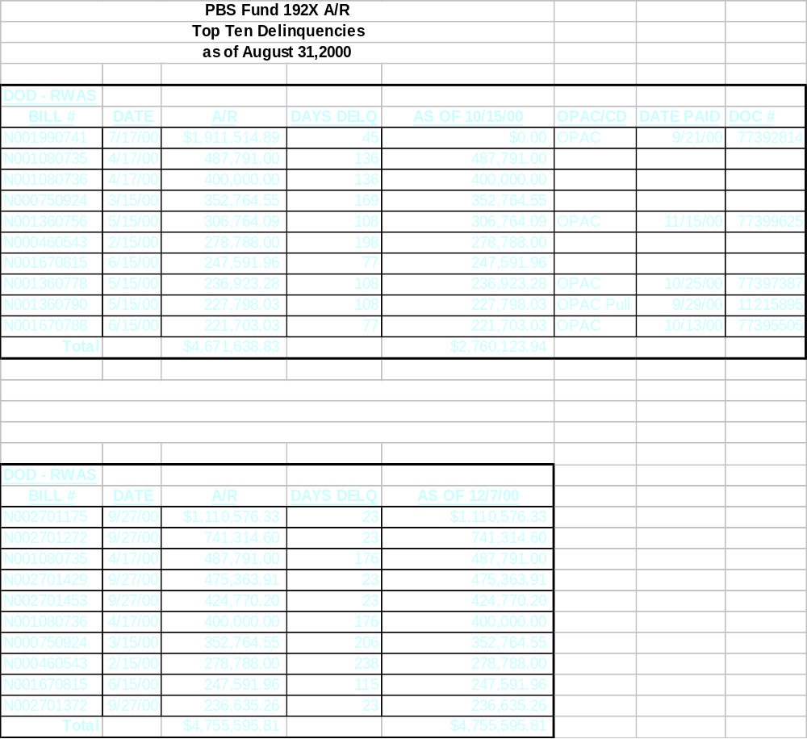

Slide 33
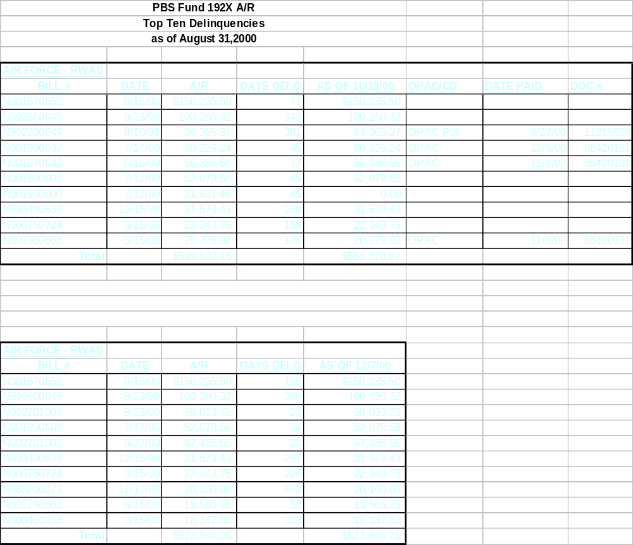

Slide 34
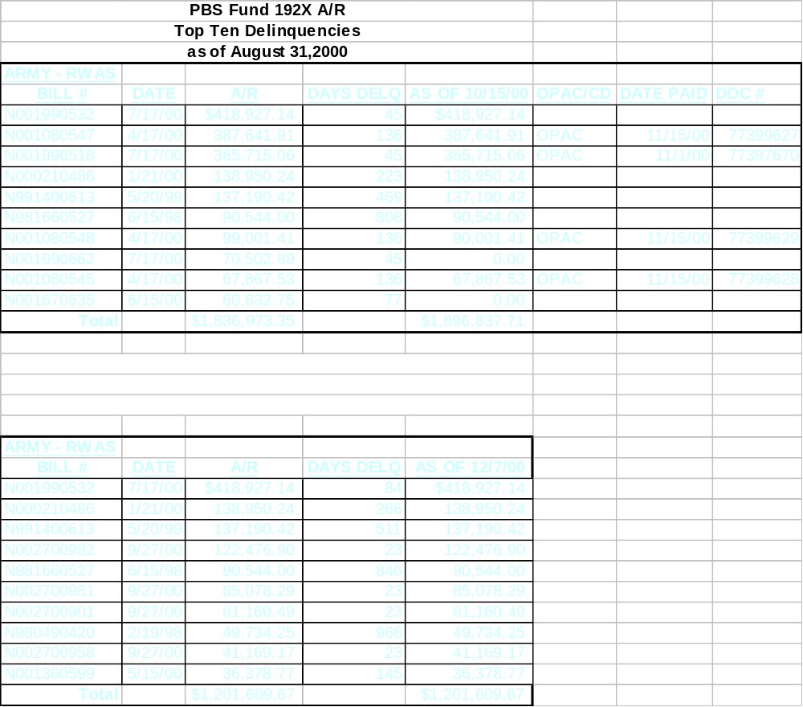

Slide 35
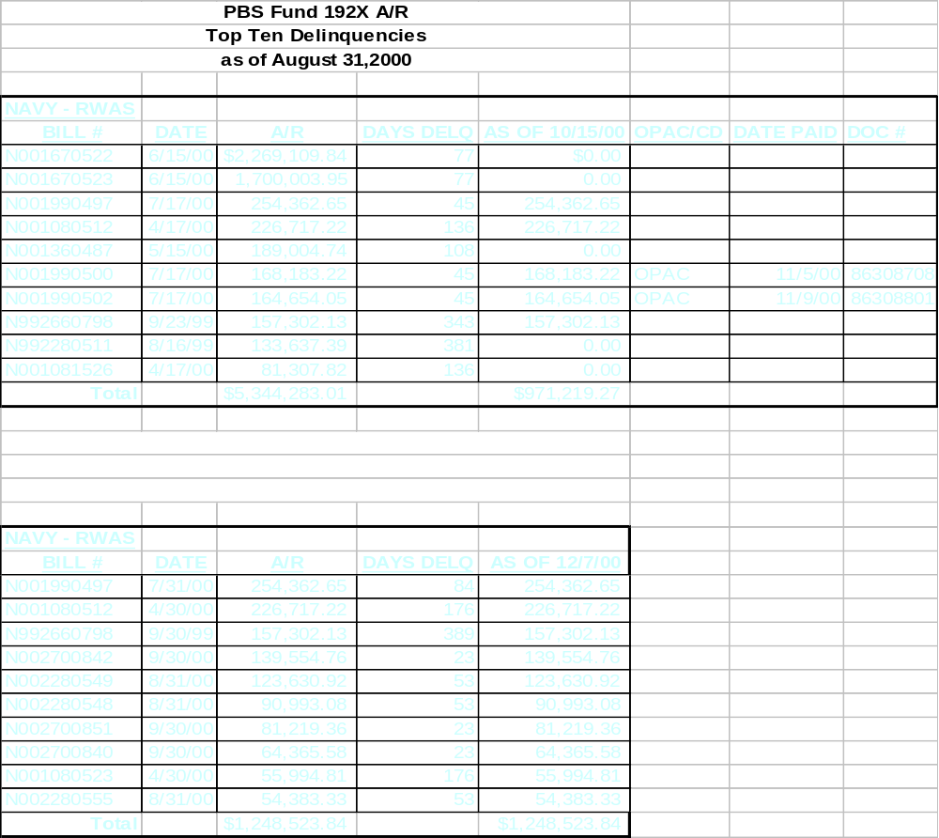

Slide 36
RWA Points of Contact
Sam Hinebaugh - 817 978-7517 Debora.hinebaugh@gsa.gov
  Credit Card
  Army
  OPAC Pulls
Ron Lutman - 817 978-7217 Ronald.lutman@gsa.gov
  DOD
Stephanie Shealey - 817 978-3023 Stephanie.shealey@gsa.gov
  Air Force
  Navy
  Corps of Engineers

Slide 37

The End !
Accounting and Financial Services, Greater Southwest Center
We’re on the ball

