Slide 1
Factors That Fuel
Growth in Travel
Based on the Nationwide Personal
Transportation Survey
Nancy McGuckin
Travel Behavior Analyst

Slide 2
Demographics and Travel Indexed to 1969

Slide 3
Women’s Increasing Share of
Drivers and Workers
1
Male Drivers per Male 16+
Female Drivers per Female 16+
0.8
Male Workers per male 16+
0.6
0.4
Female Workers per female 16+
0.2
1969
1977
1983
1990
1995
SOURCE: 1995 Nationwide Personal Transportation Survey

Slide 4
Women in the Labor Force
Nearly 60 percent of women (
age 16
and above
) are working. In 1960, under
40% of women were in the labor force
Men have shown slight declines in labor
force participation rates since the
1950's

Slide 5
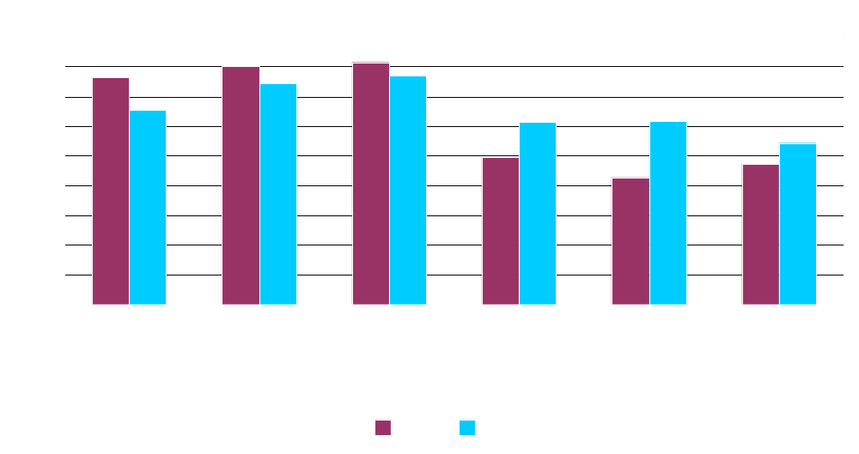
Labor Force Participation

Slide 6
Percent of Households by Type
(102 Million Households in 1998)
Married-with Children
32.0%
Married-No Children
21.0%
Families
69%
Non-
Unrelated individuals
6.0%
Families
31%
Single-with Children
16.0%
1 Person Household
25.0%
SOURCE: U.S. Census Bureau (1998 Data)

Slide 7
Trip Chaining
Single working adult men and women are more alike in their travel than different
In households with children, women are more likely than men to stop at multiple destinations on the way to or from work
Single mothers, especially of small children, are far more likely to create trip chains than either single fathers or mothers in households with two adults

Slide 8
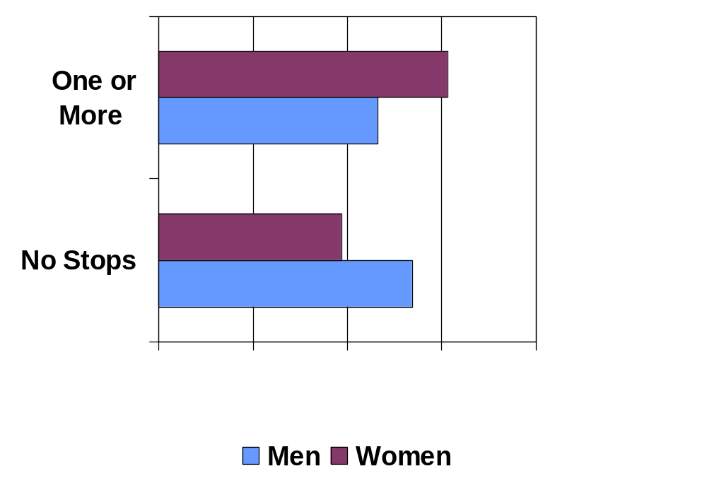
Percent of Workers Who Stop on the Way Home

Slide 9
Women’s Travel
Women take more daily trips than men,
accounting for about 200 more trips per year
In families with multiple cars, women are likely
to drive the newer household vehicle
Because of trip chaining, women are more
dependent on a vehicle to accomplish daily travel
Women are more likely to continue to travel in the
peak periods, even when given flex-time at work

Slide 10
Person Trips by Mode
By Gender
Percent
100
86.1
86.6
80
60
Male
Female
40
20
6.6
6.0
5.7
5.5
1.6
1.9
0
POV
Transit
Bike/Walk
Other
SOURCE: 1995 Nationwide Personal Transportation Survey

Slide 11
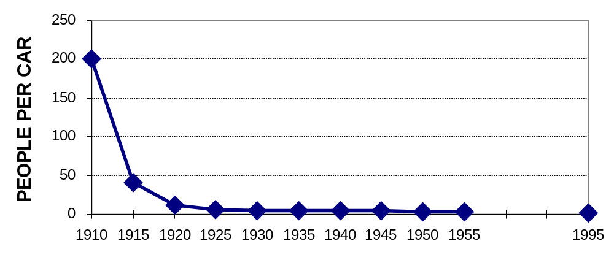
Are We at Vehicle Saturation?

Slide 12
Trends in Vehicle Ownership
Overall vehicle ownership has reached 1.0 per licensed driver, almost 20% of households have three or more cars available
There remain 8 million U.S. households with no vehicle, if they all acquired a car it would add less than 5% more to the American fleet
The annual person miles of travel in high-income households with more vehicle than drivers is 425% higher than in low-income households with 1 car per driver

Slide 13
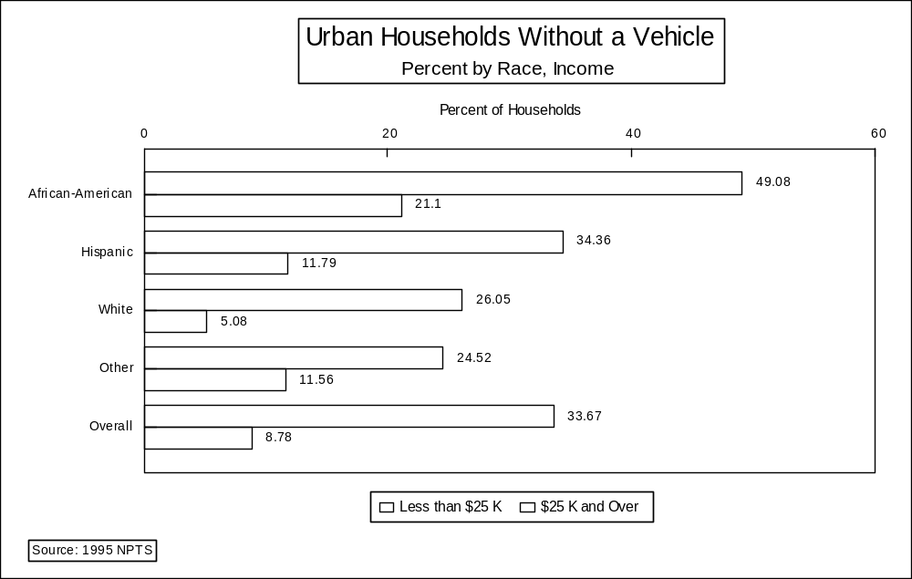

Slide 14
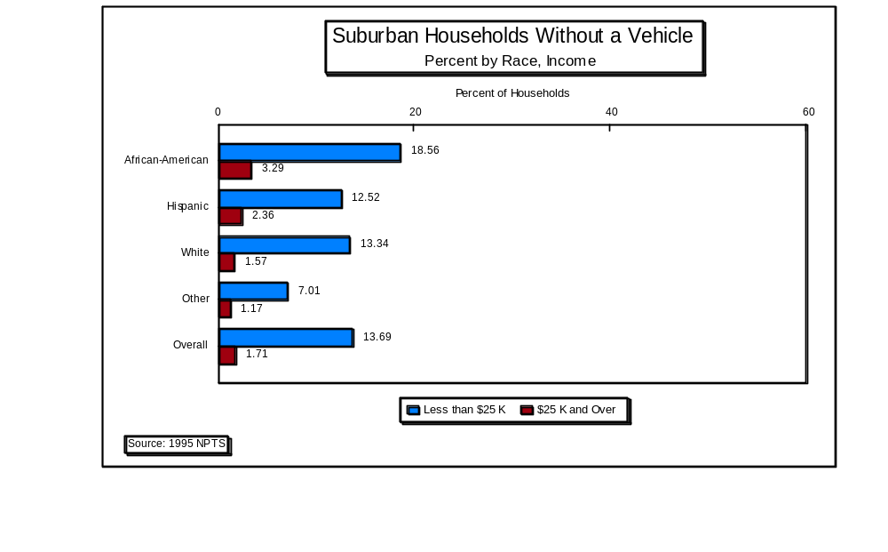

Slide 15
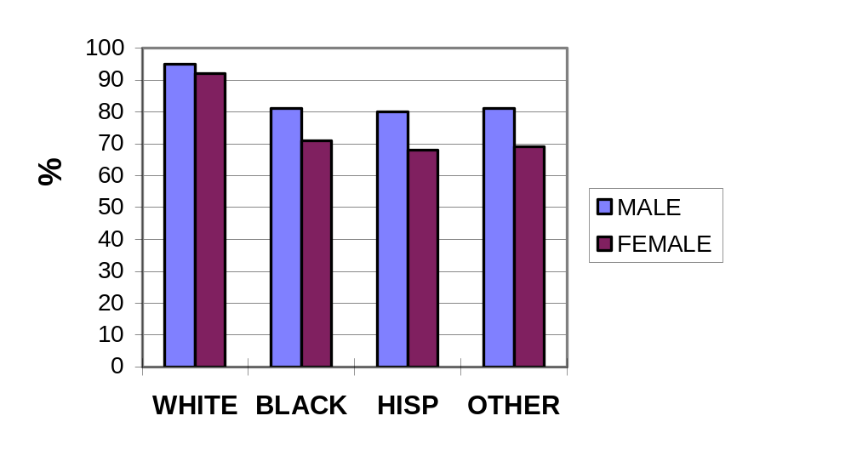
Reports of Saturation are Premature
Urban Licensed Drivers 16 - 64

Slide 16
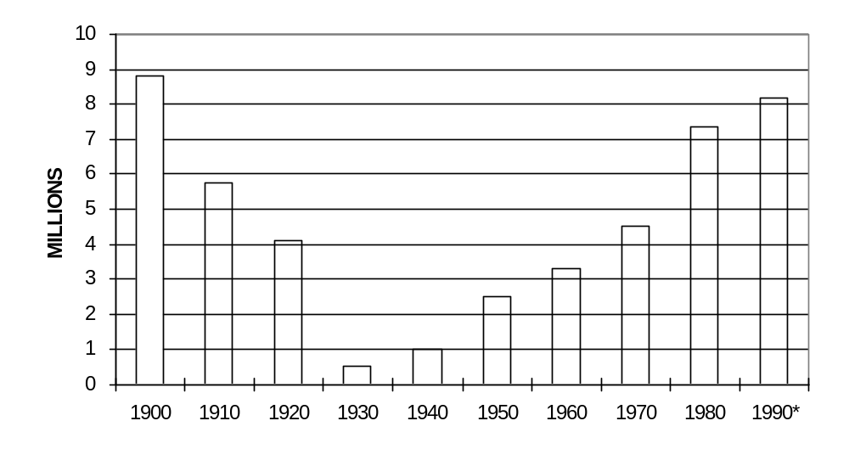
Nation of Immigrants (Again!)

Slide 17
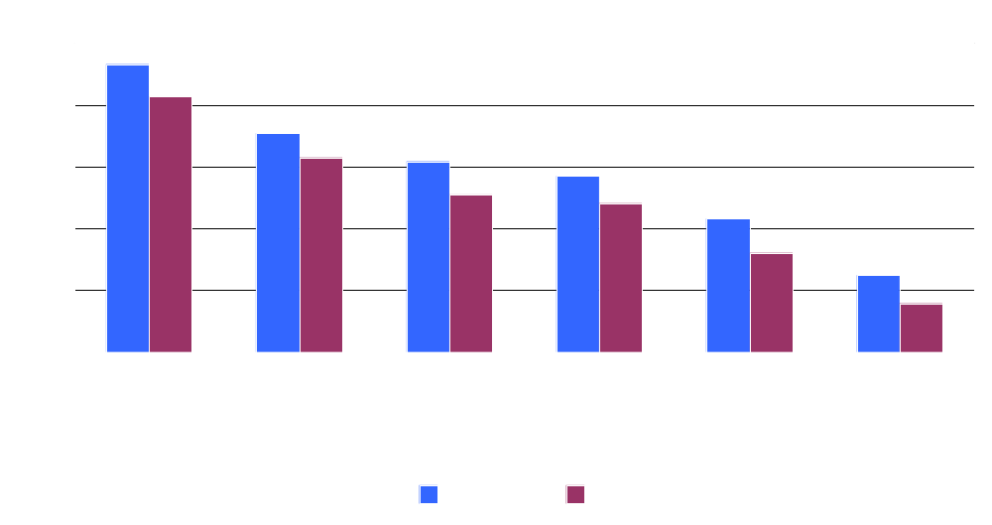
Proportion of Households w/o a Vehicle by number of years resident in U.S.

Slide 18
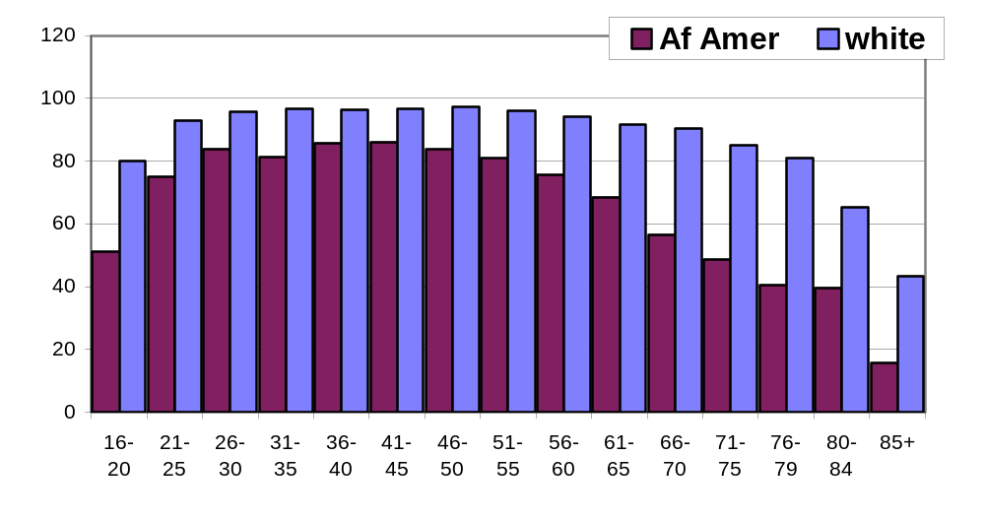
Drivers Licenses by Age Group

Slide 19
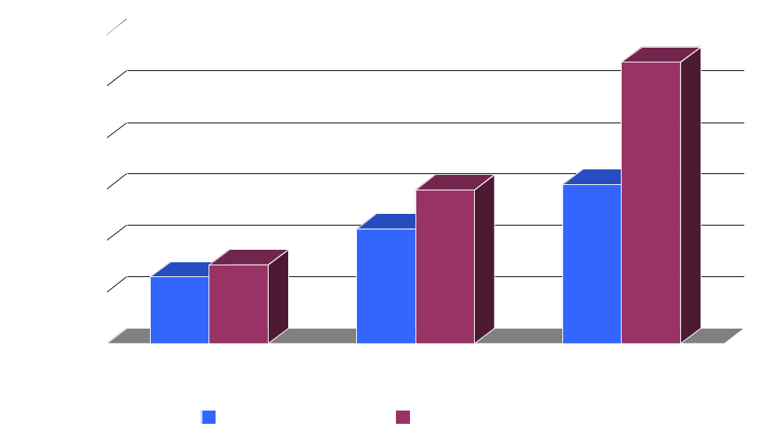
Annual Person Miles of Travel per Driver

Slide 20
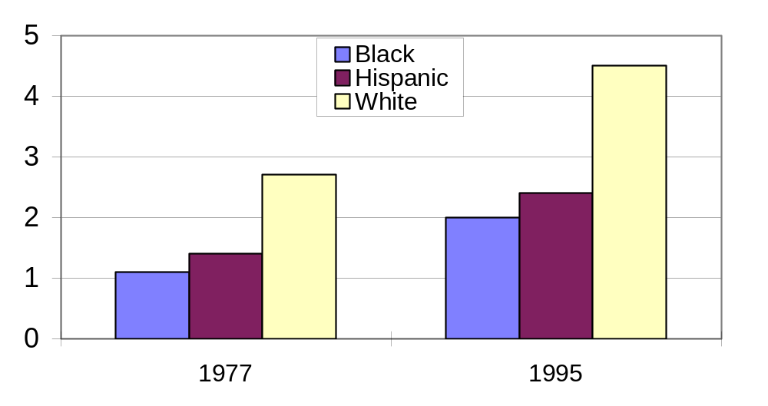
Long Distance Travel by Race and Ethnicity (annual per capita trips)

Slide 21
Demographic Changes
As baby boomers age they will continue to be highly mobile
Travel growth will predominately come from minority populations, women, and new immigrants
New immigrants are highly dependent on transit, and over time acquire cars and American driving habits
Hispanic women are 13 percent less likely to have a license than Hispanic men

Slide 22
The Future of Work
Higher participation by under-utilized workers, such as newly retired, women, minority workers, and new immigrants
Tele-work may INCREASE travel, since workers will make other trips and deliveries to households will increase (Auto vrs. Truck balance)
Tele-work may also increase miles of travel—workers who only commute once or twice a week may move out to the far fringe of metro areas

Slide 23

Where are we Heading?
Historically, more communication has equaled more travel
Affluence creates demand for more opportunities and mobility
Groups with lower mobility are likely to add to future travel demand
Multiple roles and complex lives are more dependent on private vehicles

