Slide 1














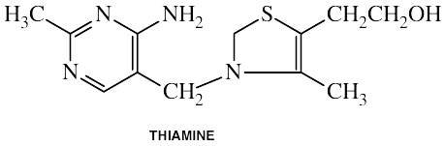












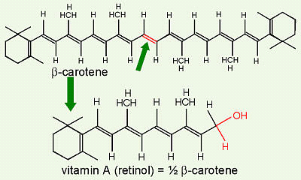









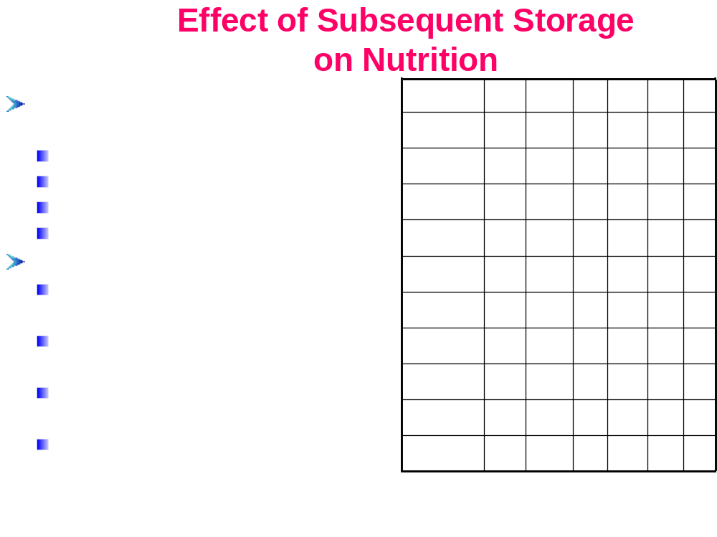
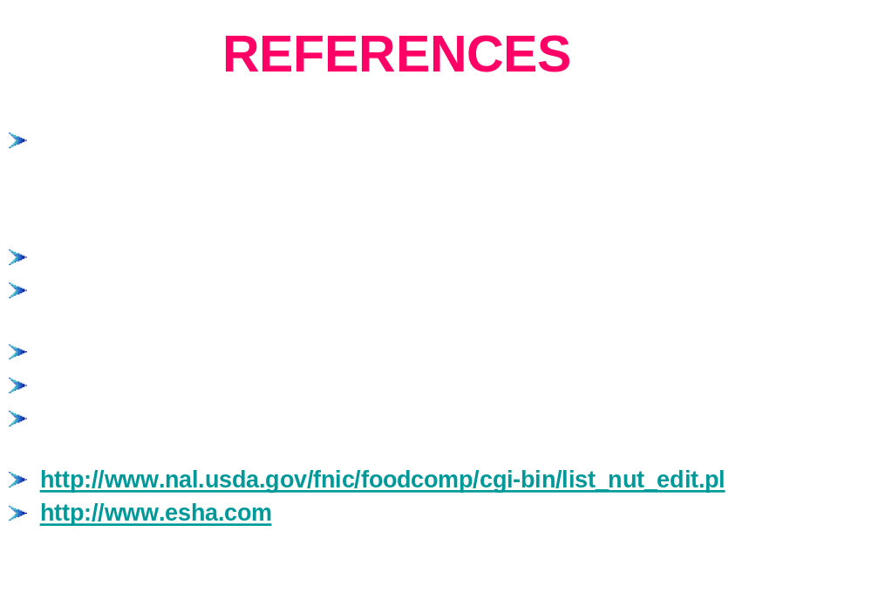
EFFECT OF PROCESSING AND SUBSEQUENT STORAGE ON NUTRITION
M.H. Perchonok ¹ and O.S. Lai²
¹ NASA/JSC, Mail Code SF3, 2101 NASA Parkway, Houston, TX77058
² Lockheed Martin Mission Services, 1300 Hercules MC:CO9 P.O. Box 58487, Houston,TX77058
Exploring COUNTERMEASURES
Vitamin C
Optimization of process, packaging, and storage conditions for
Vitamin C or Ascorbic acid:
180
white, highly water
-
soluble
mg Before
nutrient retention
Humans cannot manufacture vitamin C
160
process
(Calculated)
Exploration of alternative sterilization methods
absence of L
-
gulonolactone oxidase
140
mg After
Natural dietary sources:
process
Maximization of available nutrients by reformulation using
fresh fruits
120
(Analyzed)
ingredients with dense intrinsic nutrients
fresh vegetables
100
Treatments with food additives to provide nutrients, e.g.
fresh meats
80
During processing:
60
antioxidants
significant loss from chemical
Fortification with stable nutrient forms, e.g. encapsulation,
degradation
40
degradation under aerobic & anaerobic
20
chelating, analogs, etc.
conditions
leaching into cooking water
0
Sugar Snap
Chicken
Roasted
Cultivation of quick growing fruits, vegetables, yeasts to deliver
decomposed at 190
°
C
Peas
Fajitas
Vegetables
BACKGROUND
essential nutrients
RESEARCH PROTOCOL
Vitamin B1
Food products for space food systems are processed to
Literature
Prioritized
Vitamin B1 or Thiamine:
commercial sterility
Ten to twelve processed
Review
Food List
colorless, water
-
soluble
0.16
mg Before
While heat sterilization is the most effective food
food items will be
Process
selected per year for five
Calculated
Cannot be stored in the body
0.14
(Calculated)
preservation process, it affects vitamin and protein quality
Natural dietary sources:
mg After
years
Nutrients
Select Food Items
0.12
Process
The dehydration process has the smallest impact on
10+/yr; over 5 yr
yeast, wheat germ
(Analyzed)
nutrients
Nutritional profile will be
meats
0.1
determined:
fresh vegetables
0.08
Micronutrient stability is dependent upon the composite
1 month after processing
One Month
whole
-
grain foods
macronutrients matrix
1 year after processing
Nutritional Analysis
During processing:
0.06
A kinetic model only provides an estimate of the remaining
Reports
leached into cooking water
0.04
nutritional contents
3 years after processing
degraded by alkaline pH and sulfite
It is difficult to extrapolate between systems
Comparing
One Year
destroyed by thiaminase
0.02
Food Composition Database does not take into account the
calculated vs. analyzed
Nutritional Analysis
Reports
During storage:
0
Sugar Snap
Chicken
Roasted
effects of processing
1 month vs. 1 yr vs. 3yrs
lost even under favorable storage
Peas
Fajitas
Vegetables
Until a need for
Three Years
conditions
countermeasures is
Mitigation
Nutritional Analysis
Reports
established
Strategy
Final Report
Vitamin A
Effect of Processing on Nutrition
Max
Max
Nutrient
Nutrient
Heat
Heat
Light
Light
Oxygen
Oxygen
pH
pH
pH
pH
pH
<7
pH
Vitamin A or retinol:
<7
=7
=7
>7
Lost
>7
Lost
%
Nutrients which are sensitive to
%
Vitamin C
pale prisms, fat soluble
4000
IU Before
100
Vitamin C
100
U
U
U
U
U
U
S
S
U
U
U
heat, light, oxygen or pH are easily
U
Natural dietary sources:
Process
destroyed during processing, e.g.
Folic acid
3500
(Calculated)
100
Folic acid
100
U
U
U
U
U
U
U
U
U
U
S
vitamins C, B1
S
retinol from animals: fish oils, liver,
3000
IU After
Vitamin B1
Process
80
Vitamin B1
80
U
U
S
S
U
U
S
S
U
U
U
Losses are related to the total
U
organ meats, milk
(Analyzed)
energy input, physicochemical
Vitamin B2
carotenoid from vegetables, e.g.
2500
75
Vitamin B2
75
U
U
U
U
S
S
S
S
S
S
U
state of water
U
carrot, spinach
Minerals are not significantly
Vitamin B3
2000
75
Vitamin B3
75
S
S
S
S
S
S
S
S
S
S
S
affected by processing, but
S
During processing:
bioavailability may change
Biotin
thermal transformation
1500
60
Biotin
60
U
U
S
S
S
S
S
S
S
S
S
Relativity of nutrient retention:
S
fragmentation in high temperature
1000
Freeze
-
dried >
Thermostabilized
Vitamin E
55
Vitamin E
55
U
U
U
U
U
U
S
S
S
S
S
Pantothenic
S
During storage:
500
50
Pantothenic
50
U
U
S
S
S
S
U
U
S
S
U
acid
U
susceptible to oxidation, both
acid
chemical & light
-
catalyzed
0
Vitamin A
40
Vitamin A
40
U
U
U
U
U
U
U
U
S
S
S
S
UV degradation
Sugar
Chicken
Roasted
Vitamin D
Snap Peas
Fajitas
Vegetables
40
Vitamin D
40
U
U
U
U
U
U
S
S
S
S
U
U: unstable S: stable
U

