Slide 1

Lithium Batteries Transported as Cargo
-A pallet that had been off loaded from a Northwest Airline flight from Japan ignited on the ground at Los Angeles International airport. The pallet had been tipped over by a forklift. The fire started soon after the pallet had been righted. Part of the pallet load was 120,000 lithium primary batteries.
-The total quantity of small lithium batteries that can be shipped is currently unregulated because the quantity of lithium per battery is relatively low.
-The NFPA does not consider Halon 1301 an acceptable agent to use on lithium fires.
-Lithium reacts strongly with water forming highly explosive hydrogen gas.
-Testing has been started to determine the ability of Halon 1301 to control a cargo fire involving large quantities of small lithium batteries.

Slide 2
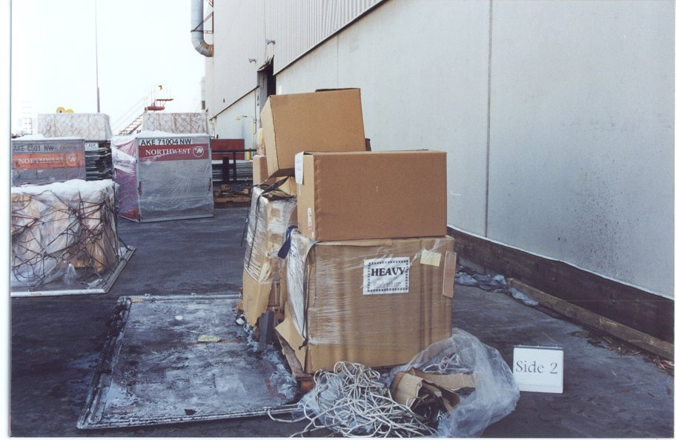
Pallet containing 120,000 lithium batteries involved in ground fire at LAX.

Slide 3
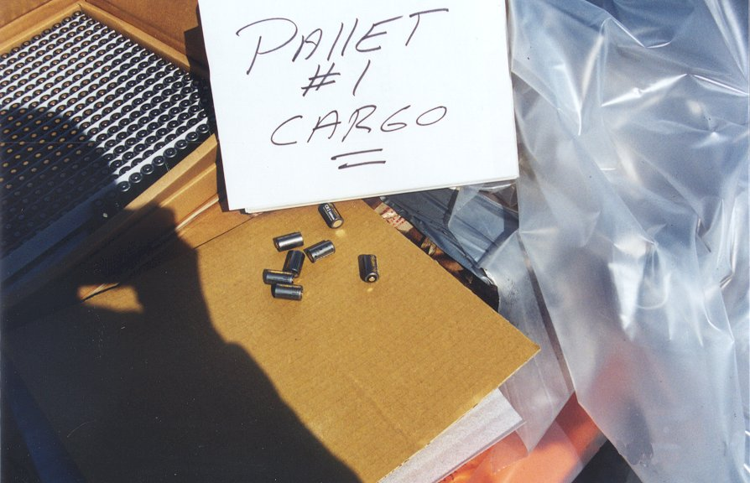
Unburned CR2 batteries from pallet. Batteries of this type are typically shipped 1000 batteries per box.

