Slide 1
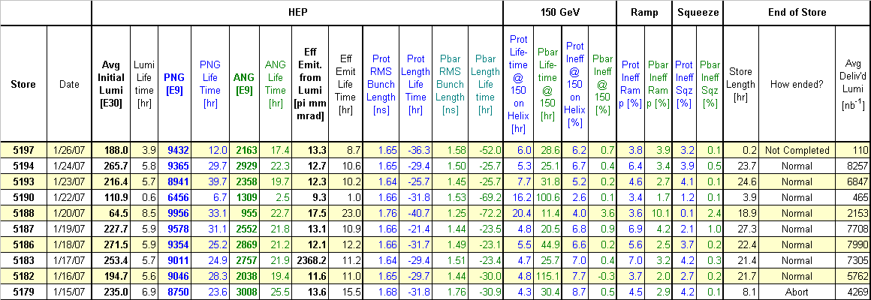
Super Table

Slide 2
Store Summary
Store | Avg Init. Lumi (E30) | Avg Deliv’d Lumi (nb⁻¹) | Time (hr) | How did it end? | Comments
5187 | 235.5 | 7708 | 27.3 | Normal
5188 | 64.76 | 2153 | 18.9 | Normal
5190 | 111.89 | 465 | 3.9 | Normal ? | B17H separator
5193 | 238.18 | 6847 | 24.6 | Normal | High losses at CDF
5194 | 273.17 | 8257 | 23.7 | Normal | D0 utility room rad trip
5197 | 193.2 |  |  | Ongoing | D17 separator spark

Slide 3
Problems
B17H separator HVPS
B48V separator polarity switch
TEL1 vacuum interlock trip
High losses at CDF
D0 utility room trip @ LBSEQ=17
D17 V separator spark during squeeze

Slide 4
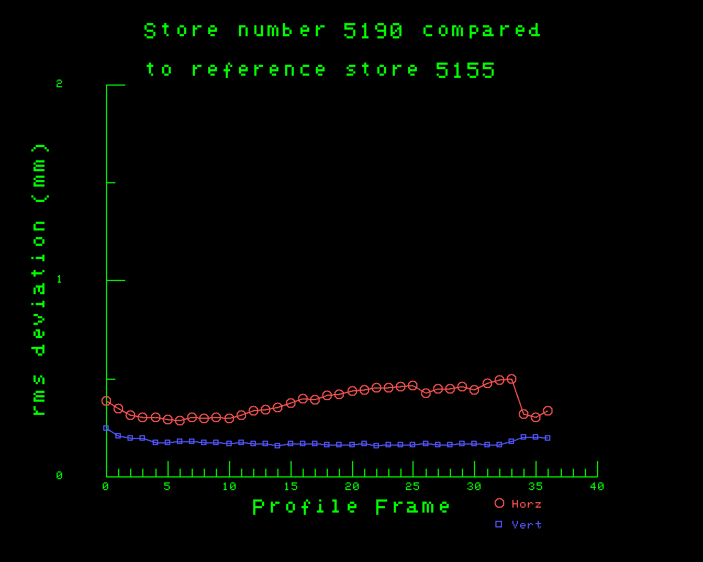
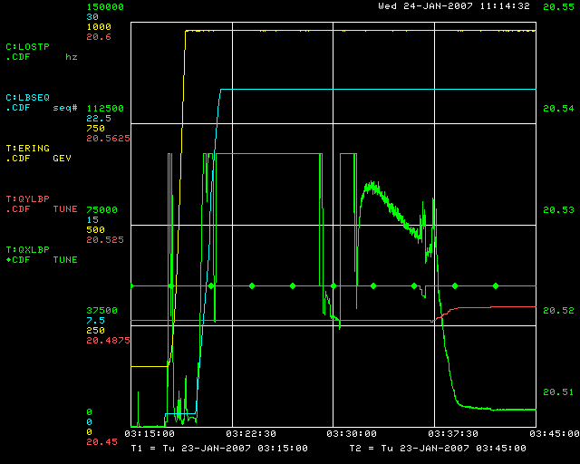
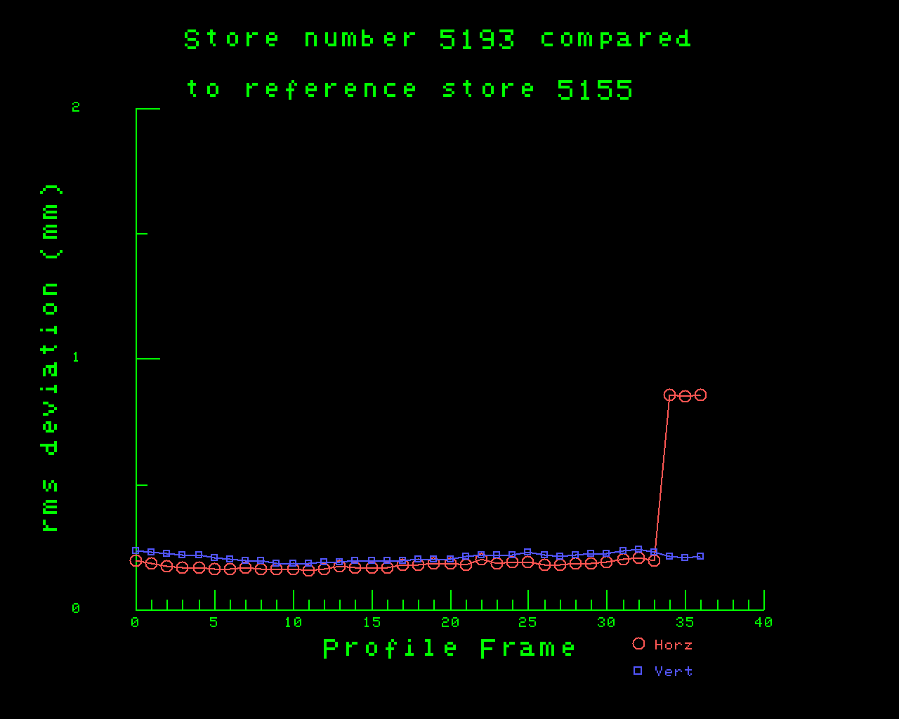
CDF losses & orbits

Slide 5
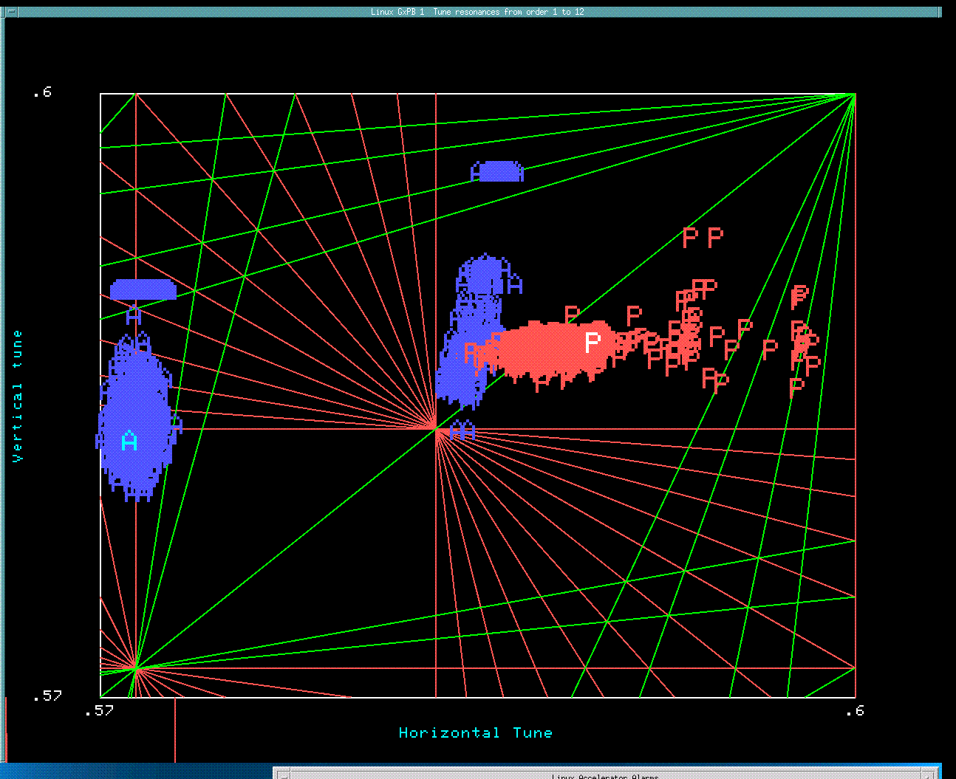
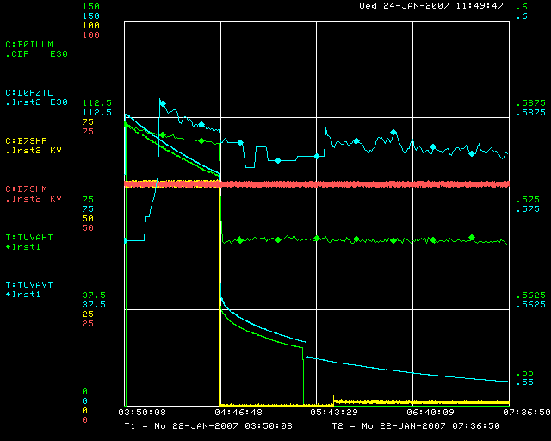
B17 Separator
Store 5190

Slide 6
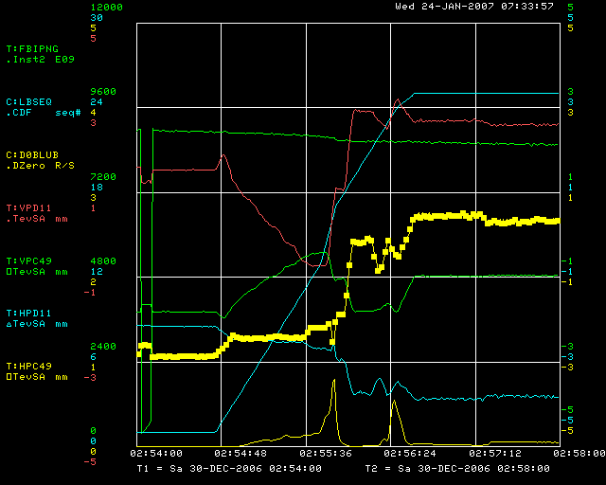
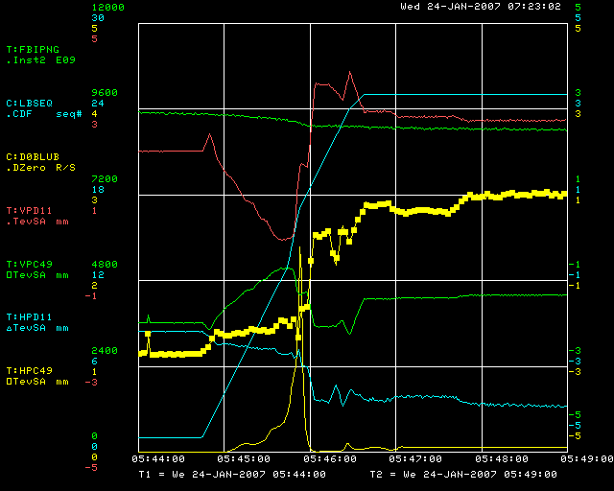
LBSEQ=17 losses
Store 5155
Store 5194

Slide 7
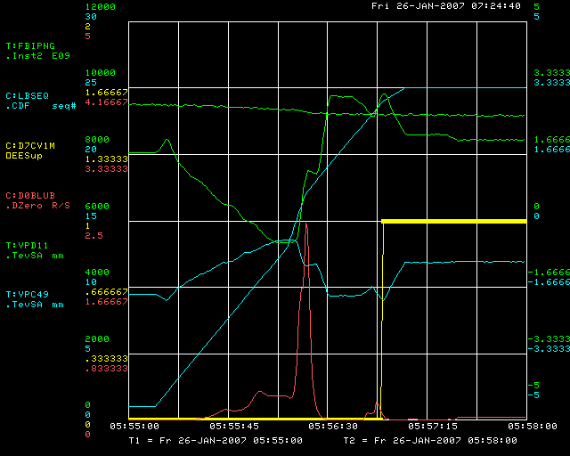
D17 Separator spark

Slide 8
Machine Maintenance & Studies
TEL2 modulator check & tune shift measurements
Orbit smoothing
D0 IP move
Helix data using P163
Tried different cogging between pbar transfers

Slide 9
Equipment maintenance
Bigger jobs included:
Vacuum work at B17,B23 & B33
Installed laser for crystal collimator
Installed new power supplies for C2 sextupole circuit
Installed additional shielding around TEL2
Lots of cryo maintenance

Slide 10
Many thanks to:
Jerry Annala, Mike Martens
EE Support
Cryo
Mechanical Support
For all of their help during the shutdown yesterday !

Slide 11
Study Requests
“Aggressive” scraping at 150GeV (Dean & Jerry)
Crystal collimator (Dean)
AC dipole measurements (Ryoichi)
P1 line matching corrections IPM (Andreas)
Digital tune meter testing
New 150 GeV Helix (Alex)
Tune and coupling correction at 153 to 200GeV. (Yuri)

Slide 12
Andreas Jansson will be tevatron coordinator
from: 1300 on 1/26 to 1900 on 1/28

