Slide 1

JCSDA
Community Radiative Transfer Model (CRTM) Framework
Yong Han, Quanhua Liu,
Paul van Delst
JCSDA 3rd Workshop on Satellite Data Assimilation,
20-21 April 2005

Slide 2
Overview
User Interface
  Forward, tangent-linear, adjoint, K-matrix (Jacobian)
  Public data structures
Developer Interface
  The components
  Internal data structures
  Changes required for analytical Jacobians
Shared Data
  What are they? How to use them?
  Shared data structures
Testing
  Code test software and datafiles.
  Comparison with obs. Testing in GDAS.
Utilities and Feedback

Slide 3
What is the CRTM Framework?
At the simplest level, it’s a collection of structure definitions, interface definitions, and stub routines.
There are User and Developer interfaces, as well as Shared Data interfaces. (I/O functions for convenience).
Why do this?
The radiative transfer problem is split into various components (e.g. gaseous absorption, scattering etc). Each component defines its own structure definition and application modules to facilitate independent development.
Want to minimise or eliminate potential software conflicts and redundancies.
Components developed by different groups can “simply” be dropped into the framework.
Faster implementation of new science/algorithms.

Slide 4
User Interface

Slide 5
Current Forward CRTM Interface
Error_Status = CRTM_Forward( Atmosphere, &
Surface, &
GeometryInfo, &
ChannelInfo, &
RTSolution )
All data contained in structures.
Additional “arguments” can be added as required to the requisite structures.
No impact on calling routine.
Allowable dimensionality
L = number of channels; M = number of profiles
INPUTS |  |  | OUTPUTS
Atmosphere | Surface | GeometryInfo | RTSolution
Scalar | Scalar | Scalar | L
M | M | M | L×M

Slide 6
Example: Definition of Atmosphere Structure
TYPE, PUBLIC :: CRTM_Atmosphere_type
! -- Dimension values
INTEGER :: Max_Layers = 0 ! K dimension
INTEGER :: n_Layers = 0 ! Kuse dimension
INTEGER :: n_Absorbers = 0 ! J dimension
INTEGER :: Max_Clouds = 0 ! Nc dimension
INTEGER :: n_Clouds = 0 ! NcUse dimension
INTEGER :: Max_Aerosols = 0 ! Na dimension
INTEGER :: n_Aerosols = 0 ! NaUse dimension
! -- Climatology model associated with the profile
INTEGER :: Climatology = INVALID_MODEL
! -- Absorber ID and units
INTEGER, DIMENSION( : ), POINTER :: Absorber_ID => NULL() ! J
INTEGER, DIMENSION( : ), POINTER :: Absorber_Units => NULL() ! J
! -- Profile LEVEL pressure and LAYER quantities
REAL( fp_kind ), DIMENSION( : ), POINTER :: Level_Pressure => NULL() ! K
REAL( fp_kind ), DIMENSION( : ), POINTER :: Pressure => NULL() ! K
REAL( fp_kind ), DIMENSION( : ), POINTER :: Temperature => NULL() ! K
REAL( fp_kind ), DIMENSION( :, : ), POINTER :: Absorber => NULL() ! K x J
! -- Clouds associated with each profile
TYPE( CRTM_Cloud_type ), DIMENSION( : ), POINTER :: Cloud => NULL() ! Nc
! -- Aerosols associated with each profile
TYPE( CRTM_Aerosol_type ), DIMENSION( : ), POINTER :: Aerosol => NULL() ! Na
END TYPE CRTM_Atmosphere_type

Slide 7
PUBLIC CRTM Data Structures
Type Name | Description
CRTM_ChannelInfo_type | Sensor channel information filled during initialisation.
CRTM_Atmosphere_type | Atmospheric state profile data. Contains Cloud and Aerosol structures.
CRTM_Surface_type | Surface type and state information. Contains SensorData structure.
CRTM_GeometryInfo_type | Earth location, zenith and azimuth angles.
CRTM_RTSolution_type | Radiative transfer results.

Slide 8
Current K-Matrix CRTM Interface
Error_Status = CRTM_K_Matrix( Atmosphere, &
Surface, &
RTSolution_K, &
GeometryInfo, &
ChannelInfo, &
Atmosphere_K, &
Surface_K, &
RTSolution )
Same structure definitions for both the forward and K-matrix structures.
Channel dependencies are handled via the structure array dimensions.
Allowable dimensionality
L = number of channels; M = number of profiles
INPUTS |  |  | OUTPUTS
Atmosphere Surface | RTSolution_K | GeometryInfo | Atmosphere_K Surface_K | RTSolution
Scalar | L | Scalar | L | L
M | L×M | M | L×M | L×M

Slide 9
Developer Interface

Slide 10
The CRTM Components
Absorption by atmospheric gaseous constituents, e.g. water vapour, ozone, etc. AtmAbsorption functions.
  Compact-OPTRAN is currently used.
  OPTRAN-v7 has been implemented.
  OSS has been implemented.
Scattering and absorption. AtmScatter functions.
  Aerosols
  Clouds
Surface Optics. SfcOptics functions.
  Emissivity (land, ocean; μW, IR; ice, snow, water, etc)
  Reflectivity (diffuse and direct)
Radiative Transfer. RTSolution functions.
  Fixed multi-stream models
  SOI model

Slide 11
INTERNAL CRTM Data Structures
Not visible via the User Interface
Developers modify the structure contents as needed
Some components are mandatory and must be supplied; others are algorithm specific.
Type Name | Description
CRTM_AtmAbsorption_type | Gaseous absorption optical depths and related parameters.
CRTM_AtmScatter_type | Scattering parameters such as single scatter albedo, asymmetry factor, optical depths, etc.
CRTM_SfcOptics_type | Surface optical properties such as emissivity and reflectivity.

Slide 12
Example: Definition of AtmScatter Structure
TYPE, PUBLIC :: CRTM_AtmScatter_type
! -- Dimension values
INTEGER :: n_Layers = 0 ! K dimension
INTEGER :: Max_Legendre_Terms = 0 ! Ic dimension
INTEGER :: n_Legendre_Terms = 0 ! IcUse dimension
INTEGER :: Max_Phase_Elements = 0 ! Ip dimension
INTEGER :: n_Phase_Elements = 0 ! IpUse dimension
! – Algorithm-specific members
REAL( fp_kind ), DIMENSION( :, :, : ), POINTER :: Phase_Coefficient => NULL()
! – Mandatory members
REAL( fp_kind ), DIMENSION( : ), POINTER :: Optical_Depth => NULL() ! K
REAL( fp_kind ), DIMENSION( : ), POINTER :: Single_Scatter_Albedo => NULL() ! K
REAL( fp_kind ), DIMENSION( : ), POINTER :: Asymmetry_Factor => NULL() ! K
REAL( fp_kind ), DIMENSION( : ), POINTER :: Delta_Truncation => NULL() ! K
END TYPE CRTM_AtmScatter_type

Slide 13
INTERNAL CRTM Functions
“Stub” functions are provided for each component. Empty shell routines with the required structure arguments.
Each component contained within its own module (or module hierarchy)
Developers modify the contents of the application function. Can also include other dependent module subprograms, or other modules.
Interfaces don’t change (eventually!), so impact of a particular component update (e.g. the gaseous absorption algorithm – replace OPTRAN with OSS) on the code is minimised.
This is an ideal characterisation, as there may be dependencies between components (e.g. scaling of polychromatic gas absorption optical depths in the radiative transfer functions.)

Slide 14
Changes still to be made
Modifications for analytic Jacobians
  CRTM design was based on forward → tangent-linear → adjoint → K-matrix approach.
  For analytic Jacobians, the K-matrix structures need to be passed in/out of the forward model call.
Example: Computation of gaseous absorption.
  Current forward model interface,
  Interface update,
K-Matrix structure is declared as an optional output argument for the analytic Jacobians.
iErr = CRTM_Compute_AtmAbsorption( Channel_Index, &
  AtmAbsorption )
iErr = CRTM_Compute_AtmAbsorption( Channel_Index, &
  AtmAbsorption, &
  AtmAbsorption_K = AtmAbsorption_K )

Slide 15
Shared Data

Slide 16
The CRTM Shared Data
Shared Data is the precomputed data that is loaded during the model initialisation. The shared data is loaded into a public data structure that can then be used by application modules.
Shared data is not visible via the User Interface.
Needed for:
  Gaseous absorption functions require regression coefficients (e.g. OPTRAN) or optical depth lookup tables (e.g. OSS)
  Surface optics functions requiring coefficients (e.g. IRSSEM)
  Scattering functions may require the same (e.g. current aerosol absorption/scattering uses channel based coefficients, but will transition to spectra)
Accessed by USE of the required shared data module.
Getting data into the system is one of the more difficult parts of CRTM development (IMO).

Slide 17
Current Shared Data CRTM Data Structures
Type Name | Description
SpcCoeff_type | Channel frequencies, polarisation, Planck function coefficients, etc.
TauCoeff_type | Coefficient data used in the AtmAbsorption functions.
AerosolCoeff_type | Coefficient data used in the AerosolScatter functions.
ScatterCoeff_type | Coefficient data used in the CloudScatter functions.
Will need the same for surface optics functions to compute surface emissivities/reflectivities.

Slide 18
Testing Software

Slide 19
Testing Outline
Data
  Simple data initially.
    Atmosphere data from ECMWF 52 profile set.
    Cloud and Surface data from Quanhua Liu.
    Aerosol data from Clark Weaver.
  Collocated surface, atmosphere and satellite observations.
Test instruments.
  Infrared: AIRS (hyperspectral) and HIRS (broadband)
  Microwave: AMSU (crosstrack scanner) and WindSat (polarimetric conical scanner)
Anticipate three phases of testing:
  Code testing using above simple datafiles.
  Comparison with theoretical results and satellite observations.
  Impact of CRTM on forecast skill.

Slide 20
Testing Software
Want to test each CRTM component (gaseous absorption, scattering, etc) in each model (Forward, K-matrix, etc) for consistency, as well as the end-to-end test.
Have some initial attempts based on pCRTM and OPTRAN integration into CRTM.
  Forward/Tangent-linear check.
  Tangent-linear/Adjoint check
  Adjoint/K-matrix check.
Each test type has a defined structure that is filled and dumped to file.
Some rudimentary visualisation tools using IDL.
The same structure definitions and file I/O is also used in the pCRTM tests – the IDL code can view these also.

Slide 21
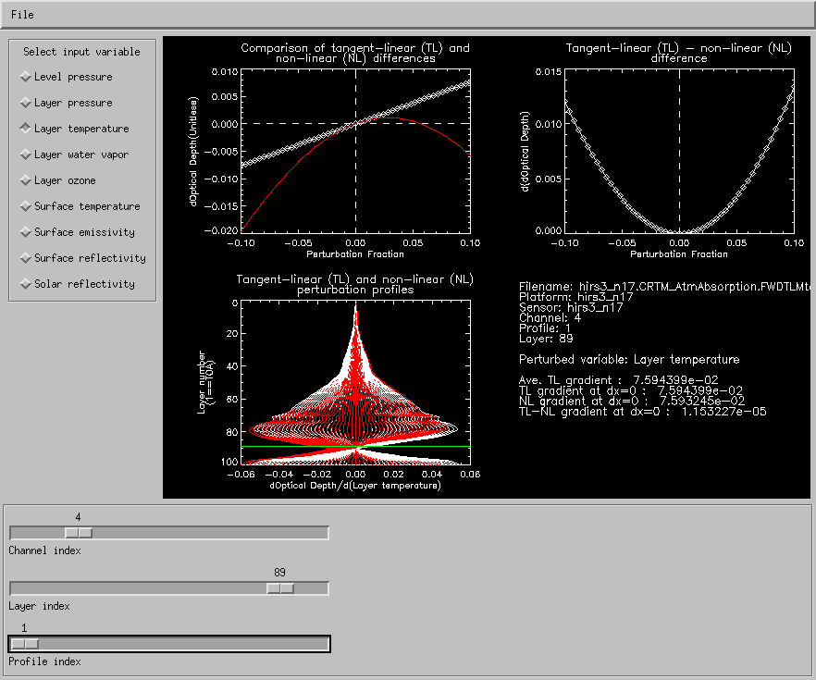
FWD/TL test results for AtmAbsorption

Slide 22
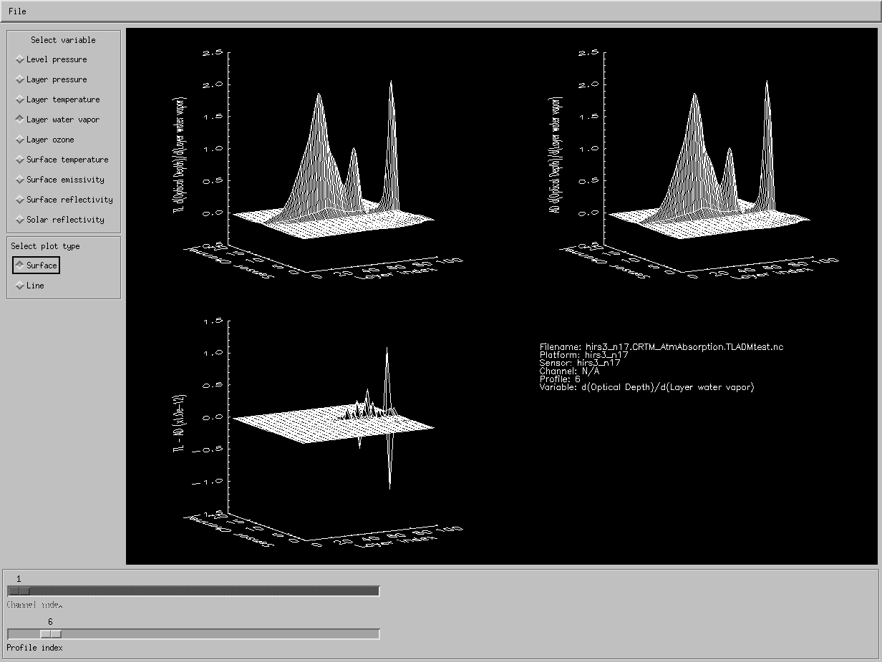
TL/AD test results for AtmAbsorption

Slide 23
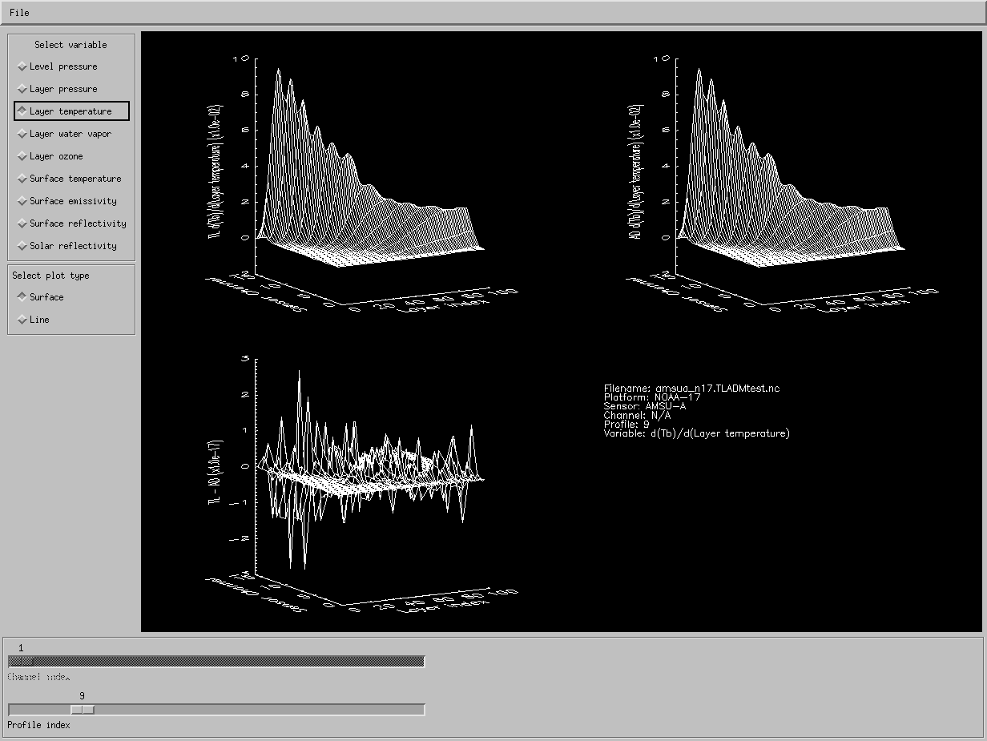
TL/AD test results for the pCRTM

Slide 24
Utilities/Feedback

Slide 25
Utilities/Feedback
What generic utilities are needed for the CRTM?
  Example: Planck functions.
  Others?
    HG phase function computation routines?
    Matrix operations/linear algebra libraries?
    Other source functions (e.g. for NLTE)?
Feedback
  What do developers need?
  How is the current setup working?
    Easy to obtain and share software?
    Easy to obtain and share data?
    Sufficient documentation? Is the website sufficient? Deficient?
  What do we need to do to make development, testing, and integration of CRTM components easier?
Looking at SourceForge as a home for CRTM developers.

