Slide 1
EVALUATION OF BIOEQUIVALENCE
FOR HIGHLY-VARIABLE DRUGS
AND DRUG PRODUCTS
Laszlo Endrenyi
University of Toronto
Laszlo Tothfalusi
Semmelweis University of Budapest
FDA/CDER
Advisory Committee on
Pharmaceutical Sciences
Rockville, MD
April 14, 2004

Slide 2
SYNOPSIS
Introduction
Several questions to be raised for the
for the consideration of the Advisory
Committee and CDER
- Is there a problem?
- Which study condition?
- Which study design?
- Which method of evaluation?
- What is the limiting variation for HVD/P?
- Is test/estimation for the ratio of
variations needed?
- Is a secondary BE test needed/useful?

Slide 3
USUAL REGULATORY CRITERION
Record: Parameters (AUC and C_{max}) of N subjects for the Test (T) and Reference (R) products
Calculate: Averages of the logarithmic parameters for both formulations
By taking antilogs, get geometric means for the two formulations
Take the ratio (T/R) of the two geometric means (GMR)
Calculate the 90% confidence limits of GMR
Criterion: The confidence limits for GMR should be between 0.80 and 1.25.

Slide 4
THE PROBLEM OF HIGHLY-VARIABLE DRUGS AND DRUG PRODUCTS (HVD/P)
Criterion: The confidence limits for GMR should be
between 0.80 and 1.25
Problem: With large variation (wide confidence limits):
it is very difficult to satisfy the regulatory criterion,
unless the number of subjects (N) is very large
Problem especially with C_{max}
which often has higher variation than AUC
Definition: Highly-variable drug
if coefficient of variation CV > 30%

Slide 5
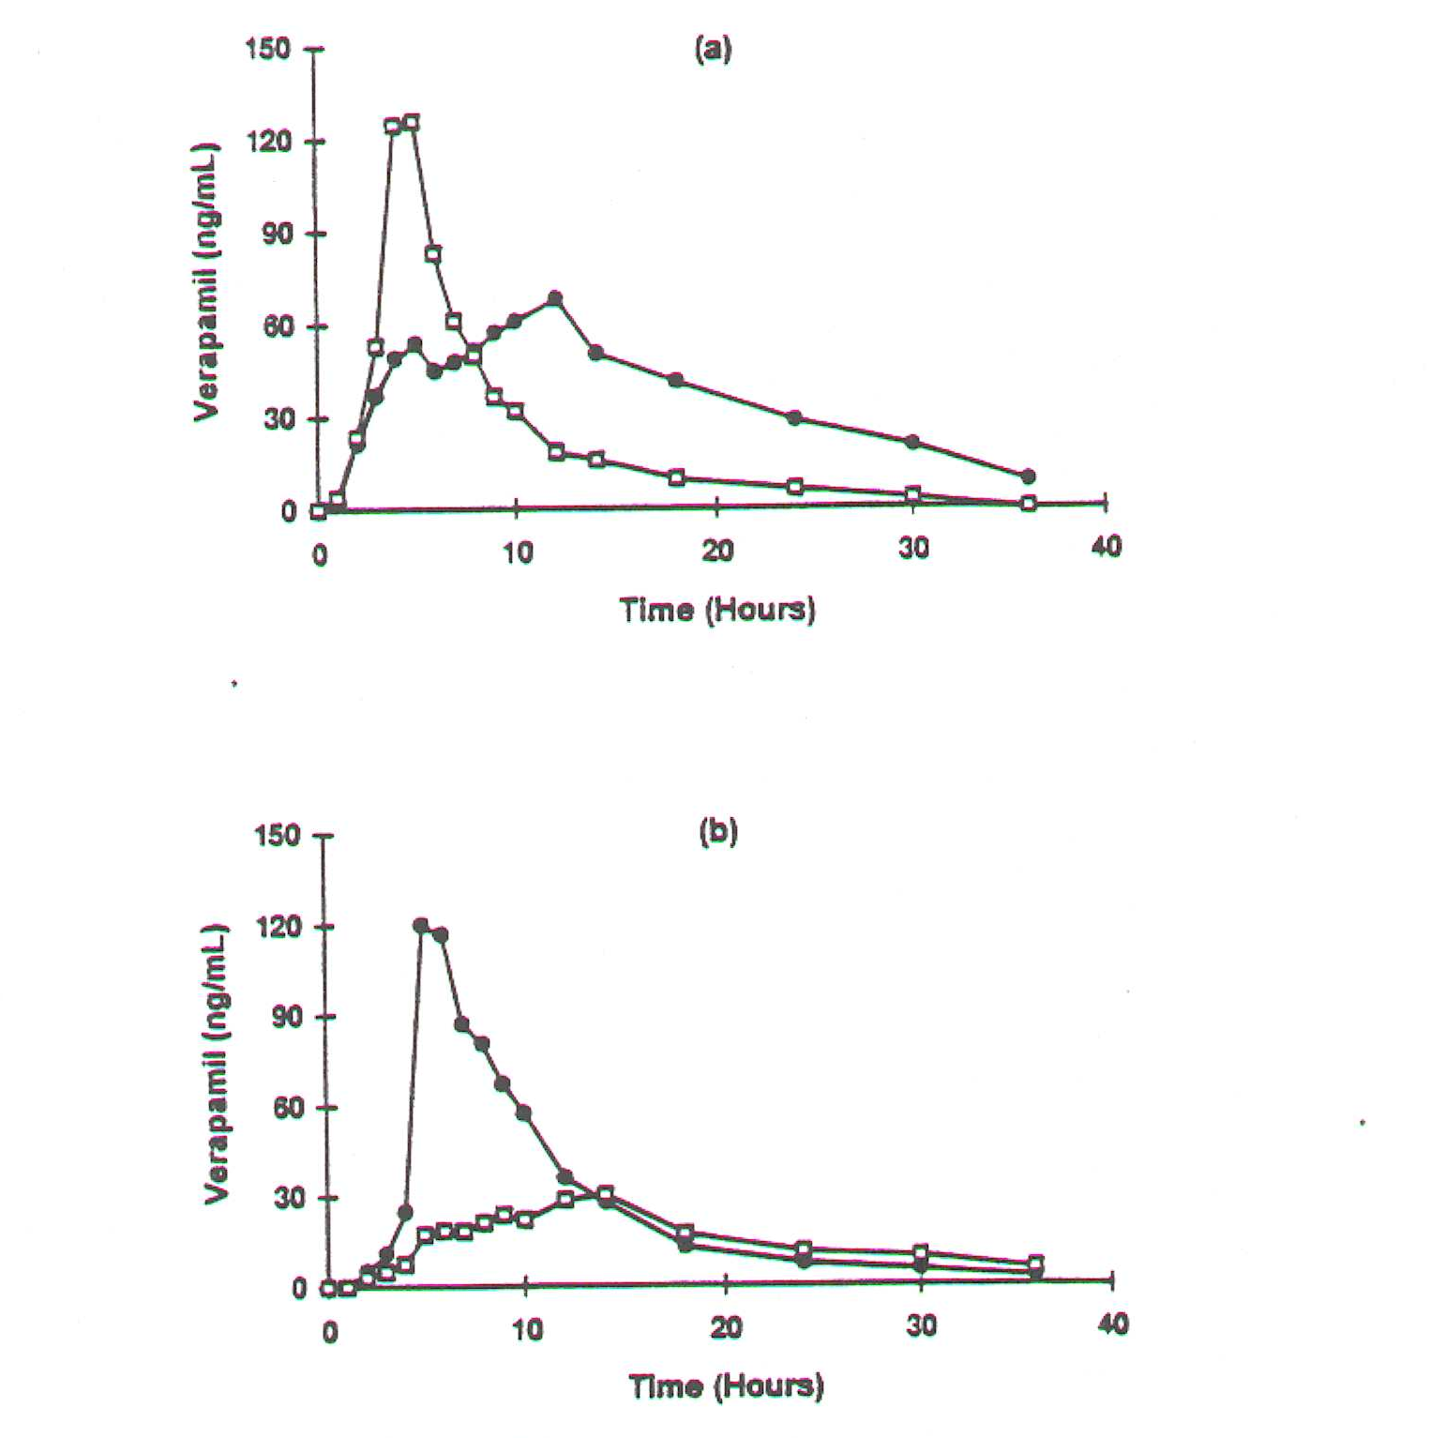
IS THERE A PROBLEM WITH BE FOR HVD/P?
- BIOEQUIVALENT WITH ITSELF?
Administer the same HVD formulation twice:
- generally can not demonstrate BE
Example: oral administration, on two occasions, of IsoptinSR 240 mg tablets
Y.-C. Tsang et al., Pharm. Res. 3: 846 - 850(1996)
Lack of bioequivalence
Apparent Subject*Period interaction

Slide 6
IS THERE A PROBLEM WITH BE FOR HVD/P?
FAILURE RATE OF BE STUDIES INCREASES WITH C.V.
Failing BE criteria: statistics on 1300 studies
90
80
70
60
50
Studies failing BE criteria (%)
40
30
20
10
0
<10
10-15
15-25
25-35
>35
Intra-individual CV%
Diane Potvin, MDS Pharma Services

Slide 7
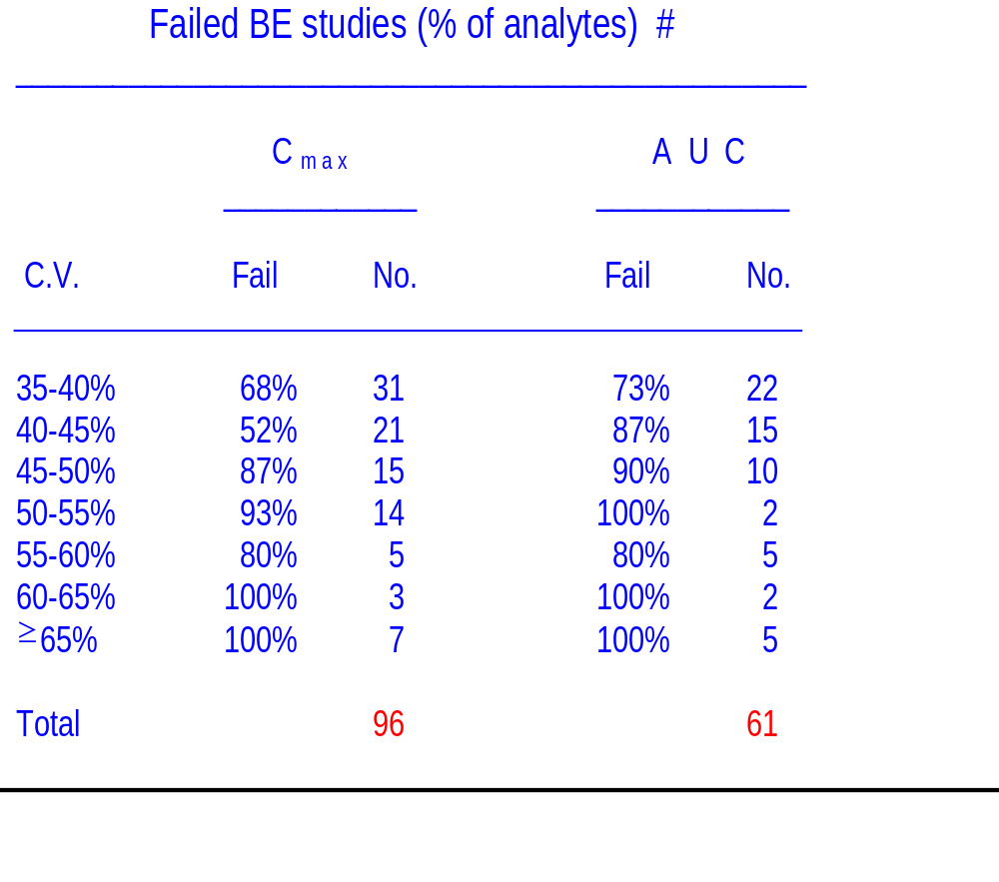
IS THERE A PROBLEM WITH BE FOR HVD/P?
FAILURE RATE OF BE STUDIES INCREASES WITH C.V.
Diane Potvin, MDS Pharma, Montréal
Failure rate is high and increases with C.V.
Fewer failures for AUC than for C_{max}
but still a substantial number

Slide 8
WHICH STUDY CONDITION?
- Single dosing
- Steady state

Slide 9
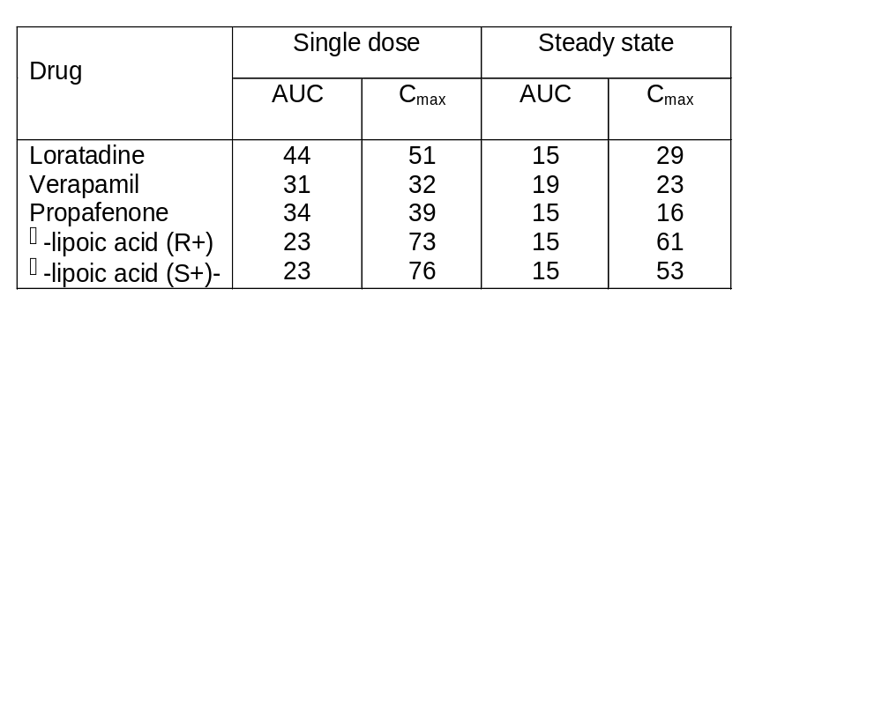
WHICH STUDY CONDITION?
STEADY-STATE STUDIES
Comparative parameters, especially of Cmax, have often (but not always) smaller variation in steady-state studies than following single oral administration
Theoretical:
A.A. El-Tahtawy et al., Pharm. Res. 11:1330-1336 (1994)
12:1634-1641 (1995)
15: 98-104 (1998)
J. Zha and L. Endrenyi, Biopharm. Stat. 7:191-204 (1997)
Observations:
H.H. Blume et al., “BioInternational 2”, pp. 117-122 (1995)
B. Schug et al., “BioInternational 96”, pp. 101-106 (1996)
Coefficients of variation (%) after single and multiple dosing
(Blume, Schug, et al.)

Slide 10
WHICH STUDY CONDITION?
STEADY-STATE STUDIES
- Single dosing
- Steady state
  Often (but not always) lower variability
  But: reduction of variability is
    - Poorly defined (large, small, negative)
    - Arbitrary (changes with accumulation)
  Estimated C_{max} has positive bias
  L.Tothfalusi and L. Endrenyi, J.Pharmacokin.
  Pharmacodyn. 30:363-385 (2003)
  In Europe but not in U.S.
  In Canada, for modified release
    (if accumulation)

Slide 11
WHICH STUDY DESIGN?
- 2x2 crossover
2 periods
2 sequences
- Replicate design
3 or 4 periods
2 sequences (recommended)
Example:
T R T R
R T R T

Slide 12
WHICH STUDY DESIGN?
REPLICATE DESIGN
Advantage:
Get clear, directly estimated
- Within-subject variations
(s_{WT}², s_{WR}²)
- Subject-by-formulation interaction
(s_{S*F}²)
Note: Favored by K.K. Midha
Comment:
Longer duration
Subject dropouts, greater expense
Issue:
Various possible methods of evaluation E.g.: ANOVA
Linear mixed-effect model
Maximum likelihood
Restricted max. likelihood
Variance component estim’n
Question:
- IS A TEST COMPARING T AND R VARIATIONS NEEDED?
- OR AN ESTIMATE?

Slide 13
WHICH STUDY DESIGN?
2x2 CROSSOVER
Advantages:
Simple execution
Simple evaluation
Available studies can be evaluated retrospectively
Comment::
Can estimate ratio of within-subject variabilities
Guilbaud, 1993, 1999; Gould, 2000
Y_{i} = T_{i} + R_{i} (i-th subject)
X_{i} = T_{i} - R_{i}
Regression of Y vs. X
Slope = b
Ratio of within-subject variances:
s_{WT}²/s_{WR}² = (1+b)/(1-b)
Issue:
Features of the method have not been studied

Slide 14
WHICH METHOD OF EVALUATION?
- Unscaled average BE
The customary procedure,
with BE limits of GMR = 0.80-1.25
- Unscaled average BE
with expanded BE limits
* Preset BE limits
e.g. GMR = 0.75-1.33
GMR = 0.70-1.43
* BE limits proportional
to estimated variation
Boddy et al., Pharm.Res. 12:1865-1868 (1995)
Scaled average BE
Schall, BioInternational 2, 91-106 (1995)
Tothfalusi et al., Pharm.Res. 18:728-733 (2001)
Tothfalusi and Endrenyi, Pharm.Res. 20:382-389 (2003
- (Scaled individual BE)
For comparisons only

Slide 15
WHICH METHOD OF EVALUATION?
UNSCALED AVERAGE BE WITH
EXPANDED LIMITS - PRESET LIMITS
Unscaled average BE
1/BEL  GMR  BEL
- lgBEL  log(GMR)  lgBEL
- lgBEL  m_{T} - m_{R}  lgBEL
BEL: BE limit
lgBEL: logarithm of BEL
GMR: Ratio of geometric means
m_{T}, m_{R}: Estimated logarithmic means
For example:
0.75  GMR  1.33
- 0.288  m_{T} - m_{R}  0.288
instead of:
0.80  GMR  1.25
- 0.223  m_{T} - m_{R}  0.223
Advantage:
Simple
Disadvantage:
Arbitrary
Only partial reduction of sample size
Not for higher variabilities

Slide 16
WHICH METHOD OF EVALUATION?
UNSCALED AVERAGE BE WITH
EXPANDED LIMITS
-PROPORTIONAL TO ESTIMATED VARIATION
Confidence interval of log(GMR) is proportional
to estimated variation
A.W. Boddy et al. Pharm. Res. 12:1865-1868 (1995)
- lgBEL_{A}*s  m_{T} - m_{R}  lgBEL_{A}*s
Proportionality factor, lgBEL_{A} = 1.0 suggested
Advantages:
- Can apply the usual two one-sided t-tests procedure
(However, see below)
- Statistical power is independent of sample size
- Statistical power is, with same sample size,
much higher than of unscaled average BE
Comments:
- The estimated limits are random variables
(lgBEL_{A}*s)
- Therefore, application of the two one-sided tests
procedure is not correct
(However, approximately correct with large N)

Slide 17
WHICH METHOD OF EVALUATION?
SCALED AVERAGE BE
Difference between logarithmic means is normalized
by estimated variation
R. Schall, BioInternational 2, 91-106 (1995)
L.Tothfalusi et al., Pharm.Res. 18:728-733 (2001)
L. Tothfalusi and L. Endrenyi, Pharm.Res. 20:382-389 (2003)
- lgBEL_{A}  (m_{T} - m_{R})/s  lgBEL_{A}
General procedure suggested for setting BE limits
Advantages:
- Statistical power is independent of variation
- Statistical power is, with same sample size,
much higher than of unscaled average BE
- Interpretation: Compare expected change due
to switching with expected difference
between replicate administrations
- Interpretation: Standardized effect size, as in
clinical comparisons
Comment:
Confidence limits estimated by:
- Noncentral t-test (2x2 crossover)
- Hyslop’s procedure (replicate or 2x2 crossover)

Slide 18
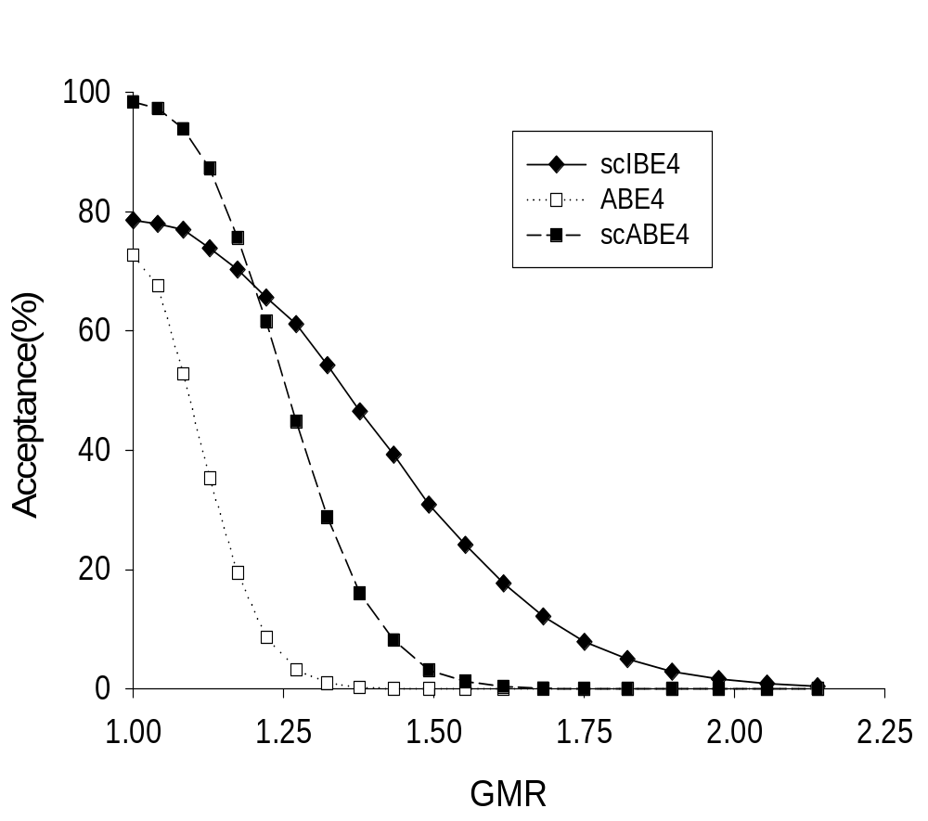
WHICH METHOD OF EVALUATION?
SCALED AVERAGE BE
Comparative performance of method
Simulations
4 periods
N = 24
CV_{WT} = CV_{WR} = 40%
Scaled average BE is much less permissive than
scaled individual BE (lower GMR’s)
Scaled average BE, at large variations, has much higher
statistical power than unscaled average BE

Slide 19
WHAT IS THE LIMITING VARIATION FOR HVD/P?
Subject to regulatory decision
(except with unscaled average BE
with preset limits)
For unscaled average BE with expanding limits,
scaled average BE:
Mixed regulatory model:
Unscaled average BE if σ  σ_{o} ,
HVD/P procedure if σ > σ_{o}
(σ_{o}: limiting variation)
Alternatives for limiting variation:
L. Tothfalusi and L. Endrenyi, Pharm.Res. 20:382-389 (2003)
CV_{o} = 20% (as for individual BE)
CV_{o} = 25% (as in Boddy et al., 1995;
preferred by K. Midha)
CV_{o} = 30% (usual definition of HVD/P)
Sponsor’s intention for using HVD/P procedure
to be stated in protocol

Slide 20
IS A SECONDARY CRITERION NEEDED?
Concern about possibly large deviations
between estimated logarithmic means
[i.e., about log(GMR)]
L. Benet, AAPS Workshop on Individual BE, 1999.
Concern arose due to features of individual BE
Comments:
Individual BE (IBE) vs. HVD/P
- With HVD/P the potential deviation is
much smaller than with IBE
- Differing sources of the deviation
* IBE: expanded, more permissive
regulatory criterion
* HVD/P: Arises as a natural, direct
consequence of variability

Slide 21
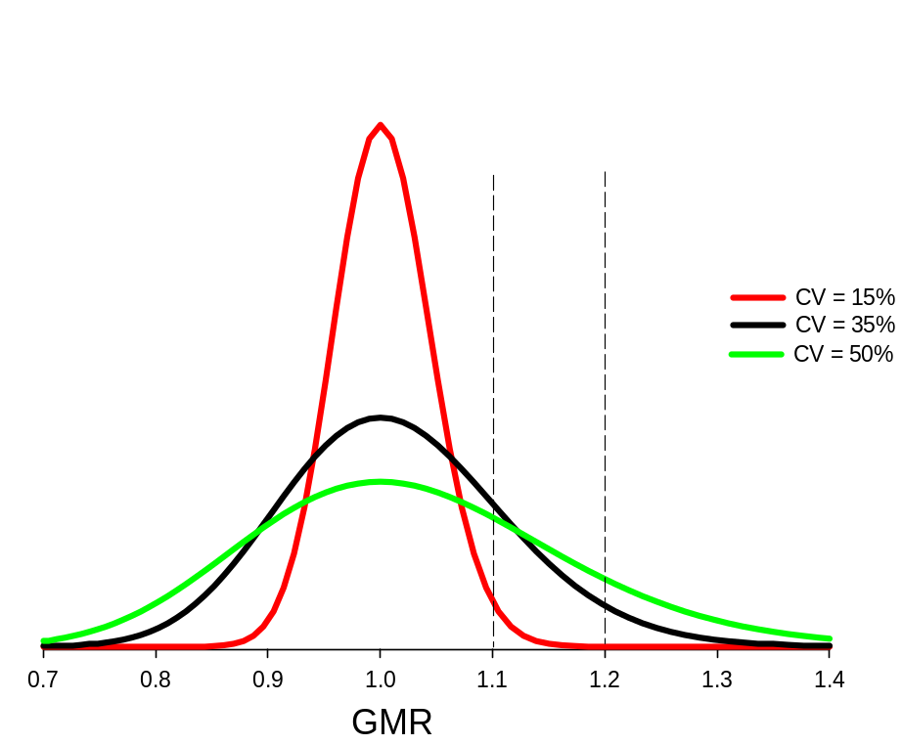
IS A SECONDARY CRITERION NEEDED?
HVD/P: Larger deviation between the (logarithmic) means arises as a natural, direct consequence of the higher variability
Larger deviations occur
at higher variations

Slide 22
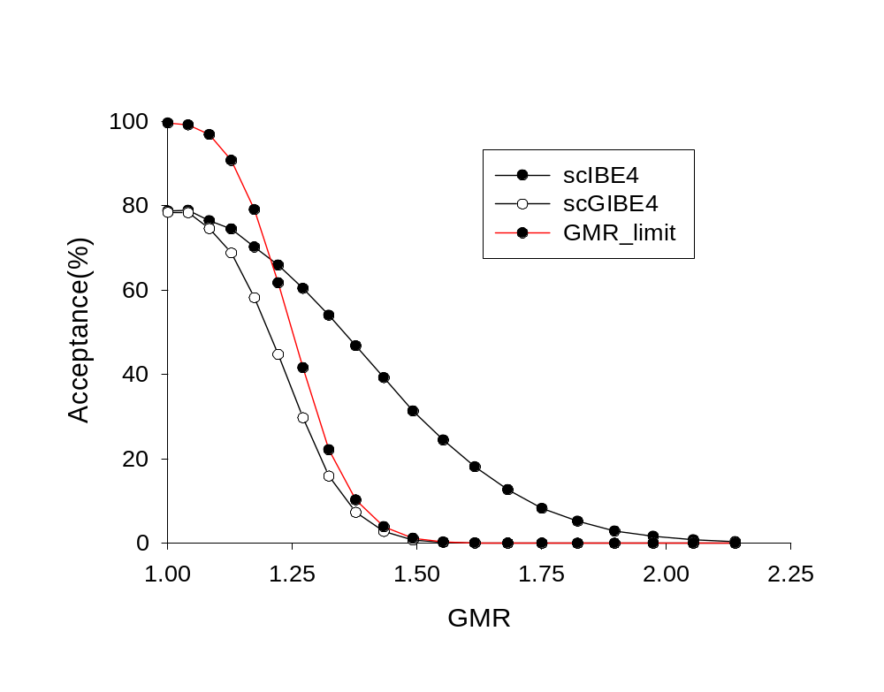
IS A SECONDARY CRITERION USEFUL?
Illustrative example:
Effect of secondary criterion on the
determination of (scaled) individual BE
GMR limit: Constraint of GMR 1.25 alone
scIBE4: Scaled individual BE
scGIBE4: Combination of the two criteria
Acceptance by the combined criterion does not
exceed acceptances by either separate criterion
Strong constraint on GMR could remove the
combined criterion from the BE criterion

Slide 23
SUMMARY
Several questions for the consideration
of the Advisory Committee and CDER
- Is there a problem?
- Which study condition?
- Which study design?
- Which method of evaluation?
- What is the limiting variation for HVD/P?
- Is test/estimation for the ratio of
variations needed?
- Is a secondary BE test needed/useful?
Further investigation of designs and features
of methods would be very useful

