Slide 1
NWSChat (Instant Messaging)
Instant Messaging system for the
NWS and Partners
NWSChat
Carlos Diaz
June 2009

Slide 2
NWSChat
NWSChat
System for Instant Messaging (IM) between NWS and “Partners” for sharing warning decision expertise and other types of significant weather information essential to the NWS’ mission of saving lives and property.
Provides media and emergency response partners with the ability to communicate significant event reports back to NWS operational personnel.
NWS partners use IM as an efficient means of seeking clarifications and enhancements to the communication stream originating from the NWS during a fast-paced significant weather or hydrologic event.
NWSChat enhanced feature (nwsbot) shows warnings/watches and other products issued by the WFO for a particular chatroom.

Slide 3
NWSChat
NWSChat Experimental Period from 12/1/2008 to 12/15/2009 – ongoing.
  One year period allows for evaluation during all seasons and weather conditions.
  NWSChat released for NWS accounts on 12 Nov. 2008
  NWSChat opened for external accounts on 1 Dec. 2008
  Experimental product Service Description Document for NWSChat in place.
  Use of other IM chat (IEM) terminated on 2 February 2009.
Web site includes account request forms, draft Terms of Use, training, and draft policy information. Hardware and Software in place for system evaluation.

Slide 4
NWSChat – Draft Policy
The Procedural Policy (Instruction) includes the following:
Types of use; Hazardous hydromet information, Decisional support communications, Significant event reporting, Other e.g. internal collaboration for non-operational purposes.
Users; NWS field offices, centers and HQ. Members of EM community, Government partners such as FAA, Media.
Requirement for User Training: For initial account and yearly thereafter.
Chat content and etiquette.
Account Naming Conventions.
Responsibilities:
OCWWS - Implementation of NWSChat program policy
CIO – Technical assistance and policy
Regions – ensure offices equipped and trained
MICs/HICs – designate local NWSChat account managers, approve external users.

Slide 5
NWSChat Status
Over 5500 individual NWSChat accounts issued to date
  NWS Participation: 2280 individual accounts
    117 WFOs
    10 RFCs
    15 CWSUs
    4 National Centers & WDTB
  Media - 1313 accounts
  EM/State/Other – 2006 accounts

Slide 6
NWSChat – What’s Next?
Continue use and evaluation of NWSChat
Plan to survey Regions for impact, with questions that will be used for Go/No-Go determination.
Review of comments and final survey results on system, policy and use at comment end period.
Time Line:
6 Month preliminary survey June 2009
Comment end period: 12-15-09
    Final recommendation decision 01-29-10
    Final Operating Capability 03-19-10

Slide 7
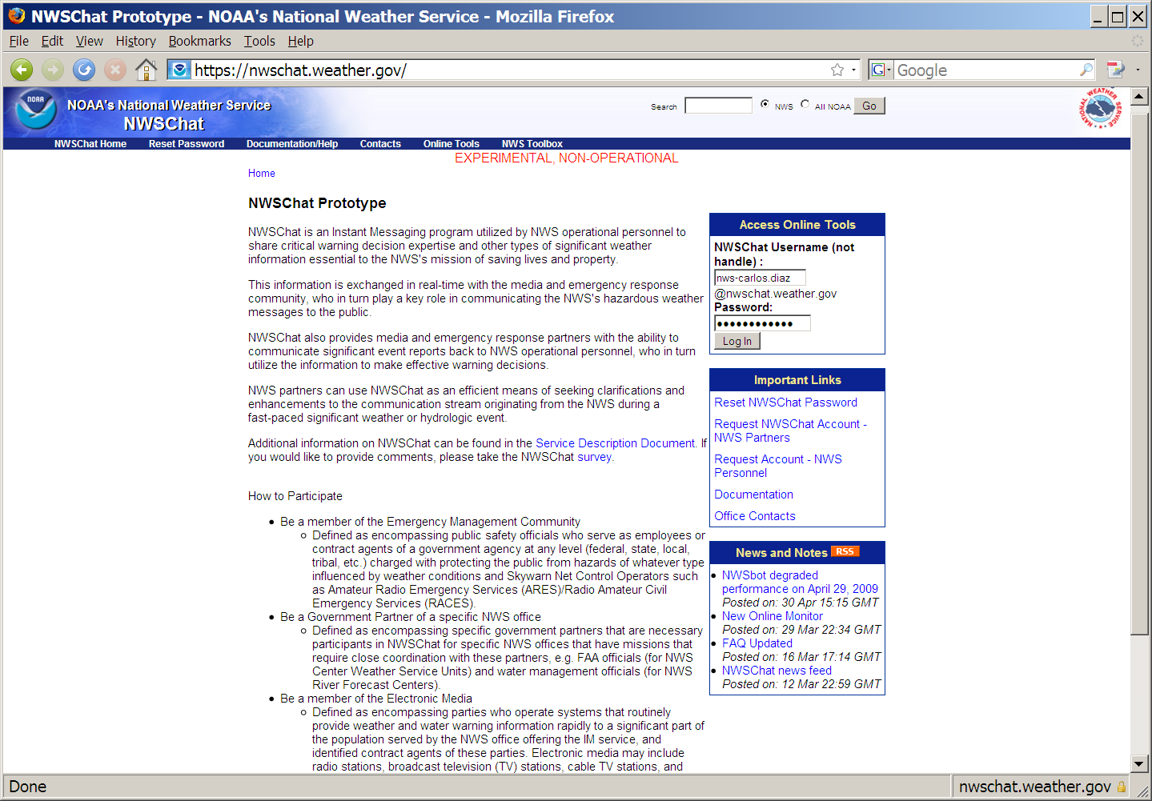

Slide 8
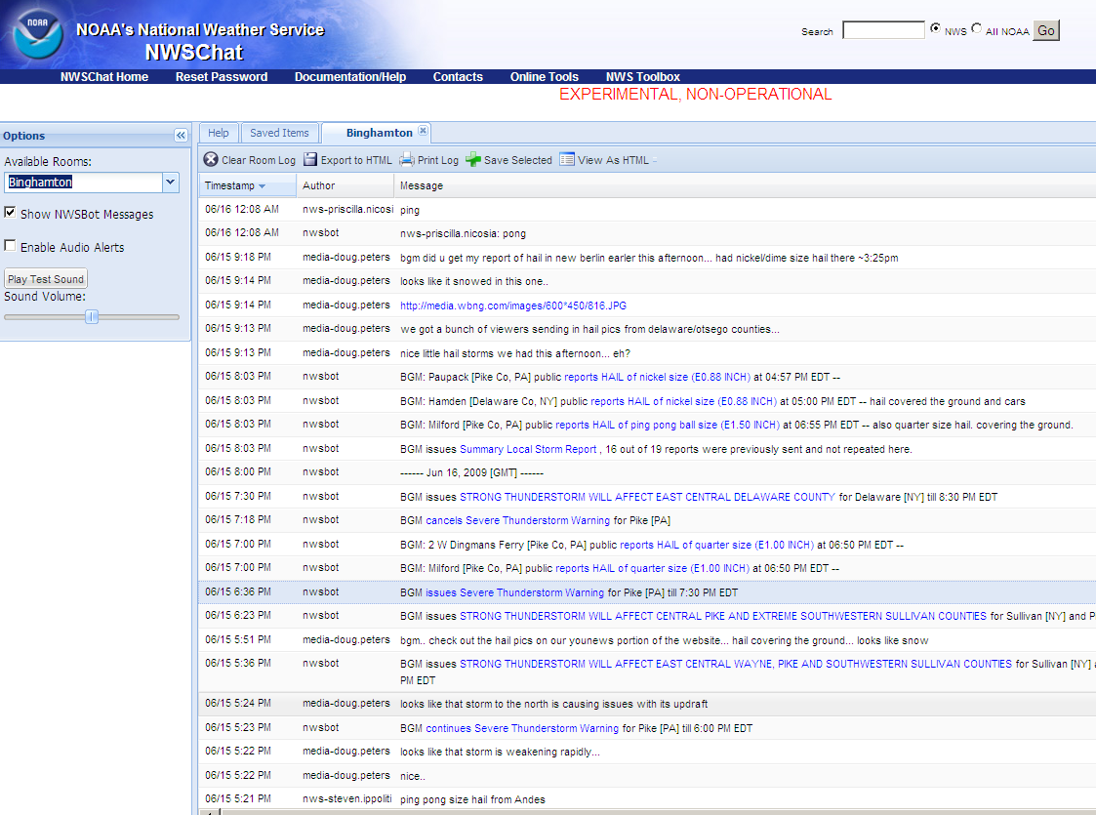

Slide 9
