Slide 1
The ICF and statistics on disability and health
  Classification, Assessment, Surveys and Terminology (CAS/EIP)
  World Health Organization
  Geneva
T Bedirhan Ustun and Marguerite Schneider
Washington City Group on Measurement of Disability Washington D C,
18 - 20 February 2002
Notes:
1
1
Previously, countries mainly reported mortality statistics on the basis of the international classification of diseases (ICD) system. This approach was useful to identify life expectancy and causes of death, but the data collected gave no further indication of health status (among the living population). Additional information on population health was needed. Resolution WHA29.35 approved the supplementary classification of impairments and handicaps. As a result, WHO issued in 1980 a tool for the classification of the consequences of disease, namely the International Classification of Impairments, Disabilities and Handicaps (ICIDH). It was field-tested in several countries and a revision process was begun in 1995 to address, inter alia, the need to use the classification as a framework for the reporting of the health status of populations. Over the subsequent five years, several WHO collaborating centres and both governmental and nongovernmental organizations have taken part in the revision and field-testing of successive versions. With the revisions, the title has evolved, and it is now proposed to call it the International Classification of Disability and Health. As it currently stands, ICIDH is a complementary member of the WHO family of international classifications. Whereas ICD provides the codes for mortality and morbidity, ICIDH provides the codes for health states of individuals.
ICD: the International Statistical Classification of Diseases and Related Health Problems. The Tenth Revision (ICD-10) was published in 1992.
The Beta-1 version issued in 1997 was entitled ICIDH-2: International Classification of Impairments, Activities and Participation. For the 1999 Beta-2 version the title was changed to ICIDH-2: International Classification of Functioning and Disability. The proposed new title is ICIDH-2: International Classification of Disability and Health. The acronym ICIDH, used as a generic term to refer to the classification, is retained for historical reasons.

Slide 2
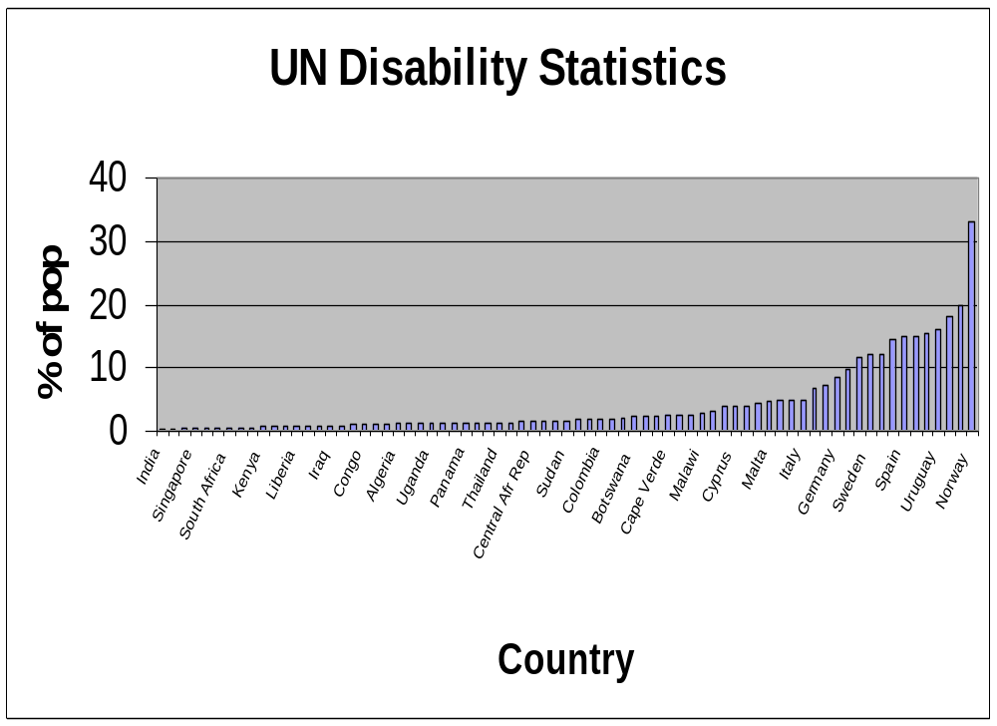

Slide 3
UN Disability rates
Wide inter-country variation
    60 fold difference (0.2 - 30%)
Reliability
  unknown - not measured
Construct validity
  not sure what is being measured

Slide 4
Possible explanations for between country variations
real differences
  levels of development
  different environments
  population age structure
  time of data collection
Methodological differences
  Census vs surveys
  different concepts of ‘disability’
  different domains
  different questions
  different levels of severity

Slide 5
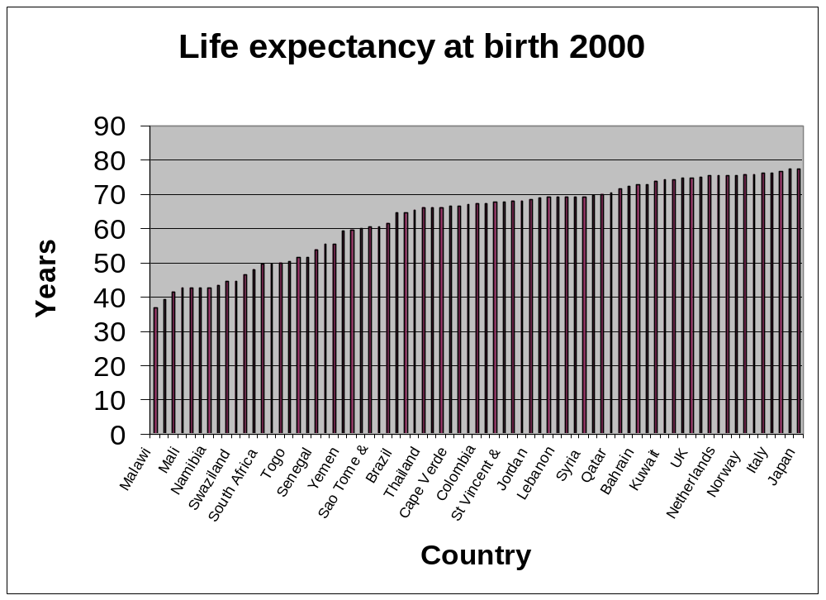

Slide 6
Life expectancy
Measuring number of years people are expected to live based on mortality statistics in countries
Reliability: Good
  different measurements give similar results
Differences indicate real and expected differences between countries
  developed vs developing
  responsive to health interventions
  internationally recognised consensus measure
  used in different indices: Human development index; Health system performance
Need indicators with similar properties for disability

Slide 7
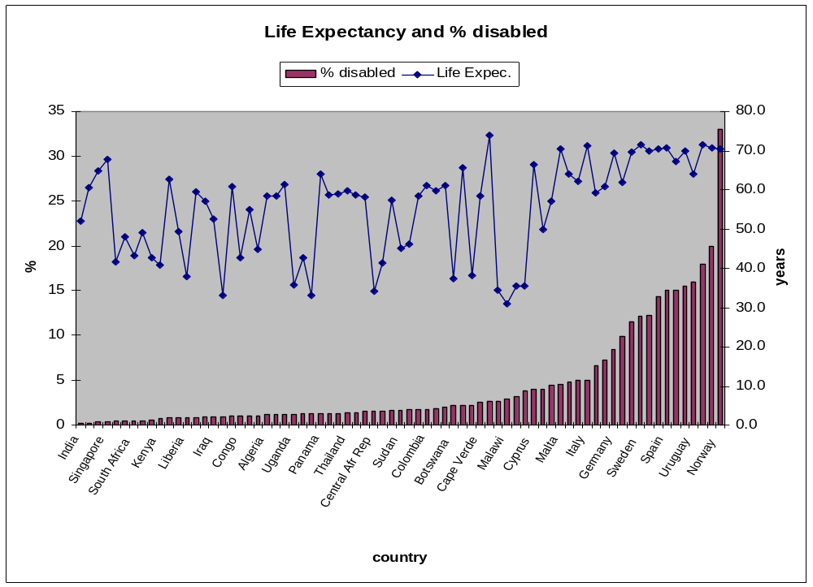

Slide 8
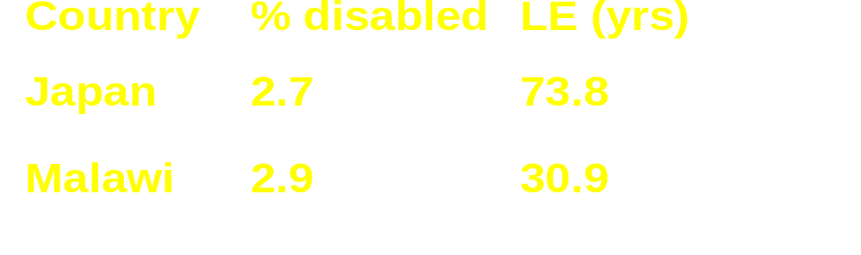
Life expectancy and % disabled
No relationship between country differences in % disabled and life expectancy
disability measure lacks face validity

Slide 9
LE and % disabled (2)
Disability levels cannot be explained by other covariates, such as
  age structure
  development level
  life expectancy
  education level
  economic level
  other contextual variables...
as disability % goes up, more face validity
Current disability statistics are not clear

Slide 10
What is wrong with disability statistics
Not holistic
  focus more on the physical (vision, hearing and mobility and severe mental handicap) than mental health
not multi-dimensional
  usually activity limitation or impairments or mix
  very limited in terms of participation and environmental factors
not comparable mainly because not using common conceptual framework

Slide 11
What is wrong with disability statistics (2)
poor reliability and validity - even if measure is reliable cannot compare if not same conceptual framework
traditionally, used set definitions of disability as input (blind, deaf, physically disabled, etc. ) - no measure of individual domains within each category
threshold is set at outset and cannot be changed and need new set of data for each purpose

Slide 12
Disability and health surveys:
Same and different
Health surveys
health condition
cause of health condition
risk factors
prognosis
health system interventions
satisfaction
Disability surveys
health condition
level of functioning at body, person and societal level
assistance required
other facilitators and barriers
satisfaction

Slide 13
WHO World Health Survey
Uses ICF domains
these domains are based on international consensus
domains lend themselves to empirical validation for cross-population comparability
  calibration tests
  vignettes
20% of domains explain 80% of variance in health level
summarise data into summary measures of population health

Slide 14
Level of health across 6 core ICF domains
6 core ICF domains used to measure level of health
  Cognition understanding - communication
  Mobility moving around
  Self-care washing, toileting, eating
  Affect depression, anxiety
  Pain physical bodily pain
  Usual activities housework, work, school
Measured in standard surveys
  WHO multi-country Survey Study in 61 countries 2000-2001
  Adjusted for self-report bias

Slide 15
Level of health across 6 core ICF domains (2)
Aggregate the level across whole population
Cross country comparisons
Less variation than current disability statistics because:
  identical concepts being measured
  same method of measurement
  reliability measured and ensured
  self-report bias is adjusted for

Slide 16
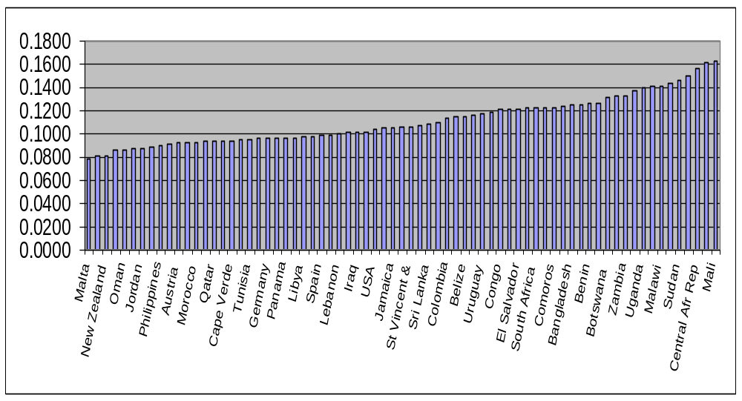
Average levels of health
(yrs lived with disability expressed as fraction of total number of years)

Slide 17
Using ICF for both disability and health statistics
According to ICF, disability and health are defined across the same domains
Surveys assess the same set of domains
questions measuring the same thing at different levels
  impairment
  capacity & performance
Key issue is the definition of a threshold level for which you define any disability for a given domain
Threshold is arbitrary and can be set at different levels for different purposes

Slide 18
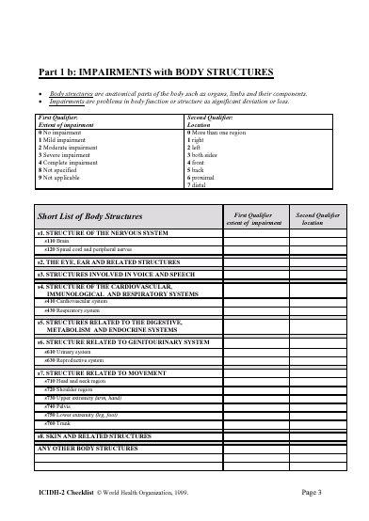
ICF Checklist
One component- One page
Salient Categories (169 out of 1494) at-a-glance
-Impairments with Body Functions
-Impairments with Body Structures
-Capacity and Performance in Activity and Participation Domains
-Environmental Factors
-Other Contextual information
Additional notes
Available for Clinicians

Slide 19
WHO Disability Assessment Schedule - WHO-DAS II
Validated across number of countries and conditions
based on ICF domains

Slide 20
What is disability?
Outcome of interaction:
  person’s health condition + contextual factors = DISABILITY
This outcome of disability can be described at 3 levels:
  body (impairment of body function or structure)
  person (activity limitations measured as capacity)
  society (participation restrictions measured as performance)
Plus description of contextual factors - personal and environmental
Notes:
Disability is the outcome of the interaction between a person’s health condition and contextual factors.
This outcome can be described at three levels of functioning:
1. The body level as an impairment of body function or body structure
2. The person level as an activity limitation measured using the construct of capacity in the information matrix
3. The society level as a participation restriction measured using the construct of performance in the information matrix
In addition the full description of the outcome requires description of the contextual factors, including both personal and environmental factors.

Slide 21
Body functions and structures
Body functions (b - codes) are the physiological functions of body systems (including psychological functions)
Body structures (s -codes) are anatomical parts of the body such as organs, limbs and their components
Impairments
  are problems in body function or structure as a significant deviation or loss
  are the manifestation of an underlying pathology
  can be temporary or permanent; progressive, regressive or static; intermittent or continuous; slight through to severe

Slide 22
Activities and Participation
Activity is the execution of a task or action by an individual
Participation is involvement in a life situation
Activity limitations are difficulties an individual may have in executing activities
Participation restrictions are problems an individual may experience in involvement in life situations

Slide 23
Constructs for A and P: Capacity
‘Just me’ - inherent ability
person’s ability to execute a task or action
notion is independent of environment
measurement within an environment (standard environment)
compared to individual without a similar health condition

Slide 24
Constructs for A and P: Performance
‘Me plus my context’ - outcome
what a person does or what happens in his or her current environment
notion is dependent on environment -
  when the environment is facilitating, the outcome is improved functioning;
  when the environment is hindering, the outcome is worsening disability.
compared to individual without a similar health condition

Slide 25
Environment
ICF Part 2: Contextual factors has two components:
  personal factors (not classified in ICF)
  environmental factors (ICF EF Section)
Environmental factors (EFs) are external factors that make up the physical, social and attitudinal environment in which people live and conduct their lives
EFs form part of both the immediate and distant or background environments
Notes:
The ICF Part 2: Contextual factors has two components:
personal factors (not classified in ICF)
environmental factors (ICF EF Section)
Environmental factors (EFs) are external factors that make up the physical, social and attitudinal environment in which people live and conduct their lives.
EFs form part of both the immediate and distant/ background environments. The same environmental factor can operate as a facilitator or barrier within a person's immediate environment as well as within the background environment.
An example is that of attitudes as experienced by an individual as well as a background factor influencing policies.

Slide 26
Environment and functioning
Body Function/Structure and Activity:
  independent of E for definition
  manifestation of latent health condition may occur through impact of EFs
  aggravation of existing impairment or Activity Limitation
  measurement of function, structure or activity within an environmental context
Participation:
  environment is integral to the definition
  description of environmental factors is part of description of participation
  changes in environment causes changes in participation
Notes:
Environmental factors have a fundamental link to the components of functioning and the outcome of disability as an impairment, activity limitation and participation restriction.
Body function/structure and activity: two aspects
Firstly, Body function and structure as well as Activity are independent of environment for their definition. However, the manifestation of a latent health condition may occur through impact of environmental factors. Examples of this would be an underlying condition of hay fever, with symptoms that only manifest in an environment with high pollen count; and the health condition of night blindness that only manifests itself when there is a lack of light, thus causing difficulty in reading.
Secondly, while the definition of body function and structure and activity is independent of environment, the measurement of these is always within an environmental context that can be described using the environmental factors framework. Activity is measured using the construct of capacity.
Participation:
The environment is integral to the definition of participation, and, therefore, the description of environmental factors must be part of describing the participation of a person (measured as performance).
An example of this would be a participation restriction in mobility occurring only in inaccessible buildings for person with activity limitations in walking. The participation restriction does not occur when the buildings are accessible.

Slide 27
The added value of ICF...
comprehensive approach for describing functioning at body, person and societal level.
common framework for
  needs assessment
  selection of a targeted population (e.g. eligibility for
  benefits)
  comparison within and across different people
  monitoring and evaluation within and between
  interventions
  prioritisation of interventions
common language for communication

Slide 28
Conclusion on ICF
Descriptive tool (not evaluative)
provides common framework
allows for clear continuum: health and disability statistics use the same framework
provides profile of individual domains
allows different thresholds for same data set

Slide 29
Conclusions: general
Current international ‘Disability Statistics’ are problematic
Census and survey data could be expressed in ICF terms, thereby:
  increasing conceptual clarity
  reliability
  comparability
ICF domains as basis for health and disability statistics

Slide 30
Contacting WHO
www.who.int/classification/icf

Slide 31
How can we include the information matrix and EFs?
Wording and sequence of questions
  ‘What difficulty do you have in….?’
  ‘What happens in your usual/current environment?’
  ‘What features of the environment make it easier or more difficult for you to…?’
Cognitive testing of what context people have in mind when reporting difficulties
Ask about a wider range of domains and environmental factors
  involvement in civil society, friendships, caring for others, etc.
  attitudes, natural environment, design of land areas, systems and policies, services such as housing, political, legal, etc.

Slide 32
Disability and health surveys: common ground
Health of a population
List of domains
Vision Communication
Hearing Mobility and dexterity
Speech Self-care
Digestion Usual activities
Bodily excretion Social functioning
Fertility
Skin & disfigurement
Breathing
Pain
Affect
Sleep
Energy/vitality
Cognition

