Slide 1
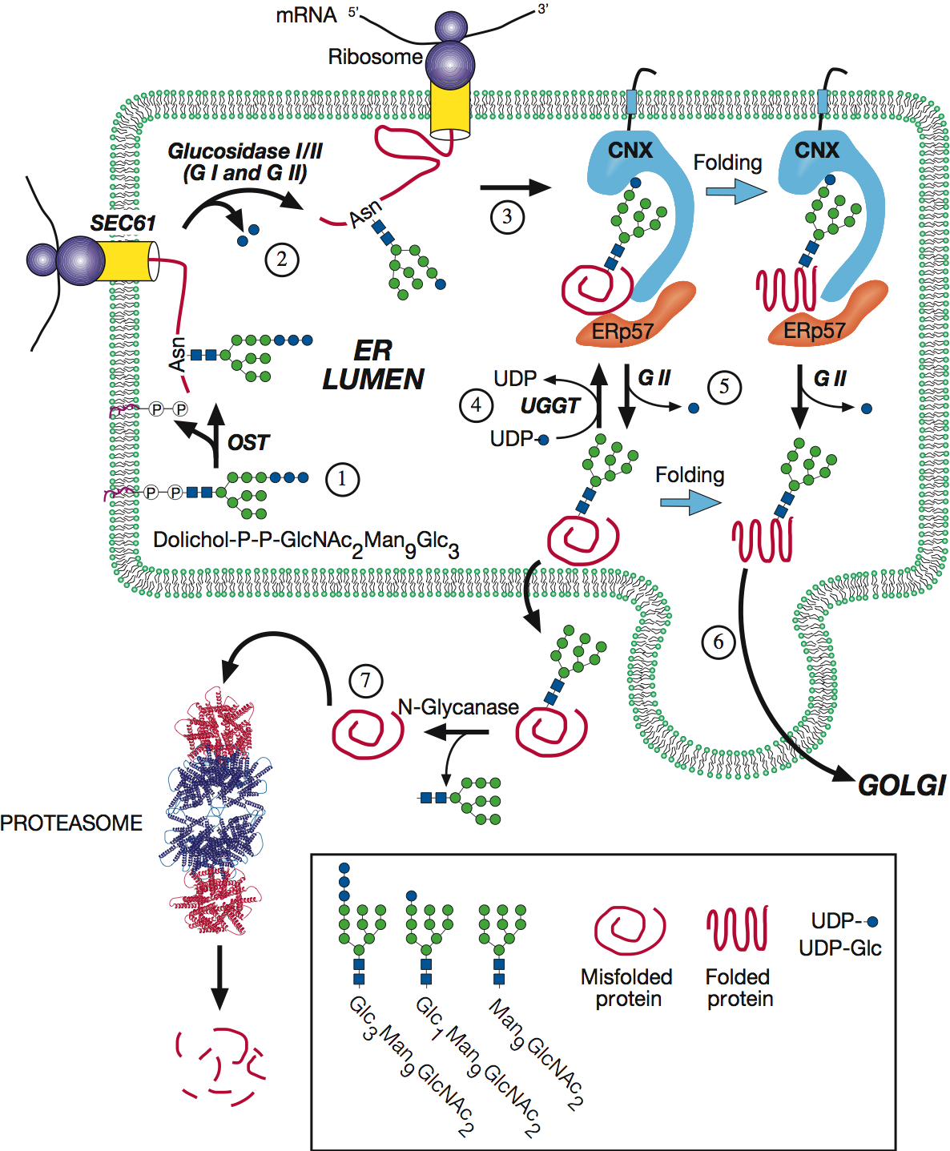


Model proposed for the quality control of glycoprotein folding
Essentials of Glycobiology
Chapter 36, Figure 2
Second Edition
Notes:
FIGURE 36.2. Model proposed for the quality control of glycoprotein folding. Proteins entering the ER are N-glycosylated by the oligosaccharyltransferase (OST) as they emerge from the translocon (SEC61) (1). Two glucose residues are removed by the sequential action of α-glucosidases GI and GII to generate monoglucosylated species (2) that are recognized by CNX and/or CRT (only CNX is shown) and are associated with ERp57 (3). The complex between the lectins and folding intermediates/misfolded glycoproteins dissociates upon removal of the last glucose by GII, and is reformed by α-glucosyltransferase (UGGT) (4). Once glycoproteins have acquired their native conformations, either free or bound to lectins, GII hydrolyzes the remaining glucose residue and releases the glycoproteins from the lectin anchors (5). These species are not recognized by UGGT and are transported to the Golgi (6). Glycoproteins remaining in misfolded conformations are retrotranslocated to the cytoplasm, where they are deglycosylated and degraded by the proteasome (7). One or more mannose residues may be removed during the whole folding process. (Modified, by permission of Oxford University Press, from Winchester B. 2005. Glycobiology 15: R1–R15.)

