Slide 1
State of Washington
Washington’s Lottery
Human Resource
Management Report
Plan & Align Workforce
Hire Workforce
Deploy Workforce
Reinforce Performance
Develop Workforce
October 2007

Slide 2
Managers’ Logic Model for Workforce Management
Outputs
Initial Outcomes
Intermediate Outcomes
Plan & Align Workforce
Articulation of managers HRM accountabilities. HR policies. Workforce planning. Job classes & salaries assigned.
Managers understand HRM accountabilities. Jobs, staffing levels, & competencies aligned with agency priorities.
Foundation is in place to build and sustain a productive, high performing workforce.
Hire
Workforce
Qualified candidate pools, interviews & reference checks. Job offers. Appts & per-
formance monitoring.
Best candidate hired & reviewed during appointment period. Successful performers retained.
The right people are in the right job at the right time.
Ultimate Outcomes
Employees are committed to the work they do & the goals of the organization
Productive, successful employees are retained
State has workforce depth & breadth needed for present and future success
Deploy
Workforce
Work assignments& requirements defined. Positive workplace environment created. Coaching, feedback, corrections.
Workplace is safe, gives capacity to perform, & fosters productive relations. Staff know job rqmts, how they’re doing, & are supported.
Time & talent is used effectively. Employees are motivated & productive.
Develop Workforce
Individual development plans. Time/ resources for training. Continuous learning environment created.
Learning environment created. Employees are engaged in develop-
ment opportunities & seek to learn.
Employees have competencies for present job & career advancement
Agencies are better enabled to successfully carry out their mission. The citizens receive efficient government services.
Reinforce Performance
Clear performance expectations linked to orgn’al goals & measures. Regular performance appraisals. Recognition. Discipline.
Employees know how performance contributes to success of orgn. Strong performance rewarded; poor performance eliminated
Successful perf is differentiated & strengthened. Employees are held accountable.

Slide 3
Standard Performance Measures
Plan & Align Workforce
Percent supervisors with current performance expectations for workforce management
Management profile
Workforce planning measure (TBD)
Percent employees with current position/competencies descriptions
Time-to-fill funded vacancies
Candidate quality
Hiring Balance (Proportion of appointment types)
Separation during review period
Percent employees with current performance expectations
Employee survey ratings on “productive workplace” questions
Overtime usage
Sick leave usage
Non-disciplinary grievances/appeals filed and disposition (outcomes)
Worker safety
Percent employees with current individual development plans
Employee survey ratings on “learning & development” questions
Competency gap analysis (TBD)
Percent employees with current performance evaluations
Employee survey ratings on “performance & accountability” questions
Disciplinary actions and reasons, disciplinary grievances/appeals filed and disposition (outcomes)
Reward and recognition practices (TBD)
Ultimate Outcomes
Hire
Workforce
Employee survey ratings on “commitment” questions
Turnover rates and types
Turnover rate: key occupational categories
Workforce diversity profile
Retention measure (TBD)
Deploy
Workforce
Develop Workforce
Reinforce Performance

Slide 4
Plan & Align Workforce
Outcomes:
Managers understand workforce management accountabilities. Jobs and competencies are defined and aligned with business priorities. Overall foundation is in place to build & sustain a high performing workforce.
Performance Measures:
Percent supervisors with current performance expectations for workforce management
Management profile
Workforce Planning measure (TBD)
Percent employees with current position/ competency descriptions
Workforce Management Expectations
Percent supervisors with current performance expectations for workforce management = 100%*
Analysis:
All supervisors have received initial PDP training (12 hours) and annual refresher training (4 hours).
Supervisors are evaluated against the workforce management expectations that have been established in their PDPs. These expectations, at a minimum, require:
  Written performance expectations with outcomes that are measurable or observable
  A training and development plan
  Ongoing timely and honest performance feedback, including written quarterly performance reviews.
Action Steps:
Continue providing ongoing manager/supervisor training and engaging in one-on-one support with managers as needed.
Continue to ensure new supervisors attend the required supervisory training.
*Based on 29 of 29 reported number of supervisors
Data as of July 1, 2007
Source: Agency-tracked Data

Slide 5
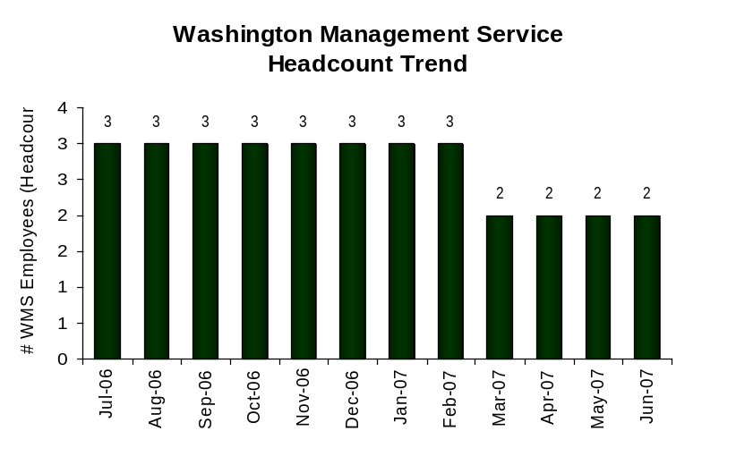
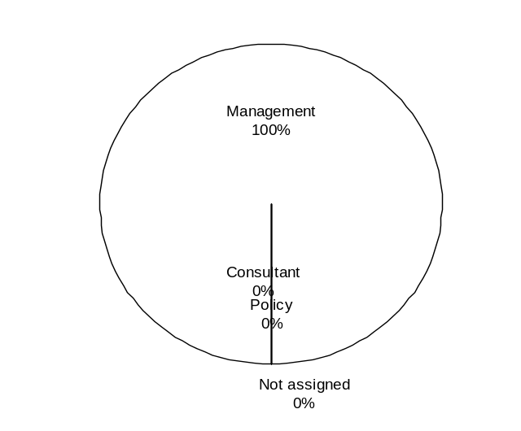
Plan & Align Workforce
Outcomes:
Managers understand workforce management accountabilities. Jobs and competencies are defined and aligned with business priorities. Overall foundation is in place to build & sustain a high performing workforce.
Performance Measures:
Percent supervisors with current performance expectations for workforce management
Management profile
Workforce Planning measure (TBD)
Percent employees with current position/ competency descriptions
Management Profile
WMS Employees Headcount = 2
Percent of agency workforce that is WMS = 1.4%
Managers* Headcount = 19
Percent of agency workforce that is Managers* = 13.7%
* In positions coded as “Manager” (includes EMS, WMS, and GS)
Analysis:
Washington’s Lottery currently has two filled WMS positions:
  Retailer Services Manager – manages two supervisory positions
  Distribution Manager – manages Warehouse/Shipping operations, including one supervisor.
The Budget Manager position is currently vacant and has been reduced to .6 to meet the agency’s mid-management reduction target.
Action Steps:
Continue to evaluate position allocations and management designations as changes occur to ensure designations remain appropriate.
Management 2
Consultant 0*
Policy 0
Not Assigned 0
* Based on headcount on June 30, 2007. One position designated as “Consultant” is currently vacant.
Data as of July 1, 2007
Source: HRMS Business Warehouse

Slide 6
Plan & Align Workforce
Outcomes:
Managers understand workforce management accountabilities. Jobs and competencies are defined and aligned with business priorities. Overall foundation is in place to build & sustain a high performing workforce.
Performance Measures:
Percent supervisors with current performance expectations for workforce management
Management profile
Workforce Planning measure (TBD)
Percent employees with current position/ competency descriptions
Current Position/Competency Descriptions
Percent employees with current position/competency descriptions = 93.3%*
Analysis:
Lottery continues review and update Position Descriptions and Job Analyses when duties change and prior to filling vacant positions.
Key Results Expected and Key Competencies are identified in each employee’s PDP. 100% of PDPs are current.
Action Steps:
The target set for 100% completion in the May 2007 HR Management Report was October 1, 2007. As of July 31, 2007, we have updated 93.3 percent of our employee Position Descriptions.
  HR will continue to work with employees and supervisors to ensure 100% completion for the HR Management Report covering the July – December 2007 reporting period.
*Based on 99 of 106 reported employee count
Applies to employees in permanent positions, both WMS & GS
Data as of July 31, 2007]
Source: Agency-tracked Data

Slide 7
Hire Workforce
Outcomes:
Best candidates are hired and reviewed during appointment period. The right people are in the right job at the right time.
Performance Measures
Time-to-fill vacancies
Candidate quality
Hiring Balance (proportion of appointment types)
Separation during review period
Time-to-fill / Candidate Quality
Time-to-fill Funded Vacancies
Average number of days to fill*: General Gov’t 30
Exempt 77
Number of vacancies filled: 9
*Equals # of days from creation of the requisition to job offer acceptance
Time Period: [January 2007 – June 2007]
Analysis:
Nine positions were filled during this reporting period. One requisition is open continuous – applicants are selected based on geographic availability, score, and in accordance with the collective bargaining agreement requirements.
Due to E-Recruiting difficulties, the Lottery does not use E-Recruiting exclusively. Rather, E-Recruiting is used only in conjunction with other recruiting avenues – for example, applications and resumes are accepted directly at the agency as well as through E-Recruiting. Time to fill is agency-tracked.
Lottery is not formally surveying managers regarding candidate quality.
The Lottery uses a thorough, multi-step hiring process that generally includes at least two panel interviews and a background investigation. Although the process can be lengthy, we believe the employees selected through this process possess the competencies necessary for success.
Action Steps:
Continue to work to reduce time to hire, particularly the time between first- and second-round interviews.
By June 30, 2008, develop a plan to implement Candidate Quality Surveys.
Candidate Quality
Of the candidates interviewed for vacancies, how many had the competencies (knowledge, skills & abilities) needed to perform the job?
  Number = [XXX] Percentage = [XXX]
Of the candidates interviewed, were hiring managers able to hire the best candidate for the job?
  Hiring managers indicating “yes”:
  Number = [XXX] Percentage = [XXX]
  Hiring managers indicating “no”:
  Number = [XXX] Percentage = [XXX]
Time Period: [mm/dd/yyyy – mm/dd/yyyy]
Lottery has not begun using formal Candidate Quality Surveys.
Data as of July 1, 2007
Source: Agency-tracked Data

Slide 8
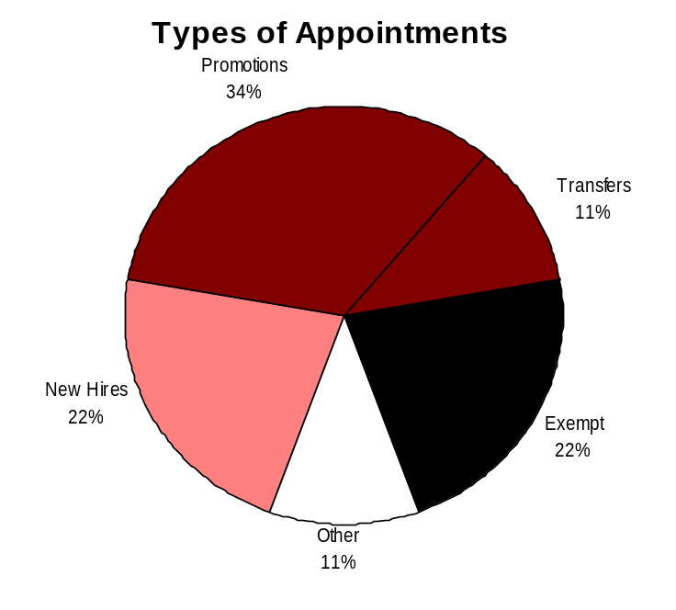
Hire Workforce
Outcomes:
Best candidates are hired and reviewed during appointment period. The right people are in the right job at the right time.
Performance Measures
Time-to-fill vacancies
Candidate quality
Hiring Balance (proportion of appointment types)
Separation during review period
Hiring Balance / Separations During Review Period
Analysis:
Figures obtained from the Business Warehouse were corrected to include actions that were not reflected.
New Hires and Promotions continue to be well-balanced.
There were no probationary or trial service separations during this time frame. The employees appointed during this time frame have demonstrated the competencies necessary for success.
Two exempt appointments included one employee new to state service and one exempt appointment from within the agency.
Action Steps:
Agency managers and Human Resources will continue to work closely together to identify high-quality candidates who possess the competencies necessary for success. This includes performing in-depth job analyses; clearly identifying critical competencies for inclusion in recruitments; careful screening of applicants; and detailed employee selection processes.
Managers will continue to closely monitor employee performance and consult with Human Resources to resolve issues early.
Total number of appointments = 9*
Time period = January 2007 through June 2007
Includes appointments to permanent vacant positions only; excludes reassignments
“Other” = Demotions, re-employment, reversion & RIF appointments
Separation During Review Period
Probationary separations - Voluntary 0
Probationary separations - Involuntary 0
  Total Probationary Separations 0
Trial Service separations - Voluntary 0
Trial Service separations - Involuntary 0
  Total Trial Service Separations 0
Total Separations During Review Period 0
Time period = January 2007 through June 2007
Data as of July 1, 2007
Source: HRMS Business Warehouse and Agency-tracked Data

Slide 9
Deploy Workforce
Outcomes:
Staff know job expectations, how they’re doing, & are supported. Workplace is safe, gives capacity to perform, & fosters productive relations. Employee time and talent is used effectively. Employees are motivated.
Performance Measures
Percent employees with current performance expectations
Employee survey ratings on “productive workplace” questions
Overtime usage
Sick leave usage
Non-disciplinary grievances/appeals filed and disposition (outcomes)
Worker safety
Current Performance Expectations
Percent employees with current performance expectations = 100%*
Analysis:
Performance expectations are established during the PDP process each year. Expectations are reviewed during the Quarterly Review process and are updated as necessary to reflect the key results expected and key competencies for the current evaluation period.
100 percent of all Lottery employees have current performance expectations, including 104 General Government employees, 2 Washington Management employees, and 33 exempt employees.
Action Steps:
Ensure that performance expectations are developed with newly appointed employees within two weeks of appointment.
Monitor quarterly performance reviews to ensure expectations are reviewed and discussed with all employees as required.
*Based on 106 of 106 reported employee count
Applies to employees in permanent positions, both WMS & GS
In addition, 33 exempt employees have current performance expectations.
Data as of July 31, 2007
Source: Agency-tracked Data

Slide 10
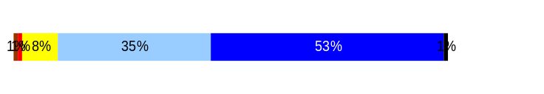
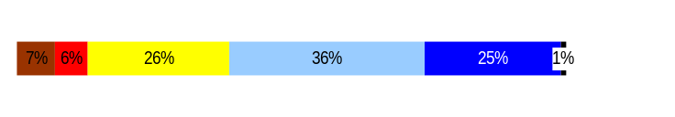
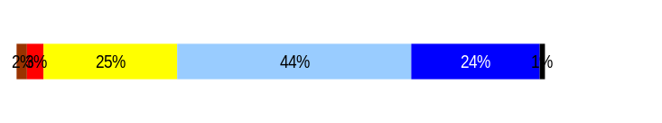
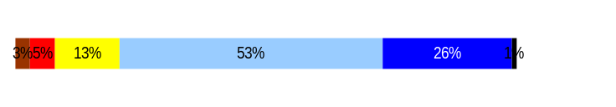
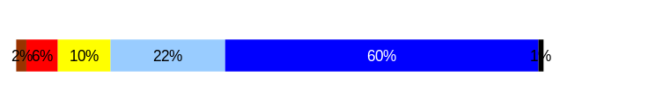
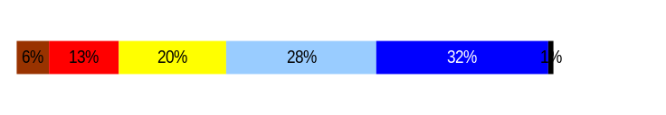
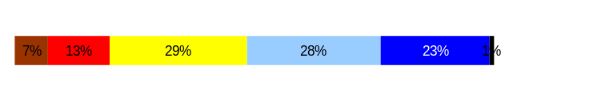
Deploy Workforce
Outcomes:
Staff know job expectations, how they’re doing, & are supported. Workplace is safe, gives capacity to perform, & fosters productive relations. Employee time and talent is used effectively. Employees are motivated.
Performance Measures
Percent employees with current performance expectations
Employee survey ratings on “productive workplace” questions
Overtime usage
Sick leave usage
Non-disciplinary grievances/appeals filed and disposition (outcomes)
Worker safety
Employee Survey “Productive Workplace” Ratings
Avg
Q4. I know what is expected of me at work.
Q1. I have opportunity to give input on decisions affecting my work.
Q2. I receive the information I need to do my job effectively.
Q6. I have the tools and resources I need to do my job effectively.
Q7. My supervisor treats me with dignity and respect.
Q8. My supervisor gives me ongoing feedback that helps me
improve my performance.
Q9. I receive recognition for a job well done.
4.38
Analysis:
No data changes since previous report.
Lottery Employee Survey ratings for “Productive Workplace” questions are equal to or above statewide averages.
Lottery managers met with employees and put action plans in place to address employee concerns following the 2006 Employee Survey.
Action Steps:
Lottery supervisors are conducting quarterly performance reviews in addition to the annual PDP in order to provide ongoing feedback.
The agency is working toward obtaining Performance Management Confirmation to further enhance employee satisfaction regarding Productive Workplace ratings.
Further analysis and follow-up will be done following the 2007 Employee Survey.
3.67
3.86
3.94
4.33
3.7
3.48
Never
Seldom
Occasionally
Usually
Always
Overall average score for Productive Workplace Ratings: 3.9
Data as of July 1, 2007
Source: DOP Employee Survey

Slide 11
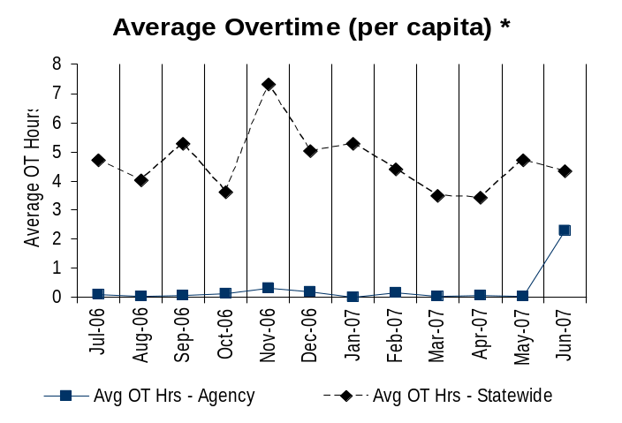
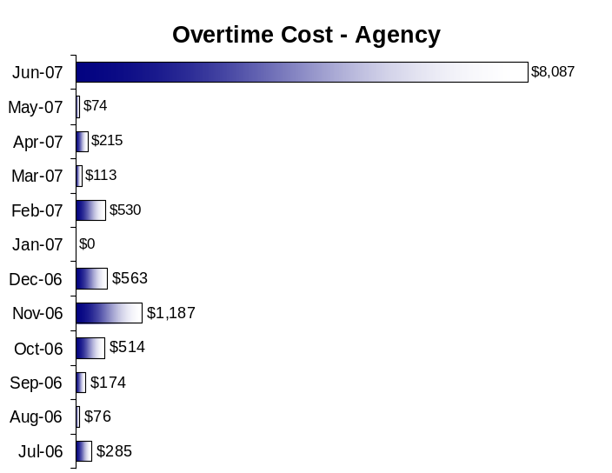
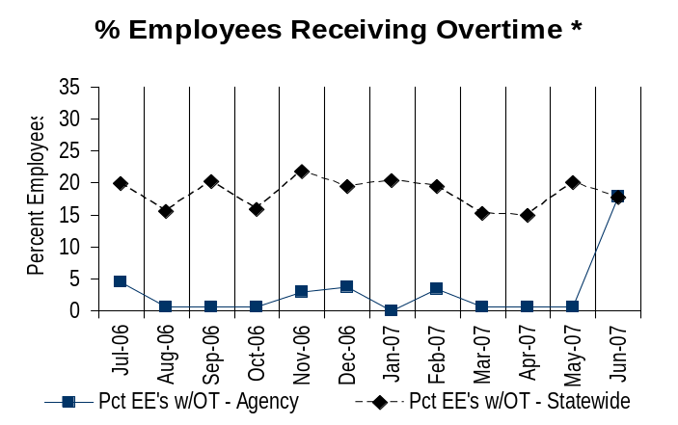
Deploy Workforce
Outcomes:
Staff know job expectations, how they’re doing, & are supported. Workplace is safe, gives capacity to perform, & fosters productive relations. Employee time and talent is used effectively. Employees are motivated.
Performance Measures
Percent employees with current performance expectations
Employee survey ratings on “productive workplace” questions
Overtime usage
Sick leave usage
Non-disciplinary grievances/appeals filed and disposition (outcomes)
Worker safety
Overtime Usage
Overall agency avg overtime usage – per capita, per month: 4.62**
*Statewide overtime values do not include DNR
**Overall agency avg overtime usage – per capita, per month = sum of monthly OT averages divided by number of months
Analysis:
Lottery’s Average Overtime (per capita) and % of Employees Receiving Overtime are consistently lower than the state average.
Approximately 52 percent of the overtime paid during between July and December 2006 was the result of a serious injury to an employee that caused the other person in the unit to work overtime in order to meet deadlines.
The overtime paid in June 2007 was primarily due to the agency’s All-Employee Conference, which took place during a weekend, resulting in overtime for overtime-eligible staff. These expenses were budgeted.
Approximately 65% of Lottery staff are overtime-exempt, which contributes to low overtime costs.
Action Steps:
Continue to closely manage overtime.
Overall agency avg employees receiving overtime per month: 3.06%**
*Statewide overtime values do not include DNR
**Overall agency avg employees receiving overtime per month = sum of monthly OT percentages divided by number of months
Data as of July 1, 2007
Source: HRMS Business Warehouse

Slide 12
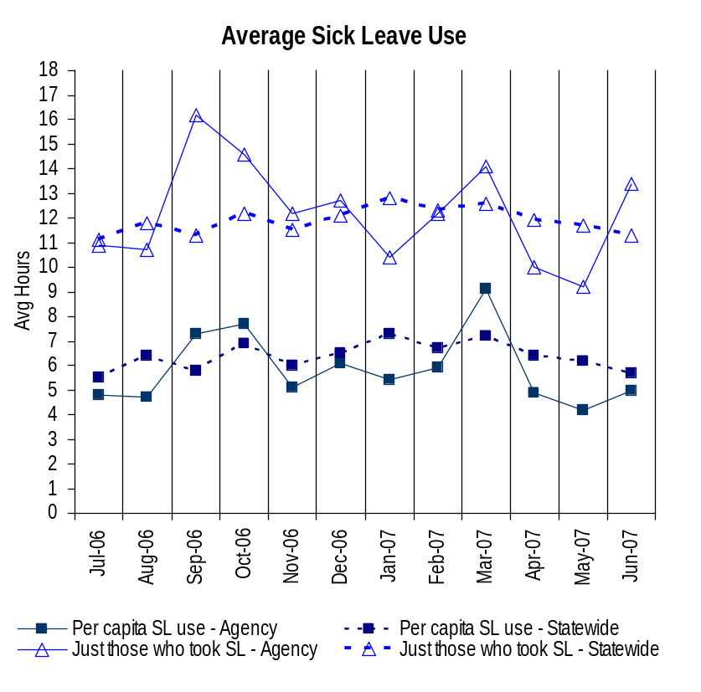
Deploy Workforce
Outcomes:
Staff know job expectations, how they’re doing, & are supported. Workplace is safe, gives capacity to perform, & fosters productive relations. Employee time and talent is used effectively. Employees are motivated.
Performance Measures
Percent employees with current performance expectations
Employee survey ratings on “productive workplace” questions
Overtime usage
Sick leave usage
Non-disciplinary grievances/appeals filed and disposition (outcomes)
Worker safety
Sick Leave Usage
Analysis:
Per Capita – Agency sick leave usage remains constant at 5.9 hours; the average usage for those who took sick leave reflects a 5.4 percent reduction this reporting period.
July 2006 through December 2006 average sick leave use for those who took sick leave was 12.9 hours, or 161.2 percent of the leave earned for the same time period. Sick leave usage for the current period of January 2007 through June 2007 is 11.6 hours, or 145 percent of the leave earned for the same period.
Sick leave usage in March 2007 was unusually high due to FMLA issues with five employees. Those five employees took 284 hours of sick leave in March.
Average sick leave balance as of December 31, 2006 was 313.05 hours; average sick leave balance as of June 30, 2007 was 328.9.
Action Steps:[
Continue to concentrate on reducing unplanned sick leave use.
Continue working with supervisors and employees regarding proper leave usage.
Continue to promote wellness activities, including influenza immunizations.
Sick Leave Hrs Used / Earned (per capita)
Avg Hrs SL Used (per capita) - Agency | % of SL Hrs Earned (per capita) - Agency
5.9 Hrs | 74.5%
Avg Hrs SL Used (per capita) – Statewide* | % of SL Hrs Earned (per capita) – Statewide*
6.4 Hrs | 82.5%
Sick Leave Hrs Used / Earned (those who took SL)
Avg Hrs SL Used (those who took SL) - Agency | % SL Hrs Earned (those who took SL) - Agency
12.2 Hrs | 152.8%
Avg Hrs SL Used (those who took SL) – Statewide* | % SL Hrs Earned (those who took SL) – Statewide*
11.9 Hrs | 148.4%
Sick Leave time period = July 2006 through June 2007
* Statewide data does not include DOL, DOR, L&I, and LCB
Source: DOP

Slide 13
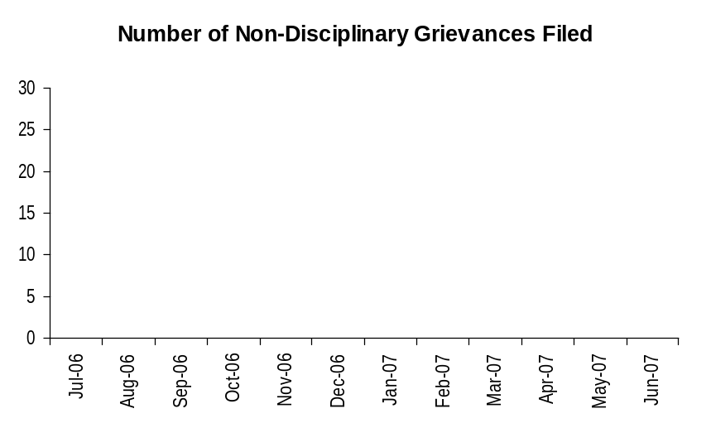
Deploy Workforce
Outcomes:
Staff know job expectations, how they’re doing, & are supported. Workplace is safe, gives capacity to perform, & fosters productive relations. Employee time and talent is used effectively. Employees are motivated.
Performance Measures
Percent employees with current performance expectations
Employee survey ratings on “productive workplace” questions
Overtime usage
Sick leave usage
Non-disciplinary grievances/appeals filed and disposition (outcomes)
Worker safety
Non-Disciplinary Grievances (represented employees)
Analysis:
No non-disciplinary grievances filed or determined during this reporting period.
Action Steps:
Continue to be diligent in applying the collective bargaining agreement and working to resolve issues at the lowest possible level.
Total Non-Disciplinary Grievances = 0
Non-Disciplinary Grievance Disposition*
(Outcomes determined during January 2007 through June 2007)
N/A – no non-disciplinary grievances filed
* There may not be a one-to-one correlation between the number of grievances filed (shown top of page) and the outcomes determined during this time period. The time lag between filing date and when a decision is rendered can cross the time periods indicated.
Data as of July 1, 2007
Source: Agency-tracked Data

Slide 14
Deploy Workforce
Outcomes:
Staff know job expectations, how they’re doing, & are supported. Workplace is safe, gives capacity to perform, & fosters productive relations. Employee time and talent is used effectively. Employees are motivated.
Performance Measures
Percent employees with current performance expectations
Employee survey ratings on “productive workplace” questions
Overtime usage
Sick leave usage
Non-disciplinary grievances/appeals filed and disposition (outcomes)
Worker safety
Non-Disciplinary Appeals (mostly non-represented employees)
Filings for DOP Director’s Review
Time Period = January 2007 through June 2007
0 Job classification
0 Rule violation
0 Name removal from register
0 Rejection of job application
0 Remedial action
0 Total filings
Filings with Personnel Resources Board
Time Period = January 2007 through June 2007
0 Job classification
0 Other exceptions to Director Review
0 Layoff
0 Disability separation
0 Non-disciplinary separation
0 Total filings
Non-Disciplinary appeals only are shown above.
There is no one-to-one correlation between the filings shown above and the outcomes displayed in the charts below. The time lag between filing date and when a decision is rendered can cross the time periods indicated.
Total outcomes = 0
Time Period = January 2007 through June 2007
Total outcomes = 0
Time Period = January 2007 through June 2007
Source: Dept of Personnel

Slide 15
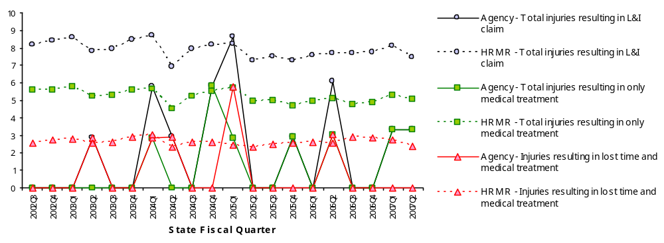
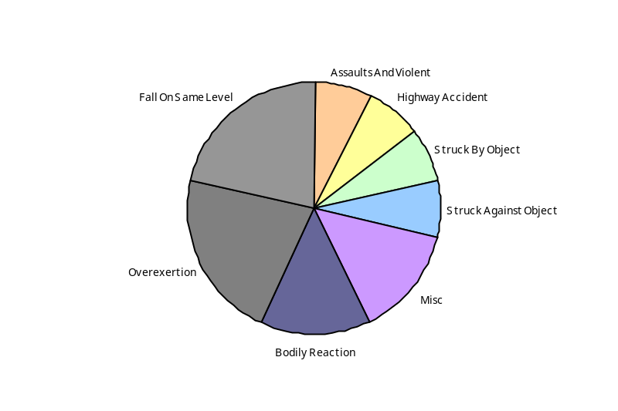
Deploy Workforce
Outcomes
Staff know job expectations, how they’re doing, & are supported. Workplace is safe, gives capacity to perform, & fosters productive relations. Employee time and talent is used effectively. Employees are motivated.
Performance Measures
Percent employees with current performance expectations
Employee survey ratings on 'productive workplace' questions
Overtime usage
Sick leave usage
Non-disciplinary grievances/appeals filed and disposition outcomes
Worker Safety
Worker Safety: Lottery, Washington State
Analysis:
In FY 07 and 08, overexertion and falls accounted for the largest percentage of injuries at 21% each. The part of the body injured most frequently is the back – 75% of injuries.
District Sales Representatives account for the largest percentage of injuries – 75% of injury claims.
Action Plan:
Provide L&I’s “Back Your Back” training video to all District Sales Representatives by January 31, 2008.
Continue working closely with injured workers to achieve early return to work, using light-duty jobs when possible.
Obtain additional records to perform further analysis and action planning.
Allowed Annual
Claims Rate*^:
Agency vs. All HR
Management Report
(HRMR) agencies
*Annual claims rate
is # claims / 100 FTE
1 FTE = 2000 hours
^Due to natural lag
in claim filing, rates
are expected to
increase significantly
over time
Injuries by Occupational
Injury and Illness
Classification (OIICS)
event:
For fiscal period 2002Q3
through 2007Q2
(categories under 3% or not
adequately coded are grouped
into 'misc.')
Oiics Code | Oiics Description | Percent | Number
61 | Assaults And Violent | 7% | 1
21 | Bodily Reaction | 14% | 2
13 | Fall On Same Level | 21% | 3
41 | Highway Accident | 7% | 1
- | Misc | 14% | 2
22 | Overexertion | 21% | 3
01 | Struck Against Object | 7% | 1
02 | Struck By Object | 7% | 1
Source: Labor & Industries, Research and Data Services (data as of 09/03/2007 )
Notes:
HRMR Safety Report Overview
The HRMR Safety Reports are:
- PowerPoint slides created by the Department of Labor and Industries
- Created for each state agency that is reporting their employee safety program results bi-
annually as part of their Human Resources Management Report (HRMR).
- Snapshots of five years of worker’s compensation claim data specific to that agency, as
well as a comparison to the combined data for agencies completing HRMR reports.
- There is a two quarter lag at the end of the five years.
This allows each agency’s payroll data to be entered into L&I’s computer system. This
payroll data is used to compute the number of workers per agency and quarter.
Definitions
Claim – When a covered worker sustains an occupational injury or illness, that worker files a
'claim’ for benefits. A 'claim number' is assigned, and all wage replacement payments, medical
provider bills, etc, for that worker and injury, are associated with that claim number.
Report Detail
'Allowed Annual Claim Rate'
This chart shows your agency's rate of injuries resulting in allowed
claims, by injury quarter, for on-the-job injuries and occupational illnesses. The rate for all
reporting agencies is shown for comparison.
- The rate is the number accepted claims per 200,000 annual worker hours (100 workers)
Three rates are included in this chart:
A)The total rate for all injuries resulting in a claim; the two groups listed below are
exclusive of each other.
B)The rate of injuries which required medical care, but no compensation for lost
time.
C)The rate of injuries which resulted in compensation for lost time in addition to
medical care.
'Injuries by Occupational Injury and Illness Classification (OIICS) Event’
This section contains a pie chart which shows your agency's injuries by type* and a table which
shows the percent and number of accepted claims by OIICS Event description and code.
This information is useful in identifying what causes injuries so prevention can occur. Prevention
might include root cause analysis, education, and hazard mitigation.
* Injury Type is based on the 2 digit Major Group code of the Event or Exposure section of the Occupational
Injury and Illness Classification System (OIICS). Groups with less than 3% of the
total injuries are combined into the 'Misc' category.
How to get this report for your agency:
All worker compensation reports will be available on the L&I website by the 20th of September or
the 20th of March of each year. The data will be provided in a PowerPoint slide to which you will
add your own analyses and action plans.

Slide 16
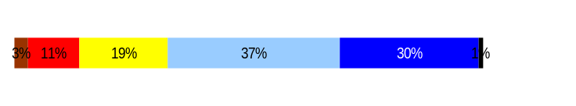
Develop Workforce
Outcomes:
A learning environment is created. Employees are engaged in professional development and seek to learn. Employees have competencies needed for present job and future advancement.
Performance Measures
Percent employees with current individual development plans
Employee survey ratings on “learning & development” questions
Competency gap analysis (TBD)
Individual Development Plans
Percent employees with current individual development plans = 100%*
Analysis:
100 percent of 106 General Government and Washington Management Service employees have current individual development plans that were developed as part of the annual PDP process.
The status of the training plan is reviewed during the Quarterly Review process.
Employee Survey ratings for questions 5 and 8 are equal to or higher than the average statewide ratings.
Lottery currently has six employees participating in the Tuition Reimbursement program and one in an in-training program.
Action Steps:
Continue monitoring employee participation in training and development and encourage developmental opportunities such as job rotations, special projects, in-training programs, participation on cross-divisional work groups.
*Based on 106 of 139 reported employee count
Applies to employees in permanent positions, both WMS & GS
Q5. I have opportunities at work to learn and grow.
Q8. My supervisor gives me ongoing feedback that helps me
improve my performance.
Employee Survey “Learning & Development” Ratings
Avg
3.8
3.7
Overall average score for Learning & Development Ratings: 3.75
Data as of July 1, 2007
Source: DOP Employee Survey

Slide 17
Reinforce Performance
Outcomes:
Employees know how their performance contributes to the goals of the organization. Strong performance is rewarded; poor performance is eliminated. Successful performance is differentiated and strengthened. Employees are held accountable.
Performance Measures
Percent employees with current performance evaluations
Employee survey ratings on “performance and accountability” questions
Disciplinary actions and reasons, disciplinary grievances/appeals filed and disposition (outcomes)
Reward and recognition practices (TBD)
Current Performance Evaluations
Percent employees with current performance evaluations = 100%*
Analysis:
Lottery has made timely evaluations a priority; all evaluations have been submitted timely for the past three years.
Lottery supervisors conduct quarterly reviews with all employees.
All Lottery employees attended PDP training that reinforced the importance of active participation in the PDP process during this reporting period.
All Lottery staff attended Performance Management training that addressed the importance of ongoing performance feedback and connecting employee expectations to the agency’s Strategic Plan.
Action Steps:
Continue requiring 100% timely annual evaluations and quarterly reviews.
Continue providing PDP training to new supervisors and annual refresher training for all supervisors.
Continue providing PDP training for all employees to reinforce the importance of active participation in the PDP process
*Based on 106 of 106 reported employee count
Applies to employees in permanent positions, both WMS & GS
Data as of July 31, 2007
Source: Agency-tracked Data

Slide 18
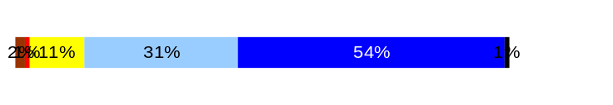
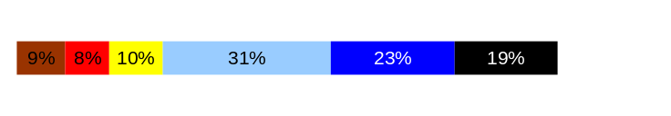
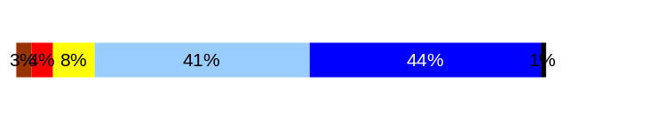
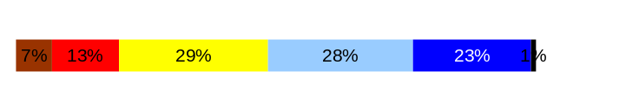
Reinforce Performance
Outcomes:
Employees know how their performance contributes to the goals of the organization. Strong performance is rewarded; poor performance is eliminated. Successful performance is differentiated and strengthened. Employees are held accountable.
Performance Measures
Percent employees with current performance evaluations
Employee survey ratings on “performance and accountability” questions
Disciplinary actions and reasons, disciplinary grievances/appeals filed and disposition (outcomes)
Reward and recognition practices (TBD)
Employee Survey “Performance & Accountability” Ratings
Q3. I know how my work contributes to the goals of my agency.
Q10. My performance evaluation provides me with meaningful information about my performance.
Q11. My supervisor holds me and my co-workers accountable for performance.
Q9. I receive recognition for a job well done.
Analysis:
Employee Survey ratings for Questions 3, 9, 10, and 11 are above the average statewide ratings.
Lottery managers put plans in place following this survey to address employee concerns.
Action Steps:
Further analysis and follow-up will be done following the 2007 Employee Survey.
Continue providing PDP training to new supervisors and annual refresher training for all supervisors to emphasize the importance of ongoing, meaningful feedback.
Continue to reinforce the importance of active employee participation in the PDP process.
The agency is working toward obtaining Performance Management Confirmation to further enhance employee satisfaction regarding Performance and Accountability ratings.
4.36
3.62
4.2
3.48
Never
Seldom
Occasionally
Usually
Always
Overall average score for “Performance & Accountability” ratings: 3.9
Data as of [Enter Date]
Source: [Enter Data Source]

Slide 19
Reinforce Performance
Outcomes:
Employees know how their performance contributes to the goals of the organization. Strong performance is rewarded; poor performance is eliminated. Successful performance is differentiated and strengthened. Employees are held accountable.
Performance Measures
Percent employees with current performance evaluations
Employee survey ratings on “performance and accountability” questions
Disciplinary actions and reasons, disciplinary grievances/appeals filed and disposition (outcomes)
Reward and recognition practices (TBD)
Formal Disciplinary Actions
Disciplinary Action Taken
Time period = January 2007 through June 2007
Analysis:
No formal disciplinary actions this reporting period.
Two employees received written reprimands during this time frame.
  Reprimands were issued due to non work-related computer use and inappropriate/unprofessional behavior.
Action Steps:
Human Resources will continue to work closely with supervisors and managers to address issues without delay.
Dismissals | 0
Demotions | 0
Suspensions | 0
Reduction in Pay* | 0
Total Disciplinary Actions* | 0
* Reduction in Pay is not currently available in HRMS/BW.
Issues Leading to Disciplinary Action
Data as of July 1, 2007
Source: Agency-tracked Data

Slide 20
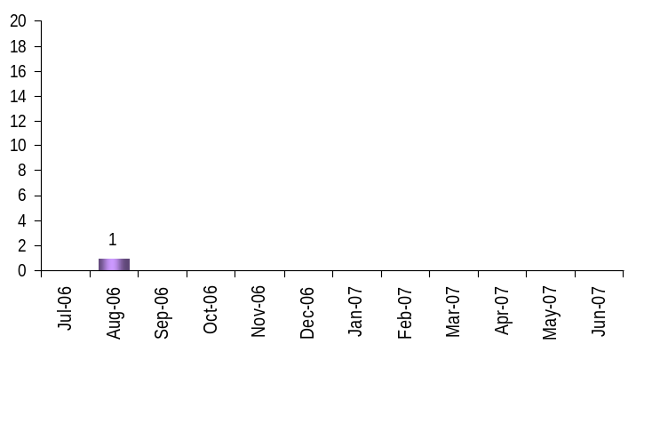
Reinforce Performance
Outcomes:
Employees know how their performance contributes to the goals of the organization. Strong performance is rewarded; poor performance is eliminated. Successful performance is differentiated and strengthened. Employees are held accountable.
Performance Measures
Percent employees with current performance evaluations
Employee survey ratings on “performance and accountability” questions
Disciplinary actions and reasons, disciplinary grievances/appeals filed and disposition (outcomes)
Reward and recognition practices (TBD)
Disciplinary Grievances and Appeals
Disciplinary Grievances
(Represented Employees)
Disciplinary Appeals
(Non-Represented Employees
filed with Personnel Resources Board)
Time Period = January 2007 through July 2007
0 Dismissal
0 Demotion
0 Suspension
0 Reduction in salary
0 Total Disciplinary Appeals Filed with PRB
Total # Disciplinary Grievances Filed: 1
There is no one-to-one correlation between the filings shown above and the outcomes displayed in the charts below. The time lag between filing date and when a decision is rendered can cross the time periods indicated.
Disposition (Outcomes) of Disciplinary Grievances
Time period = July 2006 through June 2007
The disciplinary grievance filed in August 2006 was withdrawn.
Disposition (Outcomes) of Disciplinary Appeals*
Time period = January 2007 through June 2007
*Outcomes issued by Personnel Resources Board
Data as of July 1, 2007
Source: Agency-tracked Data

Slide 21
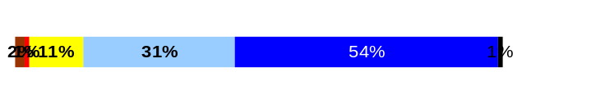
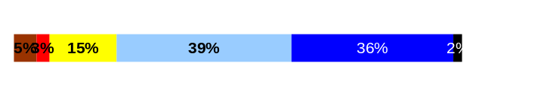
ULTIMATE OUTCOMES
Employees are committed to the work they do and the goals of the organization
Successful, productive employees are retained
The state has the workforce breadth and depth needed for present and future success
Performance Measures
Employee survey ratings on “commitment” questions
Turnover rates and types
Turnover rate: key occupational categories
Workforce diversity profile
Retention measure (TBD)
Employee Survey “Employee Commitment” Ratings
Avg
Analysis:
Lottery Employee Survey ratings for “Productive Workplace” questions are equal to or above statewide averages.
Lottery managers put plans in place following this survey to address employee concerns.
Action Steps:
Follow-up analysis will be done following the 2007 Employee Survey.
Lottery employees are encouraged to attend the agency’s internal GMAP presentations to enhance understanding of how the agency measures its success.
The agency is working toward obtaining Performance Management Confirmation as one way to further support employees regarding employee commitment topics.
Q3. I know how my work contributes to the goals of my agency.
Q12. I know how my agency measures its success.
Q9. I receive recognition for a job well done.
4.36
4.01
3.48
Never
Seldom
Occasionally
Usually
Always
Overall average score for Employee Commitment ratings: 3.9
Data as of [Enter Date]
Source: [Enter Data Source]

Slide 22
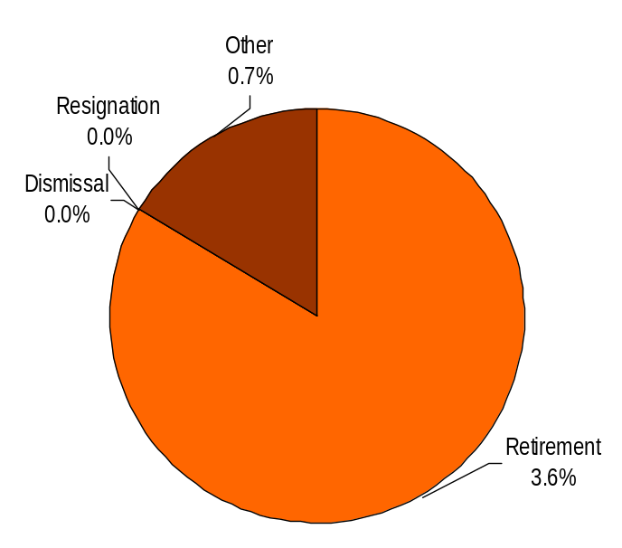
ULTIMATE OUTCOMES
Employees are committed to the work they do and the goals of the organization
Successful, productive employees are retained
The state has the workforce breadth and depth needed for present and future success
Performance Measures
Employee survey ratings on “commitment” questions
Turnover rates and types
Turnover rate: key occupational categories
Workforce diversity profile
Retention measure (TBD)
Turnover Rates
Total % Turnover (leaving state)
Time Period: January 2007 through June 2007
Analysis:
Turnover for this reporting period included five retirements and one death.
The Lottery currently experiences low turnover and a stable workforce.
The Human Resources Director regularly conducts exit interviews with staff who leave the agency. Information gathered is reviewed for trends and shared with the appropriate Division Director, the Deputy Director, and Director.
The agency has a large number of employees who are currently eligible to retire. By 2010, approximately 42 percent of the Lottery’s employees will be eligible to retire.
Action Steps:
Continue succession planning efforts. Be open about those we are mentoring, training, and moving toward advancement. Get employee involvement in their future planning.
The agency is pursuing Performance Management Confirmation that will allow the use of Performance Recognition pay, which is intended to support employee retention. This will support the training and mentoring efforts and other resources the agency is dedicating to preparing employees for advancement.
Total Turnover Actions: 6
Total % Turnover: 4.3%
Note: Movement to another agency is currently not available in HRMS/BW
Data as of July 1, 2007
Source: HRMS Business Warehouse

Slide 23
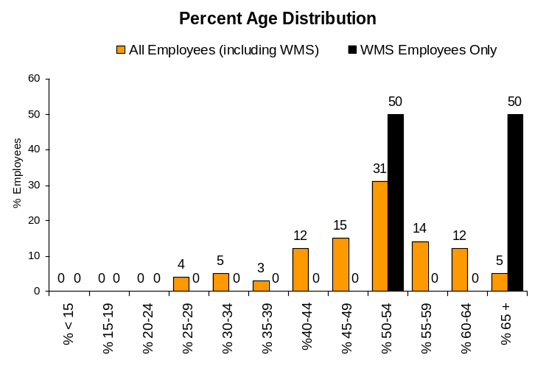
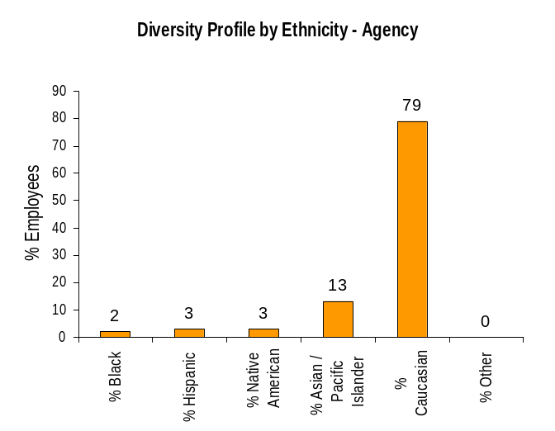
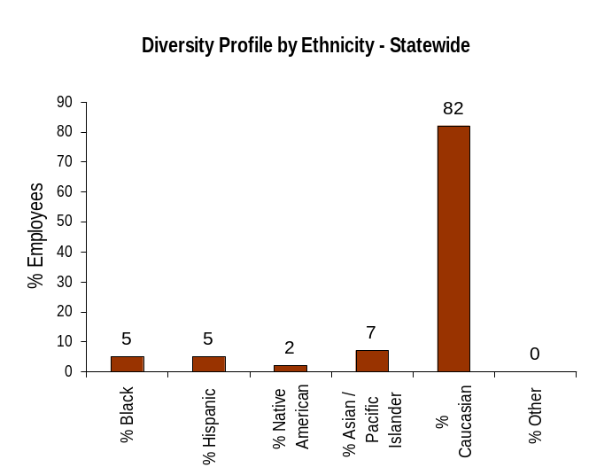
ULTIMATE OUTCOMES
Employees are committed to the work they do and the goals of the organization
Successful, productive employees are retained
The state has the workforce breadth and depth needed for present and future success
Performance Measures
Employee survey ratings on “commitment” questions
Turnover rates and types
Turnover rate: key occupational categories
Workforce diversity profile
Retention measure (TBD)
Workforce Diversity Profile
Agency State
Female 60% 53%
Disabled 4% 5%
Vietnam Vet 6% 7%
Disabled Vet 1% 2%
People of color 21% 18%
Persons over 40 88% 75%
Analysis:
The Lottery must consider and plan for the effects of an aging workforce. These can include higher sick leave usage, minor incidents that may result in significant injuries and longer recovery periods, and the loss of knowledge when experienced employees retire.
Lottery maintains a relatively high percentage for overall people of color; however, the agency is lower than the state average for Disabled and Vietnam Veterans, Black/African American, and Hispanic employees.
Action Steps:
Maintain commitment to diversity and continue efforts to build diverse candidate pools.
Strengthen succession planning efforts. Increase employee involvement in their future planning.
Emphasize safety and preventative care programs
Data as of July 1, 2007
Source: HRMS Business Warehouse

