Slide 1
Linda McKibben, MD, MPH
Paul Stange, MPH
Abigail Shefer, MD
Dale Bratzler, DO
HCFA-CDC-PRO Steering Committee
Standing Orders to Promote Appropriate Immunizations:
Reaching for HP 2010 Goals

Slide 2
The Problem: Missed Opportunities to Vaccinate Residents of NHs
Influenza and pneumococcal diseases:
  Vaccine-preventable
  High disease burden & mortality
Institutional vaccination rates are low
Increasing resistance to antimicrobials
Notes:
Epidemics of influenza occur during the winter months nearly every year and are responsible for an average of approximately 20,000 deaths per year in the United States. Influenza viruses cause disease in all age groups,, but rates of serious morbidity and mortality are highest among persons aged greater than or equal to 65 years and persons of any age who have medical conditions that place them at high risk for complications from influenza.
Pneumococcal disease accounts for 3,000 cases of meningitis, 50,000 cases of bacteremia, and 500,000 cases of pneumonia, each year and is responsible for more deaths than any other vaccine-preventable bacterial disease. Despite antimicrobial therapy and intensive medical care, the overall case-fatality rate for pneumococcal bacteremia is 15%-20% among adults, among persons 65 years and older case fatality could be as high as 40%. During the antibiotic era, outbreaks of pneumococcal disease caused by a single drug resistant pneumococcal serotype have occurred in institutional settings including nursing homes.
Of persons reporting at least one hospitalization during the previous year to the 1995 National Health Interview Survey, 89% of all persons 18-64 years and nearly 67% of all persons > 65 years did not receive pneumococcal vaccine, and 74% of persons 18-64 years and 38% of persons > 65 years did not receive influenza vaccine (CDC, unpublished data). In 12 Western states in the U.S., opportunities to provide pneumococcal and influenza vaccines were missed for up to 80% and 65% respectively, of Medicare beneficiaries admitted for pneumonia between September and December, 1994.¹⁵
Studies indicate that influenza and pneumococcal vaccines are underutilized in institutional settings, even though after they became covered benefits of Medicare Part B. The 1995 National Nursing Home Survey estimated influenza and pneumococcal vaccination use in long-term care facilities at 63% and 22%, respectively, far below the Healthy People 2000 goal of 80% for both vaccines for persons in such institutions.

Slide 3
Project Background
GOAL 1
PROs will promote ACIP-endorsed model Standing Orders Program (SOP) in skilled nursing facilities and nursing homes
  HCFA collaborates with CDC through PROs 6th SOW, April 1999
  SOP effectiveness supported by 2 systematic reviews
    Rand Healthy Aging Report
    Guide to Community Preventive Services

Slide 4
Project Background
GOAL 2
Document improved pneumococcal and influenza immunization rates of Medicare beneficiaries who are residents of skilled nursing facilities and nursing homes
  CDC evaluates using controlled before-and-after design

Slide 5
CDC Partnerships: Internal
National Immunization Program
  Immunization Services Division
    Health Services Research and Evaluation Branch
  Division of Epidemiology and Surveillance
    Adult Vaccine-Preventable Diseases Branch
Epidemiology Program Office
  Division of Prevention Research and Analytic Methods
    Office of HealthCare Partnerships
National Center for Infectious Diseases
  Division of Healthcare Quality Promotion

Slide 6
CDC Partnerships: External
HCFA’s Office for Clinical Quality and Standards
  14 states represented by Peer Review Organizations (HCFA contractors)
    ~1800 NHs in 5 controls states
    ~1600 NHs in 9 intervention states

Slide 7
Importance to CDC
Model for translating evidence-based recommendations into action
Model for delivery of adult immunizations, & other preventive services, in many settings

Slide 8
Translating Evidence into Practice
Evidence-Based Recommendations
Policy
Statement
Program Evaluation
Model Program Dissemination

Slide 9
The Community Guide’s Strategy: Matches Interventions to Problems
Increase community demand
Enhance access to immunizations
Provider- or systems-based intervention

Slide 10
Community Guide Strongly Recommended Interventions for Immunizing Adults
Increase Community Demand
  Client reminder/recall
  Multicomponent education
Increase Access to Immunizations
  Multicomponent expanding access in health-care settings
Systems-based Changes
  Provider reminder/recall
  Feedback to providers
  Standing orders programs

Slide 11

Community Guide’s Vaccine- Preventable Diseases Logic Model

Slide 12
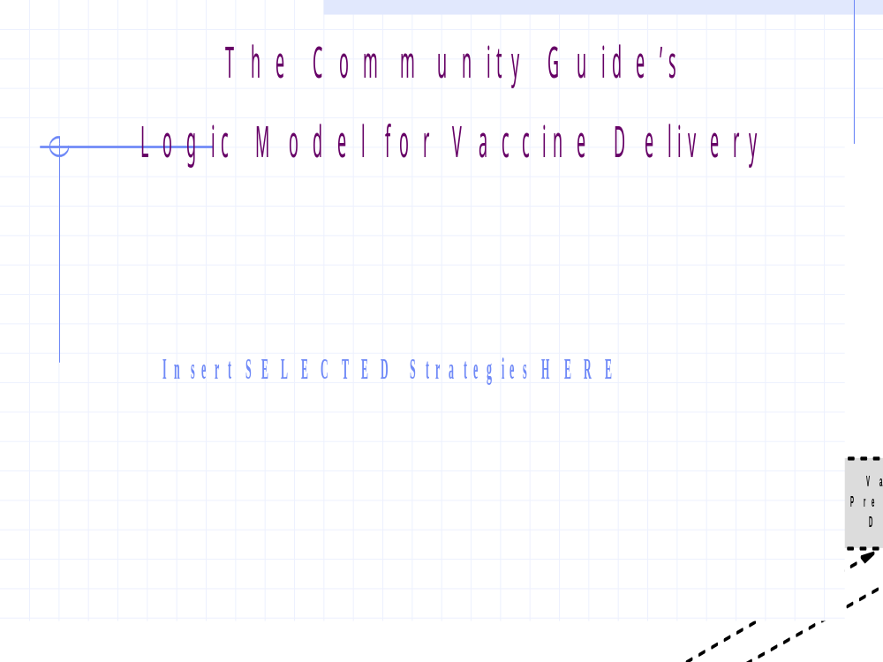

Slide 13
A Comprehensive Program
Increase
Community
Enhanced Access
Systems
–
based:
Demand:
Home Visits
Standing orders
Client Reminder/
Dedicated
Provider Reminder/
Recall
staff or seasonal
Recall
clinic
Multi
-
component
Assessment/
Reduce Costs
Feedback for
Education
Mass Campaigns
providers
Target
Vaccine
Immunization
Pop.
delivery sites
Coverage

Slide 14
Standing Orders Programs (SOPs):
The Community Guide’s Recommendations
Effective based on strength and quality of the evidence
Adult health care settings
No adverse effects reported
Alone or with other strategies
Hospitals, clinics and nursing homes

Slide 15

The ACIP Adopts
Standing Orders Program
Policy Statement
Implementation guidelines
  Safe and effective
Traditional and non-traditional settings
  Nursing homes highest priority

Slide 16
Immunization Standing Orders Programs:
ACIP definition
Systems-based (Organizational) strategy
  Institutional policy to offer vaccine on admission
Authorizes nurses and pharmacists to vaccinate clients by protocol without a physician examination

Slide 17
Blueprint for a Model
Standing Orders Program (SOP)
Infrastructure Components
Service Delivery Components
Implementation Options

Slide 18
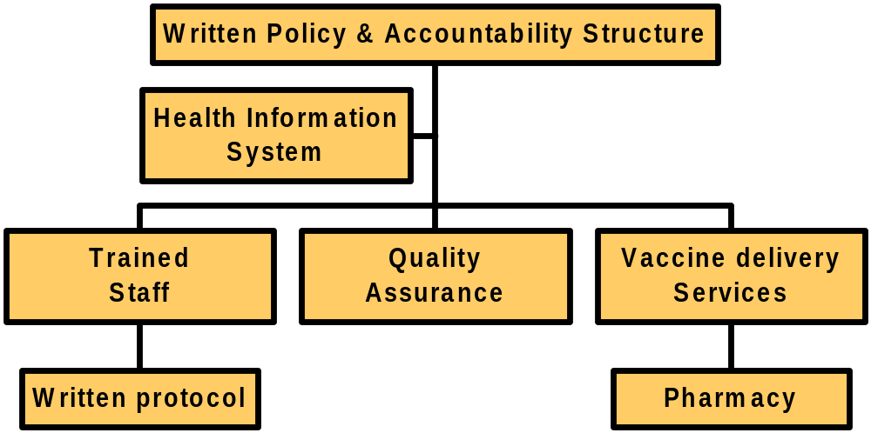
SOP Infrastructure Components

Slide 19
SOP Service Delivery Components
Non-physician
personnel obtain
vaccine through
standing
orders
& administer via
protocol
Identify
Offer &
Inform
Assess
Eligible
No
Refuse
Contraindications/Health status

Slide 20
SOP Implementation Options
Vaccine ordering mechanism
  Standing Order
  Advance physician order
  Pre-printed admission orders
Staffing

Slide 21
Five model Standing Orders Program Components per ACIP:
How PROs Will Change NH Practices…

Slide 22
#1. The facility has a written policy to offer pneumococcal and annual flu immunizations to all residents per ACIP guidelines.
PROs provide a model written policy per SOP project guidelines, which includes a policy to vaccinate residents whose vaccine history is not known.

Slide 23
Model SOP Policy for Nursing Homes
Basic principles
  Influenza & Pneumococcal vaccines
  Immunize if unknown vaccine status
Admission policy (standing orders protocols)
Annual review
Staff immunization - influenza vaccine

Slide 24
#2. Appropriately trained staff nurses or pharmacists immunize residents by a physician- or institution-approved protocol.
PROs provide a protocol template which emphasizes initiation of protocols upon admission throughout the year, not only during the annual influenza “campaign.”

Slide 25
#3. The policy eliminates the need for a physician exam (or order) at the time of administration of the vaccine.
PROs educate and promote use of standing orders programs or close alternatives.

Slide 26
#4. The resident’s personal physician is aware of the facility’s policy, and may override the facility’s standing order for residents with medical contraindications.
PROs promote and support communication between facilities and residents’ physicians.

Slide 27
#5. Quality improvement rests upon accurate documentation of vaccine status.
PROs promote standard Vaccine Administration Record (VAR) for each resident’s record.
PROs encourage use of a centralized tracking system, such as a log, card file, or computerized system which lists the vaccine histories of each current resident.

Slide 28
PROs’ Tools
Model policy
Model protocol or sets of procedures
Education regarding consent procedures
Standard vaccine information forms
Quality assurance documentation and tracking
Staff training; physician education

Slide 29
Current Activities
Baseline data collection
Immunization practices and barriers
  Short survey of all nursing homes
  Long survey of 20 homes per state with immunization coverage assessments
Cost effectiveness study – RTI
Health outcomes study - NCID

Slide 30
Scenerios of the future
Project will be recommended for expansion in the PROs 7th Scope of Work
Rolls out January 2003
National scope
Coordinated with new survey and certification procedures
Use of HCFA administrative data base as national surveillance for vaccines (2004)

