Slide 1
RPC+ Meeting
Argonne, December 7, 2007
RPC construction (glass, channels) Guarino, Repond
Gas system Northacker
HV systems Norbeck
Pad- & FE-board design Drake
Data concentrator design Drake
Data analysis: error modes Xia
muon data Bilki, Repond
electron data Mavromanolakis, Xia
DAQ software developments Kreps, May
Interface to CALICE DAQ Schlereth
Schedule and plans All

Slide 2
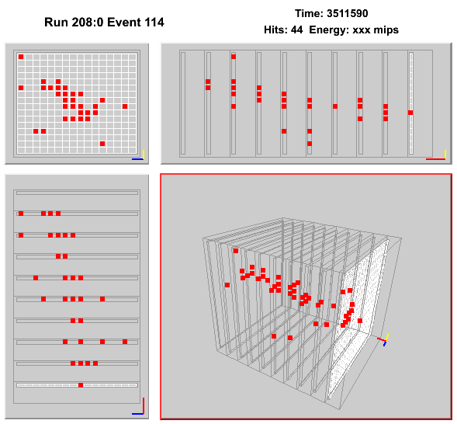
Most beautiful pion event

Slide 3
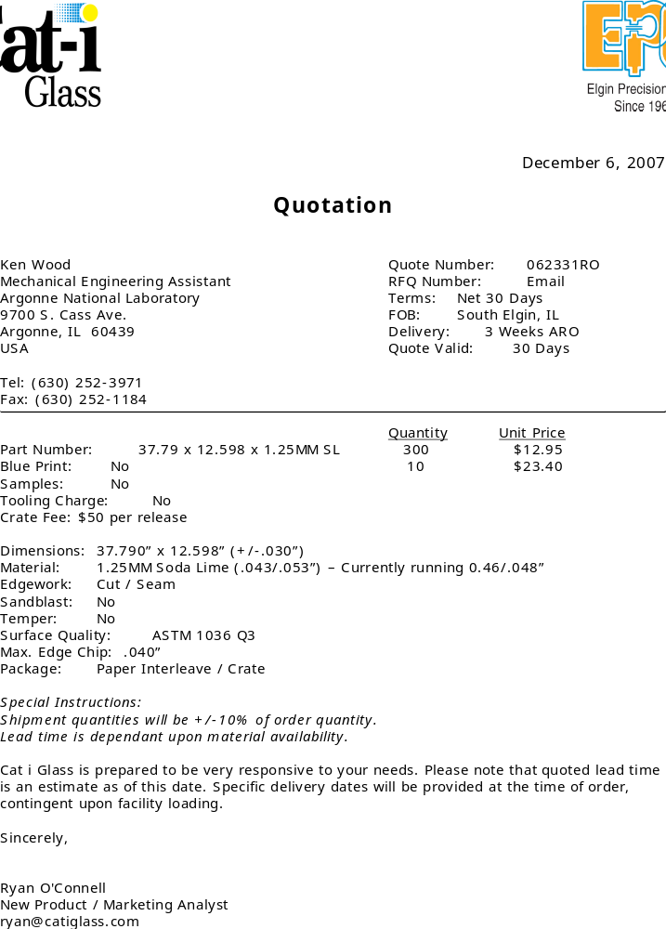
Ordered 10 pieces

Slide 4
Measurements with Cosmic Ray Test Stand
a) Install and test new DCON firmware (chamber 7) 3
- Test with CRs
- If successful install on all DCON
b) Measure noise with Lecroy power supply 1
c) Change grounding and study error modes 4
d) Study inefficiencies of layers 3, 4, 5
- Test with inverted high voltage
- Take off chambers + run charge injection
e) Measure pad multiplicity with extra Mylar (1 – 10 sheets)
Measure noise with DCOL and self-trigger 2
- Measure with Droege and Lecroy
g) Gang 3 chambers gas I/O and measure performance
h) Operate stack with 2 DCOLs
Investigate exotic chamber
DAQ rate studies
Study of charge injection parameters
Long term studies (x-y map)

Slide 5
Schedule and plans
Next meeting January 4, 2007
Large RPCs | Get glass quote, test urethane, silicon paste, look at PVC samples
Gas system | Test ganging
HV | Test with LeCroy
Pad- & FE board | Fabricate and begin test
Data concentrator | Initiate design
Error modes | Further understanding Explore different grounding Implement new firmware
Data analysis | Reconstruct data Create SW ‘killer’ Continue muon analysis Continue positron analysis Repeat noise measurement with Bertan and Lecroy
DAQ | Meet with Boston Refine strategies Further discussions on overall architecture

