Slide 1
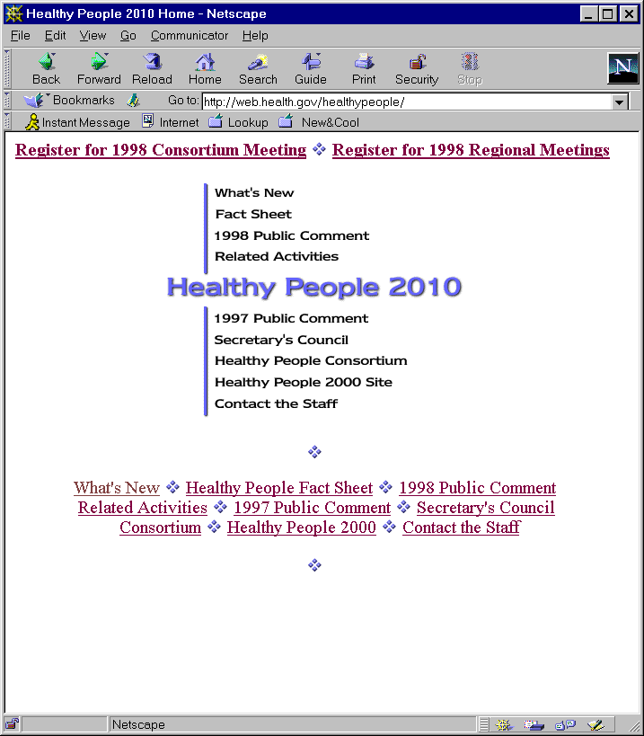
Comment on Healthy People
2010
Draft Objectives
  September 15 –
  December 15, 1998
  http://web.health.gov/
  healthypeople

Slide 2
Call for Comments on Healthy People 2010
Proposed Structure
  Goals 1 and 2
  Major sections
  Focus areas
  Figure: Healthy People 2010, Healthy people in Healthy Communities
Leading health Indicators
  Criteria
  Indicators
Specific Focus Areas
  Improvements
  Additions
  Deletions
Specific Objectives
  Improvements
  Additions
  Deletions
  Data issues
    Sources
    Targets
    Select populations

Slide 3
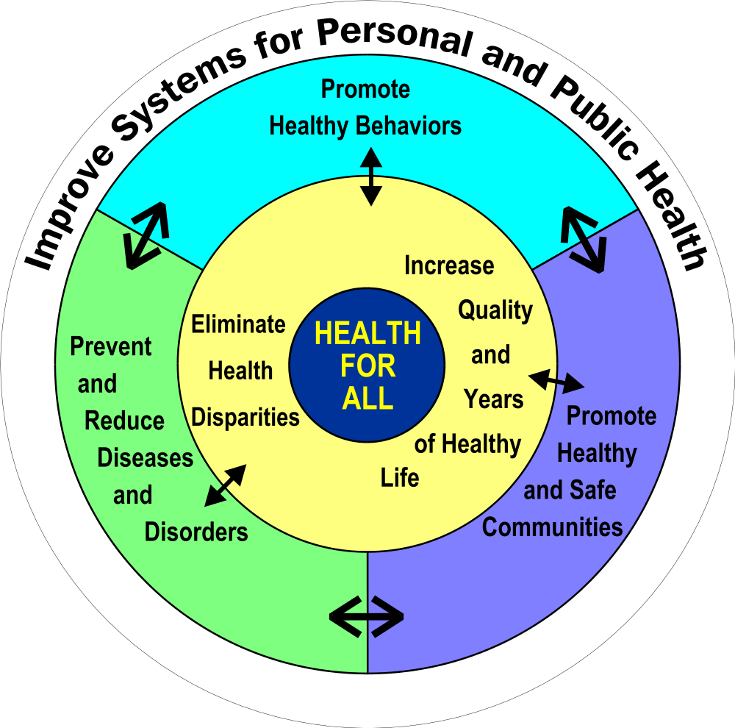
Healthy People 2010
Healthy People in Healthy Communities

Slide 4
History of the Initiative
  1979 Surgeon General’s Report, Healthy People published
  Fall 1980 Promoting Health, Preventing Disease: Objectives
  for the Nation released
  1987 Institute of Medicine formed the HEALTHY PEOPLE 2000 Consortium
  1990 Healthy People 2000: National Health Promotion and Disease Prevention Objectives released at the National Kick-off in Washington, DC
  1995 Healthy People 2000 Midcourse Review and 1995 Revisions
  1997 Developing Objectives for Healthy People 2010
  1998 Draft Healthy People 2010 Objectives

Slide 5
Healthy People 2010 Objectives:
Draft for Public Comment
Four Categories
Promote Healthy Behaviors
Promote healthy and Safe Communities
Improve Systems for Personal and Public Health
Prevent and Reduce Diseases and Disorders

Slide 6
Healthy People 2010 Objectives: Draft for Public Comment
Table of Contents
Guide for Commenting on Focus Areas and Objectives... iii
A. Introduction, Background
  1. Introduction
    1. What Is Healthy People? ....................................... 1
    2. Call for Comments.................................................... 3
    3. How Can Organizations and Individuals Contribute to Healthy People? .. ..….......…..….......…..…..........… 4
    4. Schedule of Healthy People 2010 Development ..... 6

Slide 7
Healthy People 2010 Objectives: Draft for Public Comment
Table of Contents cont.
A. Introduction, Background cont.
  2. Background
    1. Leading Health Indicators ......................................… 7
    2. Criteria for Objectives Development ......................… 9
    3. Types of Objectives ..............................................… 10
    4. Data Issues ..................................…........…..….……11
    5. The Secretary’s Council on National Health Promotion
    and Disease Prevention Objectives........................…13
    6. The Healthy People Steering Committee ................. 14
    7. Healthy People Work Group Coordinators ............... 17
    8. Acronyms and Abbreviations Used in This Book ...... 27

Slide 8
Healthy People 2010 Objectives: Draft for Public Comment
Table of Contents cont.
B. GOALS
1. Increase Quality and Years of Healthy Life........... G - 3
2. Eliminate Health Disparities ........................... G - 19
Figure: Healthy People 2010, Healthy People in Healthy Communities ……………………………........G - 23
C. OBJECTIVES
  Promote Healthy Behaviors
  1. Physical Activity and Fitness ...................................... 1-1
  2. Nutrition ......…............................................................ 2-1
  3. Tobacco Use .............................................................3-1

Slide 9
Healthy People 2010 Objectives: Draft for Public Comment
Table of Contents cont.
C. OBJECTIVES cont.
  Promote Healthy and Safe Communities
    4. Educational and Community-Based Programs .........4-1
    5. Environmental Health ............................................... 5-1
    6. Food Safety ............................................................... 6-1
    7. Injury/Violence Prevention ........................................ 7-1
      a. Injuries That Cut Across Intent ................................. 7-3
      b. Unintentional Injuries .............................................. 7-8
      c. Violence and Abuse ................................................ 7-21
    8. Occupational Safety and Health ............................... 8-1
    9. Oral Health ................................................................ 9-1

Slide 10
Healthy People 2010 Objectives: Draft for Public Comment
Table of Contents cont.
C. OBJECTIVES cont.
  Improve Systems for Personal and Public Health
    10. Access to Quality Health Services ..................................10-1
      a. Preventive Care .................................................... 10-11
      b. Primary Care ........................................................ 10-15
      c. Emergency Services .............................................. 10-22
      d. Long-Term Care and Rehabilitative Services ....... 10-25
    11. Family Planning ............................................................ 11-1
    12. Maternal, Infant, and Child Health ................................ 12-1
    13. Medical Product Safety ................................................... 13-1
    14. Public Health Infrastructure ........................................... 14-1
    15. Health Communication .................................................. 15-1

Slide 11
Healthy People 2010 Objectives: Draft for Public Comment
Table of Contents cont.
C. OBJECTIVES cont.
  Prevent and Reduce Diseases and Disorders
    16. Arthritis, Osteoporosis, and Chronic Back Conditions ....16-1
    17. Cancer ............................................................................17-1
    18. Diabetes .........................................................................18-1
    19. Disability and Secondary Conditions ............................. 19-1
    20. Heart Disease and Stroke .............................................. 20-1
    21. HIV ................................................................................. 21-1
    22. Immunization and Infectious Diseases .......................... 22-1
    23. Mental Health and Mental Disorders ............................. 23-1
    24. Respiratory Diseases ..................................................... 24-1
    25. Sexually Transmitted Diseases ......................................25-1
    26. Substance Abuse ........................................................... 26-1

Slide 12
Types of Objectives
Measurable objectives provide direction for action.
They have baselines.
Developmental objectives provide a vision for a desired outcome or health status but have no data.

Slide 13
Criteria for Measurable and
Developmental Objectives for 2010
Drive Action
Measurable
Important and Understandable
Continuity and Comparability
Scientific Evidence
Prevention Oriented
Useful and Relevant

Slide 14
Select populations
Race/Ethnicity
Gender
SES
People with disabilities

Slide 15
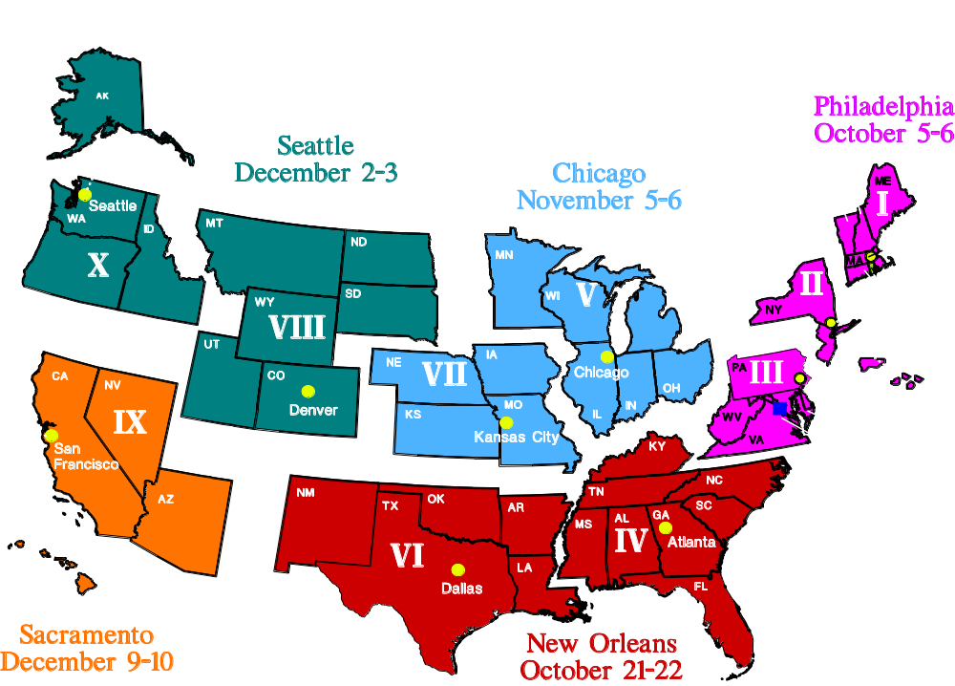
Regional Meetings for Healthy People 2010

Slide 16
You Are Invited to Attend the National Healthy People Consortium Meeting
“Building the Next Generation of Healthy People”
November 12 and 13, 1998
Capital Hilton, Washington, D.C.
Early-bird registration before October 15, 1998
Registration accepted until November 1, 1998
Non on-site registration
To register for this meeting visit
http://web.health.gov/healthypeople
1-800-367-4725

Slide 17
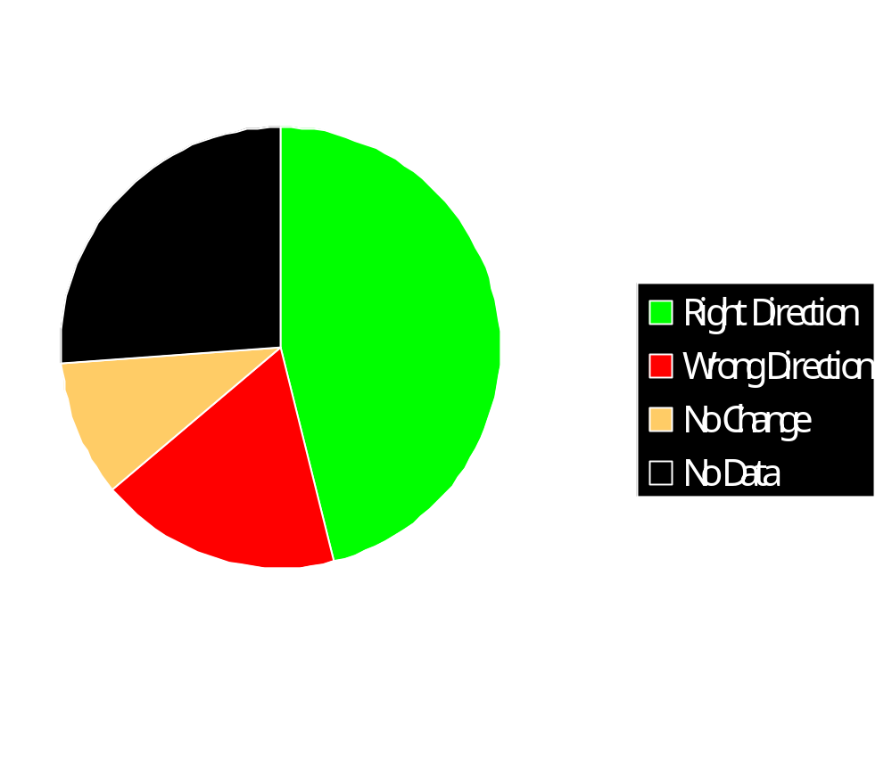
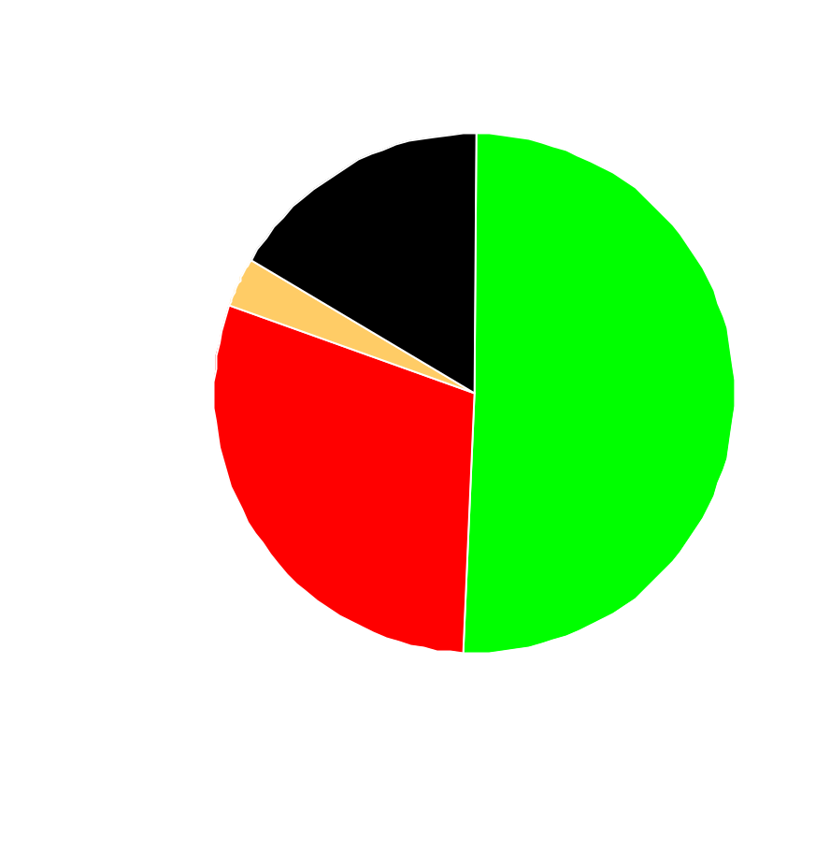
Progress on Healthy People 2000 Targets
Total Population (319 Targets)
Special Population (210 Targets)

Slide 18
Healthy People Timeline
1999 Workgroups review and integrate public
comment into document
April: Secretary’s Council Meeting
July: Clearance Process
2000
January Healthy People 2010 Released
Volume I People and Settings
Volume II 2010 Objectives
Volume III Data
Begin Release of Companion Documents
Begin Release of State Plans

Slide 19
WHAT Can Be Accomplished?
Consensus on direction
Identify challenges
Result in improved data quality
Provide incentives for change
Demonstrate returns on public investment in prevention

Slide 20
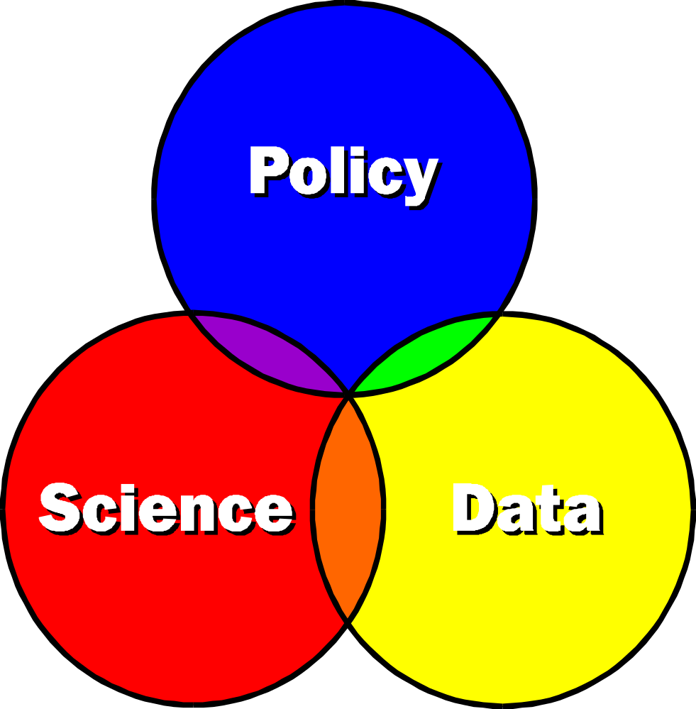
Building the Framework for Healthy People 2010

Slide 21
Call for Comments on Healthy People 2010
Submit electronic comments at:
http://web.health.gov/healthypeople
Submit paper comments to:
Office of Disease Prevention and Health Promotion
U.S. Department of Health and Human Services
Attention: Healthy People 2010 Objectives
Hubert H. Humphrey Bldg., Room 738G
200 Independence Avenue, SW
Washington, DC 20201

Slide 22
Let Your Voice be Heard!
September 15 - December 15, 1998
COMMENT!
http://web.health.gov/healthypeople

