Slide 1


Washington State
Department of Health
Human Resource Management Report
Prepared for:
Mary Selecky, Secretary
Department of Health
By:
Office of Human Resources
Department of Health
October 2006

Slide 2
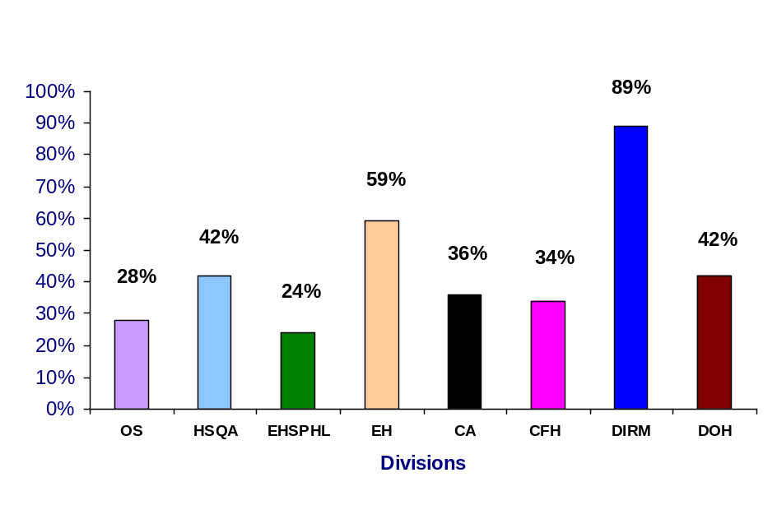
Plan & Align Workforce
Management accountability infrastructure
Percent employees with current job/competency descriptions
Assumptions:
Timeframe is July 1, 2005 through June 30, 2006
Position description review is done as part of the evaluation process. Data reflects the number of evaluations done.
Action Plan Update:
HR Portal data may be available for the next report.
(47)
(163)
(143)
(32)
(92)
(536)
(12)
(47)
OS – Office of the Secretary (43)
HSQA – Health Systems Quality Assurance (342)
EHSPHL-Epidemiology, Health Statistics and Public Health Laboratories (195)
EH-Environmental Health (275)
CA-Central Administration (90)
CFH-Community & Family Health (274)
DIRM-Division of Information Resource
Management (53)
DOH-Department of Health (1272)
Percent supervisors with current performance expectations for workforce management
WMS positions include performance expectations for workforce management.
Action Plan COMPLETED:
□ Mary Selecky communicated her expectations to the DOH Senior Management Team (SMT) and Chief Administrators on May 30, 2006.
The SMT shared that information with management teams and supervisors during June and early July.
Source: DOH PACS Database
Notes:
Notes:
Plan & Align Workforce is the foundation for the remaining four key HRM functions.
Ideally, each agency should have a comprehensive workforce plan that aligns staffing levels and competencies with business priorities, and identifies strategies to close workforce gaps. Most agencies do not have a workforce plan (a key reason WA did not get an A on Grading of the States). A future action step is to institute workforce planning in the state.
Right now, as a starting point, managers need to know what their HRM responsibilities and performance expectations are. This includes an understanding of the master agreement provisions and new HR policies. Of the XX agencies with represented employees that responded to our inquiry, XX had trained the majority of their managers on those provisions.
Next, a management accountability system needs to be in place. At this point, our best measure is whether managers are receiving performance evaluations. However, what needs to happen is implementation of the Managers HRM Report Card, so that those meaasures are incorporated in the evaluations.

Slide 3
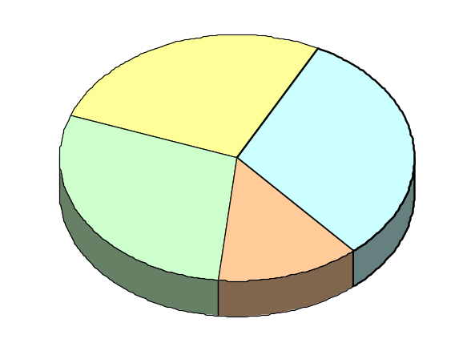
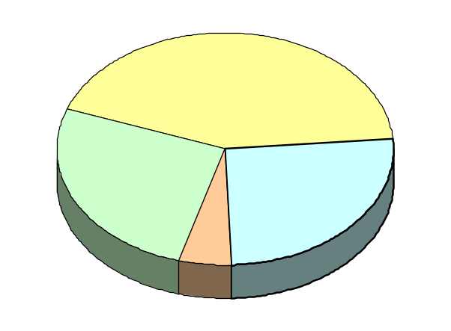
Hire Workforce
Right people in the right job at the right time
Estimated Days to fill vacancies Action Plan Update:
□ When there is a candidate pool available, the time from request of a certification to hiring is:
  DOP Certifications: Average is 57 days
  DOH Certifications: Average is 20 days
Candidate Quality Action Plan Update:
□ Pending DOP research of ability to use survey as part of E-Recruiting. Target: ON HOLD
DOH Hiring Balance 2003-05 Biennium
(547 total appointments)
DOH Hiring Balance FY 06
(226 total appointments)
27%
New Hires (148)
31%
Intra-agency Promotions (170)
43%
New Hires (98)
29%
Other (transfers, demotions, reassignments, etc. (158)
26%
Other (transfers, demotions, reassignments, etc. (58)
26%
Intra-agency Promotions (58)
13%
Inter-agency Promotions (71)
5%
Inter-agency Promotions (12)
Source: DOP Data Warehouse

Slide 4
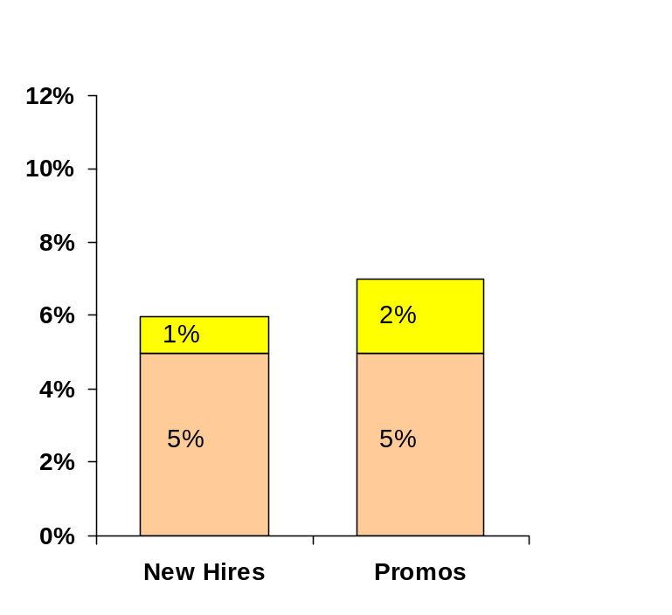
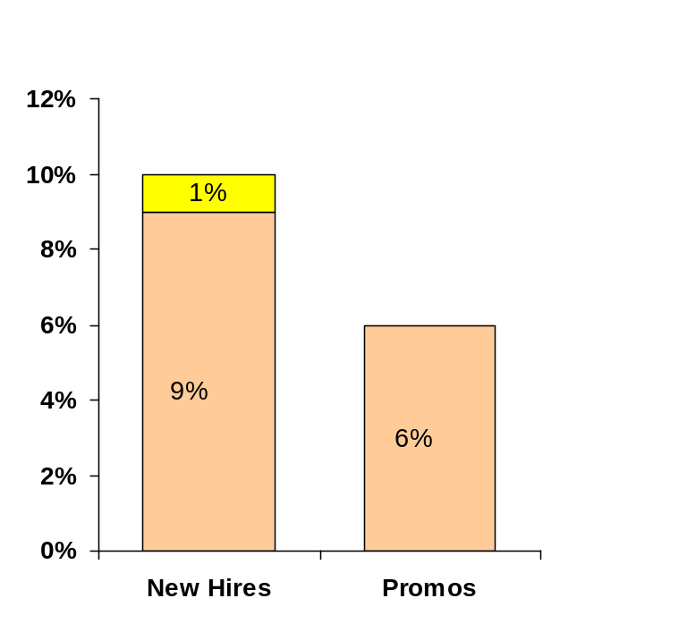
Hire Workforce
Right people in the right job at the right time
Separation during Review Period
2003-05 Biennium
Separation during Review Period
FY 06
Released
Voluntary
Released
Voluntary
(1)
(2)
(4)
(9)
(7)
(11)
(4)
Source: DOP Data Warehouse

Slide 5
Deploy Workforce
Employees are motivated and their time and talent is used effectively
Percent employees with current performance expectations
OS – Office of the Secretary (43)
HSQA – Health Systems Quality Assurance (342)
EHSPHL-Epidemiology, Health Statistics and Public Health Laboratories (195)
EH-Environmental Health (275)
CA-Central Administration (90)
CFH-Community & Family Health (274)
DIRM-Division of Information Resource
Management (53)
DOH-Department of Health (1272)
(47)
(163)
(143)
(32)
(92)
(536)
(12)
(47)
Assumptions:
Timeframe is July 1, 2005 through June 30, 2006
Action Plan Update:
Began tracking front loading of performance expectations/training plans in HR Portal June 7, 2006. Data is being entered and may be available for the next report period. Chart data reflects the number of evaluations done for this timeframe.
Source: DOH PACS Database

Slide 6
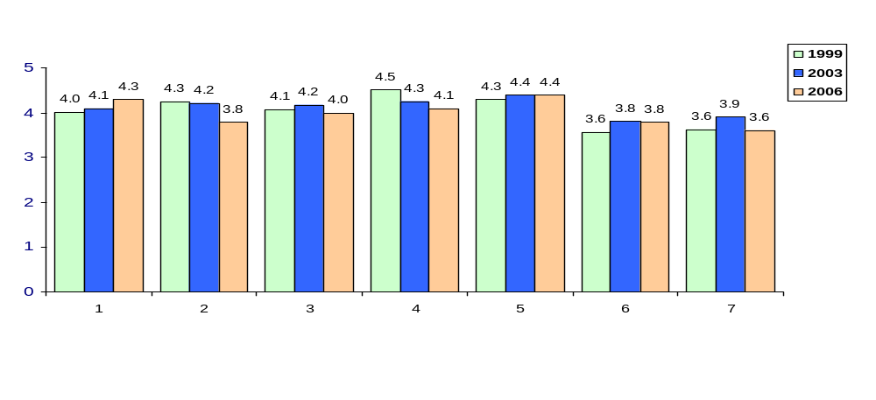
Deploy Workforce
Employees are motivated and their
time and talent is used effectively
Overall 2006 average score
for “productive workplace” questions is 4.0
Do employees have day-to-day support to enable successful job performance?
Employee survey conducted Spring 2006. DOH number of responses = 1,041
1. I know what is expected of me at work.
2. I have the opportunity to give input on decisions affecting my work.
3. I receive the information I need to do my job effectively.
4. I have the tools and resources I need to do my job effectively.
5. My supervisor treats me with dignity and respect.
6. My supervisor gives me ongoing feedback that helps me improve my performance.
7. I receive recognition for a job well done.
DOH employee survey results 1999, 2003, and 2006
Scale 1-5
Statements
Notes:
Notes:

Slide 7
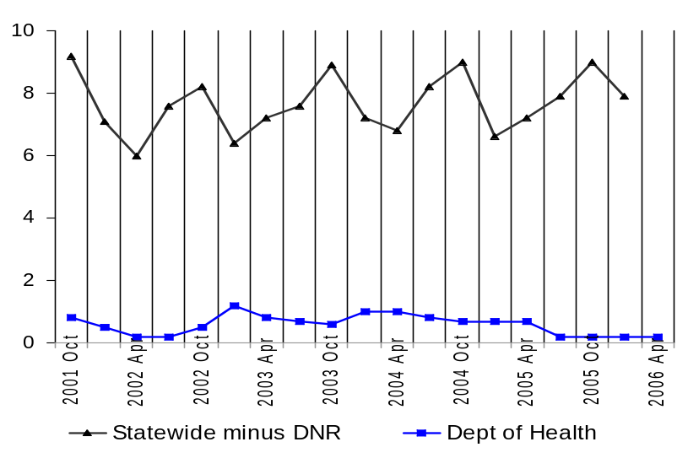




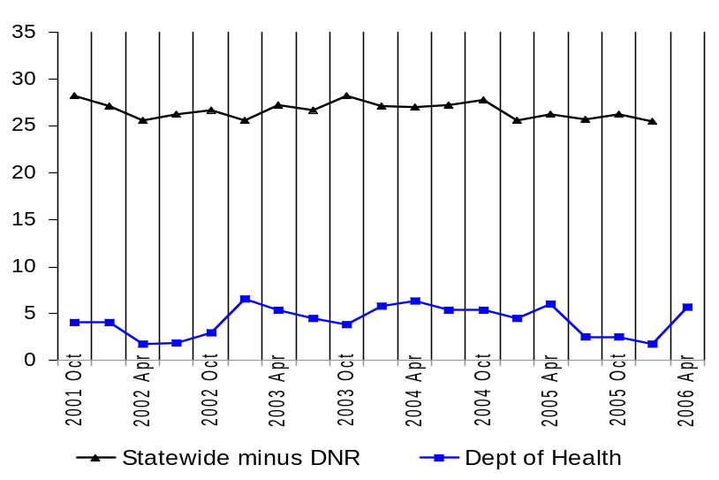
Deploy Workforce
Employees are motivated and their time and talent is used effectively
Average Overtime Hours per Employee per Quarter
FY 2003 FY 2004
Statewide,
$45,220,000
Statewide,
$46,880,000
Hours
DOH, $118,743 DOH, $125,463
Quarter
FY 2005 FY 2006
Average Percent Employees Receiving Overtime
Statewide,
$48,900,000
Statewide,
$39,815,000
Percent Employees
DOH, $113,473 DOH, $30,952
Quarter
Note: no statewide data for 4th quarter, FY06
Source: DOP Data Warehouse

Slide 8
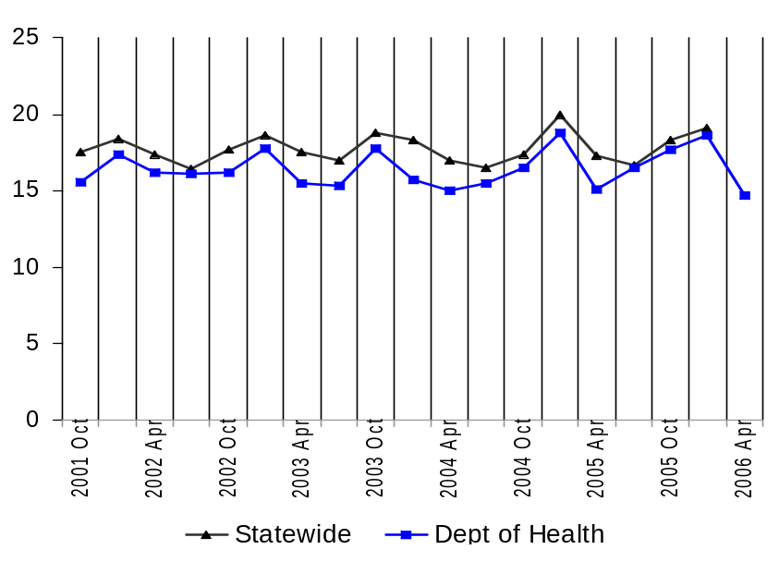
Deploy Workforce
Employees are motivated and their time and talent is used effectively
Average Sick Leave Hours per Employee per Quarter
Notes:
DOH parallels the statewide use, with a lower level of overall use of sick leave hours.
It is unknown whether the sick leave usage shown was planned or unplanned.
For the most part, only actual leave time gone from work is shown. Leave hours donated and most cashed out leave hours have been removed from this display.
Quarter
Note: no statewide data for 4th quarter, FY06
Per Capita Sick Leave Use
Just Those Who Took Sick Leave
Ave. Sick Leave Hours Used per Qtr*
% of Earned Sick Leave
Ave. Sick Leave Hours Used per Qtr*
% of Earned Sick Leave
Statewide
17.8
hours
74.1%
22.8
hours
95.1%
Department of Health
16.4
hours
68.4%
21.4
hours
89.3%
*Average since 10/01
Source: DOP Data Warehouse

Slide 9
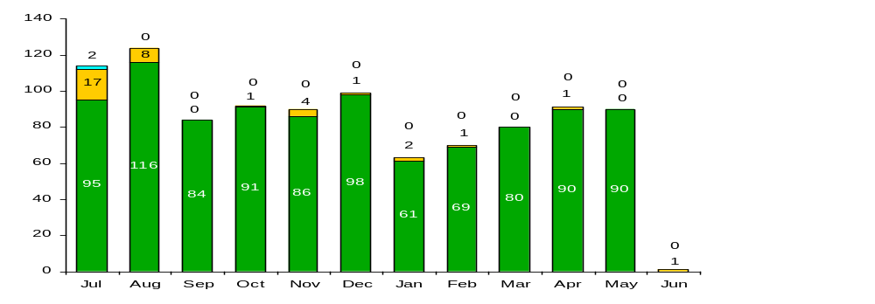
Deploy Workforce
Employees are motivated and their time and talent is used effectively
Number of Grievances Filed 7-1-05 to 6-30-06
All agencies (including DOH)
DOH WFSE
DOH SEIU
116
95
80
2005
2006
Note: no statewide data for June 2006
Notes:
Grievance filing information is reported monthly by the agency to the State Labor Relations Office (LRO).
LRO maintains both agency and statewide data.
LRO tracks which grievances move to pre-arbitration reviews and arbitrations. They also track outcomes and trends statewide and by agency.
Source: State Labor Relations Office

Slide 10
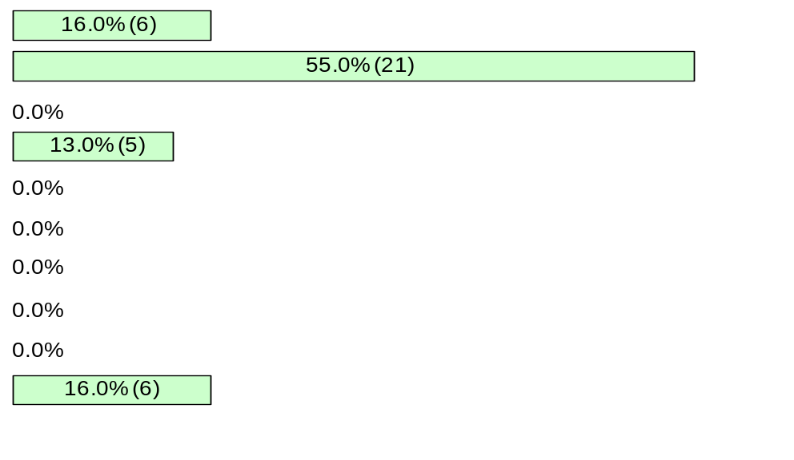
Deploy Workforce
Employees are motivated and their time and talent is used effectively
Types of Grievances Filed 7-1-05 to 6-30-06
Discipline
Compensation
Overtime
Work Hours
Bid System
Leave
Hiring/Appts
Non-discrimination
Management Rights
All other
116
95
80
Notes:
DOH has seen an overall increase in the number of grievances filed, not unexpected given that the agency was mostly non-represented prior to the Washington Federation of State Employees organizational activities.
Grievance subjects were primarily linked to collective bargaining agreement transitional issues, although we are starting to see the first of the disciplinary grievances.
Source: State Labor Relations Office

Slide 11
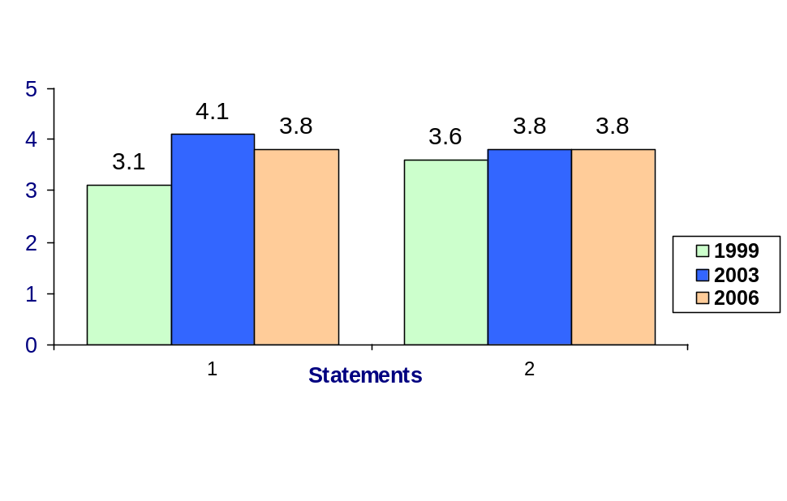
Employees are competent for present job, future advancement
Develop Workforce
Percent employees with current annual individual development plans
OS – Office of the Secretary (43)
HSQA – Health Systems Quality Assurance (342)
EHSPHL-Epidemiology, Health Statistics and Public Health Laboratories (195)
EH-Environmental Health (275)
CA-Central Administration (90)
CFH-Community & Family Health (274)
DIRM-Division of Information Resource
Management (53)
DOH-Department of Health (1272)
(47)
(163)
(143)
(32)
(92)
(536)
(12)
(47)
Source: DOH PACS Database
DOH employee survey results 1999, 2003, and 2006
Scale 1-5
Overall 2006 average score for “learning & development” questions is 3.8
Employee perceptions on learning and development
1. I have opportunities at work
to learn and grow.
2. My supervisor gives me
ongoing feedback that helps
me improve my performance.
Notes:
Notes:

Slide 12
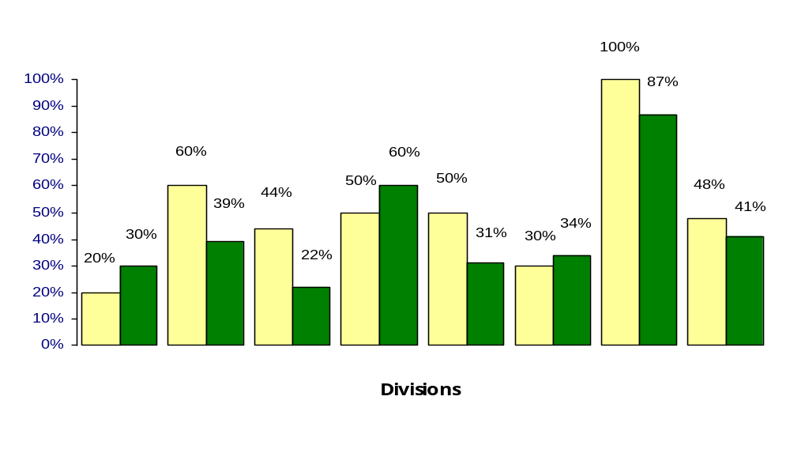
Reinforce Performance
Successful performance is recognized and employees are held accountable
Percent employees and managers with current annual performance evaluations
(6)
Managers
Employees
(41)
(27)
(148)
(7)
(15)
(10)
(76)
(116)
(83)
(460)
(10)
(22)
(9)
(2)
(40)
OS HSQA EHSPHL EH CA CFH DIRM DOH
OS – Office of the Secretary
(10 Mgrs) (33 employees)
HSQA – Health Systems Quality Assurance
(45 Mgrs) (297 employees)
EHSPHL-Epidemiology, Health Statistics and PH Lab
(16 mgrs) (179 employees)
EH-Environmental Health
(30 mgrs) (245 employees)
CA-Central Administration
(20 mgrs) (70 employees)
CFH-Community & Family Health
(30 mgrs) (244 employees)
DIRM-Division of Information Resource
Management (6 mgrs) (47 employees)
DOH-Department of Health
(157 mgrs) (1115 employees)
Source: DOH PACS Database
Notes:
Notes:

Slide 13
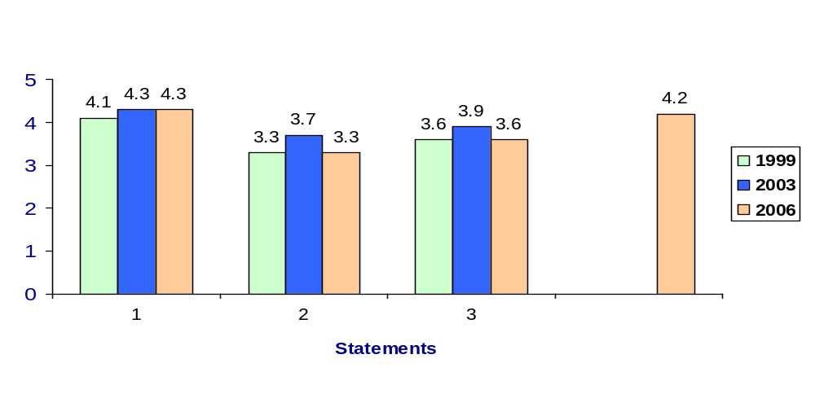
Reinforce Performance
Successful performance is recognized and employees are held accountable
Do employees see a meaningful linkage between their performance and the success of the organization?
1. I know how my work contributes to the goals of my agency.
2. My performance evaluation provides me with meaningful information about my performance.
3. I receive recognition for a job well done.
4. My supervisor holds me and my co-workers accountable for performance. (No data for 1999 and 2003.)
Overall 2006 average score for “learning & development” questions is 3.9
DOH employee survey results 1999, 2003, and 2006
Scale 1-5
Notes:
Notes:

Slide 14
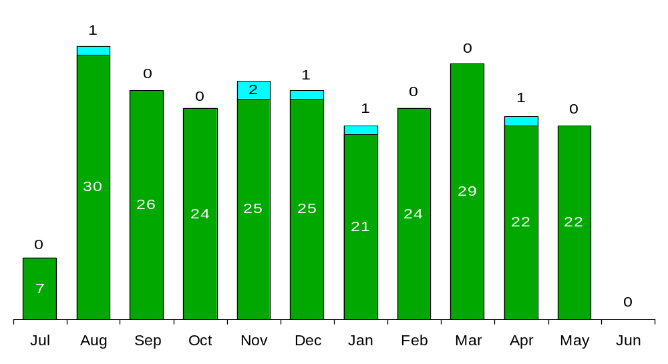
Reinforce Performance
Successful performance is recognized and employees are held accountable
Disciplinary action: Is poor performance dealt with?
Disciplinary Grievances Filed
July 1, 2005 – June 30, 2006
All agencies (including DOH)
DOH Only
Issues Leading to Disciplinary Action and Disciplinary Grievances
From July 1 – June 30, 2006, the Washington Federation of State Employees (WFSE) filed six grievances alleging violations of just cause. In four cases the disciplinary action grieved was a letter of reprimand concerning work performance. In the other two cases the action grieved was dismissal. One grievance was withdrawn; the other is pending at arbitration.
2005 2006
Note: no statewide data for June 2006
Source: State Labor Relations Office

Slide 15
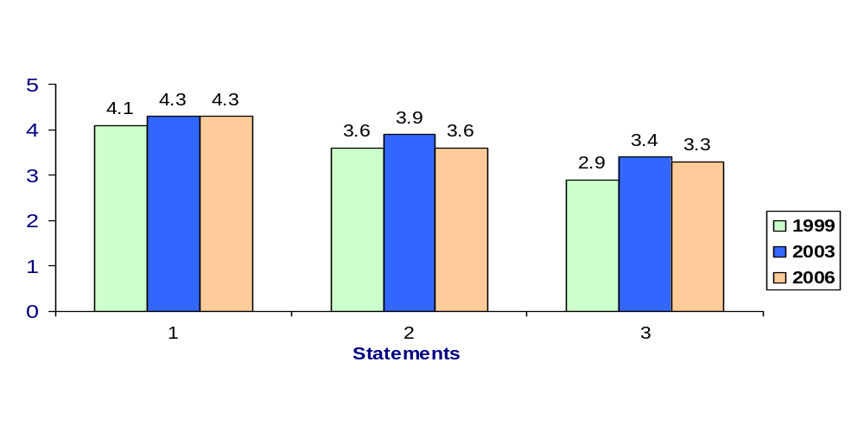
Ultimate Outcomes
Indicators of Employee Commitment
Overall 2006 average score for “performance & accountability” questions is 3.7
1. I know how my work contributes to the goals of my agency.
2. I receive recognition for a job well done.
3. I know how my agency measures its success.
DOH employee survey results 1999, 2003, and 2006
Scale 1-5
Notes:
Notes:

Slide 16
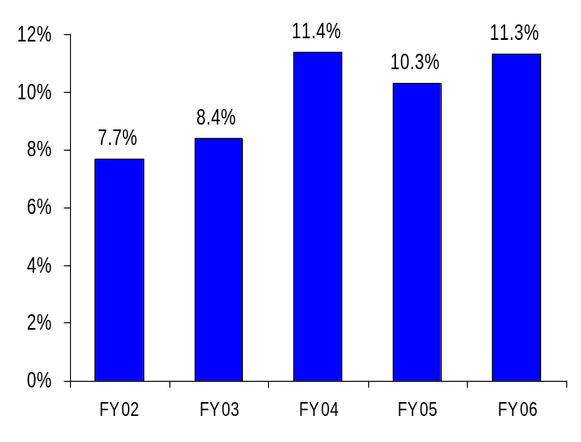
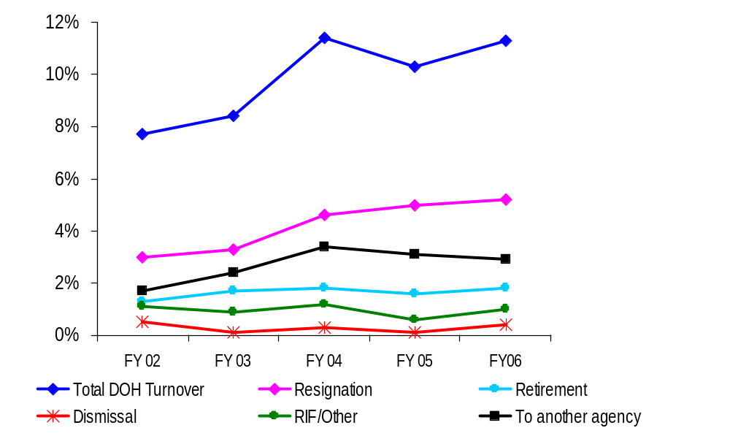
Ultimate Outcomes
Indicators of Employee Commitment
Turnover – Department of Health
(Leaving the agency)
DOH Workforce Turnover Breakdown
Source: DOP Data Warehouse
The turnover rate has slightly increased over last year.
The DOH retirement eligibility rate was updated and shows that about 13% of DOH staff are eligible to retire now.
Source: DOP Data Warehouse
Notes:
Notes:

Slide 17
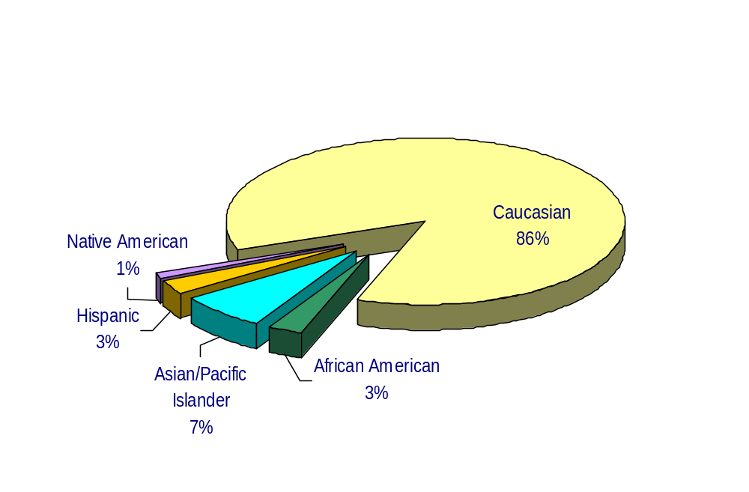
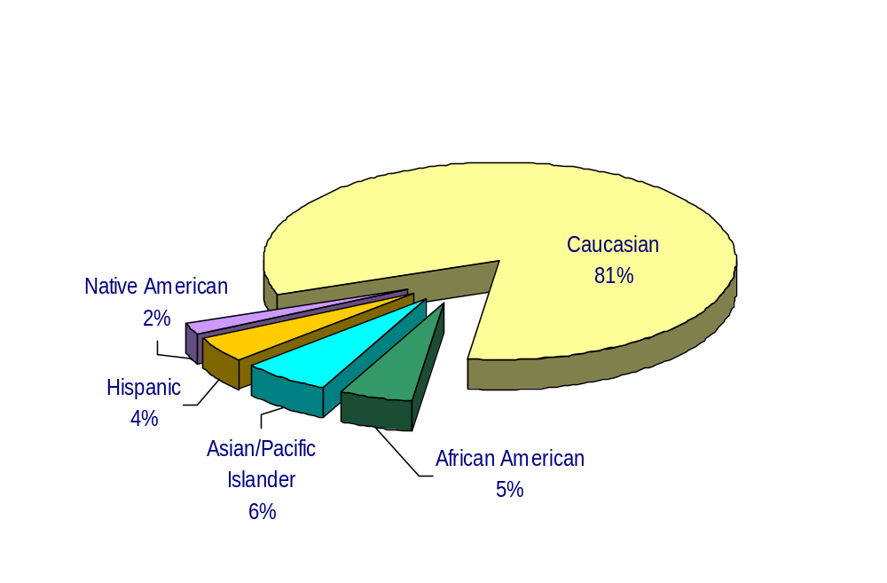
Ultimate Outcomes
Indicators of Employee Commitment
Workforce Diversity – July 1, 2006
Department of Health
Diversity Profile DOH State
Women 64% 52%
Persons with disabilities 5% 5%
Vietnam Veterans 5% 7%
Disabled Veterans 2% 2%
Persons over 40 75% 76%
People of color 14.1% 17.5%
WA State Government
Source: Business Warehouse

