Slide 1
LDCM Cloud Cover Assessment
Update and Overview
November, 2010
Pat Scaramuzza, SGT
U.S. Geological Survey Center for Earth Resources Observation and Science
Sioux Falls, SD

Slide 2
Summary of LDCM CCA Changes in 2010
Minor changes to CCA Control flow.
  Thermal data switch, no saturation switch.
Using only non-saturated version of See5 CCA.
Quality Band format has been finalized.
Creation of new ASTER dataset for thermal studies.
  15 ASTER scenes as both L1 (TOA reflectance) and L2 (kinetic temperature).
Addition of Thermal ACCA.
  Using L7 ACCA on TIRS band 1.
  Study using ASTER data suggests that surface temperature will offer no advantage over brightness temperature for the ACCA algorithm.
Addition of Cirrus CCA.
  Using 1.38 µm band threshold test from MODIS.
Notes:
Let's start with a list of changes to the LDCM CCA system in the past year.
First, there have been minor changes to the CCA control flow. We put in a switch for thermal data, so we can run TIRS data when it is available. We took out the test for saturated detectors -- we're assuming that saturation effects are going to be minimal.
And with that, we are now using only the non-saturated half of the See5 CCA algorithm.
The Quality Band format has been finalized, I'll show you that later.
We created an ASTER dataset for developing algorithms that use thermal data. With that dataset we determined that ACCA works best with brightness temperature, which is no surprise, since it was designed that way. With that knowledge we've added ACCA to our suite of CCA algorithms.
And last but not least we have added a Cirrus algorithm. This is the simple, one-threshold test taken from MODIS that used to be included with the AT-ACCA algorithm, but we decided to break it out into its own routine.

Slide 3
CCA Control System Flowchart
CCA
Weights
(CPF)
Is
TIRS data
available?
ACCA
ACCA
Mask
Yes
No
Expanded
AT-ACCA
AT-ACCA
Mask
Merge
CCA
Masks
L1G
Scene
Data
L1G
Quality
Band
Cirrus CCA
Cirrus CCA
Mask
See5 CCA
See5 CCA
Mask
Other CCAs
Other CCA
Masks
Notes:
So this is the Control system we've settled on. You can see the thermal switch here. If TIRS data is available then we'll run ACCA. If we have no TIRS data then we'll run the AT-ACCA algorithm. (We are not running AT-ACCA on data when TIRS data exists. If we want the improved disambiguation that AT-ACCA provides, we'll have to add that to ACCA sometime in the future.)
Each of the algorithms will create a cloud mask; at the end we'll merge all the masks together into the quality band that will be delivered with the L1G products.

Slide 4
CCA Algorithms compared
 | Pixels Correct | Pixels False | Pixels Ambiguous | Misclassified Clouds | Misclassified Clear
ACCA | 79.9% | 4.3% | 15.8% | 7.8% | 2.3%
AT-ACCA | 89.8% | 8.5% | 1.7% | 12.3% | 6.3%
See5-rE | 88.5% | 7.3% | 4.2% | 12.1% | 4.5%
Cirrus Simple Test (excluding high altitude playas) | 91.9% | 8.1% | n/a | 4.8% | 8.7%
Source for these numbers for ACCA, AT-ACCA, and See5-rE is Landsat 7 data from the Irish dataset.
Source for Cirrus test is the Hyperion dataset.
Notes:
Most of you have seen this table before; it's the validation metrics of each of our CCA algorithms. There may have been slight changes since the last time you saw it, because we made small improvements to the algorithms.
And there's a little reminder there that while the Cirrus test is good, it does not work on high altitude playas. These areas are small and well identified, and we're probably just going to live with errors in the Cirrus masking over those regions until a better high-altitude cloud algorithm comes along.

Slide 5
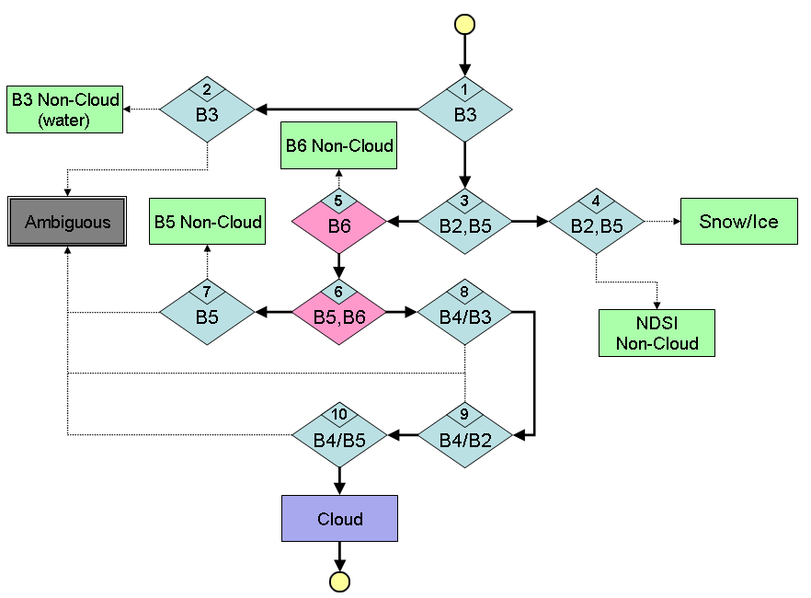
LDCM ACCA
ACCA is a simple decision tree that does crude classification of land cover and clouds, then refines the cloud estimates using statistical data from the thermal band. It was developed by NASA Goddard for the Landsat program.
The LDCM ACCA algorithm is only the classification phase of ACCA, using TIRS thermal band 1.
The snow/ice and water classifications reported by the ACCA algorithm will be provided in the Quality Band of the L1 product.
Notes:
Okay, now just to show you the basis of each of these algorithms.
ACCA is an old algorithm, you probably know it. It was made by Rich Irish at Goddard, and has been run on landsat 5 and landsat 7 data. But the whole of the ACCA algorithm just returns a scene-wide cloud score. We're using only the first part, the decision tree classifier, to make a cloud mask.
This decision tree also creates some rough land cover classifications. We're including the snow/ice and water classifications in the level 1 quality band.

Slide 6
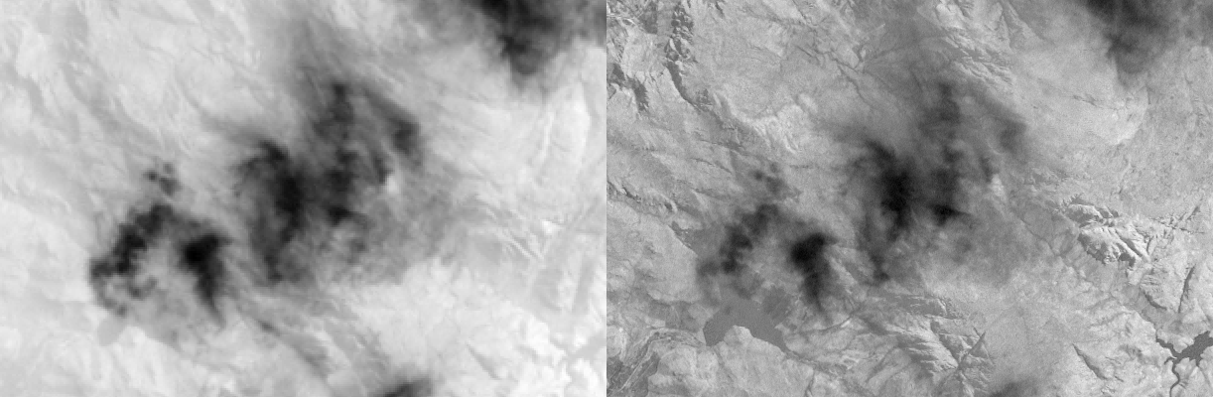
AT-ACCA
AT-ACCA is a variant of the ACCA algorithm that uses an 'artificial thermal' or AT band. This was developed as a means of running ACCA when thermal data is not available.
The AT band formula was created using the Rulequest Cubist statistical modelling software as a combination of the reflective bands (Landsat bands 1-5 & 7). It was trained on 2 million pixels randomly selected from 103 Landsat 7 scenes, and it has an RMS Average Difference from actual Band 6 brightness temperature of 9.5 K.
To reduce the number of pixels markes as 'ambiguous' by the ACCA algorithm, a disambiguation algorithm was added to AT-ACCA. This is a small McCulloch-Pitts neural network organized in a voting scheme that can re-designate ambiguous pixels as either cloudy or clear terrain.
L7 Band 6
AT band
Notes:
Now, AT-ACCA is the exact same decision tree as our ACCA algorithm, but with two enhancements. One, it uses the artificial thermal band we developed, so it doesn't require TIRS data. And two, we put on a disambiguation routine -- it's a short neural network -- that turns most of the pixels marked as ambiguous by ACCA into useful cloud or clear classifications. But you all know all this.

Slide 7
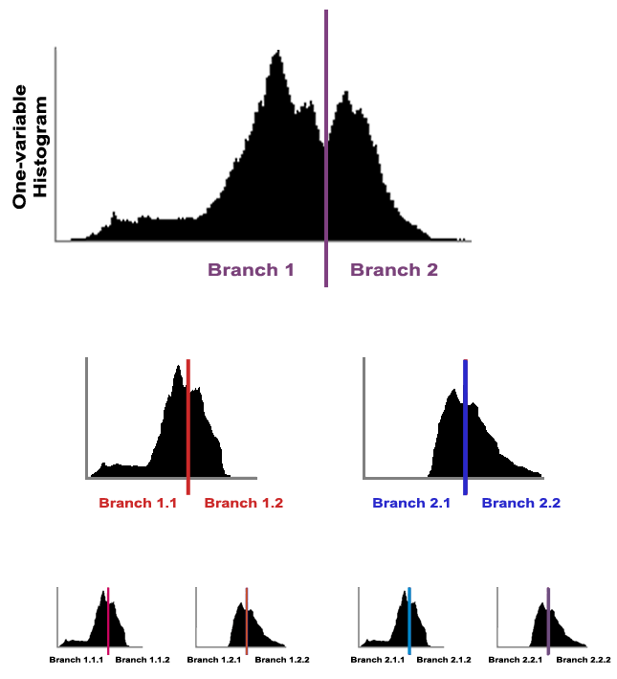
See5 CCA
The See5 CCA algorithm was created using the Rulequest C5.0 stastical classifier software.
The Rulequest C5.0 software creates a decision tree by finding the input variable which can best be divided by a threshold test. It selects the threshold value that minimizes the entropy in the dataset.
Once the dataset is divided into subsets, C5.0 then iterates over the subsets. It may select a different variable for each iteration. The user specifies how many iterations and what minimal amount of data each branch must contain. The end result is a decision tree of user-specified size.
The LDCM See5 CCA decision tree has 245 branches, and was trained using 6.4 million pixels randomly selected from 104 Landsat 7 scenes.
. . .
. . .
. . .
. . .
Notes:
See5 is a large and complicated decision tree that we developed using Rulequest statistical classifier known as 'capital C five point oh'. I put up a graphic here to show you how it creates decision trees -- it looks at the histogram of one variable in a dataset, and it finds the threshold that minimizes the information entropy in that variable. That divides the dataset in two. Then we iterate, and create more and more branches until the subsets are too small to be predictive anymore.
For the LDCM See5 algorithm that took 245 branches. It spit out a pretty accurate algorithm -- and it does not need thermal data -- but it is a large, complicated tree. (That we essentially have to treat as a black box.)
(And just to note, the c five point oh software is not necessary in the final LDCM implementation.)

Slide 8
LDCM Quality Band Format
The Quality Band for LDCM Level 1 products is a 16-bit image of the same dimensions as the L1G scene. Each pixel describes certain processing flags and land/cloud classifications.
The existing CCA algorithms contribute to some of these classifications:
ACCA -- Cloud, Snow/Ice, Water.
AT-ACCA -- Cloud, Snow/Ice, Water.
See5 CCA -- Cloud.
Cirrus CCA -- Cirrus.
Future algorithms may be developed to improve or expand the classification of these land cover categories.
Bit | Description
0 | Designated Fill
1 | Reserved
2 | Terrain Occlusion
3 | Reserved
4 | Water Confidence
5
6 | Reserved
7
Bit | Description
8 | Vegetation Confidence
9
10 | Snow/Ice Confidence
11
12 | Cirrus Confidence
13
14 | Cloud Confidence
15
Two-bit confidence levels:
  00 = Not set
  01 = 0-35% confidence
  10 = 36-64% confidence
  11 = 65-100% confidence
Notes:
Last but not least, here is the quality band format that we've settled on. This is a 16 bit image that will be delivered with the data and can be overlaid on top of it. I designed this band so that it will make sense to look at as an image -- clouds will be the whitest things in the scene, then cirrus, snow, and down until you get to water, which will be pretty dark. But it's not really an image, it's a set of flags that give a high, low, or middle confidence value for each of 5 or 6 classifications. We have some bits reserved so that we can add to this mask in the future if we wish. (Cloud shadow confidence will probably be slotted into bits 6 and 7. Bit 1 should be detector artifacts, someday.) (Note that the intermediate masks created by the individual CCA algorithms will also follow this format.)
And that's it, that's a quick update on what we're doing. You've seen most of this before, but let me know if there are any quesitons. (We've given Curtis and Zhe our results for comparison with other algorithms, and some visual examples.)

Slide 9
Planned end of slide show; all slides past this point are supporting information.

Slide 10
Cloud Datasets
'Irish' Dataset
  212 Landsat 7 L1Gs scenes. (207 used)
  Manual truth masks created by three analysts.
  For general cloud studies.
  Available online.
Hyperion Dataset
  22 Hyperion scenes, spectrally resampled to resemble Landsat 7 bands 1-5 & 7.
  Manual truth masks created by a single analyst.
  For studying Cirrus algorithms.
ASTER Dataset
  15 ASTER scenes as both L1 (TOA reflectance) and L2 (kinetic temperature).
  Manual truth masks created by a single analyst.
  For studying brightness temperature / surface temperature differences in ACCA.

Slide 11
Goddard / Rich Irish Test Data Set
212 Landsat 7 L1Gs scenes
  Provided by Rich Irish at NASA Goddard.
  Divided by latitude into 9 zones, 20-24 scenes per zone.
  Scenes acquired in 2000-2001.
  When referring to 'Irish' in this presentation, we are referring to this data set. Ireland is not represented.
207 scenes with manual cloud masks
  5 scenes were excluded due to visible gain change artifacts.
    One scene had a gain change but no visible artifacts; it was retained.
  Manual masks were created by three operators at EDC.
  Cloud masks should be treated as having ~7% error.
    Based on 11 masks duplicated by all three operators.
Polar North
Boreal
Mid-latitude North
Subtropical North
Tropical
Subtropical South
Mid-latitude South
Austral
Polar South
104 Training scenes, 103 Validation scenes.
  Scenes were tagged based on scene content and ACCA performance.
  Tags included heavyclouds, cloudfree, shadows, lowsun, manyambig, falseclouds, and manyprovisionals.
  Division into training and validation sets was performed while attempting to equalize the quantity of each tag in each set, for each latitude zone.
Irish data set and the accompanying cloud masks are available for download.
  Courtesy of EDC. Contact pscar@usgs.gov for instructions.

Slide 12
See5 Training and Validation Results
Round E algorithm, 1/2009
104 Training scenes
Entire training set: 7,922,160
Non-saturated pixels: 6,484,262 245 leaves
Saturated pixels: 1,437,898 70 leaves
103 Validation scenes
Total number of validation pixels: 3,955,741,397
Scene level validation results
Pixel level validation results
Manual Designation
% error | # of scenes | % of scenes | cum. %
0 - 5 | 64 | 62% | 62%
5 - 10 | 22 | 21% | 83%
10 - 15 | 9 | 9% | 92%
15 - 20 | 1 | 1% | 93%
20 - 25 | 3 | 3% | 96%
25 - 30 | 0 | 0% | 96%
30 - 35 | 2 | 2% | 98%
35 - 40 | 0 | 0% | 98%
40 - 45 | 0 | 0% | 98%
45 - 50 | 0 | 0% | 98%
50 - 55 | 0 | 0% | 98%
55 - 60 | 1 | 1% | 99%
60 - 65 | 0 | 0% | 99%
65 - 70 | 1 | 1% | 100%
Cloud Conf. % | Clear | Shadow | Thick | Thin | All Clouds | All Clear
< 35% | 91.8% | 93.5% | 3.8% | 28.7% | 12.1% | 91.8%
35-65% | 3.7% | 2.3% | 1.8% | 11.5% | 5.1% | 3.7%
> 65% | 4.5% | 4.2% | 94.4% | 59.8% | 82.8% | 4.5%
Total Pixels Correct: 88.5%
Total Pixels False: 7.3%
Total Ambiguous: 4.2%

Slide 13
AT equations
Final AT algorithm is the 'ATv6 Cubist r1' formulation:
AT = - 92.7 ND(B3,B5) + 261.4 ND(B2,B7)
- 48.8 ND(B2,B5) - 17.5 ND(B4,B2)
- 146.9 ND(B1,B7) + 58.7 ND(B3,B1)
- 117*ND(B2,B1) + 172*CSA*B5
+ 76*CSA*B4 + 151*CSA*B3
- 951*CSA*B2 + 539*CSA*B1
+ 28*B7 - 132*B5
- 106.2*B4 - 22.4*B3
+ 633.1*B2 - 443.6*B1
+ 302.0986
where Bx = TOA Reflectance in Landsat Band x.
(Landsat Bands 1-5 & 7 correspond to OLI bands 2-7.)
CSA = cos(solar zenith angle)
ND(x,y) = Normalized difference between x and y.
= (x-y)/(x+y)

Slide 14
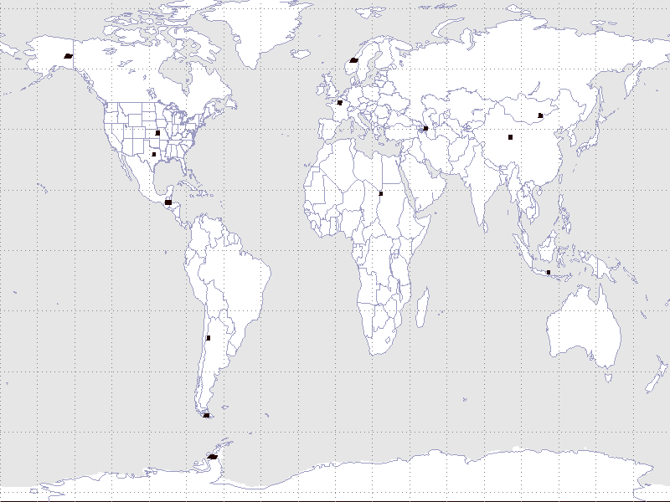
ASTER Test Scenes
15 test scenes, each containing both L1 spectral reflectance and ASTER Kinetic temperature products.
The test set has representatives of partially cloudy scenes from regions covered with desert, snow, vegetation and water.
Scenes were selected from the years 2000-2006, when ASTER had all bands functioning.

Slide 15
Comparison of ACCA Thermal options
 | Pixels Correct | Pixels False | Pixels Ambiguous | Misclassified Clouds | Misclassified Clear
Brightness T | 55.40% | 8.79% | 35.81% | 11.72% | 7.38%
Kinetic T | 55.27% | 8.67% | 36.06% | 13.63% | 6.28%
Fixed T | 49.25% | 7.37% | 43.38% | 11.69% | 5.29%
Total number of pixels in the 15 scene ASTER test set: 258,947,180
Conclusions:
ASTER data does not make a good test set for ACCA.
  High number of ambiguous pixels suggest that spectral differences in Band 5 are the problem in comparing ASTER to Landsat.
KT may have a slight (1.1%) advantage in classifying clear terrain, while BT may have a slight (1.9%) advantage in classifying clouds.
There is no clear advantage to using surface temperature in the ACCA algorithm. Brightness temperature is as good (or slightly better), and is a less complex algorithm.

Slide 16
Hyperion Cirrus results
 | Cirrus/Not-Cirrus only
 | Pixels Correct | Pixels False | Mid-confidence pixels | Misclassified Cirrus | Misclassified Not-Cirrus
Simple Test Cirrus > 0.02 | 76.8% | 23.2% | n/a | 4.4% | 26.3%
Simple Test Cirrus > 0.02 (no playas) | 91.9% | 8.1% | n/a | 4.8% | 8.7%
See5 hC-6 (parameterized) | 74.0% | 8.1% | 18.0% | 44.7% | 5.9%
In the absence of high-altitude playas, the Simple (MODIS) threshold test is the best algorithm yet studied, and it easily surpasses the ACCA accuracy goal.

