Slide 1
Nuclear Cities Initiative?
Maury Goodman
Argonne National Lab
May 1, 2003

Slide 2
Motivation
Nuclear Expertise at Argonne
Reactor Design
  CP1
Non-proliferation
  Met with Armando Travelli & James Matos;
Suggested funding through “Nuclear Cities Initiative”

Slide 3
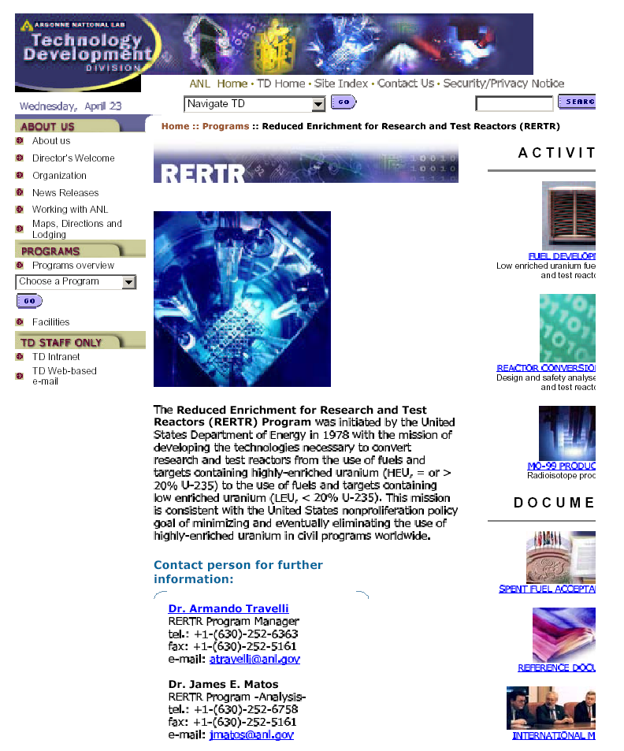

Slide 4
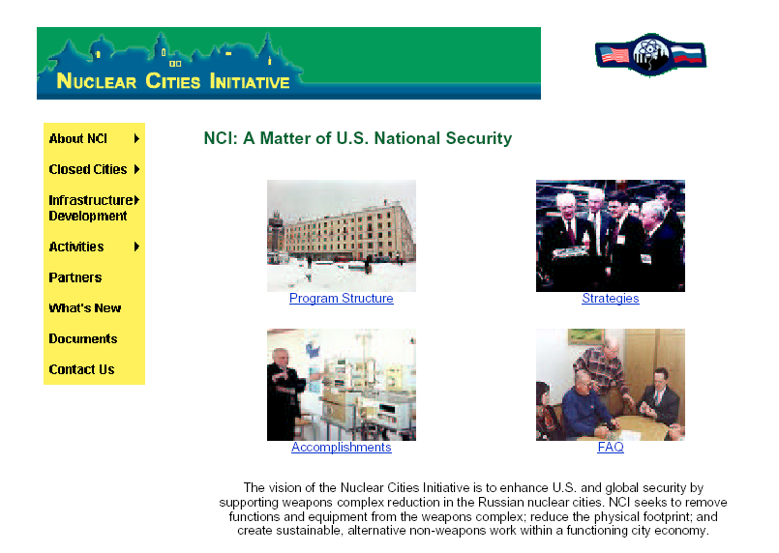
Nuclear Cities Initiative

Slide 5
Closed Cities
Zheleznogorsk 
Snezhinsk
Sarov

Slide 6
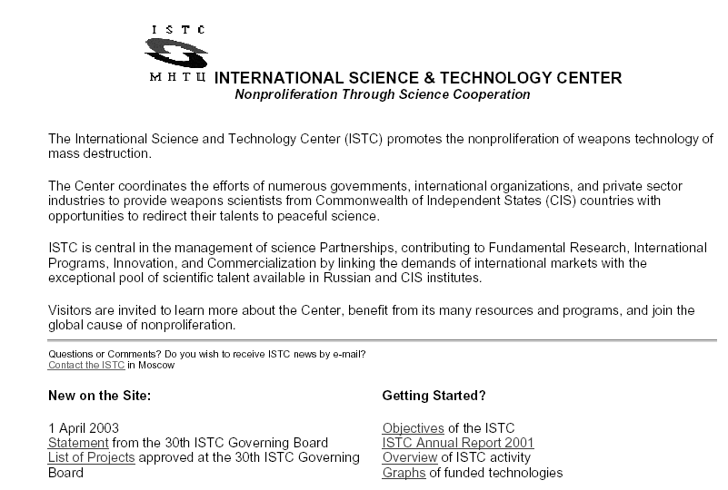

Slide 7
To Do
I was given a contact in the Department of Energy
Haven’t touched base with him yet.
Are there other opportunities for funding?

