Slide 1
Testimony of Sidney M. Wolfe MD
and Elizabeth Barbehenn, Ph.D.,
Public Citizen’s Health Research Group
FDA Non-Prescription and Endocrine
and Metabolic Drug Advisory Committees
Hearing on Possible Switch of
Orlistat to OTC Status
January 23, 2006
Principles to Consider When Deciding
on an Rx-to-OTC Switch:
Application in the Case of Orlistat

Slide 2
Ease / possibility of self-diagnosis
The actual use trial demonstrated that a significant proportion of people choosing orlistat were not very overweight. FDA data from the trial shows that in age groups 36-40 and 41-45 years, 16% of women had starting BMI’s of less than 25.3 kg/m2 and 26.4 kg/m2, respectively. Almost one-third of women had a BMI of less than 30 kg/m2. Self diagnosis, or the lack thereof, of conditions as diabetes, hypertension, often associated with obesity is also a problem.

Slide 3
Ease / possibility of self-diagnosis
Current research on cardiovascular risk stresses assessment of global risk rather than focusing simply on treating just one possible risk factor. This explains the current labeling on prescription orlistat: “The long-term effects of orlistat on morbidity or mortality associated with obesity have not been established”. The need to consider all factors including hypertension, diabetes, smoking, family history and others is one of the major arguments against OTC availability of anti-hypertensive, cholesterol-lowering, diabetes and weight reduction drugs.

Slide 4
GSK explaining why blood pressure and serum lipids were not included in integrated efficacy summary:
“..mainly because the [OTC] indication is to promote weight loss and all other benefits achieved from orlistat would be most properly handled under the supervision of a physician.”

Slide 5
FDA Response to GSK Statement
“GSK seems to be saying that overweight individuals with weight-related co-morbidities such as type 2 diabetes, hypertension or dyslipidemia are inappropriate candidates for OTC orlistat because weight loss in such patients will require management of a physician to ensure that such changes will favorably alter overall cardiovascular risks.”
FDA review by J. Golden MD, page 22

Slide 6
Further FDA response
It is difficult to imagine the proposed dichotomization of the target population into mildly-to-moderate overweight adults with and without weight-related co-morbidities ...succeeding in the real world
FDA review by J. Golden MD, page 22

Slide 7
2. Self-limited or chronic condition
This is relevant to treatment duration, the evolution of the disease and the occurrence of adverse reactions/ interactions, that may require physician monitoring. In the case of orlistat, the evolution or co-existence of diabetes, hypertension or the need for frequent long-term INR monitoring if on warfarin are serious problems.

Slide 8
Findings from Actual Use Study
465 of 681 (68%) of eligible subjects had one or more labeled exclusions including 24.4% with hypertension, 6.8% taking diabetes medication and 2.1% taking warfarin
Of 247 subjects with conditional labeled
exclusions, only 32% correctly chose not to use or said they would consult a health professional first
Correct multivitamin use never exceeded 54%

Slide 9
3. Benefit / risk ratio and its evaluation
This is related to # 1 and #2 because the difficulty of continued evaluation of benefit and risk by the patient--arguably without any input
from the physician--can significantly alter this ratio and hamper the ability to keep it favorable for the patient. A risk that might be tolerable under a physician’s supervision may not be so with OTC. The time-related increase in weight also alters the benefit / risk ratio, decreasing benefit while continuing risks.

Slide 10
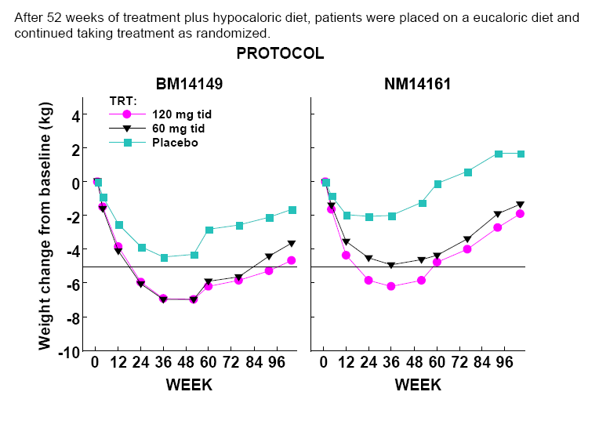

Slide 11
4. Adverse drug reactions or interactions and the ease of detecting them
There may be adverse reactions or interactions that may not be fully known to the patient or physician. This presents even more cause for concern than the already-troublesome situation involving prescription-only drugs. The common gastrointestinal adverse reactions and, especially the problems in those using warfarin or cyclosporine exemplify this as does the documented inhibition of fat soluble vitamin absorption.

Slide 12
Orlistat, decreased vitamin K absorption and warfarin
A few other OTC drugs have warnings about concomitant warfarin use. But this problem is compounded with orlistat because the drug also decreases the absorption of fat-soluble Vitamin K, whose ”deficiency”, induced by warfarin is the mechanism by which warfarin inhibits blood clotting. GSK cites a study in that finds no clinically significant decrease in blood Vitamin K levels in orlistat users, but the study actually finds a statistically significant decrease as it did with all other fat soluble vitamins that were measured.*
* Diabetes Care. 2004 Mar;27(3):856

Slide 13
5. Long-term data from prescription use
Problems that have arisen and been documented during use in prescription form are likely, if not certain, to be more common and/or more serious in the OTC version. There are 39 cases of increased INR (abnormal blood thinning) in orlistat users, include 29 taking warfarin, one with Vitamin K deficiency not using warfarin, one death, 10 hospitalizations, four with life-threatening reactions and reports by the FDA of several patients with bleeding episodes.* More of these would inevitably occur with OTC use as evidenced by the fact that 50% of 14 warfarin users chose to use OTC orlistat and might not have told their physician and thereby get weekly INR monitoring when first using orlistat, as recommended by MacWalters, et al.**
* FDA AERS files
**Ann Pharmacother. 2003 Apr;37(4):510-2. Orlistat enhances warfarin effect.

Slide 14
Conclusions
1. For the reasons discussed, the switch of orlistat to OTC status would be a serious, dangerous mistake in light of its marginal benefits, frequent co-existence of other diseases, common, bothersome G-I adverse reactions, significant inhibition of absorption of fat soluble vitamins, and problematic use in the millions of people* using warfarin or, less commonly, cyclosporine.
*23 million prescriptions filled for warfarin in 2004: Drug Topics Data

Slide 15
(Continued)
2. Physicians are increasingly rejecting the prescribing of orlistat (decrease from 2.6 million US prescriptions in f.y. 2000 to 1.0 million in f.y. 2004). It is clearly in GSK’s (and partner Roche’s) interest to seek OTC approval. Your committees need to reject this desperate attempt to revive this barely effective drug by an OTC switch.

Slide 16
(Continued)
3.“though a statistically significant weight loss for orlistat 60 mg compared to placebo is seen, there is no evidence presented that a modest, transient weight loss due to orlistat will afford any long-term clinical benefit either through a change in behaviour or a reduced risk of serious clinical diseases manifest by being overweight.”
FDA Statistical Review, p 22

