Slide 1
REQUIREMENTS REVIEW AND
ANALYSIS PROCESS
Christopher A. Moren
OFCM
Science and Technology Corporation

Slide 2
REQUIREMENTS REVIEW AND
ANALYSIS PROCESS
Office of the Federal Coordinator for Meteorology
Overview
NEEDS & REQUIREMENTS TIMELINE
DATA GATHERING - DESIGN / QUERY
DATABASE STRUCTURE
EXAMPLE OUTPUT
SUMMARY
Notes:
[Self - Introduction.]

Slide 3
REQUIREMENTS REVIEW AND
ANALYSIS PROCESS
Office of the Federal Coordinator for Meteorology
Needs and Requirements Timeline
FHWA 2nd Stakeholders Mtg
Comprehensive WIST Requirements Document (Final Draft)
WIST Requirements Document (Draft)
WIST/JAG Mtg
ICMSSR Brief on WIST Requirements Document
WIST/JAG Mtg
WIST II Symposium
ICMSSR WIST Status
Preparations for WIST Symposium
Dec 1999
Jan 2000
Feb
Mar
Apr
May
Jun
Jul
Aug
Sep
Oct
Nov
Dec
May 2001
WIST Proceedings
FHWA 1st Stakeholders Mtg
Query WIST Shareholders Validate Criteria Integrate Responses
Analyze WIST Questionnaires
Follow-up/Refinement of WIST Questionnaires
Review & Edit WIST Requirements Document
WIST
Symposium
Nov. 30-Dec. 2

Slide 4
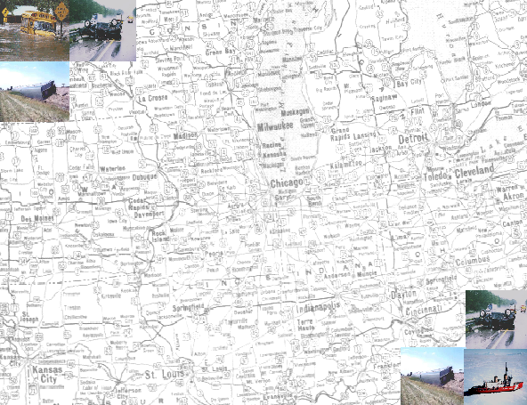
REQUIREMENTS REVIEW AND
ANALYSIS PROCESS
Office of the Federal Coordinator for Meteorology
Data Gathering - Design / Query
Design
  Surface Transportation Mode
  Provider(s)
  Customer(s)
  Weather Factors

Slide 5
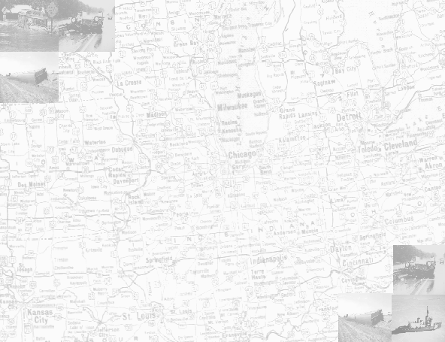
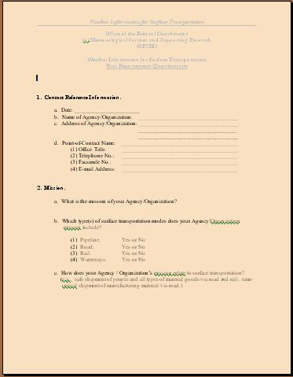
REQUIREMENTS REVIEW AND
ANALYSIS PROCESS
Office of the Federal Coordinator for Meteorology
Data Gathering - Design / Query
Query - Questionnaire
  Mission
  Weather Factors
  Time & Scale
  Providers
  Receipt Methods

Slide 6
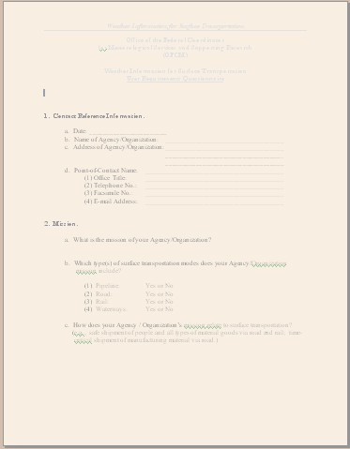
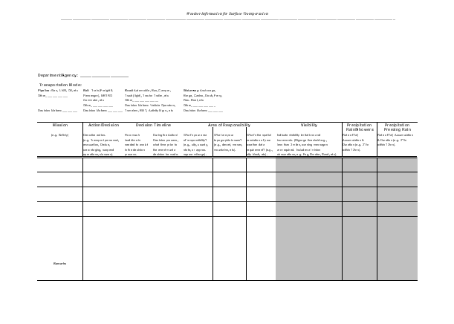
REQUIREMENTS REVIEW AND
ANALYSIS PROCESS
Office of the Federal Coordinator for Meteorology
Data Gathering - Design / Query
Query - Survey
  Mission
  Actions (Decisions)
  Additional Weather Factors (Fidelity)
  Time & Scale (Responsibilities)
  Topography

Slide 7
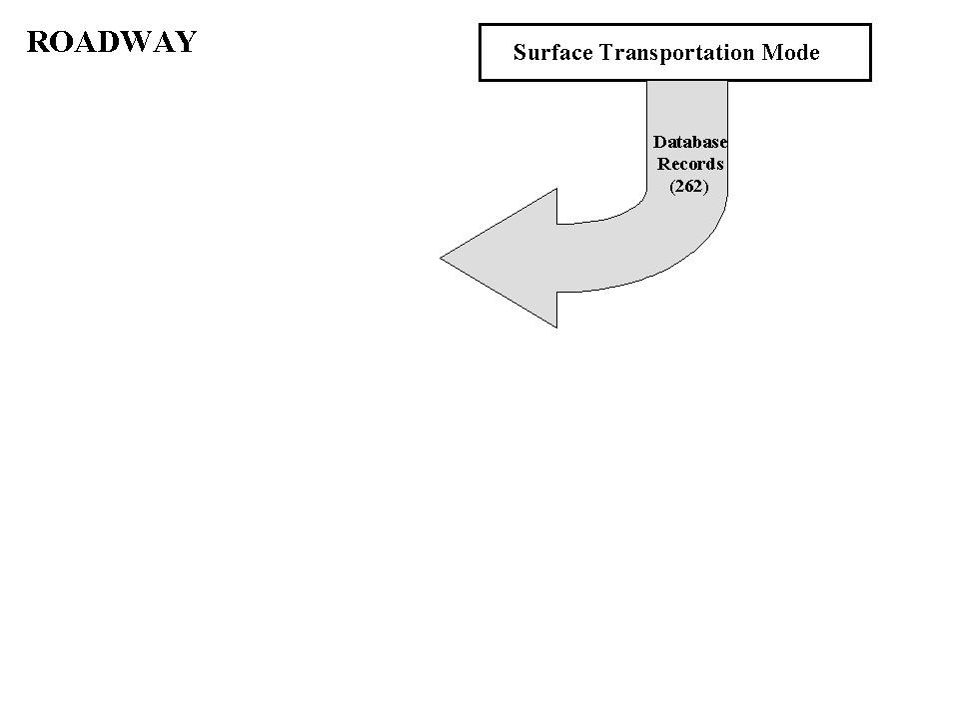
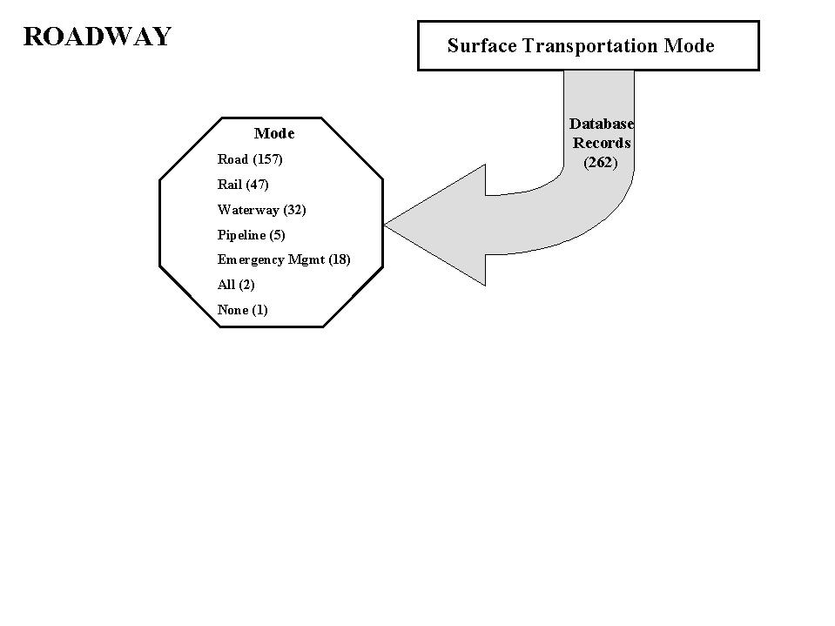
REQUIREMENTS REVIEW AND
ANALYSIS PROCESS
Office of the Federal Coordinator for Meteorology
Database Structure
Administrative Records
Scale Records
Data Records

Slide 8
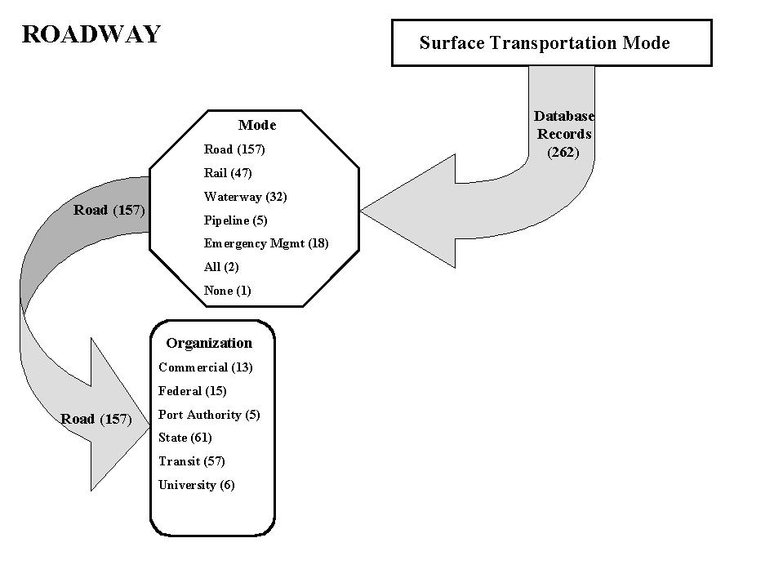
REQUIREMENTS REVIEW AND
ANALYSIS PROCESS
Office of the Federal Coordinator for Meteorology
Database Structure
Administrative
  Agency
  Organization
  Mode
  Mission
  Action - Decision
  Address(s)

Slide 9
REQUIREMENTS REVIEW AND
ANALYSIS PROCESS
Office of the Federal Coordinator for Meteorology
Database Structure - Administrative
Distribution of Records by Transportation Mode
Mode Records
All 2
Emergency Mgmt 18
Pipeline 5
Rail 47
Road 157
Waterway 32
No mode identified 1

Slide 10
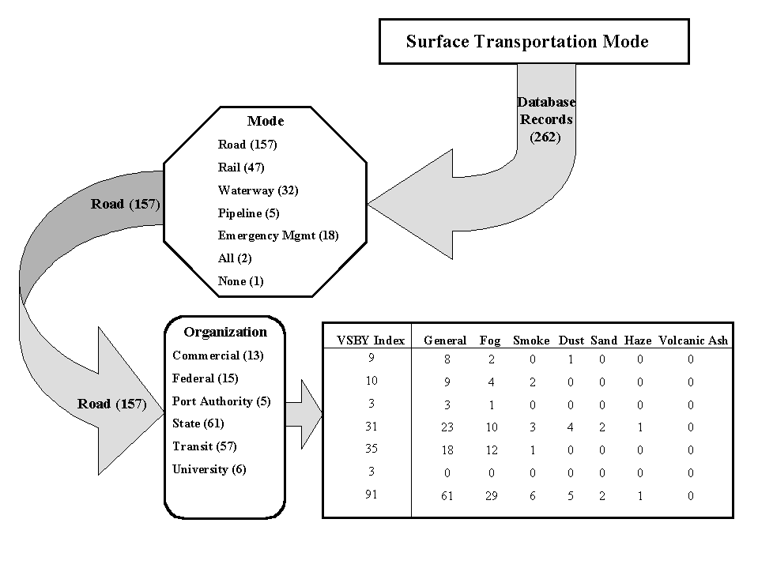
REQUIREMENTS REVIEW AND
ANALYSIS PROCESS
Office of the Federal Coordinator for Meteorology
Database Structure - Scale
Topography
Time
Spatial Resolution

Slide 11
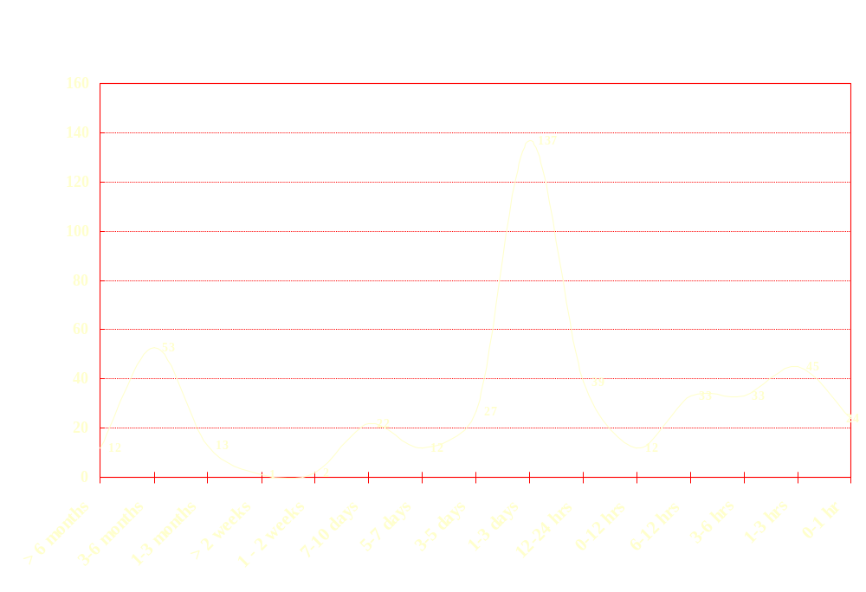
REQUIREMENTS REVIEW AND
ANALYSIS PROCESS
Office of the Federal Coordinator for Meteorology
Database Structure - Timeline
Responses
Time

Slide 12
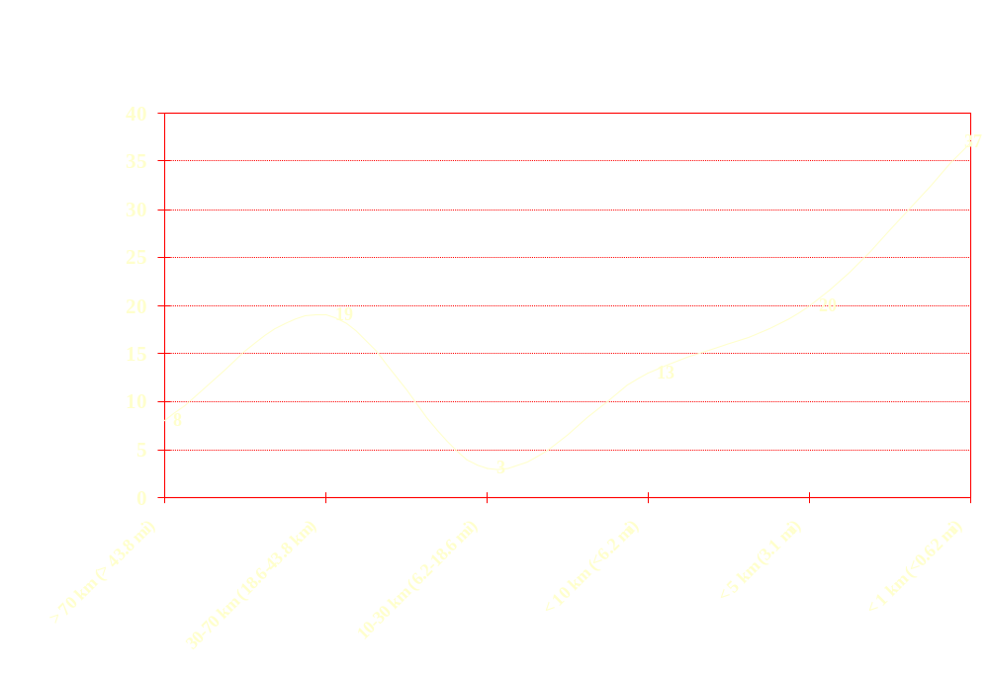
REQUIREMENTS REVIEW AND
ANALYSIS PROCESS
Office of the Federal Coordinator for Meteorology
Database Structure - Spatial Resolution
Responses
Resolution

Slide 13
REQUIREMENTS REVIEW AND
ANALYSIS PROCESS
Office of the Federal Coordinator for Meteorology
Database Structure - Data
Visibility
  Obstruction to Vision
  Threshold
  Note
Precipitation
  Type
  Threshold
  Note
Drifting Snow
Icing
Flooding

Slide 14
REQUIREMENTS REVIEW AND
ANALYSIS PROCESS
Office of the Federal Coordinator for Meteorology
Database Structure - Data
Temperature
  Type
  Threshold
  Note
Relative Humidity
  Threshold
  Note
Heat Index
  Threshold
  Note
Wind Chill
  Threshold
  Note

Slide 15
REQUIREMENTS REVIEW AND
ANALYSIS PROCESS
Office of the Federal Coordinator for Meteorology
Database Structure - Data
Wind Data
  Speed
  Direction
  Threshold
  Note
Tropical
Thunderstorm
Tornado
Lightning
  Distance
  Time
  Type

Slide 16
REQUIREMENTS REVIEW AND
ANALYSIS PROCESS
Office of the Federal Coordinator for Meteorology
Database Structure - Data
Small Craft Advisories
  SCA
  Gale
  Storm
  Note
Seas
  Wave Height
  Tides/Surge
  Currents
  Sea Ice
  Note

Slide 17
REQUIREMENTS REVIEW AND
ANALYSIS PROCESS
Office of the Federal Coordinator for Meteorology
Database Structure - Data
Optics
  Glare
  Mirages
  Note
Pollution
  Note

Slide 18
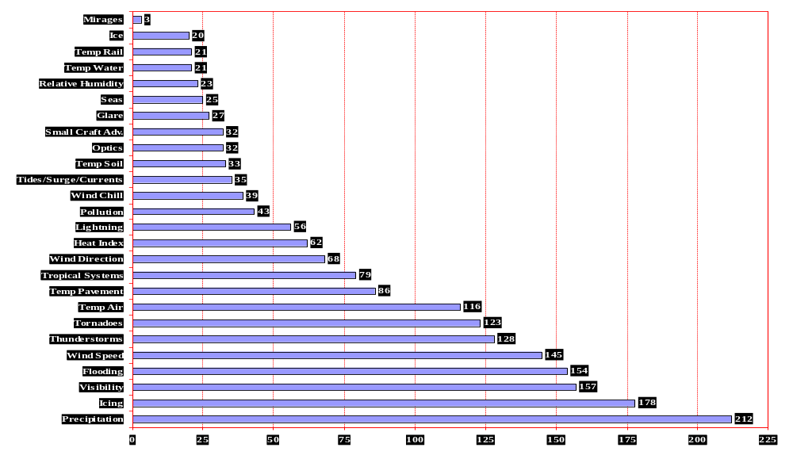
REQUIREMENTS REVIEW AND
ANALYSIS PROCESS
Office of the Federal Coordinator for Meteorology
Example Output

Slide 19
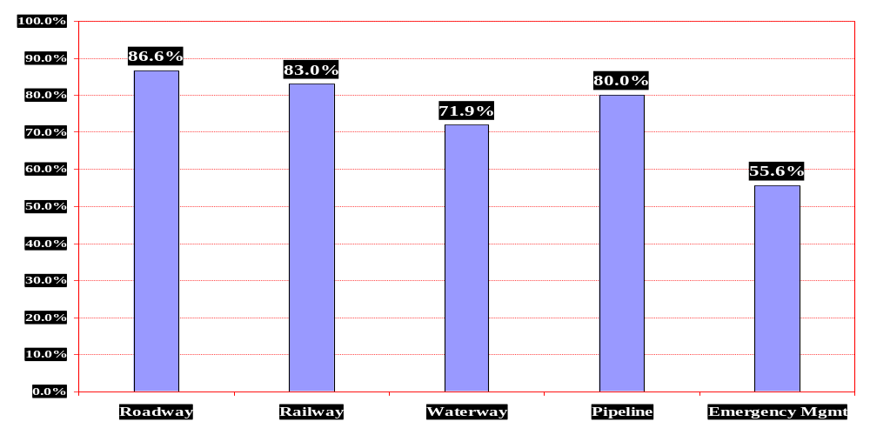
REQUIREMENTS REVIEW AND
ANALYSIS PROCESS
Office of the Federal Coordinator for Meteorology
Example Output
Normalized Precipitation by Mode

Slide 20
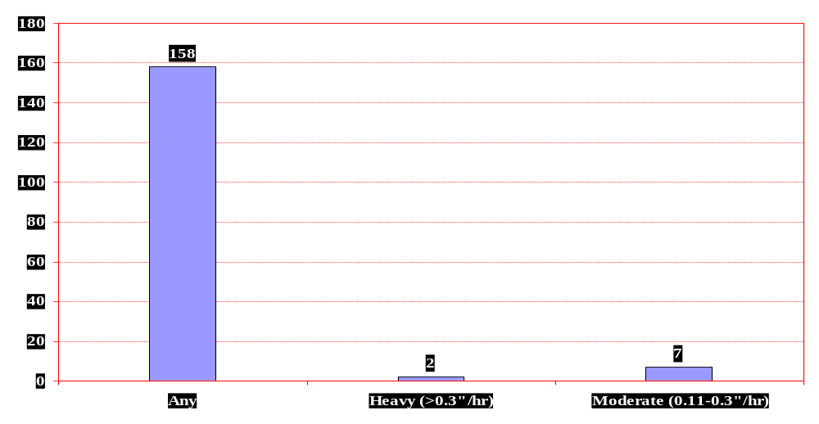
REQUIREMENTS REVIEW AND
ANALYSIS PROCESS
Office of the Federal Coordinator for Meteorology
Example Output
Freezing Rain Records

Slide 21
REQUIREMENTS REVIEW AND
ANALYSIS PROCESS
Office of the Federal Coordinator for Meteorology
Summary
Data derived from the questionnaires, interviews, and surveys provides foundation to build WIST needs and requirements
This data-set forms a nucleus from which both public and private weather providers can:
  Refine existing capabilities
  Improve capabilities and services
  Identify and leverage research and development proposals
  Implement new initiatives for surface transportation weather information heretofore not addressed
  Identify weather information needs and weather products

Slide 23
BACKUP

Slide 24
REQUIREMENTS REVIEW AND
ANALYSIS PROCESS
Office of the Federal Coordinator for Meteorology
Database Structure - Administrative
Distribution of Records by Agency
Agency Records
Federal 36
Commerce 1
Defense 5
Energy 4
Interior 4
Transportation 5
FEMA 1
NASA 5
USDA 8
USPS 3
State 188
EMA 20
Port Authority 15
Transit Authority 78
Transportation 75
Commercial 21
Association 1
User 13
Provider 7
University 17

