Slide 1
Tungsten Target Radius
November 17, 2009

Slide 2
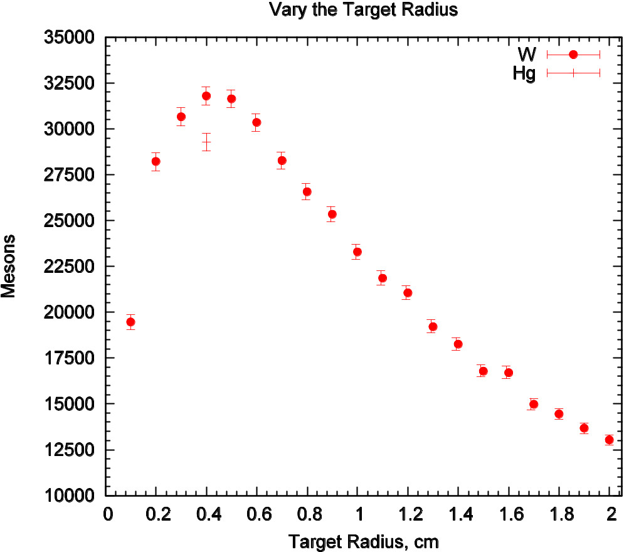
Vary Target Radius
Peak production efficiency at r= 4-5mm
Efficiency reduction at r=1cm is 27%
Tungsten effiency 8% higher than Hg

