Slide 1
The redshift of XRF 030528
?
?
or
from GRB to XRF to XRR
Arne Rau, M. Salvato, J. Greiner (MPE)

Slide 2
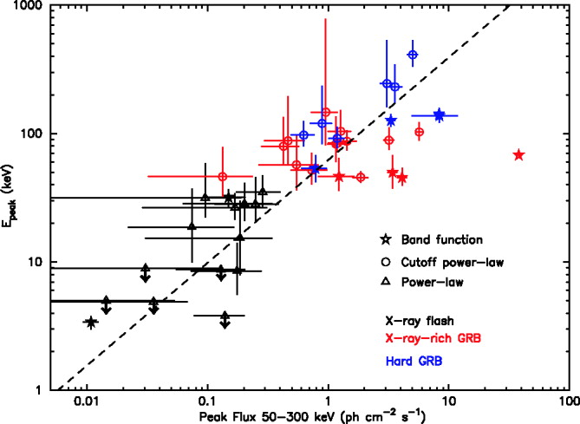
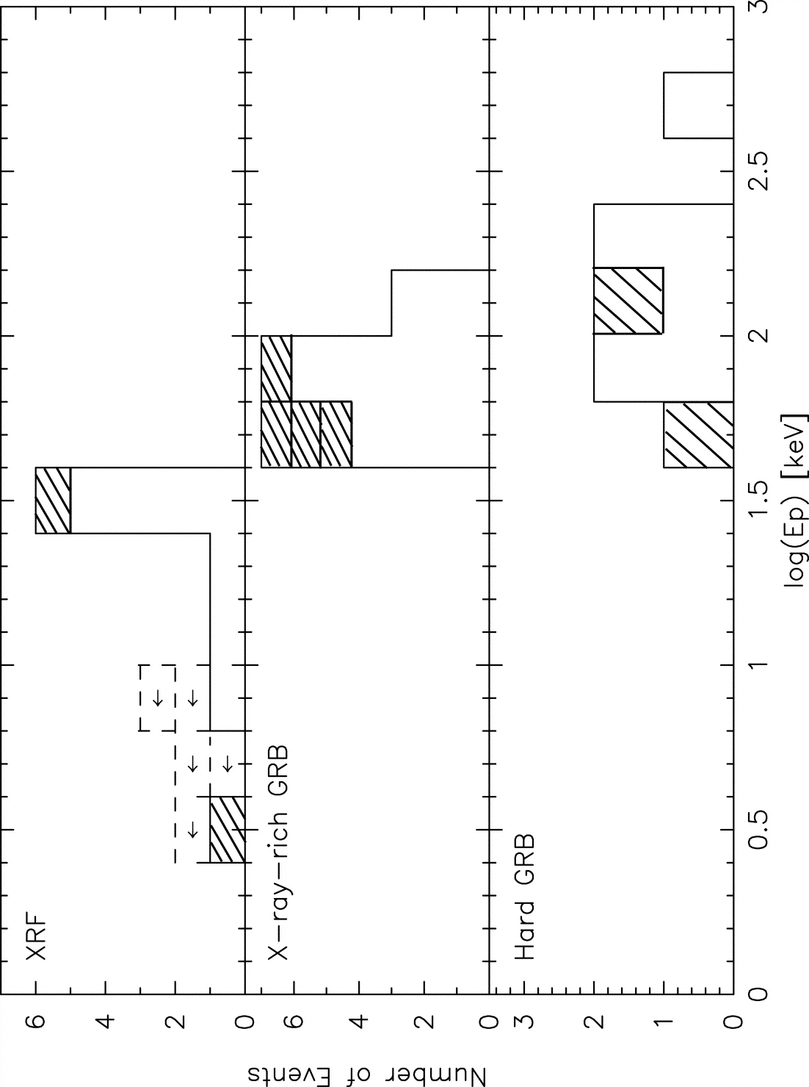
X-ray Flashes - prompt
BeppoSAX WFC (Heise et al. 2001)
similar to LGRBs except E_{peak}
HETE-2 observer frame classification:
log(S_{x}(2-30 keV) / S_{γ}(30-400 keV)) (Sakamoto et al. 2004)
>0
>-0.5
<-0.5
(Sakamoto et al. 2005)

Slide 3
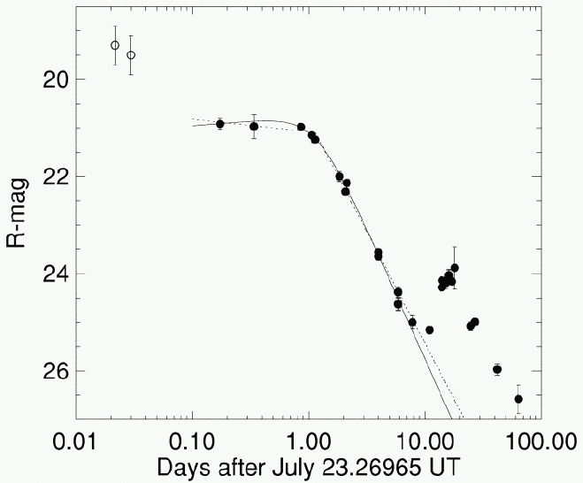
X-ray Flashes - late
XRFs/XRRs/LGRBs form continuum
X-ray, optical, radio afterglows
underlying supernova (Fynbo et al. 2003, Soderberg et al. 2005)
late type host galaxies (e.g. Bloom et al. 2003)
XRF 030723
(Fynbo et al. 2003)

Slide 4
X-ray Flashes - models
high baryon loading in the ejecta (e.g. Dermer et al. 1999)
low contrast between the bulk Lorentz factors of colliding
relativistic shells (Barraud et al. 2005)
off-axis bursts (e.g. Yamazaki et al. 2002)
high redshift (e.g. Heise et al. 2001)
Distance Scale is important:
XRF 020903: z=0.251 (Soderberg et al. 2004)
XRF 030429: z=2.66 (Jakobsson et al. 2005)
011030 (<3.5); 020427 (<2.3); 030723 (<2.3);
040701 (0.2146 ??)

Slide 5
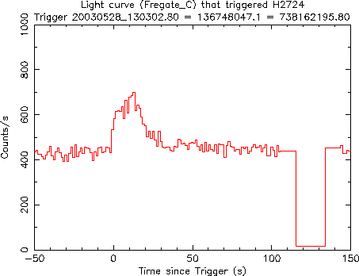
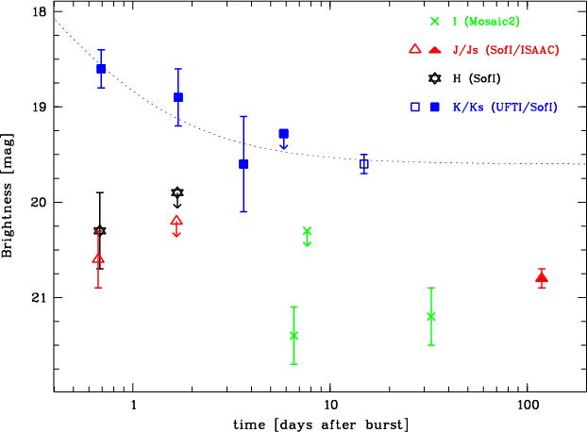
XRF
GRB 030528
GRB 030528
T₉₀ = 49.1s (30-400 keV)
E_{peak} = 32±5 keV
log (S_{X} / S_{γ}) = 0.04
T₉₀ = 49.1s (30-400 keV)
E_{peak} = 32±5 keV
log (S_{X} / S_{γ}) = 0.04
F ∝ t^{-1.2} • ν^{-(>0.4)}
(AR et al. 2004)

Slide 6
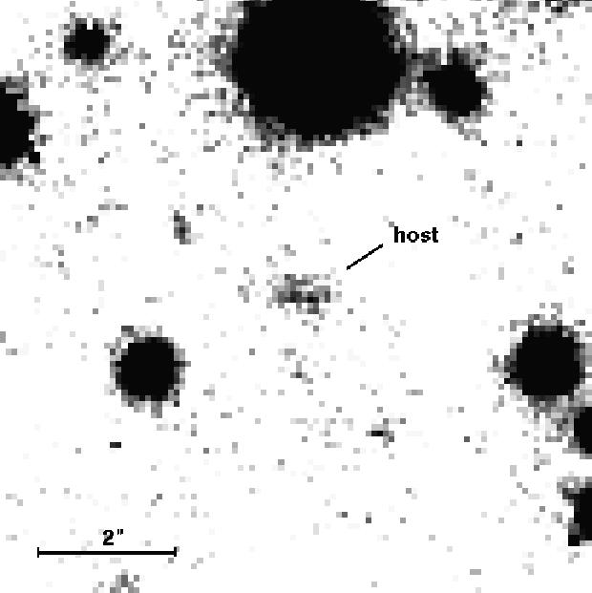
Host Galaxy - Photometry
V = 21.9 ± 0.2
R = 22.0 ± 0.2
I = 21.3 ± 0.3
J = 20.8 ± 0.1
H < 20.3
K = 19.9 ± 0.7
ISAAC J_{s}
SED consistent with late type galaxy at z<4

Slide 7
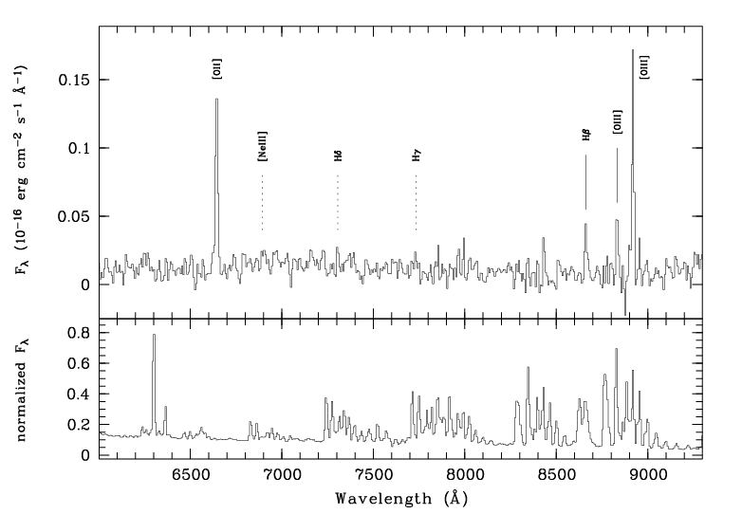
VLT/FORS2 LSS (2 hrs 300V April/May05)
host
z=0.782±0.001
sky
(AR et al. 2005, A&A accepted)

Slide 8
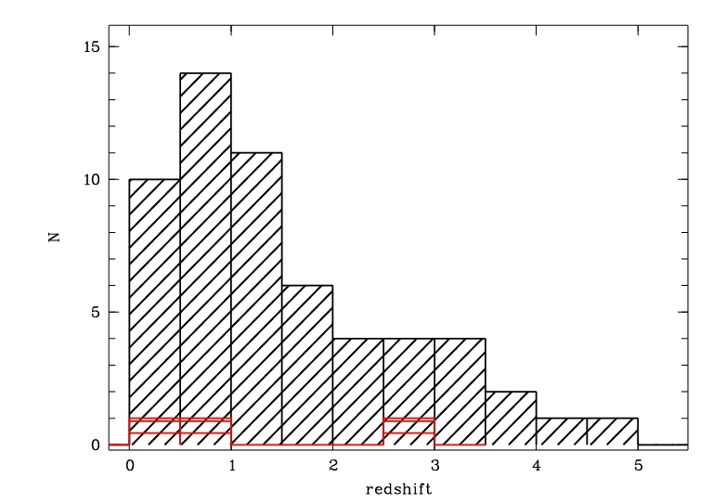
030528 in the rest frame
030528: E_{peak,obs} = 32±5 keV ⇒ E_{peak,rest} = 57±9 keV
030528: E_{peak,obs} = 32±5 keV ⇒ E_{peak,rest} = 57±9 keV
log(S_{x}/S_{γ})_{obs} = 0.04 ⇒ log(S_{x}/S_{γ})_{rest} = -0.17
030528: E_{peak,obs} = 32±5 keV ⇒ E_{peak,rest} = 57±9 keV
log(S_{x}/S_{γ})_{obs} = 0.04 ⇒ log(S_{x}/S_{γ})_{rest} = -0.17
XRF_{obs} ⇒ XRR_{rest}
030528: E_{peak,obs} = 32±5 keV ⇒ E_{peak,rest} = 57±9 keV
log(S_{x}/S_{γ})_{obs} = 0.04 ⇒ log(S_{x}/S_{γ})_{rest} = -0.17
XRF_{obs} ⇒ XRR_{rest}
030429: XRF_{obs} ⇒ XRR/GRB_{rest}
020903: XRF_{obs} ⇒ XRF_{rest}

Slide 9
Summary
z=0.782
observer frame XRF ⇒ rest frame XRR
rest frame classification scheme required
host properties (AR et al. 2005, A&A accepted)
Do we expect also short XRFs ?

Slide 11
Host Properties
metallicity from emission lines: R₂₃=log(([OIII]+[OII])/H_{β})
0.1<Z<0.6
metallicity from emission lines: R₂₃=log(([OIII]+[OII])/H_{β})
0.1<Z<0.6
absolute magnitudes
metallicity from emission lines: R₂₃=log(([OIII]+[OII])/H_{β})
0.1<Z<0.6
absolute magnitudes
stellar mass: 9⋅10⁹ M_{sun} (Brinchman & Ellis 2000) to
2⋅10¹⁰ M_{sun} (Bell et al. 2005)
metallicity from emission lines: R₂₃=log(([OIII]+[OII])/H_{β})
0.1<Z<0.6
absolute magnitudes
stellar mass: 9⋅10⁹ M_{sun} (Brinchman & Ellis 2000) to
2⋅10¹⁰ M_{sun} (Bell et al. 2005)
size: ~11 kpc
 | M_{AB} [mag] | L/L*
U | -20.5 ± 0.1 | 1.2 ± 0.2
B | -20.7 ± 0.1 | 0.5 ± 0.1
R | -21.1 ± 0.1 | 0.35 ± 0.05
J | -21.4 ± 0.1 | 0.25 ± 0.05
K_{s} | -21.6 ± 0.1 | 0.17 ± 0.05

Slide 12
Star Formation
[OII]: SFR(M_{s} yr⁻¹) = 1.4 ± 0.4 ⋅ 10⁻⁴¹L_{[OII]} (Kennicut 1998)
SFR(M_{s} yr⁻¹) = 8.4 ± 0.4 ⋅ 10⁻⁴¹L_{[OII]} (Rosa-Gonzalez 2002)
[OII]: SFR(M_{s} yr⁻¹) = 1.4 ± 0.4 ⋅ 10⁻⁴¹L_{[OII]} (Kennicut 1998)
SFR(M_{s} yr⁻¹) = 8.4 ± 0.4 ⋅ 10⁻⁴¹L_{[OII]} (Rosa-Gonzalez 2002)
UV: SFR(M_{s} yr⁻¹) = 1.4 ± 0.4 ⋅ 10⁻²⁸L_{ν,UV} (Kennicut 1998)
SFR(M_{s} yr⁻¹) = 6.4 ± 0.4 ⋅ 10⁻²⁸L_{ν,UV} (Rosa-Gonzalez 2002)
 |  | SFR | SSFR | SFR
 |  | [M_{s} yr⁻¹] | [M_{s} yr⁻¹] | [M_{s} yr⁻¹ M_{s}⁻¹]
[OII] | K98 | 6 ± 2 | 12 ± 3 | 2⋅10⁻¹⁰
 | RG02 | 37 ± 4 | 74 ± 6 | 12⋅10⁻¹⁰
UV | K98 | 4 ± 1 | 8 ± 2 | 1⋅10⁻¹⁰
 | RG02 | 17 ± 3 | 34 ± 4 | 5⋅10⁻¹⁰

Slide 13
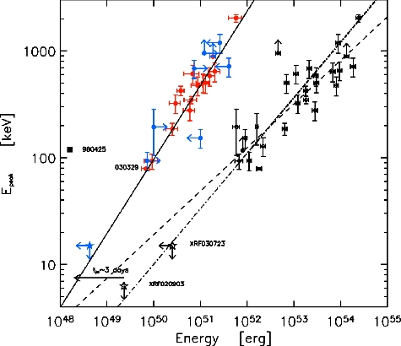
Energetics
E_{iso,γ} = 2.0±0.7x10⁵² erg (2-400keV)
030528
(Ghirlanda et al. 2004)

